Slide 1
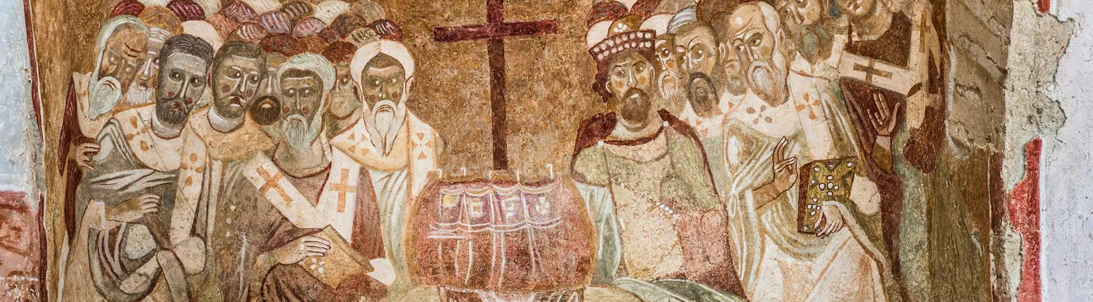
NICENE CREED
AFTER 1700 YEARS

Slide 2
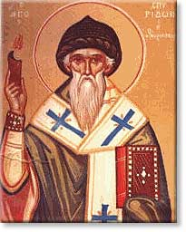
ARIUS
Pre-325
Arius was born in Libya ~250 A.D.
Tall, thin, walked barefoot, winsome personality, musical
Presbyter in Alexandria under his Bishop Alexander
Taught “there was a time when the son was not”

Slide 3
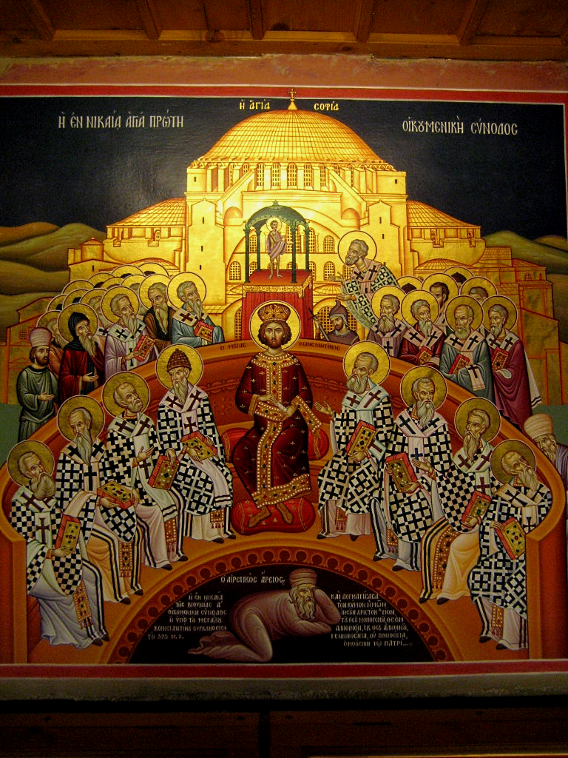
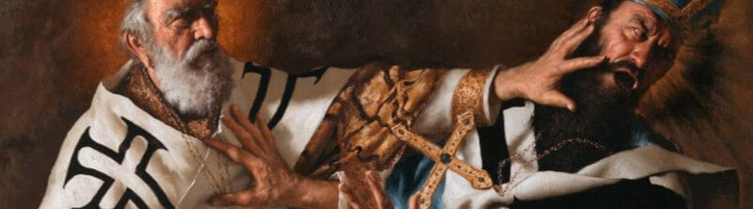
THE COUNCIL OF
NICAEA
In 325 Constantine calls a council at Nicaea
First Ecumenical Council
Deliberations about whether Arius taught falsehood
Athanasius vs
Eusebius & Arius
Arius and his teachings are condemned

Slide 4
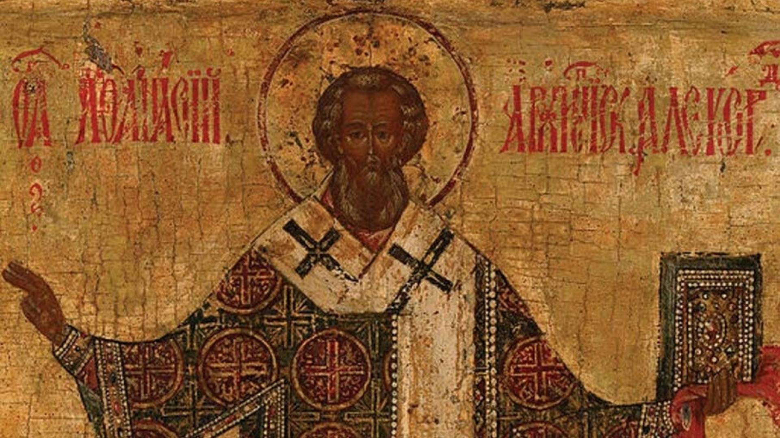
VERDICT
]
The Father and Son are co-equal and co-eternal and…
ARE homoouisious, “of one substance” / essence / being, but
NOT heteroousios “of different substance” / essence / being, &
NOT homoiousios “of similar substance” / essence / being

Slide 5
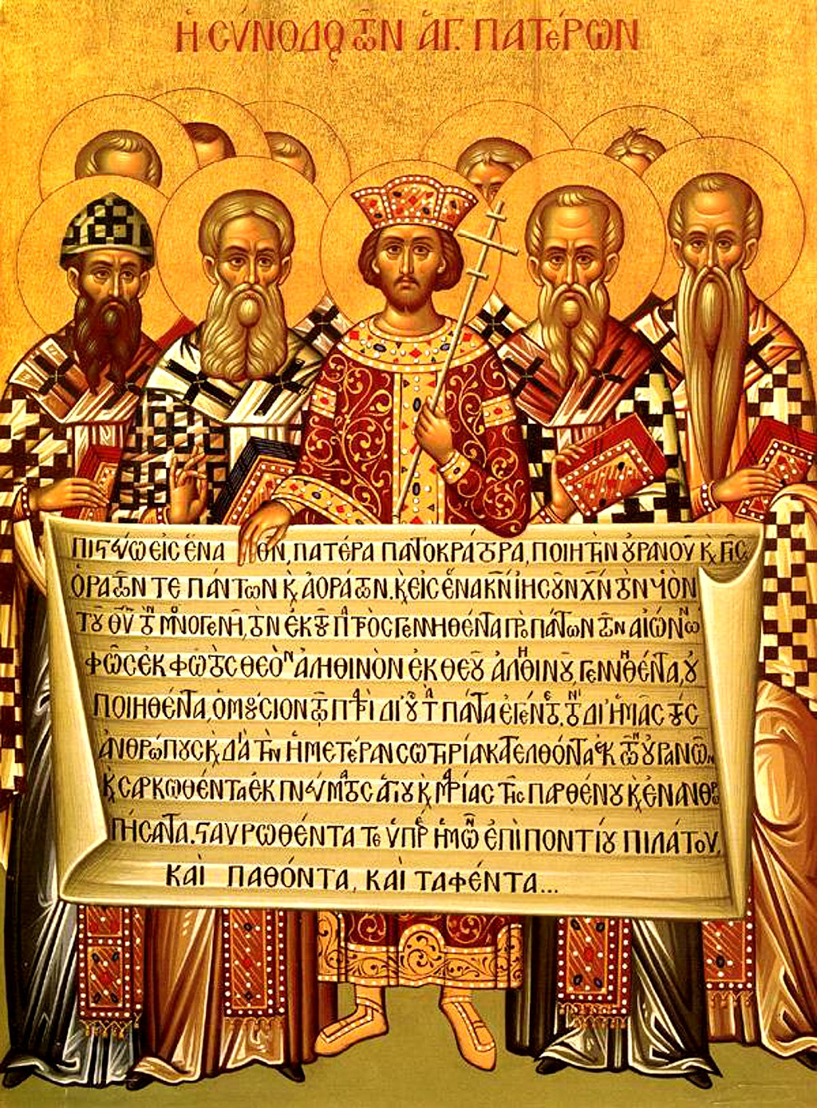
CREED
The overwhelming majority of Bishops condemned Arius as a heretic
Anyone preaching his ideas or possessing his manuscripts may be convicted of a capital crime.
Formulated an official Creed to affirm, against Arian heresy
Important to this day: Cults

Slide 6
THE NICENE CREED
We believe in one God, the Father Almighty,
Maker of all things visible and invisible.
And in one Lord Jesus Christ, the Son of God, begotten
of the Father, the only-begotten; that is, of the essence of the Father, God of God, Light of Light, very God of very God, begotten, not made, consubstantial with the Father;
By whom all things were made;
Who for us men, and for our salvation, came down and was incarnate and was made man;
He suffered, and the third day he rose again, ascended into heaven;
From thence he shall come to judge the quick and the dead.
And in the Holy Ghost.

Slide 7
Structure of the Nicene Creed (325)
01
02
03
WE BELIEVE IN THE FATHER (MAKER)
AND IN ONE LORD JESUS CHRIST (BEGOTTEN NOT MADE / CONSUBSTANTIAL)
I JESUS IS MAKER
II JESUS BECAME INCARNATE
III JESUS’S PASSION
IV JESUS WILL COME AGAIN
AND IN THE HOLY SPIRIT

Slide 8
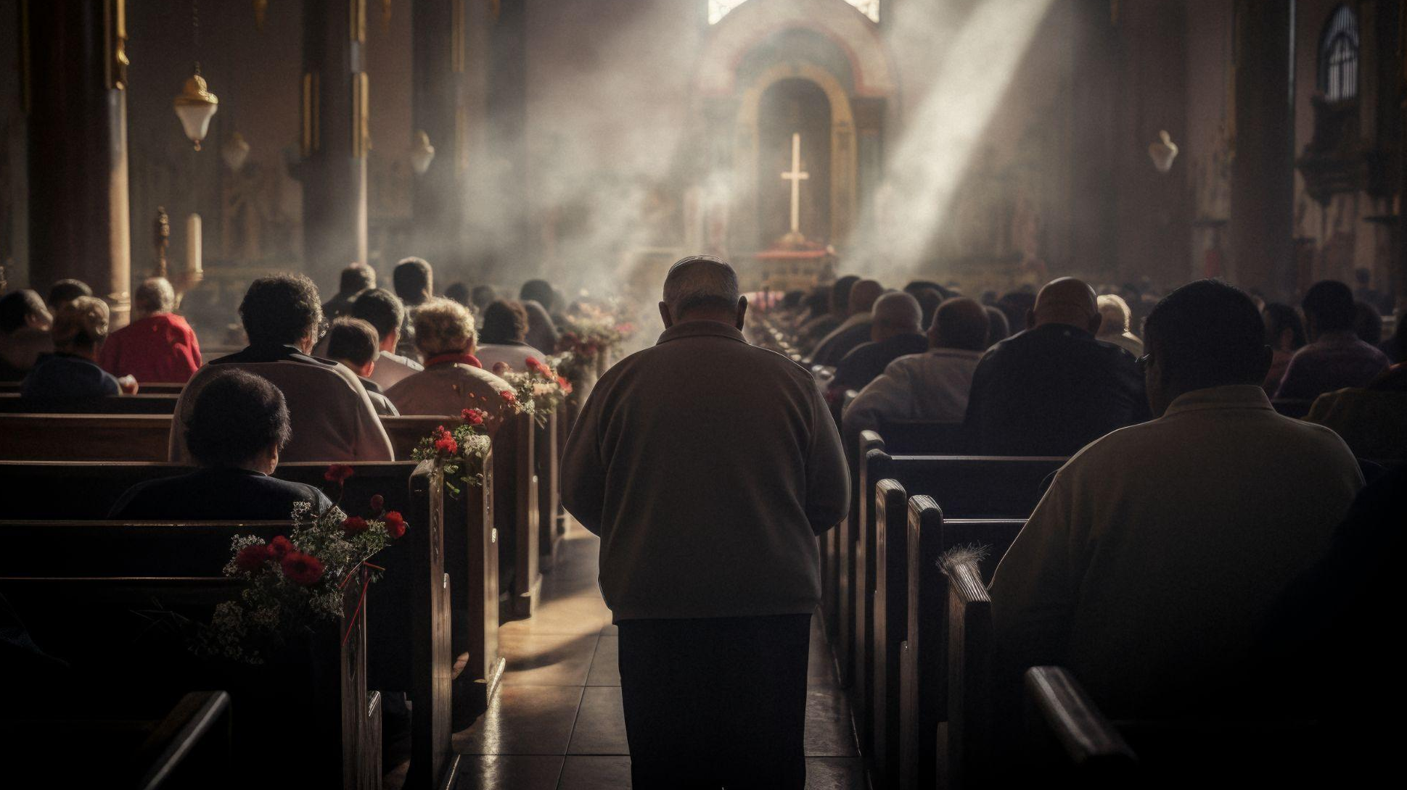
01
WE BELIEVE IN THE FATHER

Slide 9
THE NICENE CREED
1 We believe in one God, the Father Almighty,
Maker of all things visible and invisible.

Slide 10
In one God…
1 Corinthians 8:6 yet for us there is one God, the Father, from whom are all things and we exist for Him, and one Lord, Jesus Christ, by whom are all things, and we exist through Him.
Deuteronomy 6:4 “Hear, O Israel! Yahweh is our God, Yahweh is one!
Mark 12:28 And when one of the scribes came and heard them arguing, he recognized that He had answered them well and asked Him, “What commandment is the foremost of all?” 29 Jesus answered, “The foremost is, ‘Hear, O Israel! The Lord our God is one Lord;

Slide 11
…The Father Almighty
1 Corinthians 8:6 yet for us there is one God, the Father, from whom are all things and we exist for Him, and one Lord, Jesus Christ, by whom are all things, and we exist through Him.
  Ephesians 4:4 There is one body and one Spirit, just as also you were called in one hope of your calling; 5 one Lord, one faith, one baptism; 6 one God and Father of all who is over all and through all and in all.

Slide 12
Maker of all things visible and invisible
1 Corinthians 8:6 yet for us there is one God, the Father, from whom are all things and we exist for Him, and one Lord, Jesus Christ, by whom are all things, and we exist through Him.
Isaiah 42:5 Thus says the God, Yahweh, Who created the heavens and stretched them out, Who spread out the earth and its offspring, Who gives breath to the people on it, and spirit to those who walk in it…
Jeremiah 23:17 ‘Ah Lord Yahweh! Behold, You have made the heavens and the earth by Your great power and by Your outstretched arm! Nothing is too difficult for You…
Ephesians 4:6 one God and Father of all who is over all and through all and in all.

Slide 13
02
AND IN ONE LORD JESUS CHRIST

Slide 14
THE NICENE CREED
2 And in one Lord Jesus Christ,
the Son of God, begotten of the Father [the only-begotten; that is, of the essence of the Father, God of God], Light of Light, very God of very God, begotten, not made, consubstantial with the Father;

Slide 15
…and in One Lord Jesus Christ
1 Corinthians 8:6 yet for us there is one God, the Father, from whom are all things and we exist for Him, and one Lord, Jesus Christ, by whom are all things, and we exist through Him.
Romans 14:9 For to this end Christ died and lived again, that He might be Lord both of the dead and of the living.

Slide 16
the Son of God, begotten of the Father,
Mark 1:1 The beginning of the gospel of Jesus Christ, the Son of God.
Mark 15:39 And when the centurion, who was standing right in front of Him, saw the way He breathed His last, he said, “Truly this man was God’s Son!”
John 1:18 No one has seen God at any time; the only begotten God who is in the bosom of the Father, He has explained Him.
John 3:16 “For God so loved the world, that He gave His only begotten Son, that whoever believes in Him shall not perish, but have eternal life.

Slide 17
[God of God], Light of Light, very God of very God
This phrase was added as a direct result of the fourth-century Arian heresy. When you hear “eternally begotten”, one might tend to think about the future of eternity, but eternity also projects backwards!
Jesus, as God, has existed from before the beginning. As humans, who live in the realm of sequential time, this is a tough concept to understand. Arius’ teaching was that “The Logos is not eternal. God begat Him and before He was begotten, He did not exist”.
This means that there was a time when the Word did not exist. Athanasius, a young deacon at the Council, fought hard to defend the accurate teaching of the Church on this matter and his reply to Arius was “The begetting of the Logos was not an event in time, but an eternal relationship.”

Slide 18
[God of God], Light of Light, very God of very God
This set of three statements affirm Jesus is God. Jesus is not partially God, a lesser edition of God, nor is He a secondary God. Jesus is truly God-- fully, completely, essentially, and actually. The metaphor of light underlines the inseparability of Father and Son. In the same way light cannot separate from itself, so it is with Father and Son. Something to consider: Recall Jesus’ self-declaration in the gospel of John, “I am the Light of the World.” In the person of Christ we see God in the flesh-- the Light of the World who created light for the world.

Slide 19
[God of God], Light of Light, very God of very God
Jesus and the Father relate to each other as a source of light relates
The expression “light of light” comes from Athanasius’ writings. He used the analogy of light to explain that the Father and the Son were the same in substance.
Athanasius stated that a son can only be the same sort of being as his father – if the Father is God; the Son is God also.
The rhythmic 3 couplets say undeniably what Arius denied: Jesus IS God

Slide 20
[God of God], Light of Light, very God of very God
Hebrews 1:3 [Jesus] who is the radiance of His glory and the exact representation of His (God’s) nature, and upholds all things by the word of His power; who, having accomplished cleansing for sins, sat down at the right hand of the Majesty on high…
Colossians 1:15 Who is the image of the invisible God, the firstborn of all creation… 19 For in Him all the fullness of God was pleased to dwell,
Colossians 2:9 For in Him all the fullness of Deity dwells bodily

Slide 21
[God of God], Light of Light, very God of very God
Romans 9:5 whose are the fathers, and from whom is the Christ according to the flesh, who is God over all, blessed forever. Amen.
John 1:18 No one has seen God at any time; the only begotten God who is in the bosom of the Father, He has explained Him.

Slide 22
[God of God], Light of Light, very God of very God
Isaiah 43:10 “You are My witnesses,” declares Yahweh, “And My servant whom I have chosen, So that you may know and believe Me and understand that I am He. Before Me there was no god formed, and there will be none after Me.
John 8:24 Therefore I said to you that you will die in your sins. For unless you believe that I am He, you will die in your sins.”

Slide 23
[God of God], Light of Light, very God of very God
Isaiah 40:3 A voice is calling, “Prepare the way for Yahweh in the wilderness; Make smooth in the desert a highway for our God. 4 Let every valley be lifted up, and every mountain and hill be made low; And let the rough ground become a plain, And the rugged terrain a broad valley;
Mark 1:3 The voice of one crying in the wilderness, ‘Make ready the way of the Lord, Make His paths straight.’”
Who is the way made ready for?

Slide 24
[God of God], Light of Light, very God of very God
Isaiah 6:1 In the year of King Uzziah’s death I saw the Lord sitting on a throne, high and lifted up, with the train of His robe filling the temple.
John 12:40 “He has blinded their eyes and He hardened their heart, lest they see with their eyes and understand with their heart, and return and I heal them.” 41 These things Isaiah said because he saw His glory, and he spoke about Him.
Who did Isaiah see?

Slide 25
[God of God], Light of Light, very God of very God
Isaiah 44:6 “Thus says Yahweh, the King of Israel and his Redeemer, Yahweh of hosts: ‘I am the first, and I am the last, and there is no God besides Me.
Revelation 1:17 And when I saw Him, I fell at His feet like a dead man. And He placed His right hand on me, saying, “Do not fear; I am the first and the last
Who is the first and the last?

Slide 26
[God of God], Light of Light, very God of very God
Zechariah 2:10 “And I will pour out on the house of David and on the inhabitants of Jerusalem [a]the Spirit of grace and of supplication, so that they will look on Me whom they have pierced; and they will mourn for Him, as one mourns for an only son, and they will weep bitterly over Him like the bitter weeping over a firstborn.
Revelation 1:7 Behold, He is coming with the clouds, and every eye will see Him, even those who pierced Him; and all the tribes of the earth will mourn over Him. Yes, amen.
Who is speaking in Zechariah chapter 12?
Who was pierced?

Slide 27
[God of God], Light of Light, very God of very God
2 Corinthians 4:4 in whose case the god of this age has blinded the minds of the unbelieving so that they might not see the light of the gospel of the glory of Christ, who is the image of God. 5 For we do not preach ourselves but Jesus Christ as Lord, and ourselves as your slaves [b]for the sake of Jesus. 6 For God, who said, “Light shall shine out of darkness,” is the One who has shone in our hearts to give the Light of the knowledge of the glory of God in the face of Christ.

Slide 28
[God of God], Light of Light, very God of very God
Isaiah 9:2 The people who walk in darkness Will see a great light; Those who live in the land of the shadow of death, The light will shine on them.
Luke 2:32 A Light for revelation to the Gentiles, And for the glory of Your people Israel.”
Matthew 4:16 The people who were sitting in darkness saw a great Light, And those who were sitting in the land and shadow of death, Upon them a Light dawned.”
Isaiah 60:3 Nations will come to your light, And kings to the brightness of your rising.

Slide 29
[God of God], Light of Light, very God of very God
Luke 4:16 And He came to Nazareth, where He had been brought up, and as was His custom, He entered the synagogue on the Sabbath and stood up to read. 17 And the scroll of the prophet Isaiah was handed to Him. And He opened the scroll and found the place where it was written, 18 “The Spirit of the Lord is upon Me, because He anointed Me to preach the gospel to the poor, He has sent Me to proclaim release to the captives, and recovery of sight to the blind.
John 3:19 And this is the judgment, that the Light has come into the world, and men loved the darkness rather than the Light, for their deeds were evil. 20 For everyone who does evil hates the Light, and does not come to the Light lest his deeds be exposed. 21 But he who practices the truth comes to the Light, so that his deeds may be manifested as having been done by God.”

Slide 30
begotten, not made, consubstantial with the Father
The Greek word that helps with understanding “one substance” is homoousios, which translates as “the same being” or “one essence.” Confessing Jesus is of “the same being” or “one essence” with the Father is to believe Jesus is of equal divinity as the Father. Jesus is the source of creation, not as a fellow creature, but as the Creator. Something to consider: Essence and persons are used intentionally for Christians to simultaneously confess belief in God (one essence) who is Father, Son, and Holy Spirit (three persons).

Slide 31
begotten, not made, consubstantial with the Father
Confessing Jesus is of “the same being” or “one essence” with the Father is to believe Jesus is of equal divinity as the Father.
Because the Father “fathered” Jesus, Jesus was not made or created in such a way that he is a creature as humans and animals are.

Slide 32
begotten, not made, consubstantial with the Father
When developing the exact wording for the Nicene Creed, there was a big argument over which of two words to use. The term fought for at the Council by those who defended Jesus’ true divinity was homoousion to Patri, which in English is translated as “consubstantial with the Father”.
Those who supported Arius favored an ambiguous phrase, homoiousion to Patri, which means “a similar substance with the Father”. The difference between the two phrases homoousion to Patri and homoiousion to Patri is the Greek letter iota (the “i”). This is where we get the phrase “refusing to add even one iota” from!

Slide 33
begotten, not made, consubstantial with the Father
Isaiah 9:6 For a child will be born to us, a son will be given to us; and the government will rest on His shoulders; and His name will be called Wonderful Counselor, Mighty God, Eternal Father, Prince of Peace.
Isaiah 46:5 “To whom would you liken Me and make Me equal and compare Me, that we would be alike?

Slide 34
begotten, not made, consubstantial with the Father
To whom would you liken Me and make Me equal and compare Me, that we would be alike?
Matthew 11:27 All things have been handed over to Me by My Father; and no one knows the Son except the Father; nor does anyone know the Father except the Son, and anyone to whom the Son wills to reveal Him.
Matthew 28:18 And Jesus came up and spoke to them, saying, “All authority has been given to Me in heaven and on earth.

Slide 35
begotten, not made, consubstantial with the Father
To whom would you liken Me and make Me equal and compare Me, that we would be alike?
John 8:12 Then Jesus again spoke to them, saying, “I am the Light of the world; he who follows Me will never walk in the darkness, but will have the Light of life.” … 9:5 While I am in the world, I am the light of the world.”
John 11:25 Jesus said to her, “I am the resurrection and the life; he who believes in Me will live even if he dies,
John 14:6 Jesus *said to him, “I am the way, and the truth, and the life. No one comes to the Father but through Me.

Slide 36
begotten, not made, consubstantial with the Father
John 1:14 And the Word became flesh, and dwelt among us, and we beheld His glory, glory as of the only begotten from the Father, full of grace and truth. 15 John *bore witness about Him and cried out, saying, “This was He of whom I said, ‘He who comes after me has been ahead of me, for He existed before me.’” 16 For of His fullness we have all received, and grace upon grace. 17 For the Law was given through Moses; grace and truth came through Jesus Christ. 18 No one has seen God at any time; the only begotten God who is in the bosom of the Father, He has explained Him.

Slide 37
begotten, not made, consubstantial with the Father
John 3:16 “For God so loved the world, that He gave His only begotten Son, that whoever believes in Him shall not perish, but have eternal life.
John 10:30 I and the Father are one.”
John 14:9 Jesus *said to him, “Have I been with you all so long and have you not come to know Me, Philip? He who has seen Me has seen the Father; how can you say, ‘Show us the Father’? 10 Do you not believe that I am in the Father, and the Father is in Me? The words that I say to you I do not speak from Myself, but the Father abiding in Me does His works.

Slide 38
begotten, not made, consubstantial with the Father
John 17:22 The glory which You have given Me I have given to them, that they may be one, just as We are one; 23 I in them & You in Me, that they may be perfected in unity, so that the world may know that You sent Me, and loved them, even as You have loved Me. 24 Father, I desire that they also, whom You have given Me, be with Me where I am, so that they may see My glory which You have given Me, for You loved Me before the foundation of the world.

Slide 39
begotten, not made, consubstantial with the Father
1 Corinthians 8:6 yet for us there is one God, the Father, from whom are all things and we exist for Him, and one Lord, Jesus Christ, by whom are all things, and we exist through Him.
Philippians 2:6 who, although existing in the form of God, did not regard equality with God a thing to be grasped
Hebrews 1:2 in these last days spoke to us in His Son, whom He appointed heir of all things, through whom also He made the worlds, 3 who is the radiance of His glory and the exact representation of His nature, and upholds all things by the word of His power; who, having accomplished cleansing for sins, sat down at the right hand of the Majesty on high

Slide 40
begotten, not made, consubstantial with the Father
Colossians 1:15 Who is the image of the invisible God, the firstborn of all creation. 16 For in Him all things were created, both in the heavens and on earth, visible and invisible, whether thrones or dominions or rulers or authorities—all things have been created through Him and for Him.
17 And He is before all things,
And in Him all things hold together.
18 And He is the head of the body, the church;
Who is the beginning, the firstborn from the dead, so that He Himself will come to have first place in everything.
19 For in Him all the fullness of God was pleased to dwell,

