Slide 1

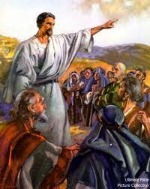
New Year, Same old (Co-)Mission
Matthew 28:18 And Jesus came up and spoke to them, saying, “All authority has been given to Me in heaven and on earth. 19 Go therefore and make disciples of all the nations, baptizing them in the name of the Father and the Son
and the Holy Spirit, 20 teaching them
to keep all that I commanded you; and
behold, I am with you always, even to
the end of the age.”

Slide 2
What is a Disciple? 4 aspects
Love God chiefly / deny yourself and all that you have
Abide in His Word
Love one another
Bear much fruit

Slide 3
What is a Disciple? Jesus says…
Love God chiefly / deny yourself and all that you have
Matthew 16:24 Then Jesus said to His disciples, “If anyone wishes to come after Me, let him deny himself, and take up his cross and follow Me. 25 For whoever wishes to save his life will lose it; but whoever loses his life for My sake will find it.
Mark 8:34 And He summoned the crowd with His disciples, and said to them, “If anyone wishes to come after Me, he must deny himself, and take up his cross and follow Me.

Slide 4
What is a Disciple? Jesus says…
Love God chiefly / deny yourself and all that you have
Luke 14:26 “If anyone comes to Me, and does not hate his own father and mother and wife and children and brothers and sisters, yes, and even his own life, he cannot be My disciple. 27 Whoever does not carry his own cross and come after Me cannot be My disciple… ⚠️… 33 So then, none of you can be My disciple who does not give up all his own possessions.

Slide 5
What is a Disciple? Jesus says…
Love God chiefly / deny yourself and all that you have
WARNING!!!!!
Luke 14:28 ⚠️For which one of you, when he wants to build a tower, does not first sit down and calculate the cost to see if he has enough to complete it? 29 Lest, when he has laid a foundation and is not able to finish, all who observe it begin to ridicule him, 30 saying, ‘This man began to build and was not able to finish.’ 31 Or what king, when he sets out to meet another king in battle, will not first sit down and consider whether he is strong enough with ten thousand men to encounter the one coming against him with twenty thousand? 32 Or else, while the other is still far away, he sends a delegation and asks for terms of peace.⚠️

Slide 6
What is a Disciple? Jesus says…
2. Abide in His Word
John 8:31 So Jesus was saying to those Jews who had believed Him, “If you abide in My word, then you are truly My disciples; 32 and you will know the truth, and the truth will make you free.” ⚠️

Slide 7
What is a Disciple? Jesus says…
2. Abide in His Word
WARNING!!!!!
John 8:36 ⚠️ So if the Son makes you free, you will be free indeed. 37 I know that you are Abraham’s seed; yet you are seeking to kill Me, because My word has no place in you. 38 I speak the things which I have seen with My Father; therefore you also do the things which you heard from your father.” 39 They answered and said to Him, “Abraham is our father.” Jesus *said to them, “If you are Abraham’s children, you would do the deeds of Abraham. 40 But now you are seeking to kill Me, a man who has told you the truth, which I heard from God. This Abraham did not do. 41 You are doing the deeds of your father.” They said to Him, “We were not born of sexual immorality; we have one Father: God.” …

Slide 8
What is a Disciple? Jesus says…
2. Abide in His Word
John 8:42 Jesus said to them, “If God were your Father, you would love Me, for I proceeded forth and have come from God, for I have not even come of Myself, but He sent Me. 43 Why do you not understand what I am saying? It is because you cannot hear My word. 44 You are of your father the devil, and you want to do the desires of your father. He was a murderer from the beginning, and does not stand in the truth because there is no truth in him. Whenever he speaks a lie, he speaks from his own nature, for he is a liar and the father of lies. ⚠️

Slide 9
What is a Disciple? Jesus says…
3. Love one another
John 13:34 A new commandment I give to you, that you love one another, even as I have loved you, that you also love one another. 35 By this all will know that you are My disciples, if you have love for one another.”

Slide 10
What is a Disciple? Jesus says…
3. Love one another
WARNING!!!!!
1 John 4:20 ⚠️If someone says, “I love God,” and hates his brother, he is a liar; for the one who does not love his brother whom he has seen, cannot love God whom he has not seen.⚠️

Slide 11
What is a Disciple? Jesus says…
4. Bear much fruit
John 15:7 ⚠️… If you abide in Me, and My words abide in you, ask whatever you wish, and it will be done for you. 8 My Father is glorified by this, that you bear much fruit, and so prove to be My disciples. 9 Just as the Father has loved Me, I have also loved you; abide in My love. 10 If you keep My commandments, you will abide in My love; just as I have kept My Father’s commandments and abide in His love. 11 These things I have spoken to you so that My joy may be in you, and that your joy may be complete.

Slide 12
What is a Disciple? Jesus says…
4. Bear much fruit
WARNING!!!!!
John 15:7 ⚠️… 4 Abide in Me, and I in you. As the branch cannot bear fruit from itself unless it abides in the vine, so neither can you unless you abide in Me. 5 I am the vine, you are the branches; he who abides in Me and I in him, he bears much fruit, for apart from Me you can do nothing. 6 If anyone does not abide in Me, he is thrown away as a branch and dries up; and they gather them, and cast them into the fire and they are burned.

Slide 13
How to make a Disciple?
Go therefore and make disciples of all the nations,
baptizing them in the name of the Father and the Son and the Holy Spirit,
20 teaching them to keep all that I commanded you
Result #1 Baptizing
An ordinance (command, stablished rite). Identifying with His death publicly (dying to self), Practiced in community church life
Entrance into visible the body of Christ

Slide 14
How to make a Disciple?
Go therefore and make disciples of all the nations,
baptizing them in the name of the Father and the Son and the Holy Spirit,
20 teaching them to keep all that I commanded you
Result #2 Teaching
2 Timothy 2:2 (multiplying)
…And the things which you have heard from me in the presence of many witnesses, entrust these to faithful men who will be able to teach others also.

Slide 15
How to make a Disciple?
Go therefore and make disciples of all the nations,
baptizing them in the name of the Father and the Son and the Holy Spirit,
20 teaching them to keep all that I commanded you
Result #2 Teaching
Ezra 7:10 (study, practice, teach)
For Ezra had set his heart to study the law of Yahweh and to practice it, and to teach His statute and judgment in Israel.

Slide 16
What should we teach?
Abiding in God’s word, reproducing, study, practice, teaching…
The source is God’s Word, but a worthy tool to tackle the scope of all of Scripture would aid and guide in the discipleship process
Hence the partnership with Disciple Daily and their Discipleship methodology

Slide 17

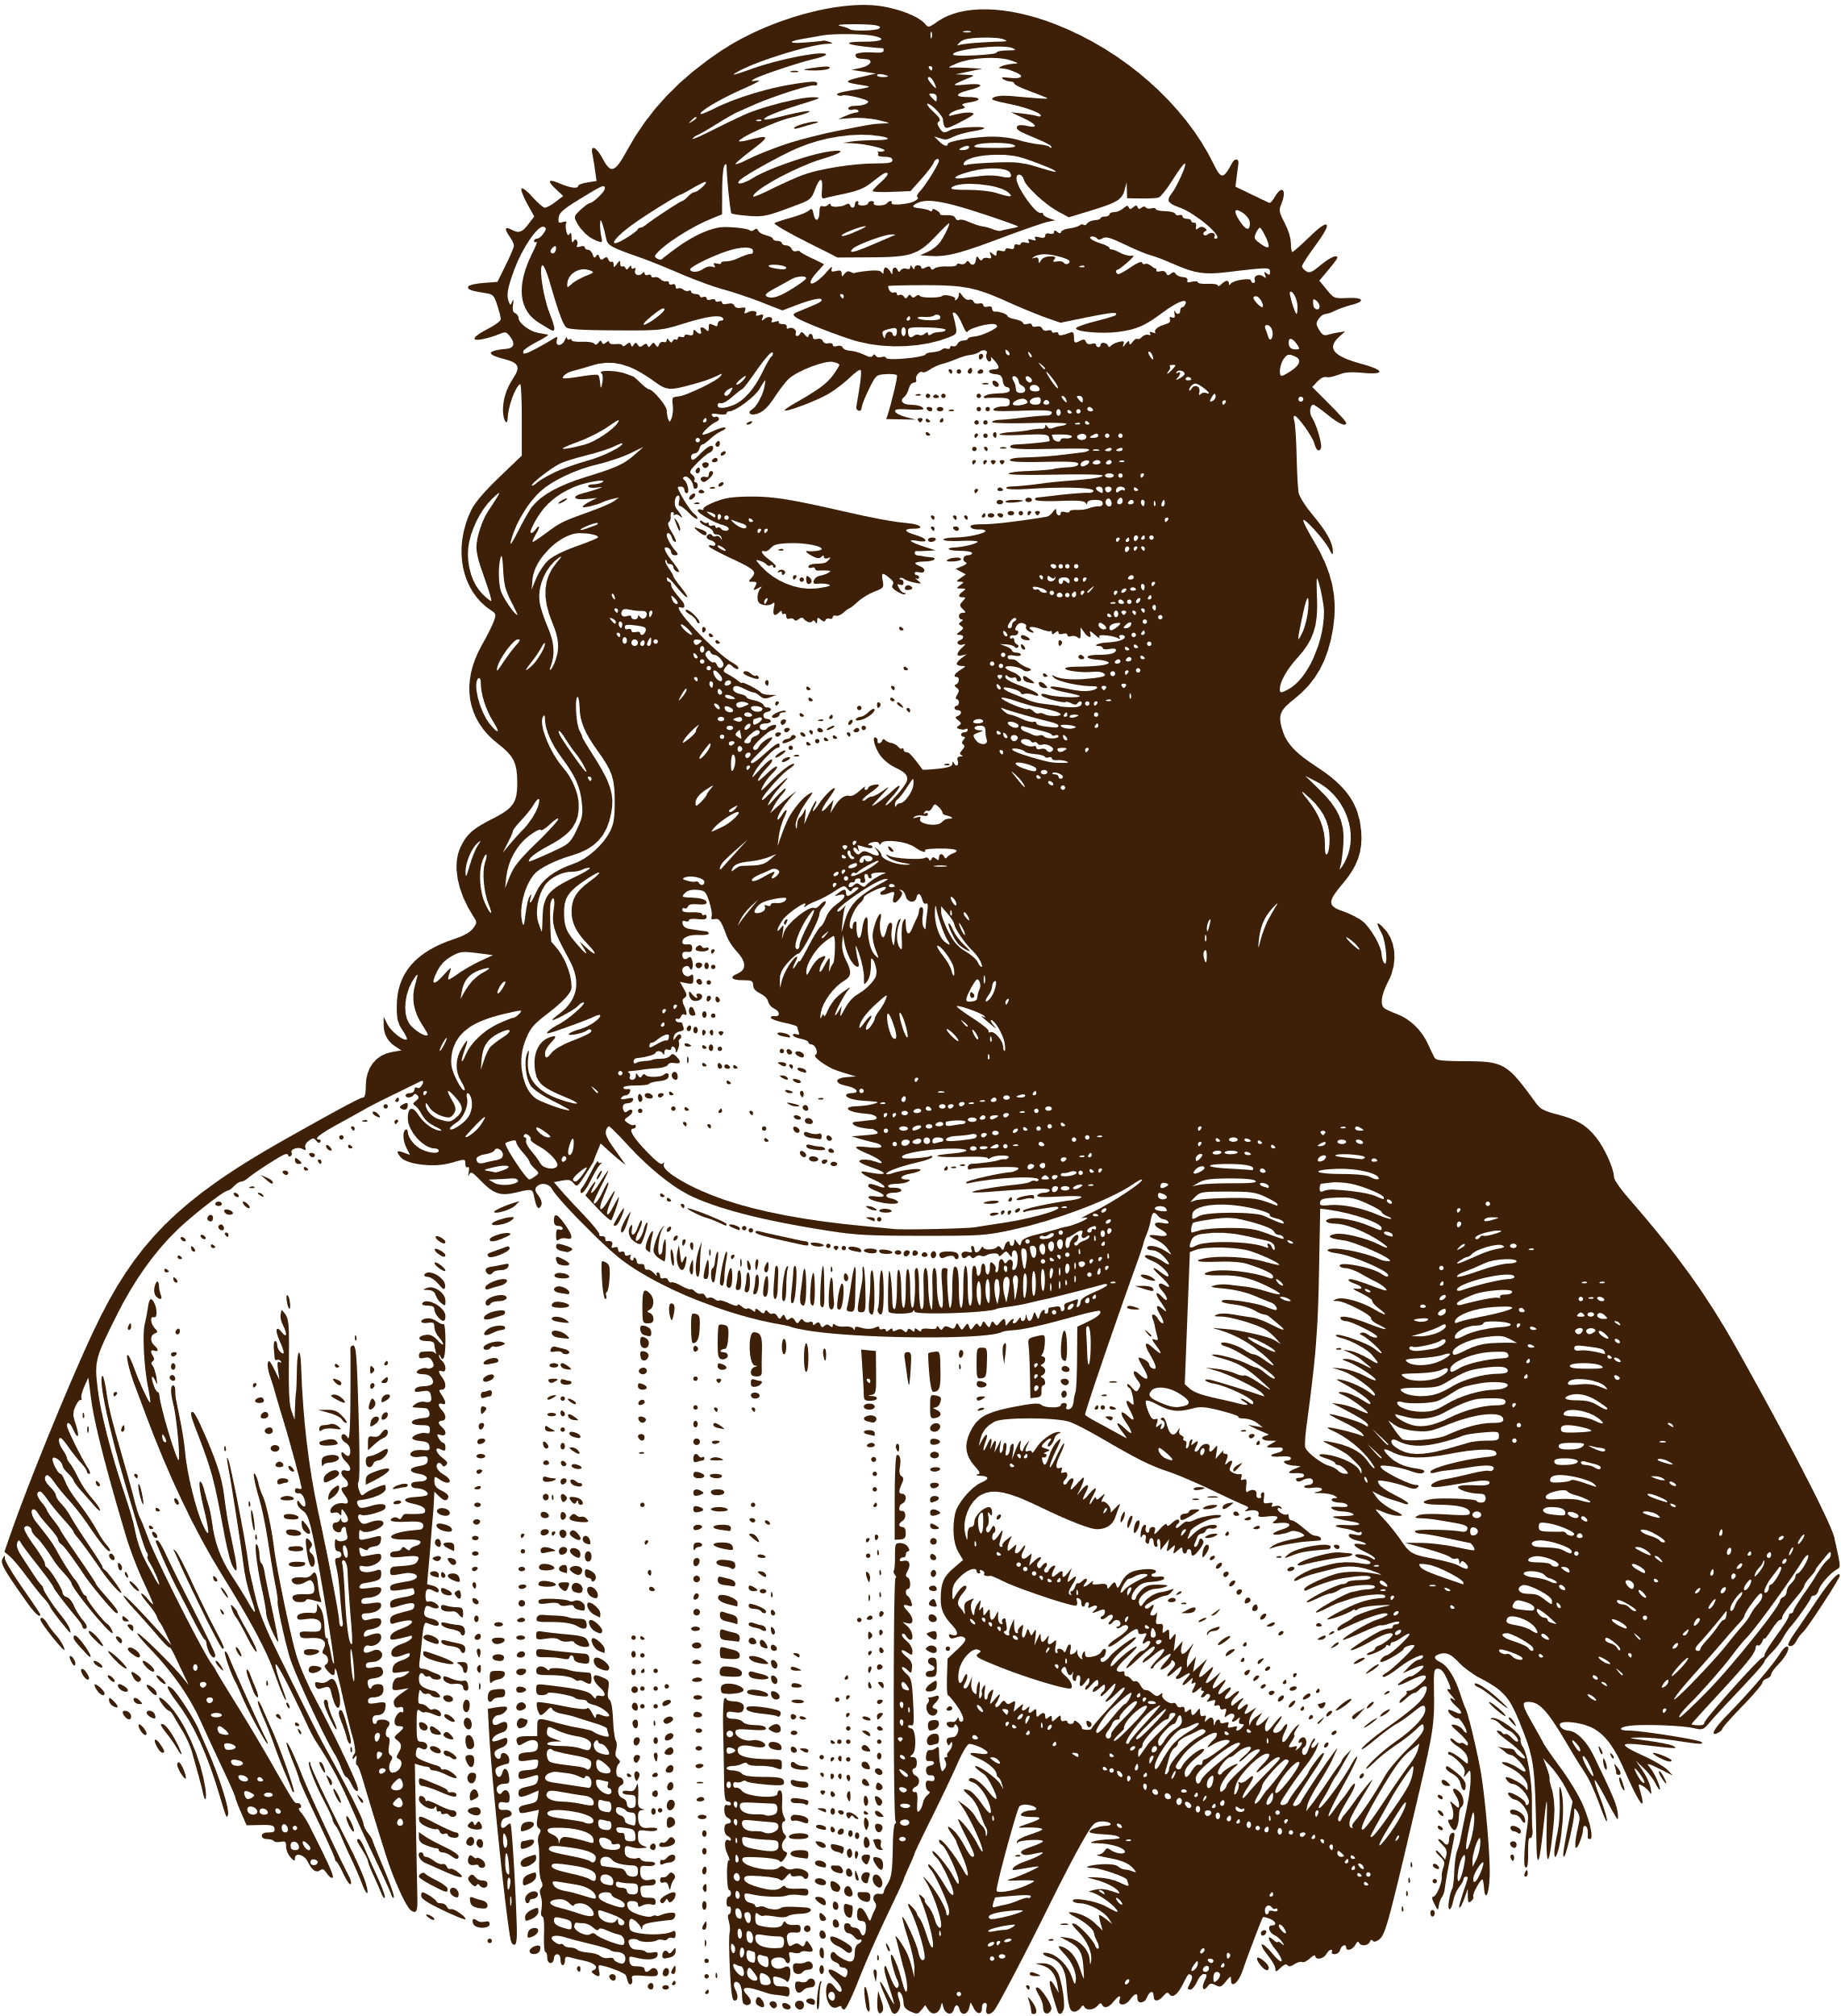
12 Stories of the
BIBLE
Disciple Daily | Unchained Ministries

Slide 18
Disciple Daily
The 12 Stories of Scripture
https://discipledaily.org/media/series/wgf4g4v/stories-of-god

