Slide 1
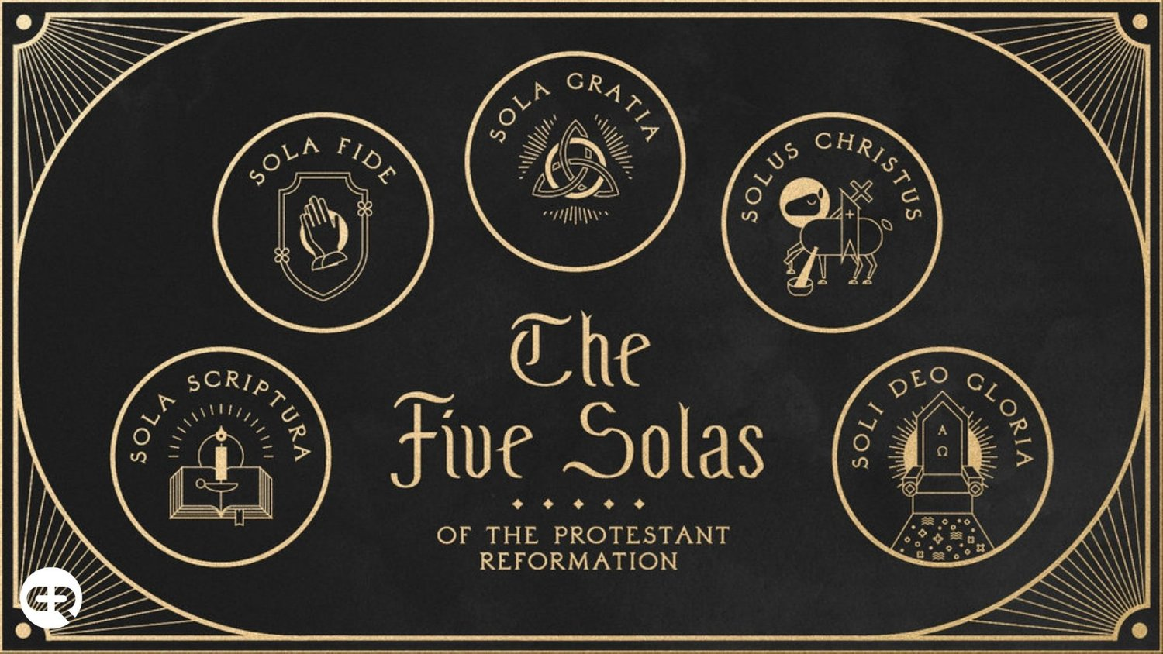
The 5 Solas of The Reformation

Slide 2
To god be the glory https://www.youtube.com/watch?v=a2EaA7E0aXk
John 4:24 God is spirit, and those who worship Him must worship in spirit and truth.”
Colossians 3:16 Let the word of Christ dwell in you richly, with all wisdom teaching and admonishing one another with psalms and hymns and spiritual songs, singing with gratefulness in your hearts to God.
Ephesians 5:19 [speak] to one another in psalms and hymns and spiritual songs, singing and making melody with your heart to the Lord; 20 always giving thanks for all things in the name of our Lord Jesus Christ to God, even the Father;

Slide 3
OCTOBER 31, 1517. –
The date most historians would say as the beginning of the Reformation when…
Martin Luther nailed his 95 theses to the church door at Wittenburg, GERMANRY
A date generally regarded as the birthday of the Reformation.

Slide 4
Quotes from Luther’s 95 Theses
1) When our Lord and Master Jesus Christ said, ``Repent'' (Mt 4:17 From that time Jesus began to [preach and say, “Repent, for the kingdom of heaven is at hand.”), he willed the entire life of believers to be one of repentance.
21) Thus those indulgence preachers are in error who say that a man is absolved from every penalty and saved by papal indulgences.
27) They preach only human doctrines who say that as soon as the money clinks into the money chest, the soul flies out of purgatory.

Slide 5
Quotes from Luther’s 95 Theses
36) Any truly repentant Christian has a right to full remission of penalty and guilt, even without indulgence letters.
62) The true treasure of the church is the most holy gospel of the glory and grace of God. 63) But this treasure is naturally most odious, for it makes the first to be last (Mt. 20:16).
94) Christians should be exhorted to be diligent in following Christ, their Head, through penalties, death and hell. 95) And thus be confident of entering into heaven through many tribulations rather than through the false security of peace (Acts 14:22).

Slide 6
Definitions:
SOLA - The Latin word sola means "alone" or "only" in English.
The 5 SOLAS - The five solas articulated five (5) fundamental beliefs of the Protestant Reformation, pillars which the Reformers believed to be essentials of the Christian life and practice.

Slide 7
The 5 SOLAS:
The 5 Solas of the Protestant Reformation is the TOUCHSTONE of Evangelical Christianity.
It is the test of genuine truths and beliefs in the midst of an ocean of beliefs and multiple religious mysteries and teachings.
The 5 Solas stands as the guidepost for all TRUE CHRISTIAN LIFE AND PRACTICE.

Slide 8
1. Sola Scriptura ("by Scripture alone")
The Scripture Alone is the Standard
Formal cause of the Reformation
In 1521 at the historic interrogation of Luther at the Diet of Worms, he declared his conscience to be captive to the Word of God saying, "Unless I am overcome with testimonies from Scripture or with evident reasons -- for I believe neither the Pope nor the Councils, since they have often erred and contradicted one another -- I am overcome by the Scripture texts which I have adduced, and my conscience is bound by God's Word.“
“Here I stand I can do no other” (allegedly)

Slide 9
Sola Scriptura
Scripture is the…
Sole infallible rule of faith for faith and practice in the church.
2 Timothy 3:16 All Scripture is God-breathed and profitable for teaching, for reproof, for correction, for training in righteousness, 17 so that the man of God may be equipped, having been thoroughly equipped for every good work.

Slide 10
2. Sola Gratia ("by grace alone")
Sola gratia is the teaching that salvation comes by God’s Grace Alone— not as something merited by the sinner. This means that salvation is an unearned gift from God for Jesus' sake.
Not by good works or religious works
Grace defined: "unmerited favor“ or rather “demerited favor”
3. Sola Fide (“through faith alone")
Sola fide is the teaching that salvation comes through man’s Faith Alone— not as cooperating with works
Not by good works or religious works
Faith is more than content and agreement, but total trust

Slide 11
Grace by which we are saved Faith through which we are saved
Ephesians 2:8 For by grace you have been saved through faith, and this not of yourselves, it is the gift of God; 9 not of works, so that no one may boast.
Locus classicus
Against partial grace or a mere power
Grace and Faith are a Gift!
Gift vs Earnings

Slide 12
4. Solus Christus ("Christ alone”)
By Christ's Work Alone are We Saved
Solus Christus is the teaching that CHRIST is the only mediator between God and man, and that there is salvation through no other (hence, the phrase is sometimes rendered in the ablative case, solo Christo, meaning that salvation is "by Christ alone").
Christ alone is the foundation and focus of our faith
Christ alone is the way to God
Christ alone can save us and not…
Man
Church
Works
Rituals

Slide 13
Theology of the mediator
A middle person who intervenes on behalf of
As sinners God is unapproachable
As we normatively do not have access directly to God audibly or face to face, through the history of mankind we have accessed God through mediators
OT: only priests could enter the Holy of Holies in the tabernacle/temple
OT: Many ongoing priest would perpetually make imperfect sacrifices
NT: One final great High priest made a perfect sacrifice of Himself once for all

Slide 14
New Testament Offices
1 Timothy 2:5 For there is one God, and one mediator also between God and men, the man Christ Jesus
One = sola
Men in former times had many men as mediators in an ongoing fashion
Men now since the cross of Christ have one man (God-man) as mediator in a finished final once for all way- to all who are saved by grace through faith!

Slide 15
5. Soli Deo Gloria (“to the Glory of God alone")
If we are saved by God’s grace alone apart from the cooperation of man…
If we are saved through our faith, a gracious gift of God, apart from our own good or religious works…
If we are saved by the once for all sacrifice and suficient high priestly work of our one and only mediator Christ alone…
If all of this is based on God’s perfect and sufficient revelation scripture alone, and not men / traditions etc…
Then God ALONE get’s all the glory, not men, not an organization, not actions…
ALL OF SALVATION IS TO THE GLORY OF GOD ALONE

Slide 16
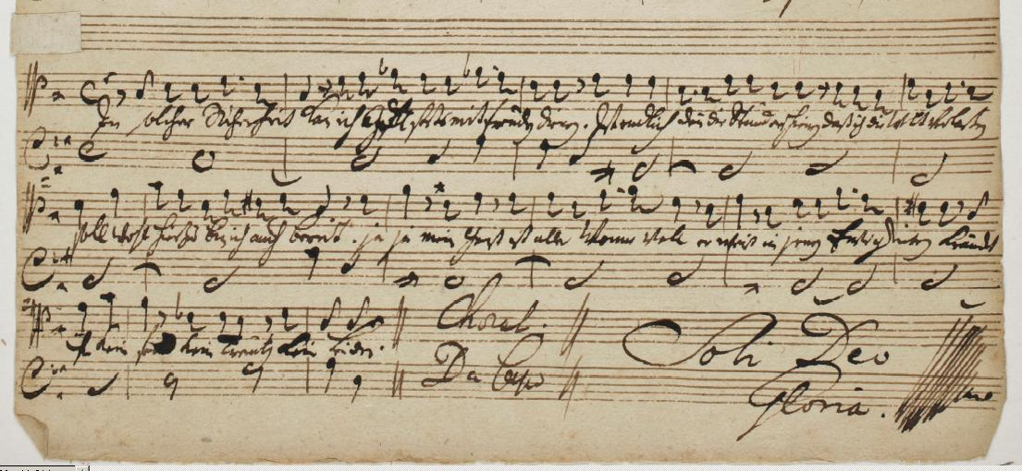
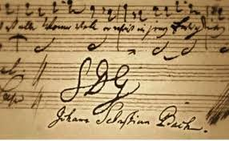
TO GOD BE THE GLORY!
1 Corinthians 10:31 Whether, then, you eat or drink or whatever you do, do all to the glory of God.
Whether mundane or extraordinary, all we do should be done by faith to the glory of God.
The Reformers made no distinction between the spiritual or temporal; sacred or secular. They believed that God had created us to be workers or producers and that whether you were in the pulpit, orchard, or kitchen all that we do when done by faith would bring glory to God.
Example: Bach

Slide 17
TO GOD BE THE GLORY!
Ephesians 2:10 For we are His workmanship, created in Christ Jesus for good works, which God prepared beforehand so that we would walk in them.
Genes 1:27 And God created man in His own image, in the image of God He created him; male and female He created them.
Isaiah 60:21 Then all your people will be righteous; They will possess the land forever, The branch of My planting, The work of My hands, That I may show forth My beautiful glory.

Slide 18
TO GOD BE THE GLORY!
Psalm 115: 1 Not to us, O Yahweh, not to us, but to Your name give glory. Because of Your lovingkindness, because of Your truth.2 Why should the nations say, “Where, now, is their God?” 3 But our God is in the heavens; He does whatever He pleases. [the psalm goes on to refute idols / graven images]
Isaiah 42:8 I am Yahweh, that is My name; I will not give My glory to another, Nor My praise to graven images.
Romans 11:36 For from Him and through Him and to Him are all things. To Him be the glory forever. Amen.

Slide 19
The 5 Solas of the Protestant Reformation
1. Sola Scriptura
2. Solus Christus
3. Sola Gratia
4. Sola Fide
5. Soli Deo Gloria

Slide 20
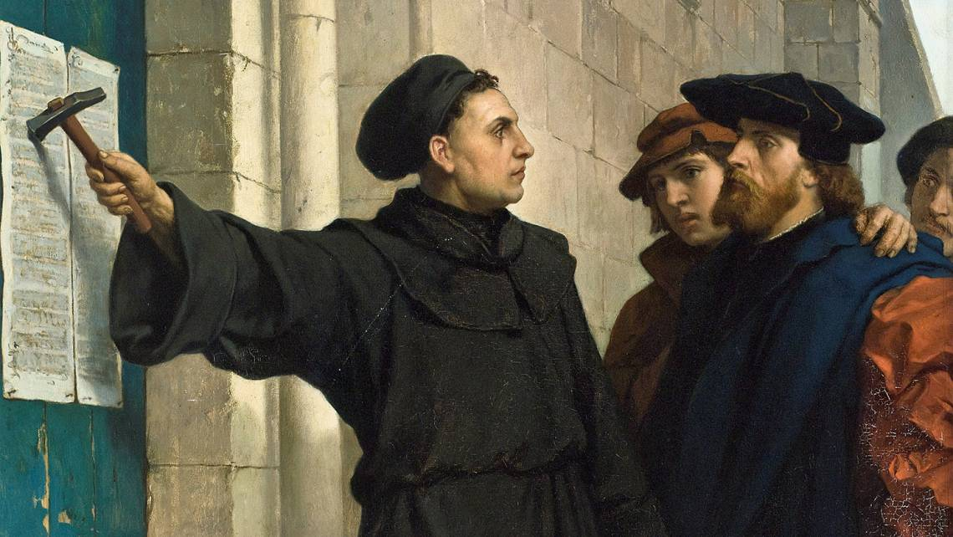
5 Days til Reformation Day
Tuesday October 31st
“Halloween”
Remember Martin Luther and the Reformation and that:
We are saved by God’s grace alone, through faith alone, in Christ alone, to the Glory of God alone, on the basis of Scripture alone.

