Slide 1
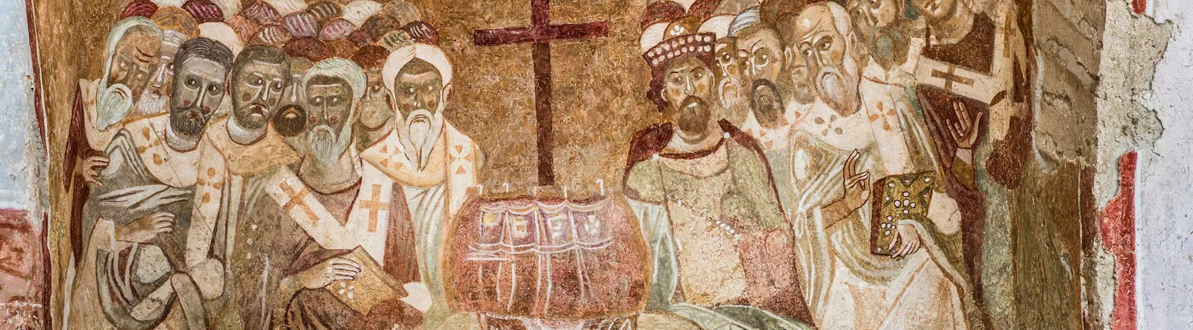
NICENE CREED
AFTER 1700 YEARS

Slide 2
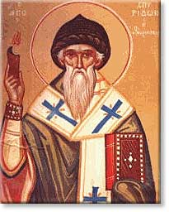
ARIUS
Pre-325
Arius was born in Libya ~250 A.D.
Tall, thin, walked barefoot, winsome personality, musical
Presbyter in Alexandria under his Bishop Alexander

Slide 3
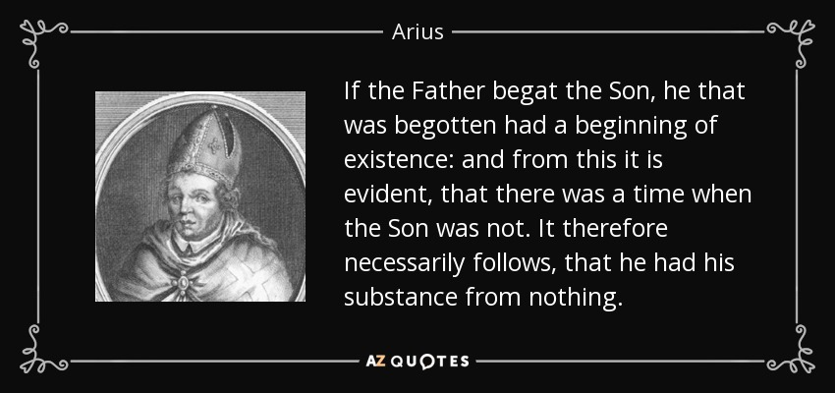
Famous song lyrics ♬“There was (once) a time when Christ was not” ♬
CHALLENGE
BEGOTTEN
CHURCH HISTORY VOLUME ONE, EVERETT FERGUSON
Began teaching contrary to Alexander’s teaching that the Father and the Son are co-eternal.
Arius thought that “begotten” meant “created” or “made.”
“Arius taught that Jesus Christ was not derived from the substance of the Father, but, as the first and highest of God’s creations, became the instrument of all the rest of creation.”

Slide 4
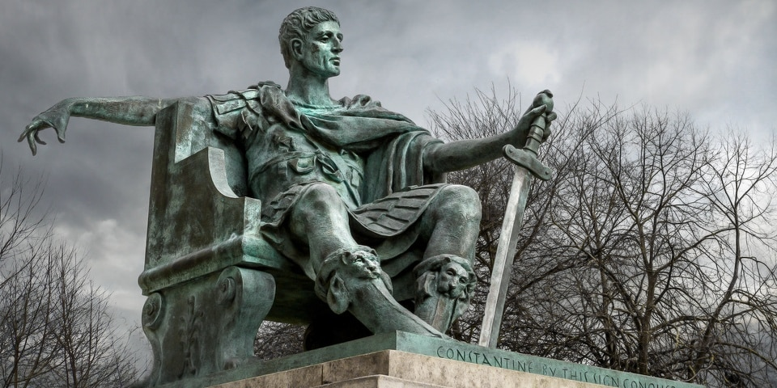
Emperor Constantine
Converted to Christianity
Saw the theological conflict and wanted to resolve it.
Used his power to convene bishops from the east and the west

Slide 5
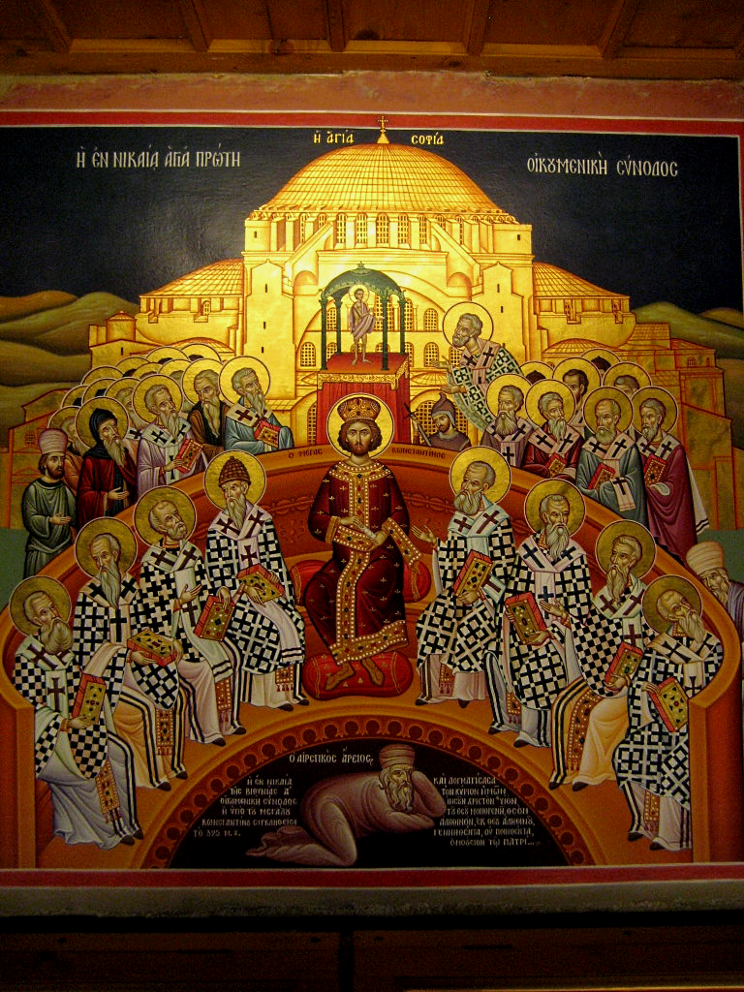
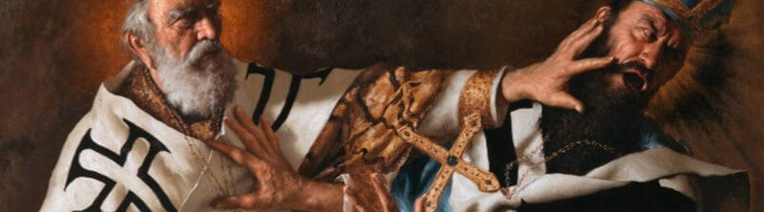
THE COUNCIL OF
NICAEA
In 325 Constantine calls a council at Nicaea
Historically named the Council of Nicaea
Invited Bishops from the West and the East
First Ecumenical Council
Deliberations about whether Arius taught falsehood
Athanasius vs
Eusebius & Arius

Slide 6
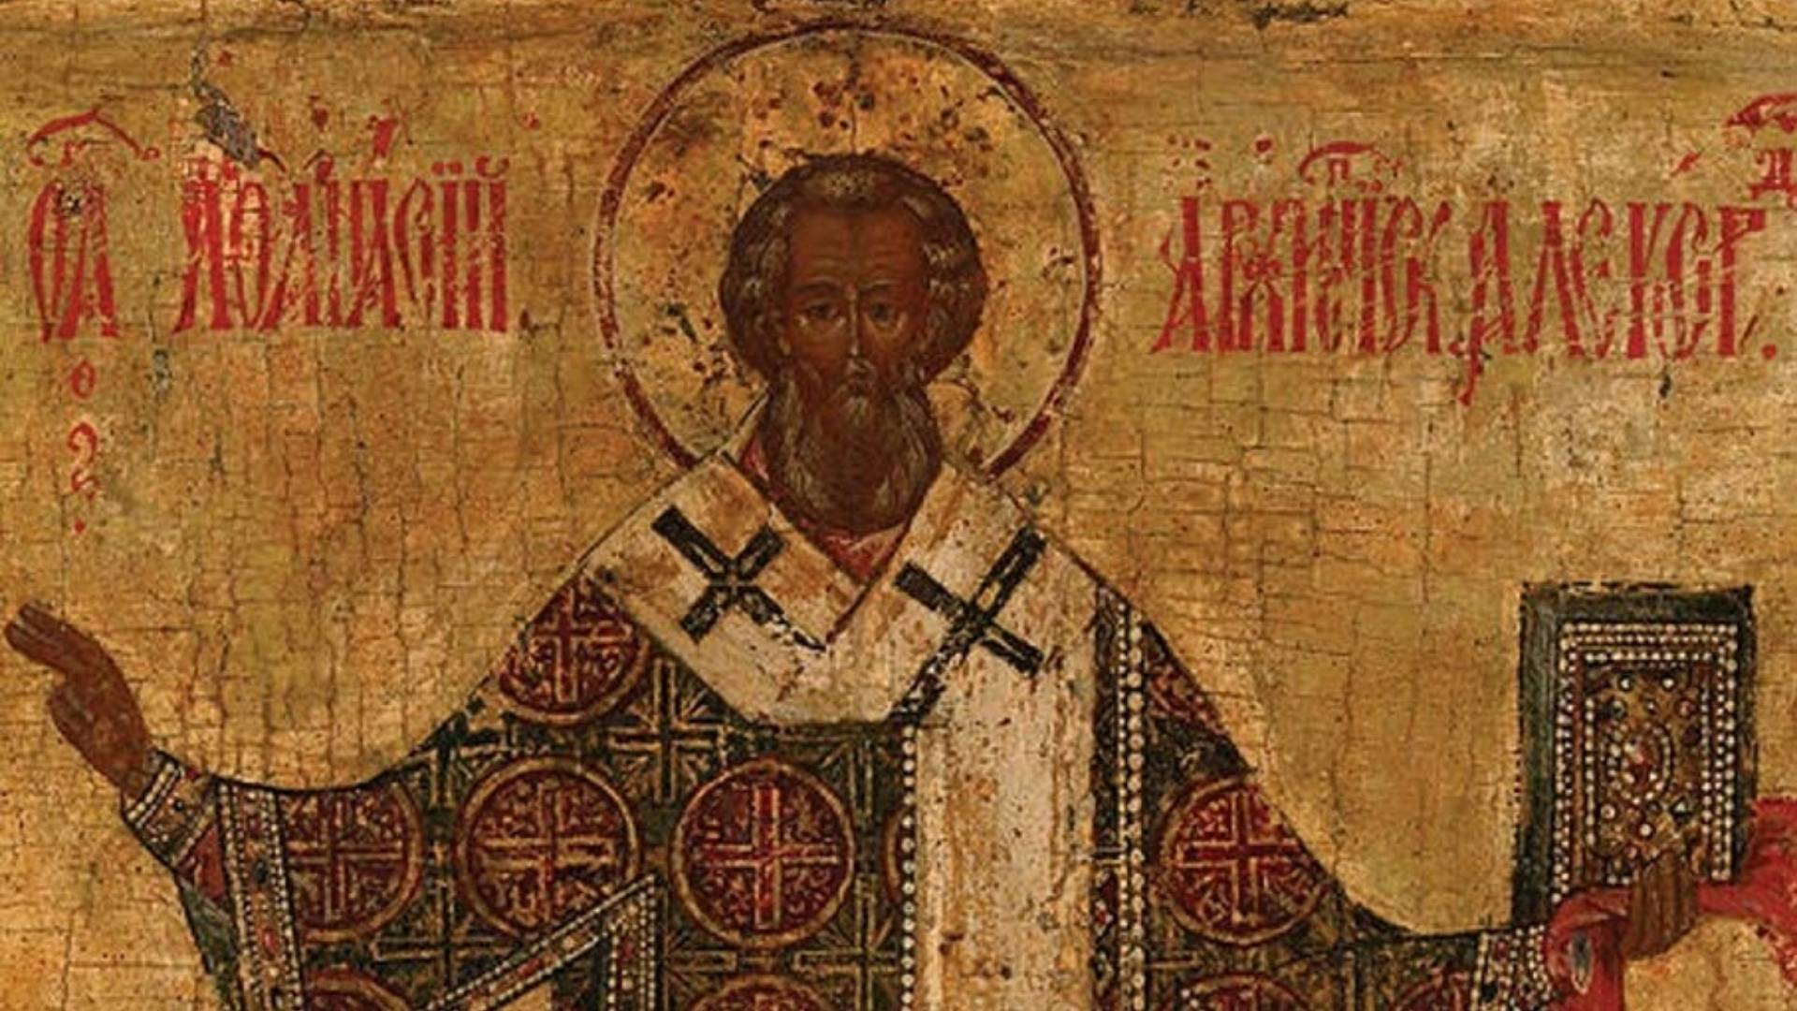
VERDICT
Athanasius insisted that there is no place in Christian thought for any kind of an intermediate being between God and man, between Creator and creature. And he argues passionately that true redemption is accomplished only through God the Son, not an intermediary. The Father and Son are co-equal and co-eternal and…
ARE homoouisious, “of one substance” / essence / being, but
NOT heteroousios “of different substance” / essence / being, and
NOT homoiousios “of similar substance” / essence / being
All but 3 agreed of the ~250 bishops attending

Slide 7
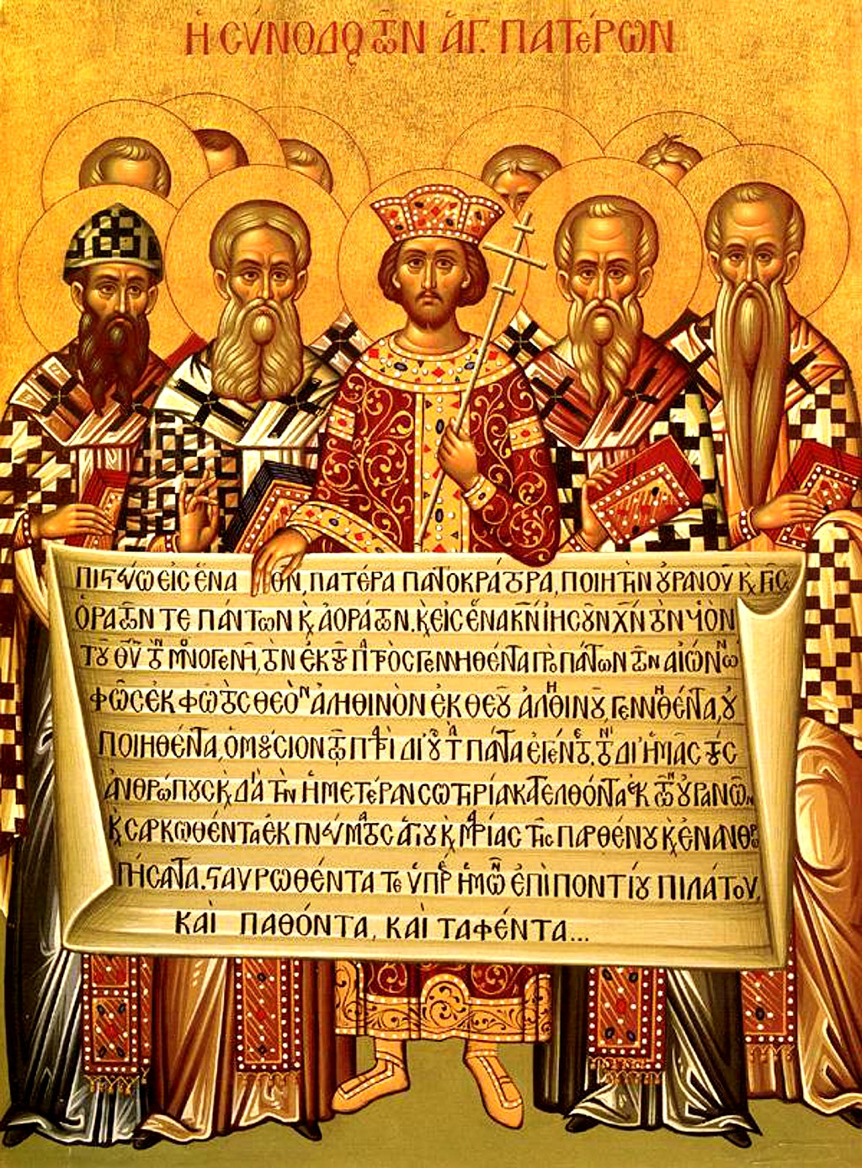
CREED
The overwhelming majority of Bishops condemned Arius as a heretic
Anyone preaching his ideas or possessing his manuscripts may be convicted of a capital crime.
Formulated an official Creed to affirm, against Arian heresy
Important to this day: Cults

Slide 8
What is a Creed?
Credo: where we get “creed” literally means “I believe.”
Creeds are statements of belief rooted deeply in scripture
Shareable, summary statements of Christian beliefs.
Said aloud for us to declare and for others to hear
They are personal and individual
Also value in the people of God confessing together (corporately) what “we believe,” too.
Creeds are memorable and shareable because of their short lengths, allowing for biblical truths to easily pass from generation to generation (which reflects the rich, oral tradition followers of God have been doing for a long time!
Examples: Ex 13:14-16; Deut 6:4-9, 20-25; I Cor 15:3-4; I Tim 4:16; II Tim 2:15-18).

Slide 9
THE NICENE CREED
We believe in one God, the Father Almighty,
Maker of all things visible and invisible.
And in one Lord Jesus Christ, the Son of God, begotten of the Father, Light of Light, very God of very God, begotten, not made, consubstantial with the Father;
By whom all things were made;
Who for us men, and for our salvation, came down and was incarnate and was made man;
He suffered, and the third day he rose again, ascended into heaven;
From thence he shall come to judge the quick and the dead.
And in the Holy Ghost.

Slide 10
Structure of the Nicene Creed (325)
01
02
03
WE BELIEVE IN THE FATHER (MAKER)
AND IN ONE LORD JESUS CHRIST (BEGOTTEN NOT MADE / CONSUBSTANTIAL)
I JESUS IS MAKER
II JESUS BECAME INCARNATE
III JESUS’S PASSION
IV JESUS WILL COME AGAIN
AND IN THE HOLY SPIRIT

Slide 11
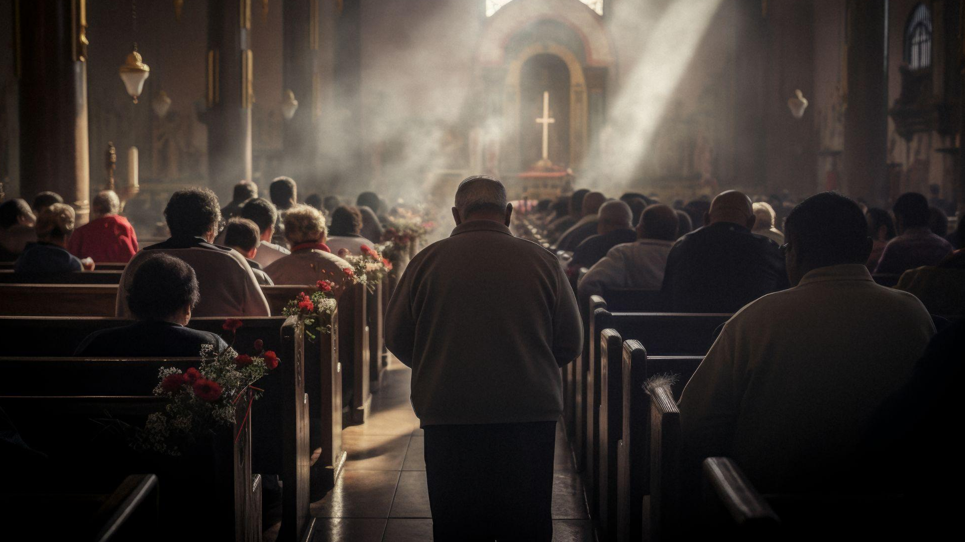
01
WE BELIEVE IN THE FATHER

Slide 12
THE NICENE CREED
1 We believe in one God, the Father Almighty,
Maker of all things visible and invisible.

Slide 13
In one God…
Deuteronomy 6:4 “Hear, O Israel! Yahweh is our God, Yahweh is one!
1 Corinthians 8:6 yet for us there is one God, the Father, from whom are all things and we exist for Him, and one Lord, Jesus Christ, by whom are all things, and we exist through Him.
Mark 12:28 And when one of the scribes came and heard them arguing, he recognized that He had answered them well and asked Him, “What commandment is the foremost of all?” 29 Jesus answered, “The foremost is, ‘Hear, O Israel! The Lord our God is one Lord;

Slide 14
In one God…
Isaiah 43:10 …Before Me there was no god formed, and there will be none after Me.
Isaiah 45:5 I am Yahweh, and there is no other; Besides Me there is no God. …6 …there is no one besides Me. I am Yahweh, and there is no other.
Cf. John 8:24 …unless you believe that I am He, you will die in your sins.”

Slide 15
The Father Almighty:
Paterology: The Study of the Father. Neglected/forgotten?
“Father” is the name that Jesus Himself used and gave to us for God. While the use of the word “Father” to refer to God may seem commonplace to the Christians of today, it was a unique concept in the early years of the Church. No other religion dares to bring God to such an intimate relationship to man that we may consider ourselves as His children. The Old Testament people did not even call out God’s name. We should not fail to grasp the significance, and uniqueness of this relationship that we, as Christians, profess to have with God.

Slide 16
The Father Almighty:
Father has 2 main indications
  Ontology: that God is the first origin of everything [creator] and transcendent authority [sovereign]
  Relation: that he is at the same time goodness and loving with care for all his children.
Some of the ways we can think of God being a “father” includes:
  Father of the universe, for he created everything
  Father of humanity, for he created mankind
  A loving and caring father that wants us to be with Him
  Father because He sustains us
  Father because He makes us His children through faith

Slide 17
…The Father Almighty
1 Corinthians 8:6 yet for us there is one God, the Father, from whom are all things and we exist for Him, and one Lord, Jesus Christ, by whom are all things, and we exist through Him.
  Ephesians 4:4 There is one body and one Spirit, just as also you were called in one hope of your calling; 5 one Lord, one faith, one baptism; 6 one God and Father of all who is over all and through all and in all.

Slide 18
…The Father Almighty
Matthew 23: 9b… One is your Father, He who is in heaven.
Psalm 68:5 A father of the fatherless and a judge for the widows, is God in His holy habitation.
Hebrews 12:7 It is for discipline that you endure; God deals with you as with sons; for what son is there whom his father does not discipline?
Proverbs 3:11 My son, do not reject the discipline of Yahweh or loathe His reproof, 12 For whom Yahweh loves He reproves, even as a father reproves the son in whom he delights.

Slide 19
…The Father Almighty
Isaiah 64:8 But now, O Yahweh, You are our Father; We are the clay, and You our potter; And all of us are the work of Your hand. Cf. Romans 9
Malachi 2:10 “Do we not all have one father? Has not one God created us? Why do we deal treacherously each against his brother so as to profane the covenant of our fathers?
1 John 3:1 See how great a love the Father has given to us, that we would be called children of God; and we are. For this reason the world does not know us, because it did not know Him.

Slide 20
…The Father Almighty
Ephesians 1:3 Blessed be the God and Father of our Lord Jesus Christ, who has blessed us with every spiritual blessing in the heavenly places in Christ
Isaiah 63:16 For You are our Father, though Abraham does not know us and Israel does not recognize us. You, O Yahweh, are our Father, our Redeemer from everlasting is Your name.
Matthew 6:9 “Pray, then, in this way: ‘Our Father who is in heaven, Hallowed be Your name.

Slide 21
…The Father Almighty
Mark 14:36 And He was saying, “Abba! Father! All things are possible for You; remove this cup from Me; yet not what I will, but what You will.”
Romans 8:15 For you have not received a spirit of slavery leading to fear again, but you have received the Spirit of adoption as sons by whom we cry out, “Abba! Father!”
Galatians 4:6 And because you are sons, God sent forth the Spirit of His Son into our hearts, crying, “Abba! Father!”

Slide 22
Maker of all things visible and invisible
The Father is all-powerful, sovereign, supreme Creator.
God made everything ex nihilo (out of nothing, no materials!) in Heaven and Earth.
From top to bottom, corner to corner, and all visible and invisible realms of creation, God made it all.
The 2 categories of creation:
  Visible (seen): 6 Days of Creation
  Invisible (unseen): Pre-Creation unseen realm
Arius confused the Son with visible creation, such that there was a time when He was not.

Slide 23
Maker of all things visible and invisible
God is the creator. He comes before anything was created, and creation is His, and His alone.
The universe is ‘a marvelously composed hymn to the power of the Almighty.’ -Gregory of Nyssa, who made significant contributions to the Nicene Creed.
When the Creed was written most people thought that a whole pantheon of gods made the world. Some today still believe that; for others there are no divine powers at all. This clear proclamation continues to make a powerful statement.

Slide 24
Maker of all things visible and invisible
God is the single, unique creator in a world that believed in gods, spirits, demiurges and more. In our more scientific times, it proclaims that reality is more than we can see, smell, taste and touch, that what we can measure and study is not all that there is.
The Nicene Creed gives Christians a distinctly different perspective on ‘life, the universe and everything.’ The Creed starts in this way to establish the overarching role of God in the world and our total commitment to him. It opens us to a message that is, literally, cosmic in scale yet also intimate.

Slide 25
Maker of all things visible and invisible
How Majestic Is Your Name: For the choir director. According to the Gittith. A Psalm of David.
Psalm 8:1 O Yahweh, our Lord, How majestic is Your name in all the earth, Who displays Your splendor above the heavens! 2 From the mouth of infants and nursing babies You have established strength because of Your adversaries, To make the enemy and the revengeful cease. 3 When I see Your heavens, the work of Your fingers, the moon and the stars, which You have established;…

Slide 26
Maker of all things visible and invisible
…Psalm 8:4 What is man that You remember him, and the son of man that You care for him? 5 Yet You have made him a little lower than the angels, and You crown him with glory and majesty! 6 You make him to rule over the works of Your hands; You have put all things under his feet, 7 All sheep and oxen, and also the animals of the field, 8 The birds of the heavens and the fish of the sea, whatever passes through the paths of the seas. 9 O Yahweh, our Lord, how majestic is Your name in all the earth!

Slide 27
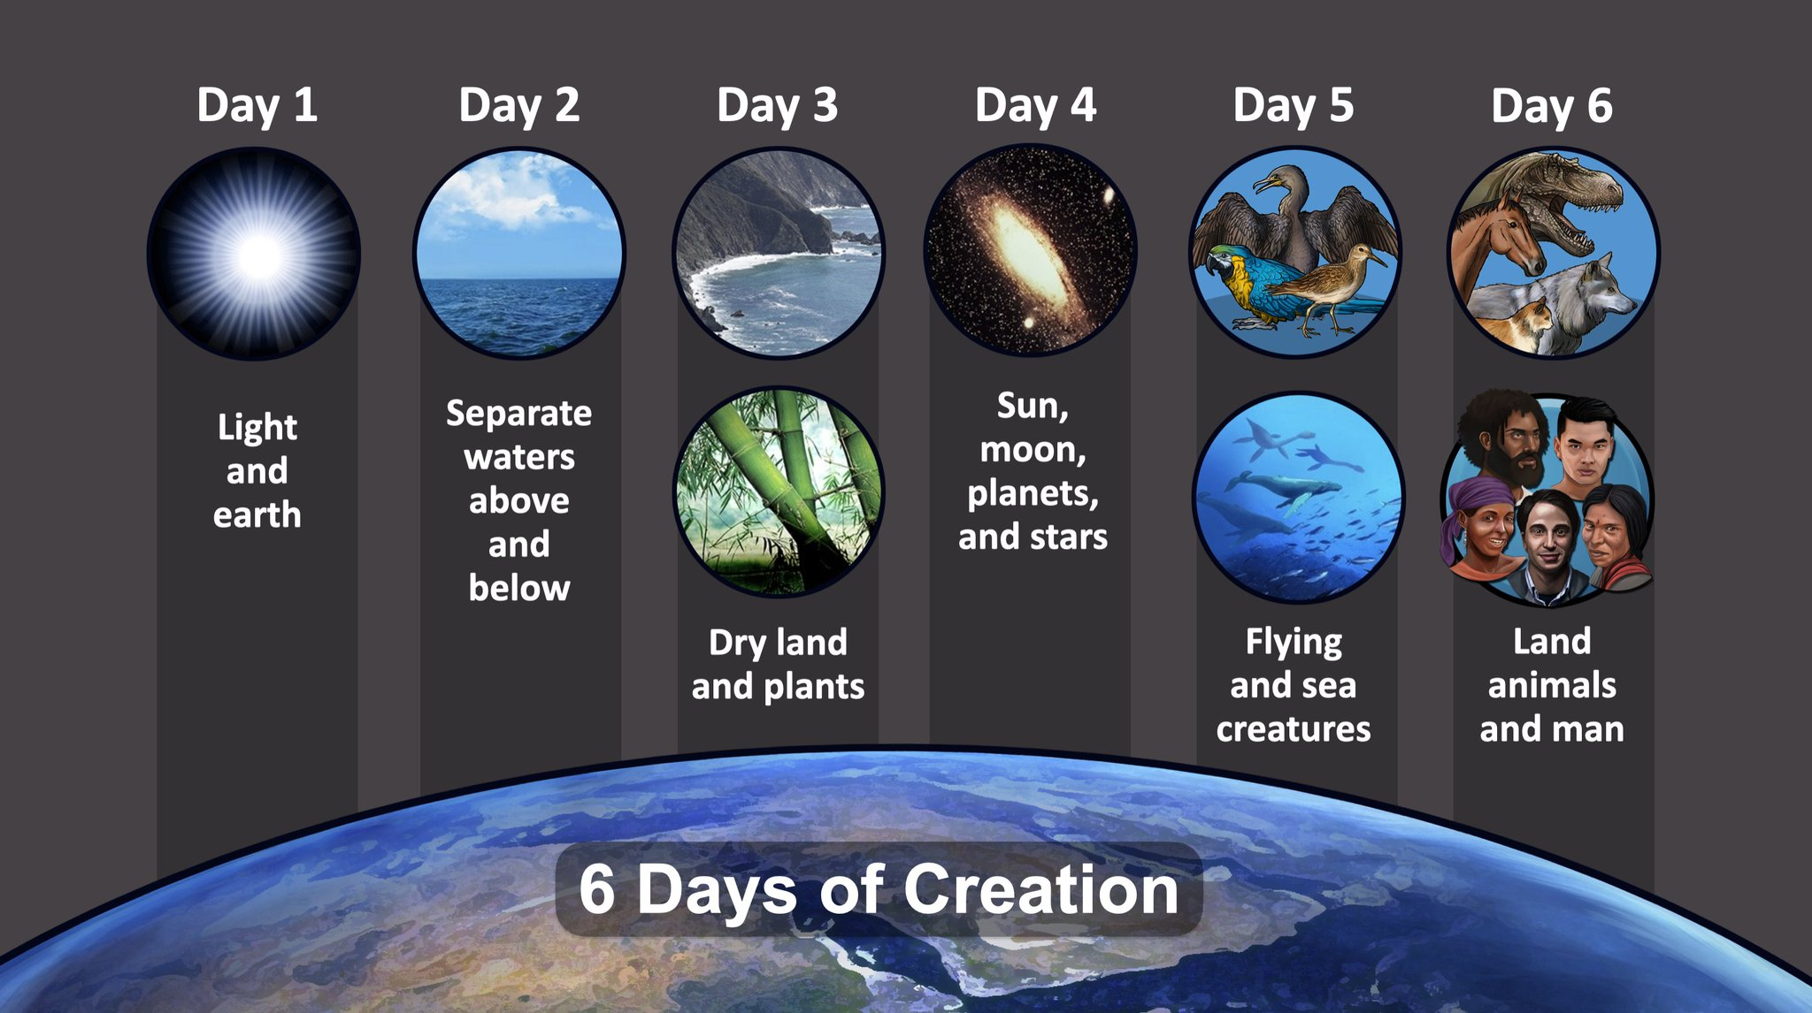
Maker of all things visible and invisible
Genesis 1:1 In the beginning God created the heavens and the earth.
  Light 1:3-5
  Waters 1:6-8
  Land/Plants 1:9-10
  Celestial objects 1:14-19
  Birds/fish 1:20-23
  Land animals & Man 1:24-31
Job 38:4 Where were you when I laid the foundation of the earth? Tell Me, if you know understanding [whole chapter]

Slide 28
Maker of all things visible and invisible
Psalm 139:13 For You formed my inward parts; You wove me in my mother’s womb. 14 I will give thanks to You, for I am fearfully and wonderfully made; Wonderful are Your works, and my soul knows it very well. 15 My frame was not hidden from You, when I was made in secret, and intricately woven in the depths of the earth; 16 Your eyes have seen my unshaped substance; and in Your book all of them were written the days that were formed for me, when as yet there was not one of them.

Slide 29
Maker of all things visible and invisible
Psalm 19:1 The heavens are telling of the glory of God; And the expanse is declaring the work of His hands. 2 Day to day pours forth speech, and night to night reveals knowledge. 3 There is no speech, nor are there words; Their voice is not heard. 4 Their line has gone out through all the earth, And their utterances to the end of the world. In them He has placed a tent for the sun, 5 Which is as a bridegroom coming out of his chamber; It rejoices as a strong man to run his course. 6 Its rising is from one end of the heavens, And its circuit to the other end of them;
And there is nothing hidden from its heat.

Slide 30
Maker of all things visible and invisible
Isaiah 42:5 Thus says the God, Yahweh, Who created the heavens and stretched them out, Who spread out the earth and its offspring, Who gives breath to the people on it, and spirit to those who walk in it…
Jeremiah 23:17 ‘Ah Lord Yahweh! Behold, You have made the heavens and the earth by Your great power and by Your outstretched arm! Nothing is too difficult for You…

Slide 31
Maker of all things visible and invisible
Acts 17:24 The God who made the world and all things in it, since He is Lord of heaven and earth, does not dwell in temples made with hands; 25 nor is He served by human hands, as though He needed anything, since He Himself gives to all people life and breath and all things; 26 and He made from one man every nation of mankind to inhabit all the face of the earth, having determined their appointed times and the boundaries of their habitation
Romans 11:33 Oh, the depth of the riches and wisdom and knowledge of God! How unsearchable are His judgments and unfathomable His ways! 34 For who has known the mind of the Lord, or who became His counselor? 35 Or who has first given to Him that it might be repaid to him? 36 For from Him and through Him and to Him are all things. To Him be the glory forever. Amen.

Slide 32
Maker of all things visible and invisible
Ephesians 4:6 one God and Father of all who is over all and through all and in all.
Colossians 1:16 For in [Jesus] all things were created, both in the heavens and on earth, visible and invisible, whether thrones or dominions or rulers or authorities—all things have been created through Him and for Him.
John 1:1 In the beginning was the Word, and the Word was with God, and the Word was God. 2 He was in the beginning with God. 3 All things came into being through Him, and apart from Him nothing came into being that has come into being.

Slide 33
Maker of all things visible and invisible
1 John 3:1 See how great a love the Father has given to us, that we would be called children of God; and we are. For this reason the world does not know us, because it did not know Him. (cf. Psalm 139)
Revelation 4:11 “Worthy are You, our Lord and our God, to receive glory and honor and power, for You created all things, and because of Your will they [a]existed, and were created.”

Slide 34
Maker of all things visible and invisible
Hebrews 11:3 By faith we understand that the worlds were prepared by the word of God, so that what is seen was not made out of things which are visible.
1 Timothy 1:17 Now to the King of the ages, immortal, invisible, the only God, be honor and glory forever and ever. Amen.
Romans 4:17 as it is written, “A father of many nations have I made you”—in the presence of Him whom he believed, even God, who gives life to the dead and calls into being that which does not exist.

Slide 35
Maker of all things visible and invisible
Revelation 11:17 saying, “We give You thanks, O Lord God, the Almighty, who is and who was, because You have taken Your great power and have begun to reign.
Revelation 15:3 And they *sang the song of Moses, the slave of God, and the song of the Lamb, saying,
“Great and marvelous are Your works,
O Lord God, the Almighty;
Righteous and true are Your ways,
King of the nations!

Slide 36
Maker of all things visible and invisible
Romans 1:18 For the wrath of God is revealed from heaven against all ungodliness and unrighteousness of men who suppress the truth in unrighteousness, 19 because that which is known about God is evident within them; for God made it evident to them. 20 For since the creation of the world His invisible attributes, both His eternal power and divine nature, have been clearly seen, being understood through what has been made, so that they are without excuse. 21 For even though they knew God, they did not glorify Him as God or give thanks, but they became futile in their thoughts, and their foolish heart was darkened. 22 Professing to be wise, they became fools, 23 and exchanged the glory of the incorruptible God for an image in the likeness of corruptible man and of birds and four-footed animals and crawling creatures.

