Slide 1
WORSHIP IN SONG
Reformation Song https://youtu.be/_jjCdKey4zg?si=275ra7PsuDmoe5s- John 4:24 God is spirit, and those who worship Him must worship in spirit and truth.”
Colossians 3:16 Let the word of Christ dwell in you richly, with all wisdom teaching and admonishing one another with psalms and hymns and spiritual songs, singing with gratefulness in your hearts to God.
Ephesians 5:19 [speak] to one another in psalms and hymns and spiritual songs, singing and making melody with your heart to the Lord; 20 always giving thanks for all things in the name of our Lord Jesus Christ to God, even the Father.

Slide 2
The Spirit-Filled Christian
Design for Discipleship – Book 2

Slide 4
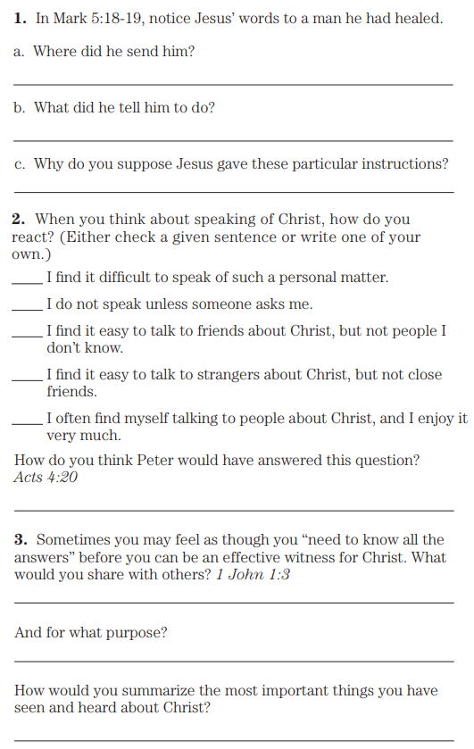
Mark 5:18 And as He was getting into the boat, the man who had been demon-possessed was pleading with Him that he might accompany Him. 19 And He did not let him, but He *said to him, “Go home to your people and report to them what great things the Lord has done for you, and how He had mercy on you.”
Acts 4:20 for we cannot stop speaking about what we have seen and heard.”
1 John 1:3 what we have seen and heard we proclaim to you also, so that you may also have fellowship with us; and indeed our fellowship is with the Father, and with His Son Jesus Christ.

Slide 5
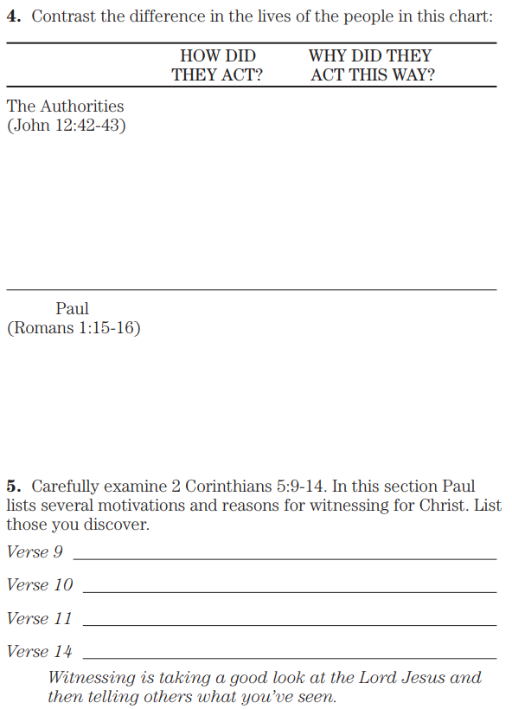
John 12:42 Nevertheless many even of the rulers believed in Him, but because of the Pharisees they were not confessing Him, for fear that they would be put out of the synagogue; 43 for they loved the glory of men rather than the glory of God.
Romans 1:15 In this way, for my part, I am eager to proclaim the gospel to you also who are in Rome. 16 For I am not ashamed of the gospel, for it is the power of God for salvation to everyone who believes, to the Jew first and also to the Greek.
2 Corinthians 5:9 Therefore we also have as our ambition, whether at home or absent, to be pleasing to Him. 10 For we must all appear before the judgment seat of Christ, so that each one may be recompensed for his deeds in the body, according to what he has done, whether good or bad. 11 So then, knowing the fear of the Lord, we persuade men, but we have been made manifest to God; and I hope that we have been made manifest also in your consciences. 12 We are not again commending ourselves to you but are giving you an opportunity to boast of us, so that you will have an answer for those who boast in appearance and not in heart. 13 For if we are out of our mind, it is for God, or if we are of right mind, it is for you. 14 For the love of Christ controls us, having concluded this, that one died for all, therefore all died.

Slide 6
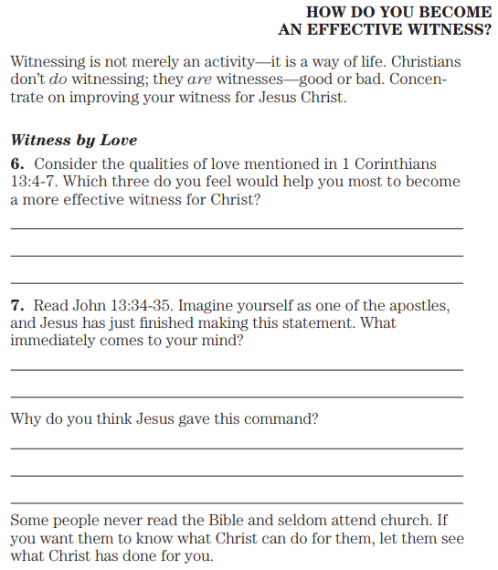
1 Corinthians 13:4 Love is patient, love is kind, is not jealous, does not brag, is not puffed up; 5 it does not act unbecomingly, does not seek its own, is not provoked, does not take into account a wrong suffered; 6 it does not rejoice in unrighteousness, but rejoices with the truth; 7 it bears all things, believes all things, hopes all things, endures all things.
John 13:34 A new commandment I give to you, that you love one another, even as I have loved you, that you also love one another. 35 By this all will know that you are My disciples, if you have love for one another.”

Slide 7
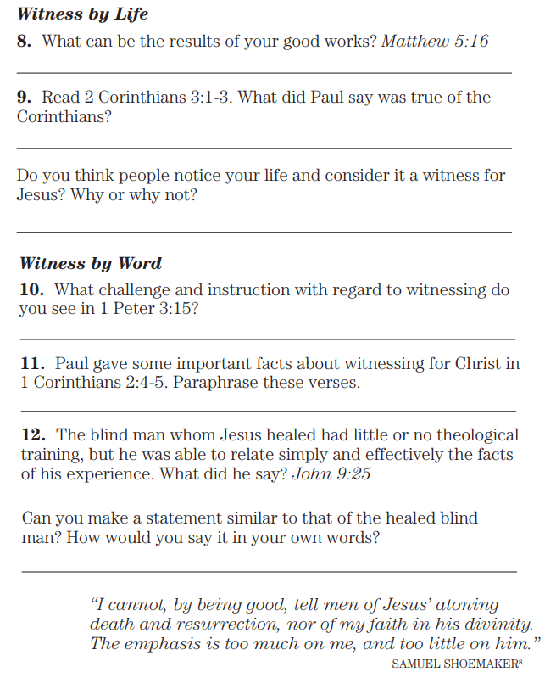
Matthew 5:16 Let your light shine before men in such a way that they may see your good works, and glorify your Father who is in heaven.
2 Corinthians 3:1 Are we beginning to commend ourselves again? Or do we need, as some, letters of commendation to you or from you? 2 You are our letter, having been written in our hearts, known and read by all men, 3 being manifested that you are a letter of Christ, ministered to by us, having been written not with ink but with the Spirit of the living God, not on tablets of stone but on tablets of hearts of flesh.
1 Peter 3:15 but sanctify Christ as Lord in your hearts, always being ready to make a defense to everyone who asks you to give an account for the hope that is in you, yet with gentleness and fear
1 Corinthians 2:4 and my word and my preaching were not in persuasive words of wisdom, but in demonstration of the Spirit and of power, 5 so that your faith would not be in the wisdom of men, but in the power of God.
John 9:25 He then answered, “Whether He is a sinner, I do not know; one thing I do know, that though I was blind, now I see.”

Slide 8
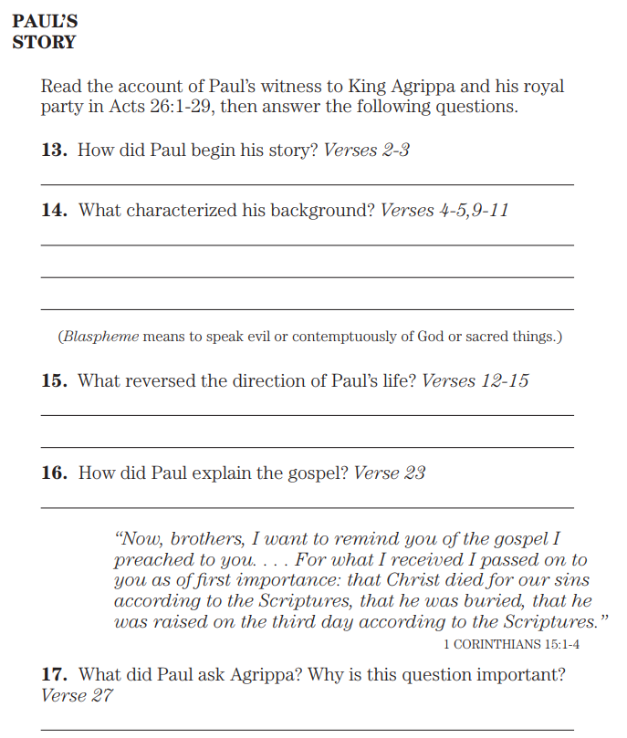
Acts 26:1 Now Agrippa said to Paul, “You are permitted to speak for yourself.” Then Paul, stretching out his hand, began to make his defense:
2 “Concerning all the things of which I am accused by the Jews, I regard myself blessed, King Agrippa, that I am about to make my defense before you today; 3 especially because you are an expert in all customs and questions among the Jews; therefore I beg you to listen to me patiently.
4 “So then, all Jews know my manner of life from my youth, which from the beginning was spent among my own nation and at Jerusalem; 5 since they have known about me for a long time, if they are willing to testify, that I lived as a Pharisee according to the strictest sect of our religion. 6 And now I am standing here being tried for the hope of the promise made by God to our fathers; 7 the promise to which our twelve tribes hope to attain, as they earnestly serve God night and day. And for this hope, O King, I am being accused by Jews. 8 Why is it considered unbelievable among all of you if God does raise the dead?
9 “So then, I thought to myself that I had to do many things hostile to the name of Jesus the Nazarene. 10 And this is just what I did in Jerusalem; not only did I lock up many of the saints in prisons, having received authority from the chief priests, but also when they were being put to death I cast my vote against them. 11 And as I punished them often in all the synagogues, I tried to force them to blaspheme; and being furiously enraged at them, I kept pursuing them even to foreign cities.

Slide 9
…Paul Tells of His Conversion
Acts 26:12 “While so engaged as I was journeying to Damascus with the authority and commission of the chief priests, 13 at midday, O King, I saw on the way a light from heaven, brighter than the sun, shining all around me and those who were journeying with me. 14 And when we had all fallen to the ground, I heard a voice saying to me in the [h]Hebrew language, ‘Saul, Saul, why are you persecuting Me? It is hard for you to kick against the goads.’ 15 And I said, ‘Who are You, Lord?’ And the Lord said, ‘I am Jesus whom you are persecuting. 16 But rise up and stand on your feet; for this purpose I have appeared to you, to appoint you a servant and a witness not only to the things which you have seen, but also to the things in which I will appear to you; 17 rescuing you from the Jewish people and from the Gentiles, to whom I am sending you, 18 to open their eyes so that they may turn from darkness to light and from the authority of Satan to God, that they may receive forgiveness of sins and an inheritance among those who have been sanctified by faith in Me.’
19 “So, King Agrippa, I did not prove disobedient to the heavenly vision, 20 but kept declaring both to those of Damascus first, and also at Jerusalem and then throughout all the region of Judea, and even to the Gentiles, that they should repent and turn to God, practicing deeds appropriate to repentance. 21 For this reason some Jews seized me in the temple and were trying to put me to death. 22 Therefore, having obtained help from God to this day, I stand here bearing witness both to small and great, stating nothing but what the Prophets and Moses said was going to take place; 23 that the Christ was to suffer, and that as first of the resurrection from the dead, He was going to proclaim light both to the Jewish people and to the Gentiles.”

Slide 10
…
Acts 26:24 Now while Paul was saying this in his defense, Festus *said in a loud voice, “Paul, you are out of your mind! Great learning is driving you out of your mind.” 25 But Paul *said, “I am not out of my mind, most excellent Festus, but I utter words of sober truth. 26 For the king knows about these matters, and I speak to him also with confidence, since I am persuaded that none of these things escape his notice; for this has not been done in a corner. 27 King Agrippa, do you believe the Prophets? I know you believe.” 28 But Agrippa replied to Paul, “In such short time are you persuading me to become a Christian?” 29 And Paul said, “I would pray to God, that whether in a short or long time, not only you, but also all who hear me this day, might become such as I am, except for these chains.”

