Slide 2
Colossians 3:16 Let the word of Christ dwell in you richly, with all wisdom teaching and admonishing one another with psalms and hymns and spiritual songs, singing with gratefulness in your hearts to God. My Hope is Built

Slide 3
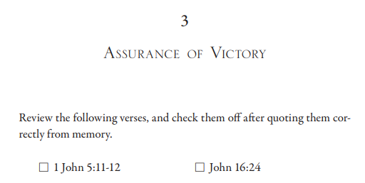
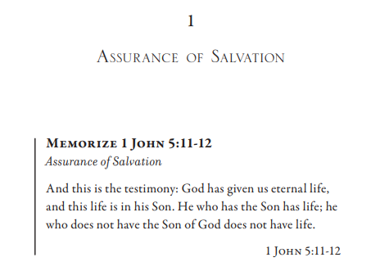
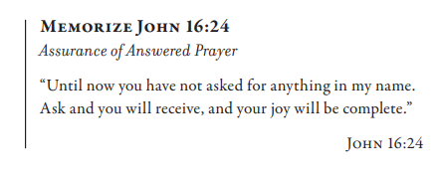

Slide 4
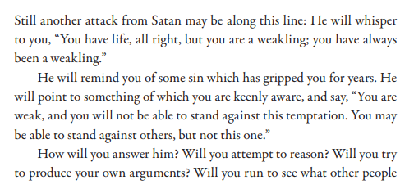

Slide 5
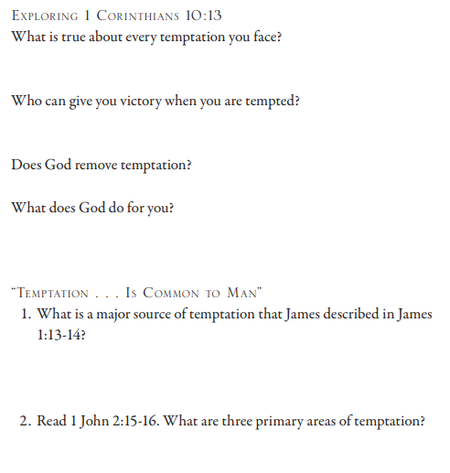
1 Corinthians 10: 13 No temptation has overtaken you but such as is common to man, but God is faithful, who will not allow you to be tempted beyond what you are able, but with the temptation will provide the way of escape also, so that you will be able to endure it. James 1:13 Let no one say when he is tempted, “I am being tempted by God”; for God cannot be tempted by evil, and He Himself does not tempt anyone. 14 But each one is tempted when he is carried away and enticed by his own lust. 1 John 2:15 Do not love the world nor the things in the world. If anyone loves the world, the love of the Father is not in him. 16 For all that is in the world, the lust of the flesh and the lust of the eyes and the boastful pride of life, is not from the Father, but is from the world.

Slide 6
1 Peter 5:8 Be of sober spirit, be watchful. Your adversary, the devil, prowls around like a roaring lion, seeking someone to devour. 2 Thessalonians 3:3 But the Lord is faithful, who will strengthen and guard you from the evil one. Hebrews 4:15 For we do not have a high priest who cannot sympathize with our weaknesses, but One who has been tempted in all things like we are, yet without sin. Matthew 6:9 “Pray, then, in this way: ‘Our Father who is in heaven, Hallowed be Your name.

Slide 7
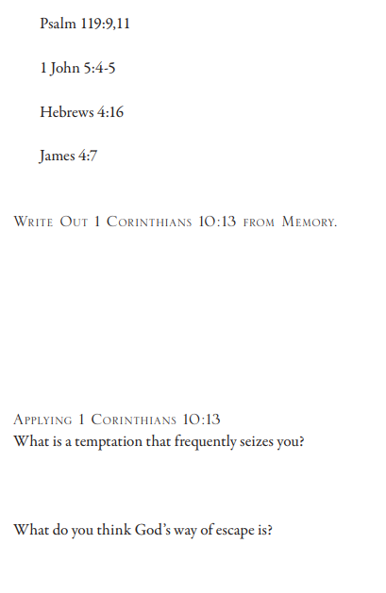
Psalm 119:9 How can a young man keep his way pure? By keeping it according to Your word… 11 Your word I have treasured in my heart, That I may not sin against You. 1 John 5:4 For everything that has been born of God overcomes the world; and this is the overcoming that has overcome the world—our faith. 5 Who is the one who overcomes the world, but he who believes that Jesus is the Son of God? Hebrews 4:16 Therefore let us draw near with confidence to the throne of grace, so that we may receive mercy and find grace to help in time of need. James 4:7 Be subject therefore to God. Resist the devil and he will flee from you.

