Slide 2
Now Thank We All Our God https://www.youtube.com/watch?v=iLjJJBFlXR0 John 4:24 God is spirit, and those who worship Him must worship in spirit and truth.” Colossians 3:16 Let the word of Christ dwell in you richly, with all wisdom teaching and admonishing one another with psalms and hymns and spiritual songs, singing with gratefulness in your hearts to God. Ephesians 5:19 [speak] to one another in psalms and hymns and spiritual songs, singing and making melody with your heart to the Lord; 20 always giving thanks for all things in the name of our Lord Jesus Christ to God, even the Father.

Slide 3
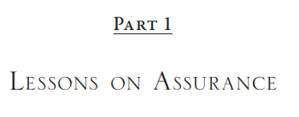
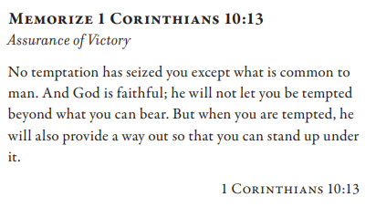
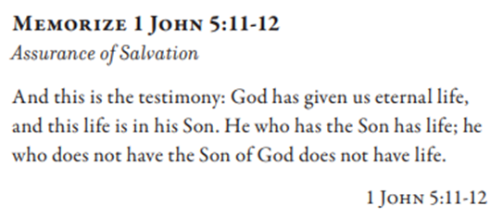
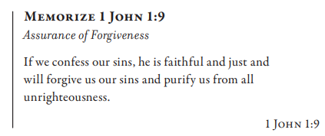
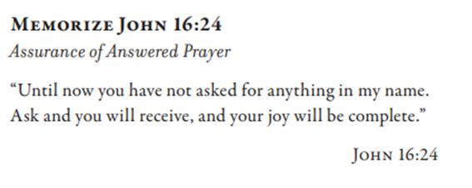

Slide 4
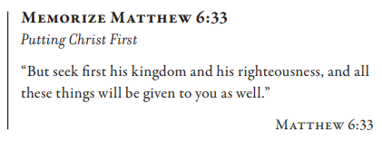
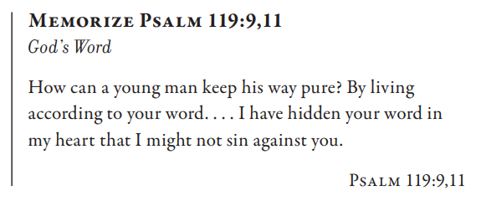
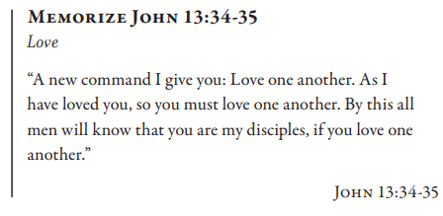

Slide 5
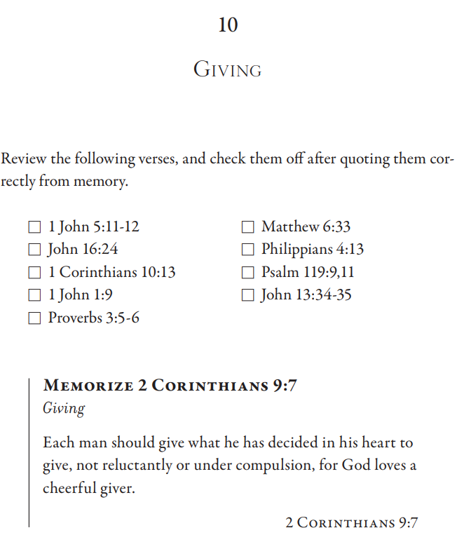
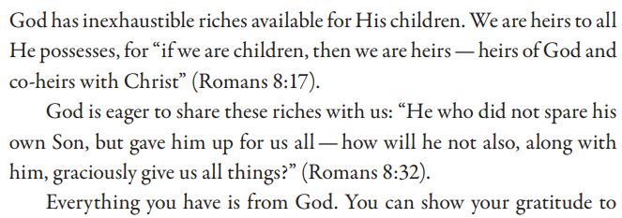
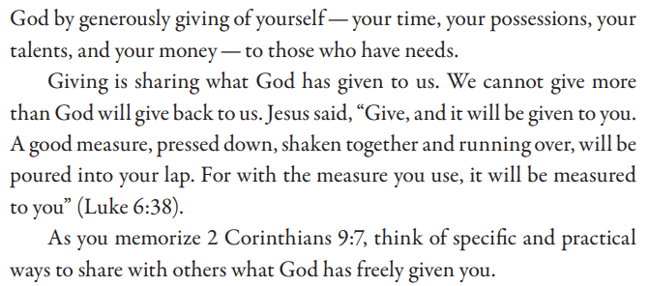

Slide 6
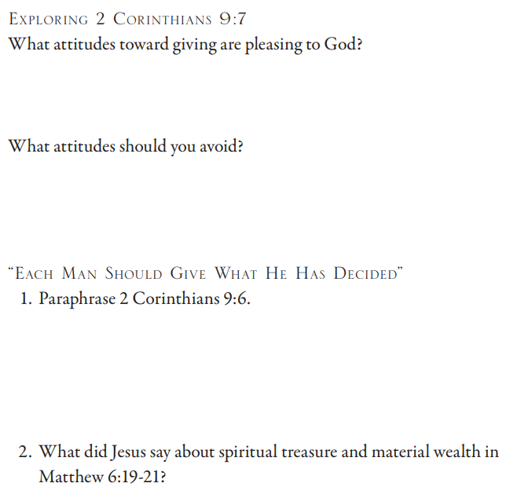
2 Corinthians 9:7 Each one must do just as he has purposed in his heart, not grudgingly or under compulsion, for God loves a cheerful giver. 2 Corinthians 9:6 Now this I say, he who sows sparingly will also reap sparingly, and he who sows with blessing will also reap with blessing. Matthew 6:19 “Do not store up for yourselves treasures on earth, where moth and rust destroy, and where thieves break in and steal. 20 But store up for yourselves treasures in heaven, where neither moth nor rust destroys, and where thieves do not break in or steal; 21 for where your treasure is, there your heart will be also.

Slide 7
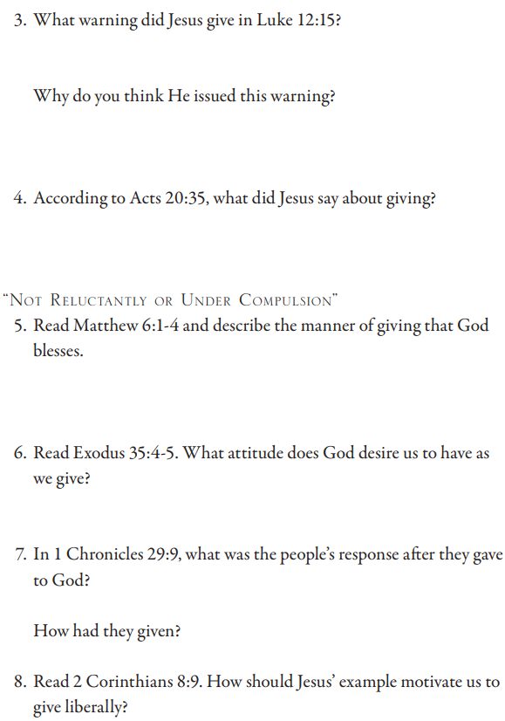
Luke 12:15 Then He said to them, “Watch out and be on your guard against every form of greed, for not even when one has an abundance does his life consist of his possessions.” Acts 20:35 In everything I showed you that by laboring in this manner you must help the weak and remember the words of the Lord Jesus, that He Himself said, ‘It is more blessed to give than to receive.’” Matthew 6:1 “Beware of doing your righteousness before men to be noticed by them; otherwise you have no reward with your Father who is in heaven. 2 “Therefore, when you give to the poor, do not sound a trumpet before you, as the hypocrites do in the synagogues and in the streets, so that they may be glorified by men. Truly I say to you, they have their reward in full. 3 But when you give to the poor, do not let your left hand know what your right hand is doing, 4 so that your giving will be in secret; and your Father who sees what is done in secret will reward you. Exodus 34:4 So he carved out two stone tablets like the former ones, and Moses rose up early in the morning and went up to Mount Sinai, as Yahweh had commanded him, and he took two stone tablets in his hand. 5 Then Yahweh descended in the cloud and stood there with him, and He called upon the name of Yahweh. 1 Chronicles 29:9 Then the people were glad because they had offered so willingly, for they made their freewill offering to Yahweh with a whole heart, and King David also was exceedingly glad. 2 Corinthians 8:9 For you know the grace of our Lord Jesus Christ, that though being rich, yet for your sake He became poor, so that you through His poverty might become rich.

Slide 8
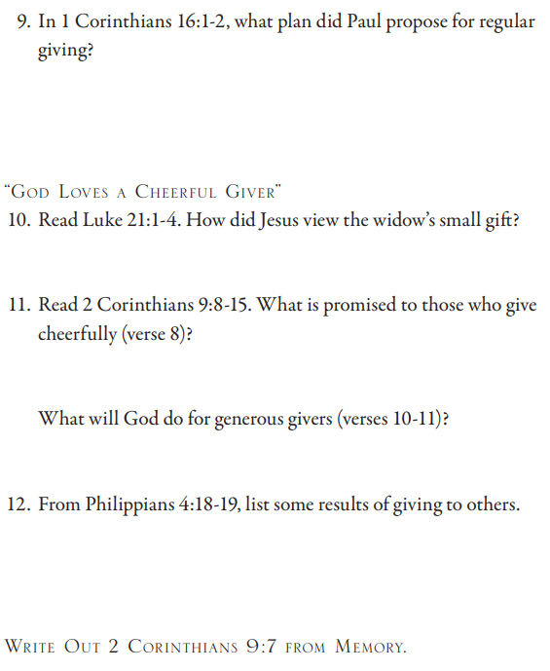
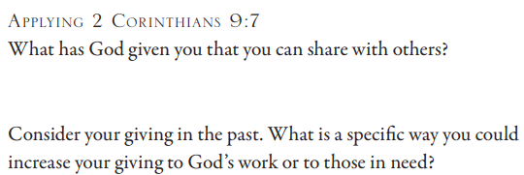
1 Corinthians 16:1 Now concerning the collection for the saints, as I directed the churches of Galatia, so do you also. 2 On the first day of every week each one of you is to set something aside, saving whatever he has prospered, so that no collections be made when I come.
Luke 12:1 At this time, after so many thousands of the crowd had gathered together that they were trampling on one another, He began saying to His disciples first, “Be on your guard for the leaven of the Pharisees, which is hypocrisy. 2 But there is nothing covered up that will not be revealed, and hidden that will not be known. 3 Accordingly, whatever you have said in the dark will be heard in the light, and what you have whispered in the inner rooms will be proclaimed upon the housetops. 4 “But I say to you, My friends, do not fear those who kill the body and after that have no more that they can do.
2 Corinthians 9:8 And God is able to make every grace abound to you, so that in everything at every time having every sufficiency, you may have an abundance for every good deed; 9 as it is written, “He scattered abroad, he gave to the needy, His righteousness stands forever.” 10 Now He who supplies seed to the sower and bread for food will supply and multiply your seed and increase the harvest of your righteousness; 11 you will be enriched in everything for all generosity, which through us is bringing about thanksgiving to God. 12 For the ministry of this service is not only fully supplying the needs of the saints, but is also abounding through many thanksgivings to God. 13 Because of the proven character given by this ministry, they will glorify God for your obedience to your confession of the gospel of Christ and for the generosity of your fellowship toward them and toward all, 14 while they also, by prayer on your behalf, long for you because of the surpassing grace of God on you. 15 Thanks be to God for His indescribable gift!

