Slide 1
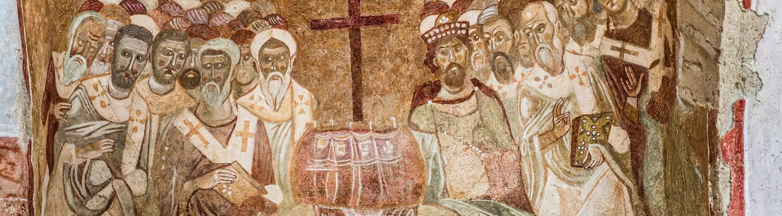
NICENE CREED
AFTER 1700 YEARS

Slide 2
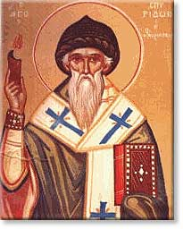
ARIUS
Pre-325
Arius was born in Libya ~250 A.D.
Tall, thin, walked barefoot, winsome personality, musical
Presbyter in Alexandria under his Bishop Alexander
Taught “there was a time when the son was not”

Slide 3
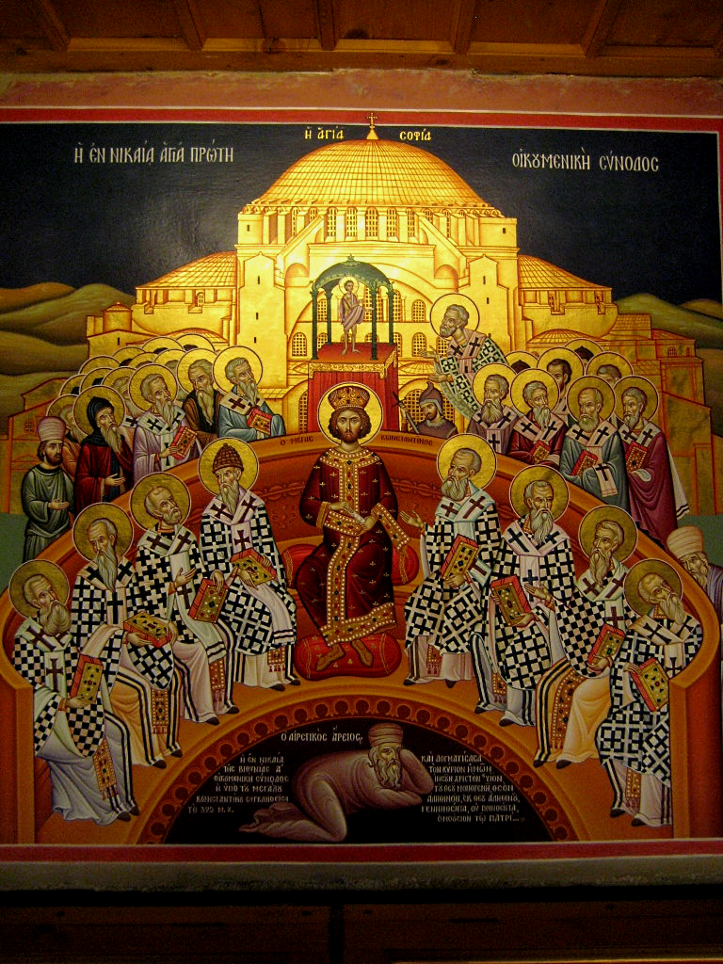
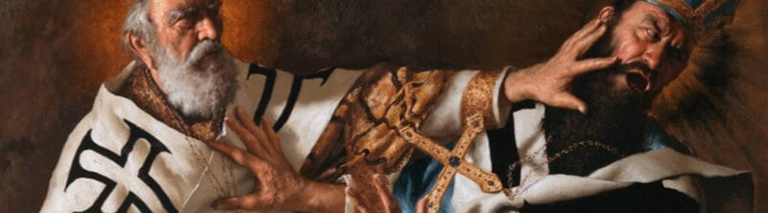
THE COUNCIL OF
NICAEA
In 325 Constantine calls a council at Nicaea
First Ecumenical Council
Deliberations about whether Arius taught falsehood
Athanasius vs
Eusebius & Arius
Arius and his teachings are condemned

Slide 4
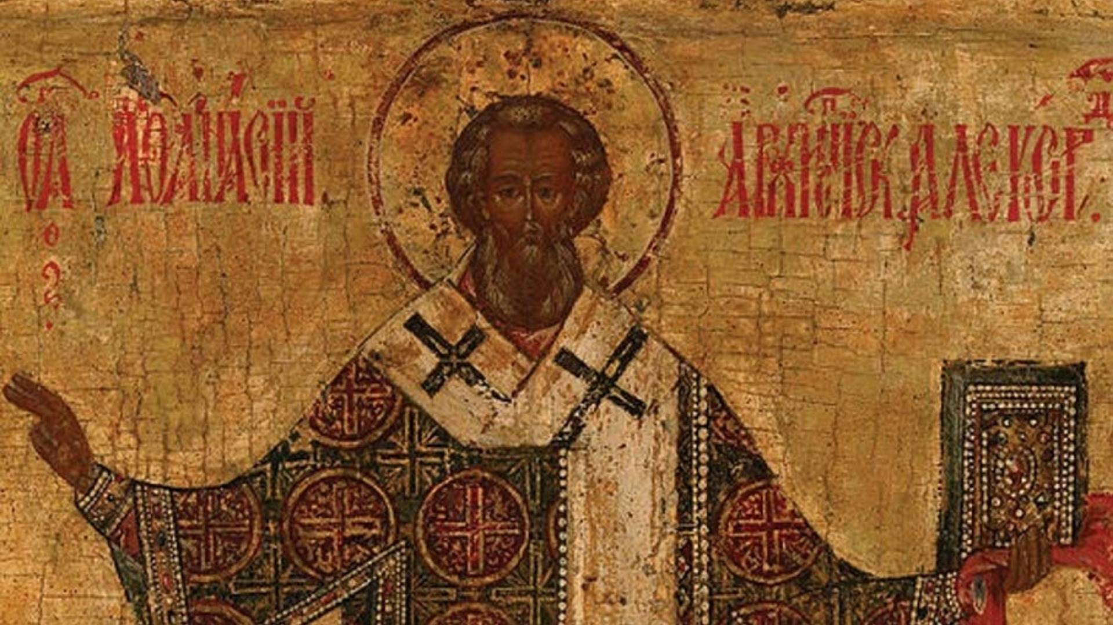
VERDICT
]
The Father and Son are co-equal and co-eternal and…
ARE homoouisious, “of one substance” / essence / being, but
NOT heteroousios “of different substance” / essence / being, &
NOT homoiousios “of similar substance” / essence / being

Slide 5
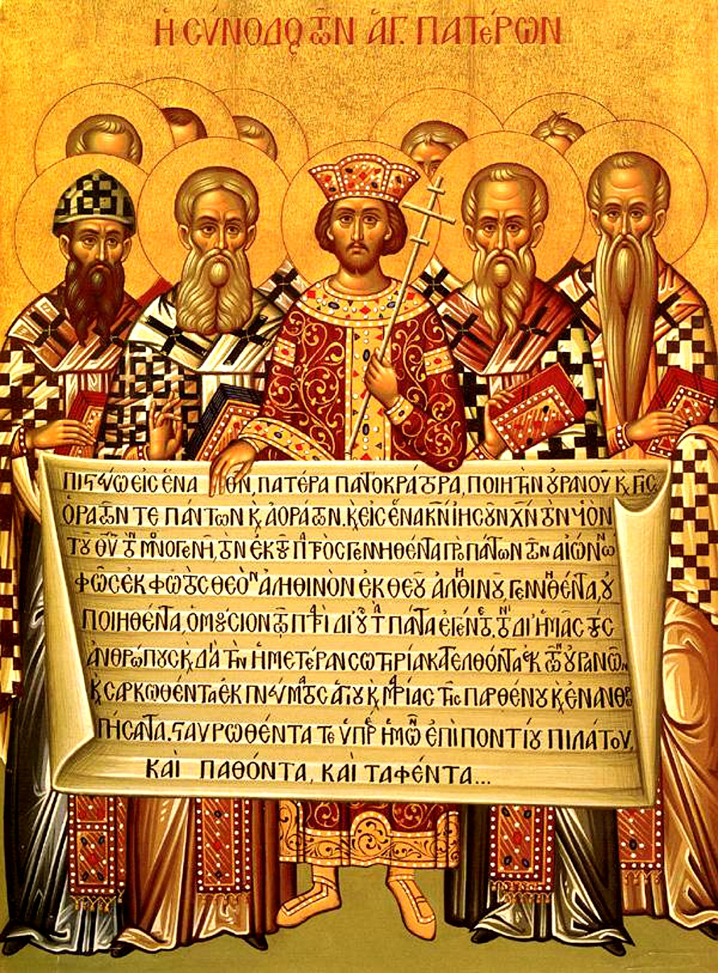
CREED
The overwhelming majority of Bishops condemned Arius as a heretic
Anyone preaching his ideas or possessing his manuscripts may be convicted of a capital crime.
Formulated an official Creed to affirm, against Arian heresy
Important to this day: Cults

Slide 6
THE NICENE CREED
We believe in one God, the Father Almighty,
Maker of all things visible and invisible.
And in one Lord Jesus Christ, the Son of God, begotten of the Father, Light of Light, very God of very God, begotten, not made, consubstantial with the Father;
By whom all things were made;
Who for us men, and for our salvation, came down and was incarnate and was made man;
He suffered, and the third day he rose again, ascended into heaven;
From thence he shall come to judge the quick and the dead.
And in the Holy Ghost.

Slide 7
Structure of the Nicene Creed (325)
01
02
03
WE BELIEVE IN THE FATHER (MAKER)
AND IN ONE LORD JESUS CHRIST (BEGOTTEN NOT MADE / CONSUBSTANTIAL)
I JESUS IS MAKER
II JESUS BECAME INCARNATE
III JESUS’S PASSION
IV JESUS WILL COME AGAIN
AND IN THE HOLY SPIRIT

Slide 8
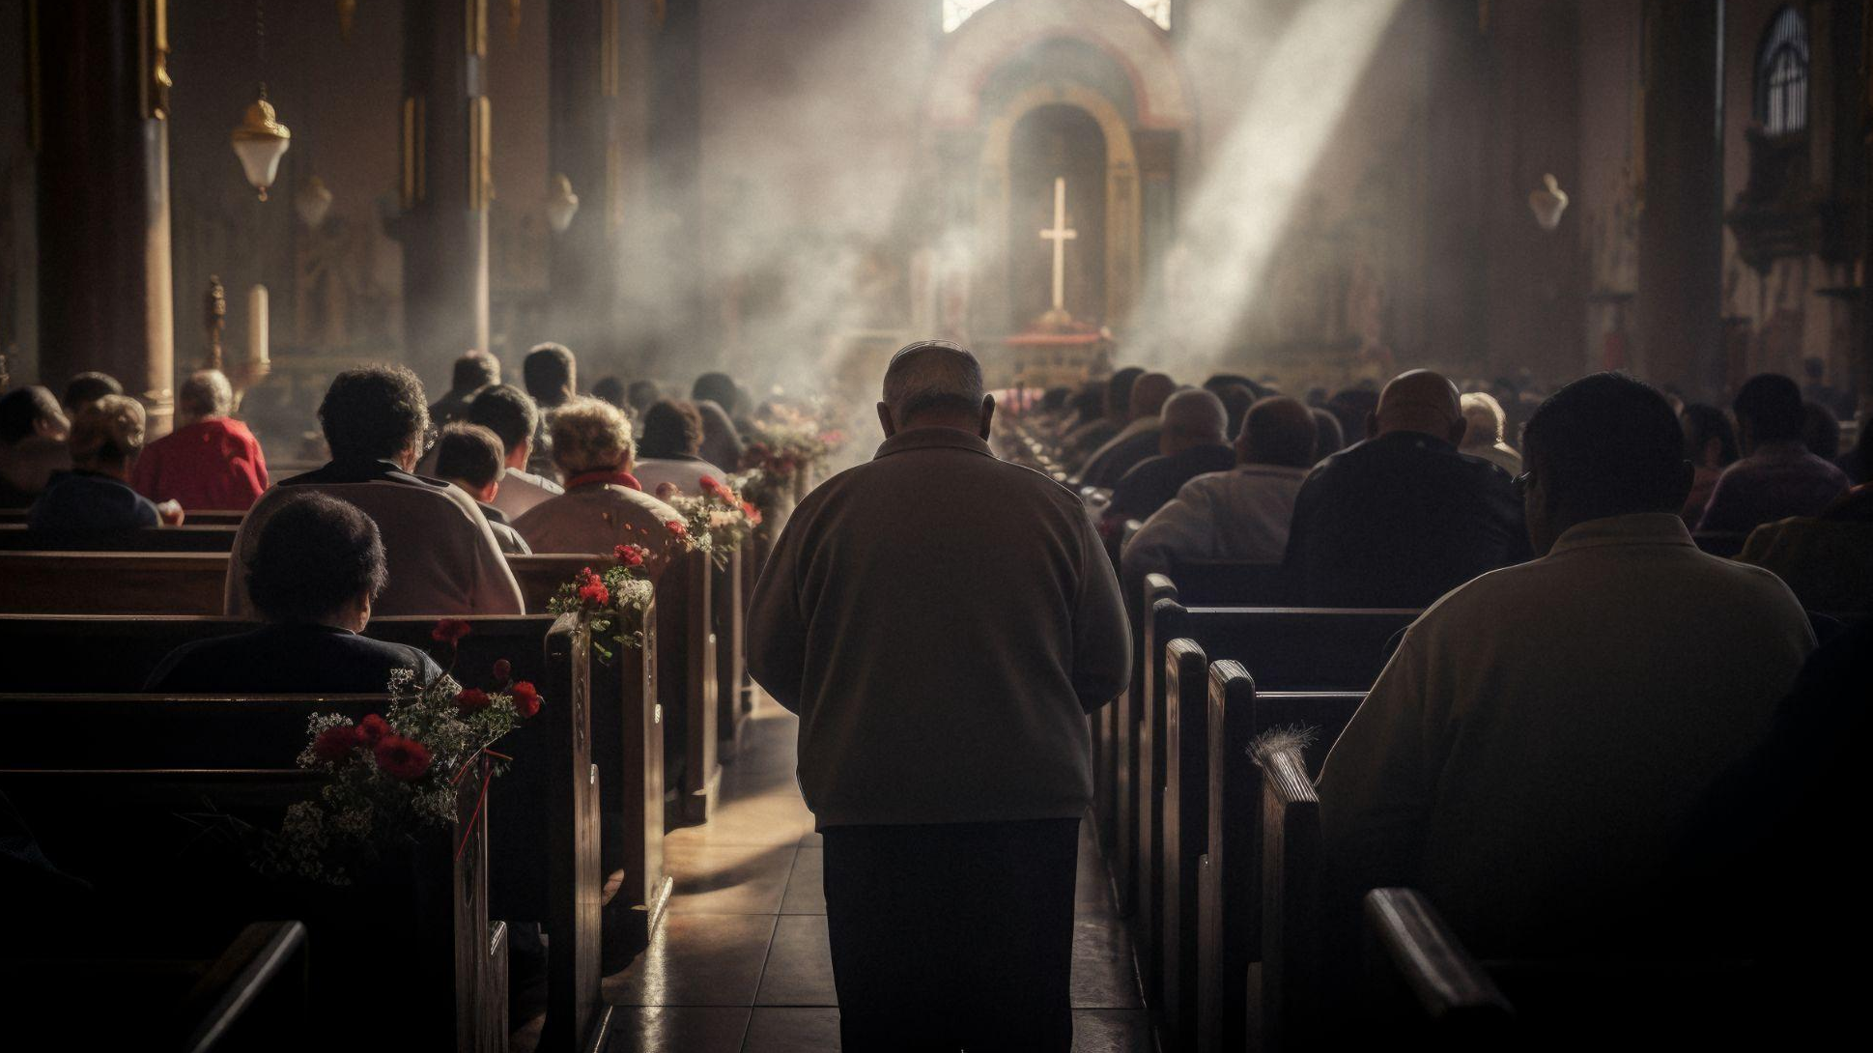
01
WE BELIEVE IN THE FATHER

Slide 9
THE NICENE CREED
1 We believe in one God, the Father Almighty,
Maker of all things visible and invisible.

Slide 10
In one God…
Deuteronomy 6:4 “Hear, O Israel! Yahweh is our God, Yahweh is one!
1 Corinthians 8:6 yet for us there is one God, the Father, from whom are all things and we exist for Him, and one Lord, Jesus Christ, by whom are all things, and we exist through Him.
Mark 12:28 And when one of the scribes came and heard them arguing, he recognized that He had answered them well and asked Him, “What commandment is the foremost of all?” 29 Jesus answered, “The foremost is, ‘Hear, O Israel! The Lord our God is one Lord;

Slide 11
In one God…
Isaiah 43:10 …Before Me there was no god formed, and there will be none after Me.
Isaiah 45:5 I am Yahweh, and there is no other; Besides Me there is no God. …6 …there is no one besides Me. I am Yahweh, and there is no other.
Cf. John 8:24 …unless you believe that I am He, you will die in your sins.”

Slide 12
…The Father Almighty
1 Corinthians 8:6 yet for us there is one God, the Father, from whom are all things and we exist for Him, and one Lord, Jesus Christ, by whom are all things, and we exist through Him.
  Ephesians 4:4 There is one body and one Spirit, just as also you were called in one hope of your calling; 5 one Lord, one faith, one baptism; 6 one God and Father of all who is over all and through all and in all.

Slide 13
…The Father Almighty
Hebrews 12:7 It is for discipline that you endure; God deals with you as with sons; for what son is there whom his father does not discipline? Cf. Proverbs 3:11-12
1 John 3:1 See how great a love the Father has given to us, that we would be called children of God; and we are. For this reason the world does not know us, because it did not know Him.
Matthew 6:9 “Pray, then, in this way: ‘Our Father who is in heaven, Hallowed be Your name.
Galatians 4:6 And because you are sons, God sent forth the Spirit of His Son into our hearts, crying, “Abba! Father!”

Slide 14
Maker of all things visible and invisible
The Father is all-powerful, sovereign, supreme Creator.
God made everything ex nihilo (out of nothing, no materials!) in Heaven and Earth.
From top to bottom, corner to corner, and all visible and invisible realms of creation, God made it all.
The 2 categories of creation:
  Visible (seen): 6 Days of Creation
  Invisible (unseen): Pre-Creation unseen realm
Arius confused the Son with visible creation, such that there was a time when He was not.

Slide 15
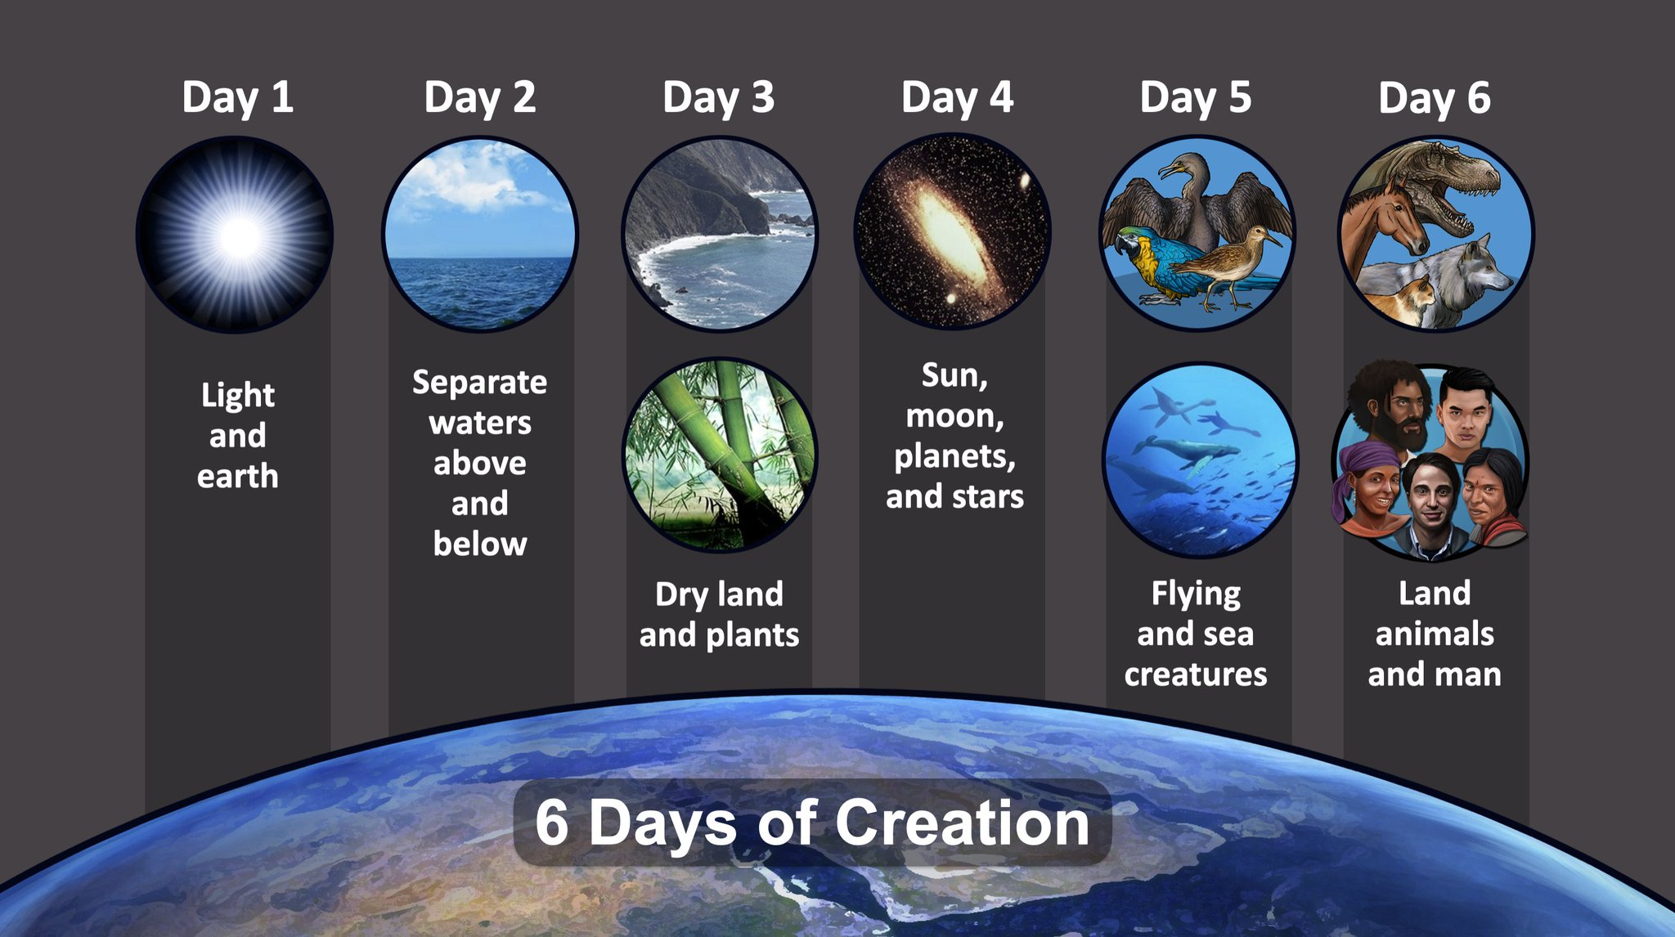
Maker of all things visible and invisible
Genesis 1:1 In the beginning God created the heavens and the earth.
  Light 1:3-5
  Waters 1:6-8
  Land/Plants 1:9-10
  Celestial objects 1:14-19
  Birds/fish 1:20-23
  Land animals & Man 1:24-31
Job 38:4 Where were you when I laid the foundation of the earth? Tell Me, if you know understanding [whole chapter]

Slide 16
Maker of all things visible and invisible
Psalm 139:13 For You formed my inward parts; You wove me in my mother’s womb. 14 I will give thanks to You, for I am fearfully and wonderfully made; Wonderful are Your works, and my soul knows it very well. 15 My frame was not hidden from You, when I was made in secret, and intricately woven in the depths of the earth; 16 Your eyes have seen my unshaped substance; and in Your book all of them were written the days that were formed for me, when as yet there was not one of them.

Slide 17
Maker of all things visible and invisible
Psalm 19:1 The heavens are telling of the glory of God; And the expanse is declaring the work of His hands. 2 Day to day pours forth speech, and night to night reveals knowledge. 3 There is no speech, nor are there words; Their voice is not heard. 4 Their line has gone out through all the earth, And their utterances to the end of the world. In them He has placed a tent for the sun, 5 Which is as a bridegroom coming out of his chamber; It rejoices as a strong man to run his course. 6 Its rising is from one end of the heavens, And its circuit to the other end of them; And there is nothing hidden from its heat.

Slide 18
Maker of all things visible and invisible
Isaiah 42:5 Thus says the God, Yahweh, Who created the heavens and stretched them out, Who spread out the earth and its offspring, Who gives breath to the people on it, and spirit to those who walk in it…
Jeremiah 23:17 ‘Ah Lord Yahweh! Behold, You have made the heavens and the earth by Your great power and by Your outstretched arm! Nothing is too difficult for You…

Slide 19
Maker of all things visible and invisible
Acts 17:24 The God who made the world and all things in it, since He is Lord of heaven and earth, does not dwell in temples made with hands; 25 nor is He served by human hands, as though He needed anything, since He Himself gives to all people life and breath and all things; 26 and He made from one man every nation of mankind to inhabit all the face of the earth, having determined their appointed times and the boundaries of their habitation
Romans 11:33 Oh, the depth of the riches and wisdom and knowledge of God! How unsearchable are His judgments and unfathomable His ways! 34 For who has known the mind of the Lord, or who became His counselor? 35 Or who has first given to Him that it might be repaid to him? 36 For from Him and through Him and to Him are all things. To Him be the glory forever. Amen.

Slide 20
Maker of all things visible and invisible
Ephesians 4:6 one God and Father of all who is over all and through all and in all.
Colossians 1:16 For in [Jesus] all things were created, both in the heavens and on earth, visible and invisible, whether thrones or dominions or rulers or authorities—all things have been created through Him and for Him.
John 1:1 In the beginning was the Word, and the Word was with God, and the Word was God. 2 He was in the beginning with God. 3 All things came into being through Him, and apart from Him nothing came into being that has come into being.

Slide 21
Maker of all things visible and invisible
Hebrews 11:3 By faith we understand that the worlds were prepared by the word of God, so that what is seen was not made out of things which are visible.
Romans 4:17 as it is written, “A father of many nations have I made you”—in the presence of Him whom he believed, even God, who gives life to the dead and calls into being that which does not exist.
Revelation 4:11 “Worthy are You, our Lord and our God, to receive glory and honor and power, for You created all things, and because of Your will they existed, and were created.”

Slide 22
Maker of all things visible and invisible
Romans 1:18 For the wrath of God is revealed from heaven against all ungodliness and unrighteousness of men who suppress the truth in unrighteousness, 19 because that which is known about God is evident within them; for God made it evident to them. 20 For since the creation of the world His invisible attributes, both His eternal power and divine nature, have been clearly seen, being understood through what has been made, so that they are without excuse. 21 For even though they knew God, they did not glorify Him as God or give thanks, but they became futile in their thoughts, and their foolish heart was darkened. 22 Professing to be wise, they became fools, 23 and exchanged the glory of the incorruptible God for an image in the likeness of corruptible man and of birds and four-footed animals and crawling creatures.

Slide 23
02
AND IN ONE LORD JESUS CHRIST

Slide 24
THE NICENE CREED
2 And in one Lord Jesus Christ, the Son of God, begotten of the Father, Light of Light, very God of very God, begotten, not made, consubstantial with the Father;

Slide 25
…and in One Lord Jesus Christ
The goal of the Nicene Creed is to clearly showcase the full deity and full humanity of Jesus along with the three-in-one nature of God. This phrase moves us into confessing the second person of the Trinity, Jesus Christ.
Contra Arius we must affirm that Jesus is Lord and Christ in the fullest measure of their meaning

Slide 26
…and in One Lord Jesus Christ
In Jesus’ time, “lordship” meant absolute, undisputed ownership. The person called “lord” was an absolute, undisputed master. Throughout the New Testament, those who interacted with Jesus, but did not yet believe, addressed Him with titles of honour, like “teacher” or “rabbi”. The titles of “Lord” and “Master” were reserved only for His disciples and apostles – those that truly believed.

Slide 27
…and in One Lord Jesus Christ
This is why in Mark 4:45, when Judas betrayed Jesus with a kiss, he called Jesus “Rabbi” and not “Lord”. By our profession of Jesus as “Lord”, like His disciples, we signify that He is undisputed master over our lives and is worthy of worship.
To say Jesus is Lord is to say we are doulos or servant / bondservant / most accurately… slave

Slide 28
…and in One Lord Jesus Christ
“Jesus” comes from the Hebrew name Yeshua, meaning “the Lord / God saves”. It is significant that when the Son of God became man, He was given a human name. This demonstrates His humanity. Jesus is fully human and fully God. We have become used to calling him “Jesus Christ”. But in reality, “Christ” is not His surname! “Christ” means “anointed one”

Slide 29
…and in One Lord Jesus Christ
In the Old Testament, priests, prophets, and kings were anointed with oil as a sign of being chosen by God. At His Baptism, Jesus was anointed, not by oil, but by the Holy Spirit who descended upon Him like a dove.
In the ancient world, anointing (with oil) symbolized being chosen by God for some special mission or purpose

Slide 30
…and in One Lord Jesus Christ
The Reign of Yahweh’s Anointed
Psalm 2:1 Why do the nations rage and the peoples meditate on a vain thing? 2 The kings of the earth take their stand and the rulers take counsel together against Yahweh and against His Anointed, saying, 3 “Let us tear their fetters apart and cast away their cords from us!” 4 He who sits in the heavens laughs, the Lord mocks them. 5 Then He speaks to them in His anger and terrifies them in His fury, saying, 6 “But as for Me, I have installed My King upon Zion, My holy mountain.” 7 “I will surely tell of the decree of Yahweh: He said to Me, ‘You are My Son, today I have begotten You.

Slide 31
…and in One Lord Jesus Christ
1 Corinthians 8:6 yet for us there is one God, the Father, from whom are all things and we exist for Him, and one Lord, Jesus Christ, by whom are all things, and we exist through Him.
Philippians 2:9 Therefore, God also highly exalted Him, and bestowed on Him the name which is above every name…

Slide 32
…and in One Lord Jesus Christ
Romans 14:9 For to this end Christ died and lived again, that He might be Lord both of the dead and of the living.
Matthew 28:18 And Jesus came up and spoke to them, saying, “All authority has been given to Me in heaven and on earth.
1 Peter 3:22 who is at the right hand of God, having gone into heaven, after angels and authorities and powers had been subjected to Him.

Slide 33
…and in One Lord Jesus Christ
Colossians 1:17 And He is before all things, and in Him all things hold together.
Luke 6:46 “Now why do you call Me, ‘Lord, Lord,’ and do not do what I say?
John 13:13 You call Me Teacher and Lord; and you are right, for so I am.
2 Corinthians 4:5 For we do not preach ourselves but Jesus Christ as Lord, and ourselves as your slaves for the sake of Jesus.

Slide 34
…and in One Lord Jesus Christ
Galatians 3:27 For all of you who were baptized into Christ have clothed yourselves with Christ.
Romans 10:9 that if you confess with your mouth Jesus as Lord, and believe in your heart that God raised Him from the dead, you will be saved;
John 20:28 Thomas answered and said to Him, “My Lord and my God!”

Slide 35
…and in One Lord Jesus Christ
Matthew 16:13 Now when Jesus came into the district of Caesarea Philippi, He was asking His disciples, saying, “Who do people say that the Son of Man is?” 14 And they said, “Some say John the Baptist; and others, Elijah; but still others, Jeremiah, or one of the prophets.” 15 He *said to them, “But who do you say that I am?” 16 And Simon Peter answered and said, “You are the Christ, the Son of the living God.” 17 And Jesus answered and said to him, “Blessed are you, Simon Bar-Jonah, because flesh and blood did not reveal this to you, but My Father who is in heaven. 18 And I also say to you that you are Peter, and upon this rock I will build My church; and the gates of Hades will not overpower it. 19 I will give you the keys of the kingdom of heaven; and whatever you bind on earth shall have been bound in heaven, and whatever you loose on earth shall have been loosed in heaven.” 20 Then He warned the disciples that they should tell no one that He was the Christ.

Slide 36
…and in One Lord Jesus Christ
1 Timothy 2:5 For there is one God, and one mediator also between God and men, the man Christ Jesus,
Galatians 2:20 I have been crucified with Christ, and it is no longer I who live, but Christ lives in me. And the life which I now live in the flesh I live by faith in the Son of God, who loved me and gave Himself up for me.

Slide 37
…and in One Lord Jesus Christ
Romans 6:23 For the wages of sin is death, but the gracious gift of God is eternal life in Christ Jesus our Lord.
Colossians 1:27 to whom God willed to make known what is the riches of the glory of this mystery among the Gentiles, which is Christ in you, the hope of glory.

Slide 38
…and in One Lord Jesus Christ
2 Corinthians 13:14 The grace of the Lord Jesus Christ, and the love of God, and the fellowship of the Holy Spirit, be with you all.

