Slide 1
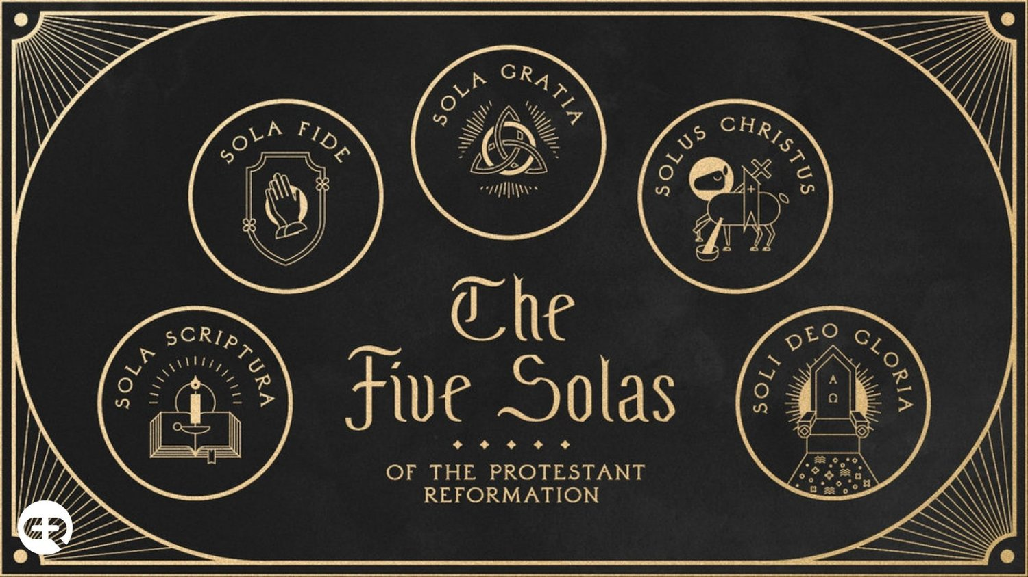
The 5 Solas of The Reformation

Slide 2
He Will Hold me Fast https://www.youtube.com/watch?v=BP0dtwXWQ_M
John 4:24 God is spirit, and those who worship Him must worship in spirit and truth.”
Colossians 3:16 Let the word of Christ dwell in you richly, with all wisdom teaching and admonishing one another with psalms and hymns and spiritual songs, singing with gratefulness in your hearts to God.
Ephesians 5:18 And do not get drunk with wine, for that is dissipation, but be filled with the Spirit, 19 speaking to one another in psalms and hymns and spiritual songs, singing and making melody with your heart to the Lord; 20 always giving thanks for all things in the name of our Lord Jesus Christ to God, even the Father;

Slide 3
OCTOBER 31, 1517. –
The date most historians would say as the beginning of the Reformation when…
Martin Luther nailed his 95 theses to the church door at Wittenburg, GERMANRY
A date generally regarded as the birthday of the Reformation.

Slide 4
Definitions:
SOLA - The Latin word sola means "alone" or "only" in English.
The 5 SOLAS - The five solas articulated five (5) fundamental beliefs of the Protestant Reformation, pillars which the Reformers believed to be essentials of the Christian life and practice.

Slide 5
The 5 SOLAS:
The 5 Solas of the Protestant Reformation is the TOUCHSTONE of Evangelical Christianity.
It is the test of genuine truths and beliefs in the midst of an ocean of beliefs and multiple religious mysteries and teachings.
The 5 Solas stands as the guidepost for all TRUE CHRISTIAN LIFE AND PRACTICE.

Slide 6
1. Sola Scriptura ("by Scripture alone")
The Scripture Alone is the Standard
Formal cause of the Reformation
In 1521 at the historic interrogation of Luther at the Diet of Worms, he declared his conscience to be captive to the Word of God saying, "Unless I am overcome with testimonies from Scripture or with evident reasons -- for I believe neither the Pope nor the Councils, since they have often erred and contradicted one another -- I am overcome by the Scripture texts which I have adduced, and my conscience is bound by God's Word.“
“Here I stand I can do no other” (allegedly)

Slide 7
Sola Scriptura
Scripture is the…
Sole infallible rule of faith for faith and practice in the church.
2 Timothy 3:16 All Scripture is God-breathed and profitable for teaching, for reproof, for correction, for training in righteousness, 17 so that the man of God may be equipped, having been thoroughly equipped for every good work.

Slide 8
2. Sola Gratia ("by grace alone")
Sola gratia is the teaching that salvation comes by God’s Grace Alone— not as something merited by the sinner. This means that salvation is an unearned gift from God for Jesus' sake.
Not by good works or religious works
Grace defined: "unmerited favor“ or rather “demerited favor”

Slide 9
The need for God’s grace: man’s sinfulness
Romans 3:10 as it is written, “There is none righteous, not even one
Romans 3:23 for all have sinned and fall short of the glory of God
1 Kings 8:46 “When they sin against You (for there is no man who does not sin)…
Matthew 15:19 For out of the heart come evil thoughts, murders, adulteries, sexual immoralities, thefts, false witness, slanders.
Jeremiah 17:9 “The heart is more deceitful than all else and is desperately sick; Who can know it?
John 3:19 And this is the judgment, that the Light has come into the world, and men loved the darkness rather than the Light, for their deeds were evil.

Slide 10
The need for God’s grace: man’s sinfulness
Job 14:1 “Man, who is born of woman, is short-lived and full of turmoil. 2 Like a flower he comes forth and withers. He also flees like a shadow and does not stand. 3 You also open Your eyes on him and bring me into judgment with Yourself. 4 Who can make the clean out of the unclean? No one!
1 Corinthians 2:13 of which depths we also speak, not in words taught by human wisdom, but in those taught by the Spirit, combining spiritual depths with spiritual words.
Ephesians 4: 18 [the lost are] darkened in their mind, alienated from the life of God because of the ignorance that is in them, because of the hardness of their heart. 19 And they, having become callous, have given themselves over to sensuality for the practice of every kind of impurity with greediness.

Slide 11
The Essential Grace of God
Titus 2:11 For the grace of God has appeared, bringing salvation to all men, 12 instructing us that, denying ungodliness and worldly desires, we should live sensibly, righteously, and godly in the present age, 13 looking for the blessed hope and the appearing of the glory of our great God and Savior, Jesus Christ, 14 who gave Himself for us that He might redeem us from all lawlessness, and purify for Himself a people for His own possession, zealous for good works. 15 These things speak and exhort and reprove with all authority. Let no one disregard you.

Slide 12
The Revealed Nature of God
Exodus 34:6 Then Yahweh passed by in front of him and called out, “Yahweh, Yahweh God, compassionate and gracious, slow to anger, and abounding in lovingkindness and truth; 7 who keeps lovingkindness for thousands, who forgives iniquity, transgression, and sin; yet He will by no means leave the guilty unpunished, visiting the iniquity of fathers on the children and on the grandchildren to the third and fourth generations.” (OT)
John 1:14 And the Word became flesh, and dwelt among us, and we beheld His glory, glory as of the only begotten from the Father, full of grace and truth… 16 For of His fullness we have all received, and grace upon grace. (NT)

Slide 13
Grace from beginning to the end
Genesis 3:17 Then to Adam He said, “Because you have listened to the voice of your wife and have eaten from the tree about which I commanded you, saying, ‘You shall not eat from it’; Cursed is the ground because of you; In pain you will eat of it. All the days of your life… 21 Then Yahweh God made garments of skin for Adam and his wife, and He clothed them.
Revelation 22:21 The grace of the Lord Jesus be with all. Amen.

Slide 14
Grace by which we are saved
Ephesians 2:8 For by grace you have been saved through faith, and this not of yourselves, it is the gift of God; 9 not of works, so that no one may boast.
Locus classicus
Against partial grace
Against aberrant views of grace (synergy, power, etc)

Slide 15
Grace by which we are saved
Ephesians 2:1 And you were dead]in your transgressions and sins, 2 in which you formerly walked according to the course of this world, according to the ruler of the power of the air, the spirit that is now working in the sons of disobedience, 3 among whom we all also formerly conducted ourselves in the lusts of our flesh, doing the desires of the flesh and of the mind, and were by nature children of wrath, even as the rest. 4 But God, being rich in mercy because of His great love with which He loved us, 5 even when we were dead in our transgressions, made us alive together with Christ—by grace you have been saved—

Slide 16
Monergism
Monergism not Synergism
Romans 8:6 For the mind set on the flesh is death, but the mind set on the Spirit is life and peace, 7 because the mind set on the flesh is hostile toward God, for it does not subject itself to the law of God, for it is not even able to do so, 8 and those who are in the flesh are not able to please God.
John 3:19 And this is the judgment, that the Light has come into the world, and men loved the darkness rather than the Light, for their deeds were evil
Man is unable to save himself, it is a work of God!

Slide 17
Case Study: Paul
Who was Saul/Paul?
Acts 22:6 “But it happened that as I was on my way, approaching Damascus about noontime, a very bright light suddenly flashed from heaven all around me, 7 and I fell to the ground and heard a voice saying to me, ‘Saul, Saul, why are you persecuting Me?’ 8 And I answered, ‘Who are You, Lord?’ And He said to me, ‘I am Jesus the Nazarene, whom you are persecuting.’ 9 And those who were with me beheld the light, to be sure, but did not understand the voice of the One who was speaking to me. 10 And I said, ‘What should I do, Lord?’ And the Lord said to me, ‘Rise up and go on into Damascus, and there you will be told of all that has been determined for you to do.’ 11 But since I could not see because of the glory of that light, being led by the hand by those who were with me, I came into Damascus..

Slide 18
3. Sola Fide ("by faith alone")
Perhaps no other doctrine caused as much turmoil during the Reformation as Sola Fide.
It was the very doctrine that prompted Martin Luther in his 95 theses to challenge the Catholic position of indulgences.
The starting point of the REFORMATION.
The Material cause of the Reformation (remember Sola Scriptura was the Formal cause, the basis, that led to the great focal point, Sola Fide)

Slide 19
Justification by Faith Alone
Sola fide is the teaching that a man is saved, specifically justified, by faith and faith alone.
JUSTIFICATION means to be declared righteous by God
Salvation is received by FAITH only, without any mixture of or need for good works
Important: saving faith is always evidenced by good works. F -> S + W
“Faith yields justification and good works” vs the Roman Catholic formula "Faith and good works yield justification.“ F + W -> S

Slide 20
Self-justification refuted
Romans 10:10 Brothers, my heart’s desire and my prayer to God for them is for their salvation. 2 For I testify about them that they have a zeal for God, but not according to knowledge. 3 For not knowing about the righteousness of God and seeking to establish their own, they did not subject themselves to the righteousness of God. 4 For Christ is the end of the law for righteousness to everyone who believes.

Slide 21
Faith saves!
John 3:16 “For God so loved the world, that He gave His only begotten Son, that whoever believes in Him shall not perish, but have eternal life.
Romans 10:8 But what does it say? “The word is near you, in your mouth and in your heart”—that is, the word of faith which we are preaching, 9 that if you confess with your mouth Jesus as Lord, and believe in your heart that God raised Him from the dead, you will be saved;

Slide 22
Faith through which we are saved
Ephesians 2:8 For by grace you have been saved through faith, and this not of yourselves, it is the gift of God; 9 not of works, so that no one may boast.
Locus classicus: Against works based or inclusive salvation (synergism)
Grace and faith are a gift!

Slide 23
Great exchange, double imputation of sin / justification
2 Corinthians 5:21 He made Him who knew no sin to be sin on our behalf, so that we might become the righteousness of God in Him.

Slide 24
Abraham, our Patriarch (Father in the faith) & his salvation
Romans 4:16 For this reason it is by faith, in order that it may be according to grace, so that the promise will be guaranteed to all the seed, not only to those who are of the Law, but also to those who are of the faith of Abraham, who is the father of us all— 17 as it is written, “A father of many nations have I made you”—in the presence of Him whom he believed, even God, who gives life to the dead and calls into being that which does not exist. 18 In hope against hope he believed, so that he might become a father of many nations according to that which had been spoken, “So shall your seed be.” 19 And without becoming weak in faith he contemplated his own body, now as good as dead since he was about a hundred years old, and the deadness of Sarah’s womb; 20 yet, with respect to the promise of God, he did not waver in unbelief but grew strong in faith, giving glory to God, 21 and being fully assured that what God had promised, He was able also to do. 22 Therefore it was also counted to him as righteousness. 23 Now not for his sake only was it written that it was counted to him, 24 but for our sake also, to whom it will be counted, as those who believe upon Him who raised Jesus our Lord from the dead, 25 He who was delivered over on account of our transgressions, and was raised on account of our justification.

Slide 25
Abraham, our Patriarch (Father in the faith) & his salvation
Genesis 15:5 After these things the word of Yahweh came to Abram in a vision, saying, “Do not fear, Abram, I am a shield to you; Your reward shall be very great.” 2 And Abram said, “O Lord Yahweh, what will You give me, as I go on being childless, and the heir of my house is Eliezer of Damascus?” 3 And Abram said, “Since You have given no seed to me, behold, one born in my house is my heir.” 4 Then behold, the word of Yahweh came to him, saying, “This one will not be your heir; but one who will come forth from your own body, he shall be your heir.” 5 And He brought him outside and said, “Now look toward the heavens, and number the stars, if you are able to number them.” And He said to him, “So shall your seed be.” 6 Then he believed in Yahweh; and He counted it to him as righteousness.
Declared/counted righteous before or after test & covenant?

Slide 26
BY FAITH:
The distinction here can best be summarized by the notion that the Scripture declares that we are saved by grace through a faith that works rather than faith and works.
Another way to think of Sola Fide is that we are saved by grace through faith alone but not through a faith that is alone. It is faith alone that is the basis for our salvation, but our salvation is made clearly evident by our works.
Works are a result of justifying faith: James 2 & Ephesians 2:10

