Slide 1
WORSHIP IN SONG
There is a Fountain https://www.youtube.com/watch?v=vKAMsC2jrL4
John 4:24 God is spirit, and those who worship Him must worship in spirit and truth.”
Colossians 3:16 Let the word of Christ dwell in you richly, with all wisdom teaching and admonishing one another with psalms and hymns and spiritual songs, singing with gratefulness in your hearts to God.
Ephesians 5:19 [speak] to one another in psalms and hymns and spiritual songs, singing and making melody with your heart to the Lord; 20 always giving thanks for all things in the name of our Lord Jesus Christ to God, even the Father.

Slide 2
Your life in christ
Design for Discipleship – Book 1

Slide 4
Matthew 1:21 And she will bear a Son; and you shall call His name Jesus, for He will save His people from their sins.”
Luke 1:31 And behold, you will conceive in your womb and bear a son, and you shall name Him Jesus. 32 He will be great and will be called the Son of the Most High, and the Lord God will give Him the throne of His father David, 33 and He will reign over the house of Jacob forever, and there will be no end of His kingdom.”
Luke 2:52 And Jesus was advancing in wisdom and stature, and in favor with God and men.

Slide 5
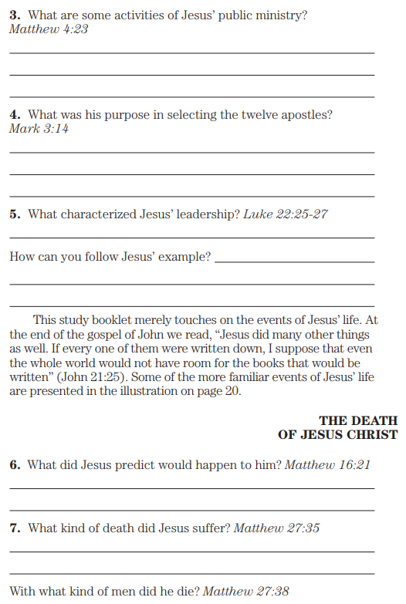
Matthew 4:23 And Jesus was going throughout all Galilee, teaching in their synagogues and preaching the gospel of the kingdom, and healing every kind of disease and every kind of sickness among the people.
Mark 3:14 And He appointed twelve (whom He also named apostles) to be with Him and to send them out to preach,
Luke 22:25 And He said to them, “The kings of the Gentiles lord it over them, and those who have authority over them are called ‘Benefactors.’ 26 But not so with you; rather the one who is the greatest among you must become like the youngest, and the leader like the servant. 27 For who is greater, the one who reclines at the table or the one who serves? Is it not the one who reclines? But I am among you as the one who serves.
Matthew 16:21 From that time Jesus began to show His disciples that He must go to Jerusalem, and suffer many things from the elders and chief priests and scribes, and be killed, and be raised up on the third day.
Matthew 27:35 And when they had crucified Him, they divided up His garments among themselves by casting lots…
…38 At that time two robbers *were crucified with Him, one on the right and one on the left.

Slide 6
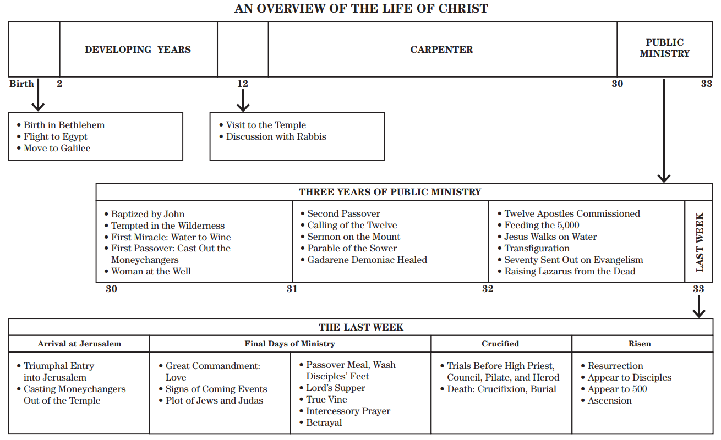

Slide 7
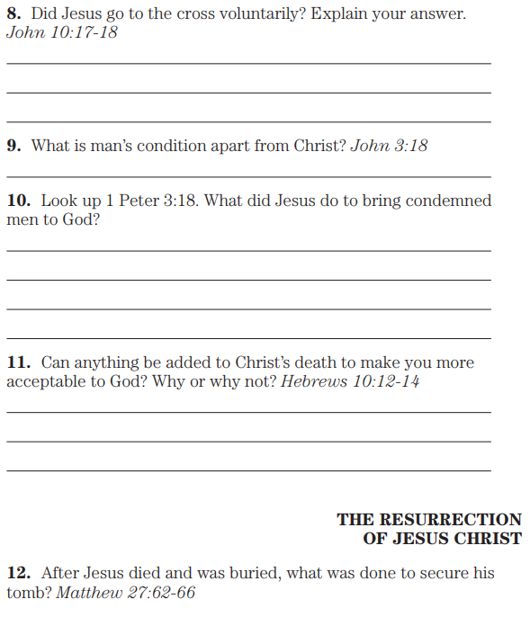
John 10:17 For this reason the Father loves Me, because I lay down My life so that I may take it again. 18 No one takes it away from Me, but from Myself, I lay it down. I have authority to lay it down, and I have authority to take it up again. This commandment I received from My Father.”
John 3:18 He who believes in Him is not judged; he who does not believe has been judged already, because he has not believed in the name of the only begotten Son of God.
1 Peter 3:18 For Christ also suffered for sins once for all, the righteous for the unrighteous, so that He might bring you to God, having been put to death in the flesh, but made alive in the spirit;
Hebrews 10:12 but He, having offered one sacrifice for sins for all time, sat down at the right hand of God, 13 waiting from that time until His enemies are put as a footstool for His feet. 14 For by one offering He has perfected for all time those who are being sanctified.
Matthew 27:62 Now on the next day, the day after the Preparation, the chief priests and the Pharisees gathered together with Pilate, 63 and said, “Sir, we remember that when He was still alive that deceiver said, ‘After three days I am to rise again.’ 64 Therefore, order for the grave to be made secure until the third day, lest His disciples come and steal Him away and say to the people, ‘He has risen from the dead,’ and the last deception will be worse than the first.” 65 Pilate said to them, “You have a guard; go, make it as secure as you know how.” 66 And they went and made the grave secure, and along with the guard they set a seal on the stone.

Slide 8
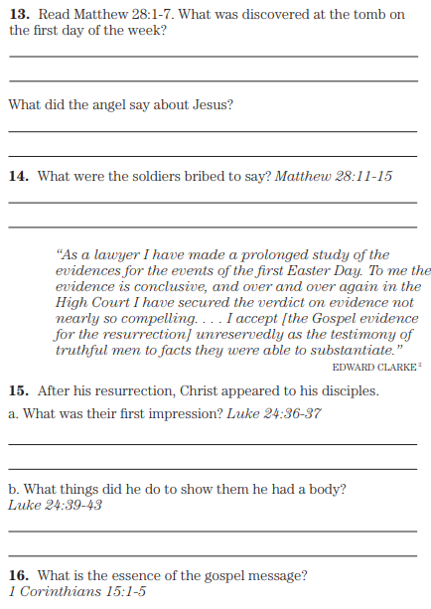
Matthew 28: 1 Now after the Sabbath, as it began to dawn toward the first day of the week, Mary Magdalene and the other Mary came to look at the grave. 2 And behold, there was a great earthquake, for an angel of the Lord descended from heaven and came and rolled away the stone and sat upon it. 3 And his appearance was like lightning, and his clothing as white as snow. 4 And the guards quaked from fear of him and became like dead men. 5 And the angel answered and said to the women, “Do not be afraid; for I know that you are looking for Jesus who has been crucified. 6 He is not here, for He has risen, just as He said. Come, see the place where He was lying. 7 And go quickly and tell His disciples that He has risen from the dead; and behold, He is going ahead of you into Galilee, there you will see Him; behold, I have told you.”…
…11 Now while they were on their way, behold, some of the guard came into the city and reported to the chief priests all that had happened. 12 And when they had assembled with the elders and took counsel together, they gave a large sum of money to the soldiers, 13 and said, “You are to say, ‘His disciples came by night and stole Him away while we were asleep.’ 14 And if this is heard before the governor, we will win him over and keep you out of trouble.” 15 And they took the money and did as they had been instructed; and this story was widely spread among the Jews, and is to this day.

Slide 9
Luke 24:36 Now while they were telling these things, He Himself stood in their midst and *said to them, “Peace to you.” 37 But being startled and frightened, they were thinking that they were seeing a spirit…
…39 See My hands and My feet, that it is I Myself; touch Me and see, for a spirit does not have flesh and bones as you see that I have.” 40 And when He had said this, He showed them His hands and His feet. 41 And while they still were not believing because of their joy and were still marveling, He said to them, “Have you anything here to eat?” 42 They gave Him a piece of a broiled fish, 43 and He took it and ate it before them.
15 Now I make known to you, brothers, the gospel which I proclaimed as good news to you, which also you received, in which also you stand, 2 by which also you are saved, if you hold fast the word which I proclaimed to you as good news, unless you believed for nothing. 3 For I delivered to you as of first importance what I also received, that Christ died for our sins according to the Scriptures, 4 and that He was buried, and that He was raised on the third day according to the Scriptures, 5 and that He appeared to Cephas, then to the twelve.

