Slide 2
Colossians 3:16 Let the word of Christ dwell in you richly, with all wisdom teaching and admonishing one another with psalms and hymns and spiritual songs, singing with gratefulness in your hearts to God. All Glory be to Christ

Slide 3
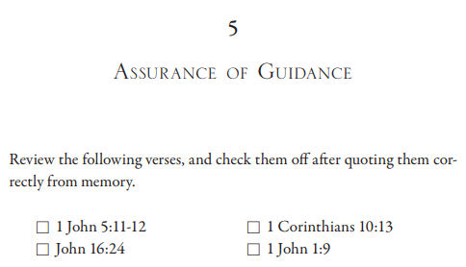
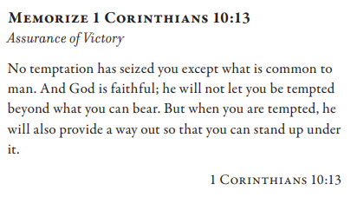
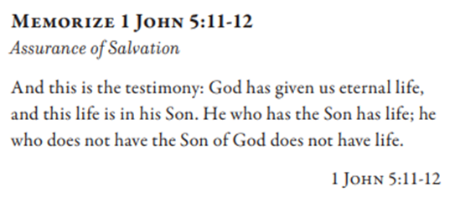
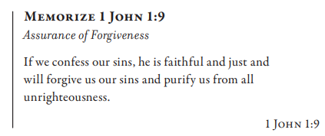
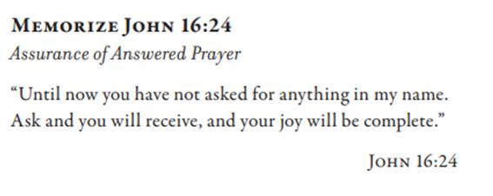

Slide 5
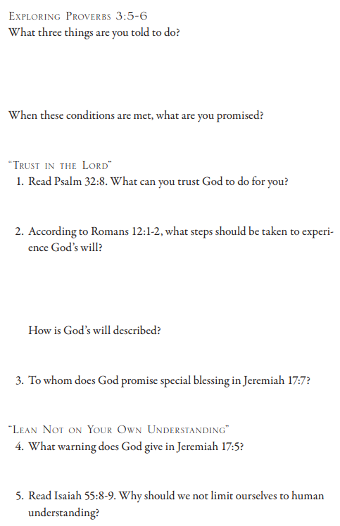
Proverbs 3:5 Trust in Yahweh with all your heart and do not lean on your own understanding. 6 In all your ways acknowledge Him, and He will make your paths straight. Psalm 32:8 I will give you insight and teach you in the way which you should go; I will counsel you with My eye upon you. Romans 12:1 Therefore I exhort you, brothers, by the mercies of God, to present your bodies as a sacrifice—living, holy, and pleasing to God, which is your spiritual service of worship. 2 And do not be conformed to this world, but be transformed by the renewing of your mind, so that you may approve what the will of God is, that which is good and pleasing and perfect. Jeremiah 17: 7 Blessed is the man who trusts in Yahweh And whose trust is Yahweh. … 5 Thus says Yahweh, “Cursed is the man who trusts in mankind and makes flesh his strength, And whose heart turns away from Yahweh. Isaiah 55:8 “For My thoughts are not your thoughts, nor are your ways My ways,” declares Yahweh. 9 “For as the heavens are higher than the earth, so are My ways higher than your ways and My thoughts than your thoughts.

Slide 6
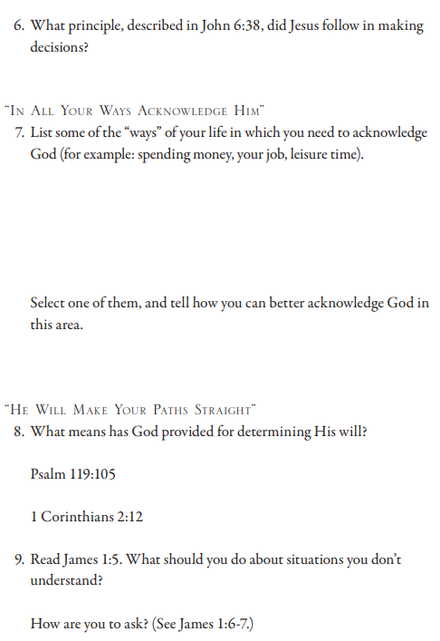
John 6:38 For I have come down from heaven, not to do My own will, but the will of Him who sent Me. Psalm 119:105 Your word is a lamp to my feet and a light to my path. 1 Corinthians 2:12 Now we have received, not the spirit of the world, but the Spirit who is from God, so that we may know the depths graciously given to us by God James 1:7 5 But if any of you lacks wisdom, let him ask of God, who gives to all generously and without reproach, and it will be given to him. 6 But he must ask in faith, doubting nothing, for the one who doubts is like the surf of the sea, driven and tossed by the wind. 7 For that man ought not to expect that he will receive anything from the Lord

Slide 7
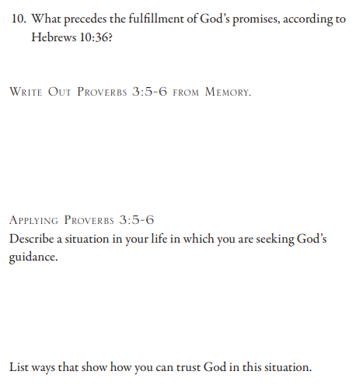
Hebrews 10:36 For you have need of endurance, so that when you have done the will of God, you may receive the promise.

