Slide 2
Rock of Ages https://www.youtube.com/watch?v=VyE5HwkYN78 John 4:24 God is spirit, and those who worship Him must worship in spirit and truth.” Colossians 3:16 Let the word of Christ dwell in you richly, with all wisdom teaching and admonishing one another with psalms and hymns and spiritual songs, singing with gratefulness in your hearts to God. Ephesians 5:19 [speak] to one another in psalms and hymns and spiritual songs, singing and making melody with your heart to the Lord; 20 always giving thanks for all things in the name of our Lord Jesus Christ to God, even the Father.

Slide 3
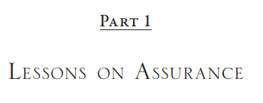
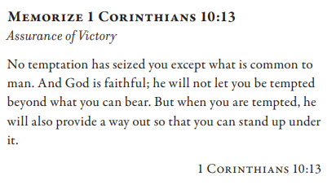
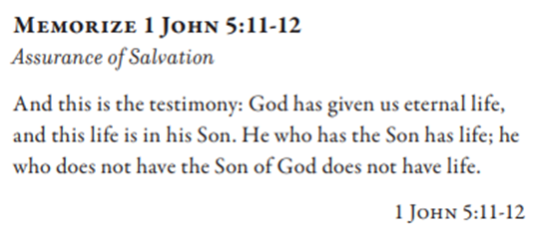
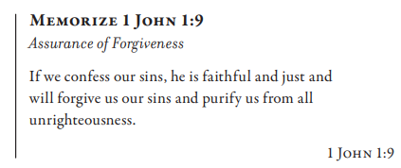
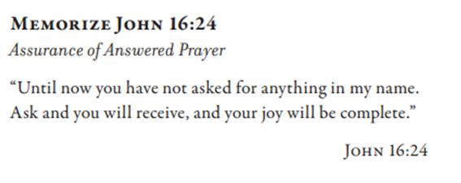

Slide 4
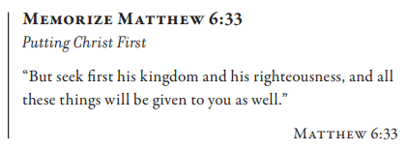
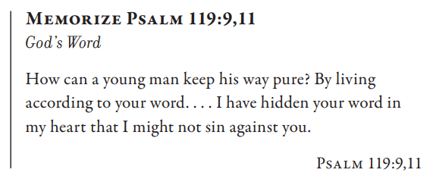

Slide 5
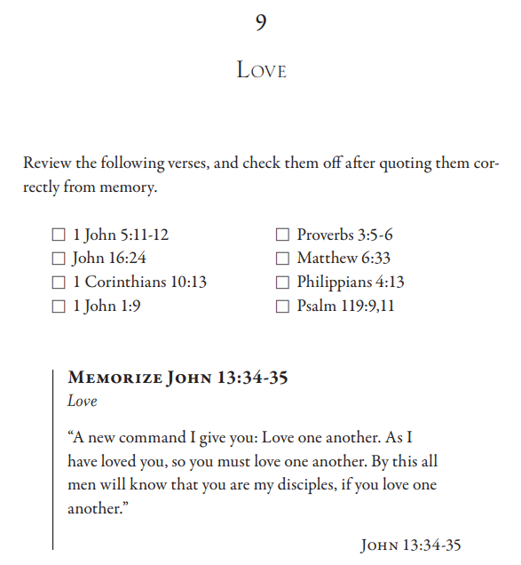
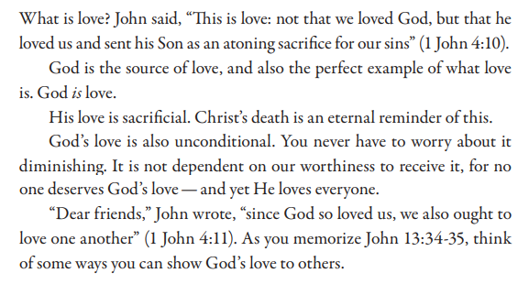

Slide 6
John 13:34 A new commandment I give to you, that you love one another, even as I have loved you, that you also love one another. 35 By this all will know that you are My disciples, if you have love for one another.” Matthew 22:37 And He said to him, “‘You shall love the Lord your God with all your heart, and with all your soul, and with all your mind.’ 38 This is the great and foremost commandment. 39 And the second is like it, ‘You shall love your neighbor as yourself.’ 1 John 4:7 Beloved, let us love one another, for love is from God; and everyone who loves has been born of God and knows God. John 3:16 “For God so loved the world, that He gave His only begotten Son, that whoever believes in Him shall not perish, but have eternal life. 1 Peter 1:22 Since you have in obedience to the truth purified your souls for a love of the brothers without hypocrisy, fervently love one another from the heart

Slide 7
John 15:12 “This is My commandment, that you love one another, just as I have loved you. 13 Greater love has no one than this, that one lay down his life for his friends. 1 John 2:5 but whoever keeps His word, truly in him the love of God has been perfected. By this we know that we are in Him: 6 the one who says he abides in Him ought himself to walk in the same manner as He walked. Galatians 5:13 For you were called to freedom, brothers; only do not turn your freedom into an opportunity for the flesh, but through love serve one another. 1 John 4:10 In this is love, not that we have loved God, but that He loved us and sent His Son to be the propitiation for our sins.
John 13:1 Now before the Feast of the Passover, Jesus knowing that His hour had come that He would depart out of this world to the Father, having loved His own who were in the world, He loved them to the end. 2 And during supper, the devil having already put into the heart of Judas Iscariot, the son of Simon, to betray Him, 3 Jesus, knowing that the Father had given all things into His hands, and that He had come forth from God and was going back to God, 4 *got up from supper, and *laid aside His garments; and taking a towel, He tied it around Himself. 5 Then He *poured water into the washbasin, and began to wash the disciples’ feet and to wipe them with the towel which He had tied around Himself. 6 So He *came to Simon Peter. He *said to Him, “Lord, are You going to wash my feet?” 7 Jesus answered and said to him, “What I am doing you do not realize now, but you will understand afterwards.” … 34 A new commandment I give to you, that you love one another, even as I have loved you, that you also love one another. 35 By this all will know that you are My disciples, if you have love for one another.”

Slide 8
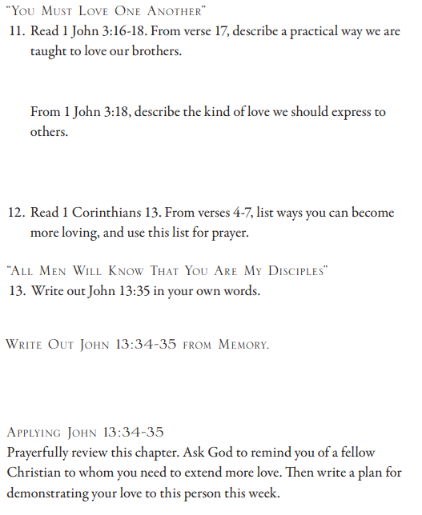
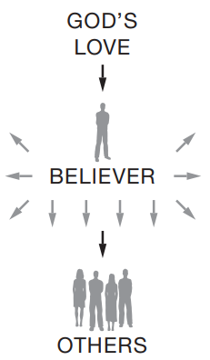
1 John 3:16 By this we have known love, that He laid down His life for us; and we ought to lay down our lives for the brothers. 17 But whoever has the world’s goods, and sees his brother in need and closes his heart against him, how does the love of God abide in him? 18 Little children, let us not love with word or with tongue, but in deed and truth.
1 Corinthians 13:4 Love is patient, love is kind, is not jealous, does not brag, is not puffed up; 5 it does not act unbecomingly, does not seek its own, is not provoked, does not take into account a wrong suffered; 6 it does not rejoice in unrighteousness, but rejoices with the truth; 7 it bears all things, believes all things, hopes all things, endures all things. John 13:34 A new commandment I give to you, that you love one another, even as I have loved you, that you also love one another. 35 By this all will know that you are My disciples, if you have love for one another.”

