Slide 1
WORSHIP IN SONG
He Leadeth Me https://youtu.be/rpYM6Et_hVY?si=2_O-cAHl_9_Fzexx John 4:24 God is spirit, and those who worship Him must worship in spirit and truth.”
Colossians 3:16 Let the word of Christ dwell in you richly, with all wisdom teaching and admonishing one another with psalms and hymns and spiritual songs, singing with gratefulness in your hearts to God.
Ephesians 5:19 [speak] to one another in psalms and hymns and spiritual songs, singing and making melody with your heart to the Lord; 20 always giving thanks for all things in the name of our Lord Jesus Christ to God, even the Father.

Slide 2
Your life in christ
Design for Discipleship – Book 1

Slide 4
Acts 1:9 And after He had said these things, He was lifted up while they were looking on, and a cloud received Him out of their sight. 10 And as they were gazing intently into [a]the sky while He was going, behold, two men in white clothing stood beside them. 11 They also said, “Men of Galilee, why do you stand looking toward heaven? This Jesus, who has been taken up from you into heaven, will come in just the same way as you have watched Him go into heaven.”

Slide 5
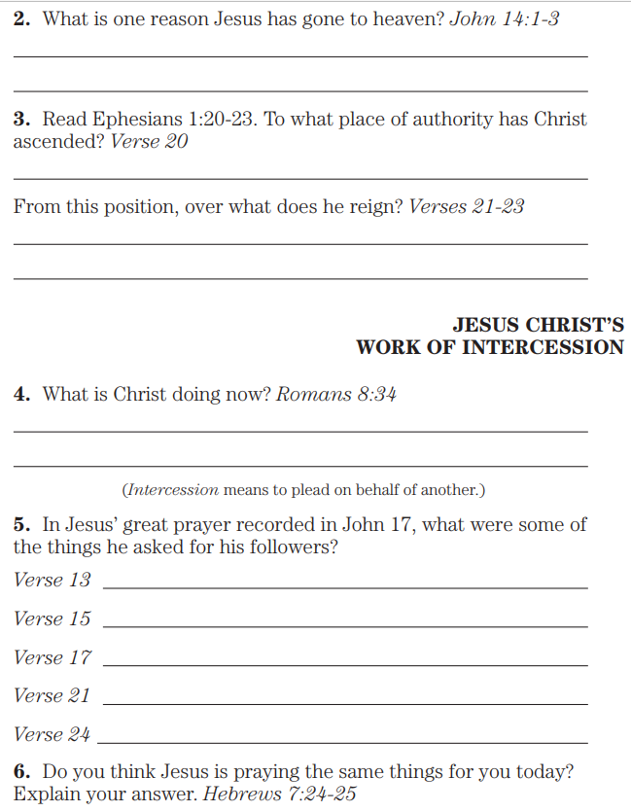
John 14:1 “Do not let your heart be troubled; believe in God, believe also in Me. 2 In My Father’s house are many dwelling places; if it were not so, I would have told you; for I go to prepare a place for you. 3 And if I go and prepare a place for you, I will come again and receive you to Myself, that where I am, there you may be also.
Ephesians 1:20 which He worked in Christ, by raising Him from the dead and seating Him at His right hand in the heavenly places, 21 far above all rule and authority and power and dominion, and every name that is named, not only in this age but also in the one to come. 22 And He put all things in subjection under His feet, and gave Him as head over all things to the church, 23 which is His body, the fullness of Him who fills all in all.
Romans 8:34 who is the one who condemns? Christ Jesus is He who died, yes, rather who was raised, who is at the right hand of God, who also intercedes for us.
John 17:13 But now I come to You; and these things I speak in the world so that they may have My joy made full in themselves...
15 I do not ask You to take them out of the world, but to keep them from the evil one...
17 Sanctify them by the truth; Your word is truth...
21 that they may all be one; even as You, Father, are in Me and I in You, that they also may be in Us, so that the world may believe that You sent Me...
24 Father, I desire that they also, whom You have given Me, be with Me where I am, so that they may see My glory which You have given Me, for You loved Me before the foundation of the world.
Hebrews 7: ²⁴ but Jesus, on the other hand, because He continues forever, holds His priesthood permanently. ²⁵ Therefore He is able also to save forever those who draw near to God through Him, since He always lives to make intercession for them.

Slide 6
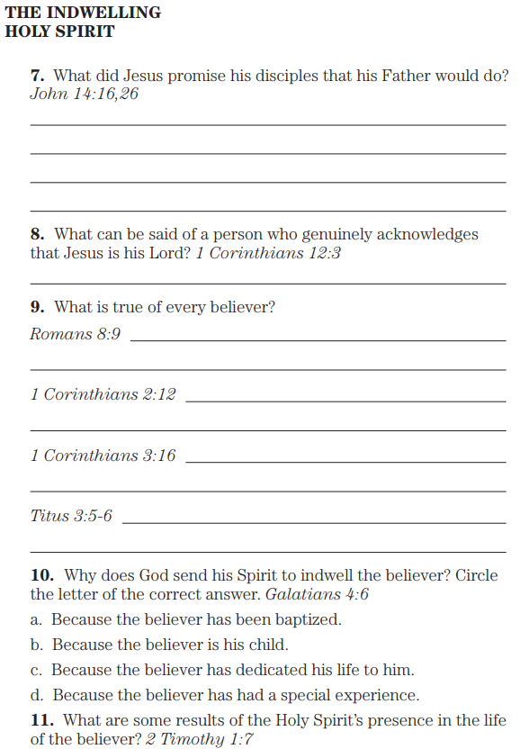
John 4:16 And I will ask the Father, and He will give you another Advocate, that He may be with you forever;
…26 But the Advocate, the Holy Spirit, whom the Father will send in My name, He will teach you all things, and bring to your remembrance all that I said to you.
1 Corinthians 12:3 Therefore I make known to you that no one speaking by the Spirit of God says, “Jesus is accursed,” and no one can say, “Jesus is Lord,” except by the Holy Spirit.
Romans 8:9 However, you are not in the flesh but in the Spirit, if indeed the Spirit of God dwells in you. But if anyone does not have the Spirit of Christ, he does not belong to Him.
1 Corinthians 2:12 Now we have received, not the spirit of the world, but the Spirit who is from God, so that we may know the depths graciously given to us by God,
1 Corinthians 3:16 Do you not know that you are a sanctuary of God and that the Spirit of God dwells in you?
Titus 3:5 He saved us, not by works which we did in righteousness, but according to His mercy, through the washing of regeneration and renewing by the Holy Spirit, 6 whom He poured out upon us richly through Jesus Christ our Savior,
Galatians 4:6 And because you are sons, God sent forth the Spirit of His Son into our hearts, crying, “Abba! Father!”
2 Timothy 1:7 For God has not given us a spirit of timidity, but of power and love and self-discipline.

Slide 7
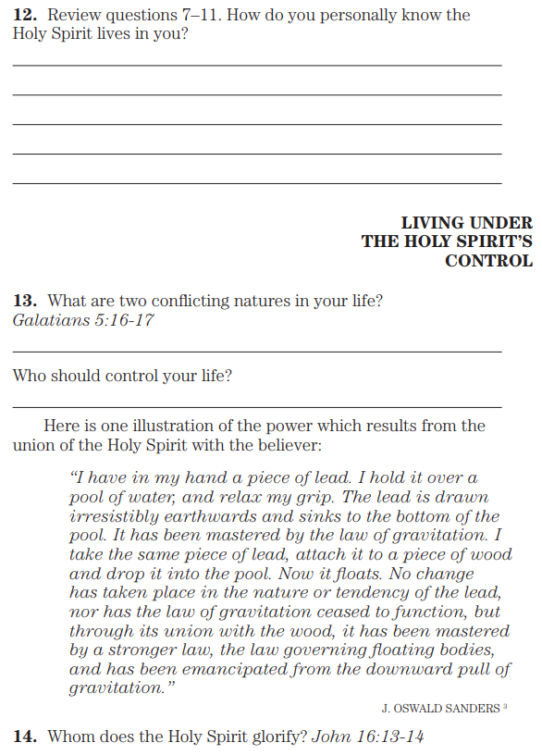
Galatians 5:16 But I say, walk by the Spirit and you will not carry out the desire of the flesh. 17 For the flesh sets its desire against the Spirit, and the Spirit against the flesh; for these are in opposition to one another, so that you do not do the things that you want.
John 16:13 But when He, the Spirit of truth, comes, He will guide you into all the truth; for He will not speak from Himself, but whatever He hears, He will speak; and He will disclose to you what is to come. 14 He will glorify Me, for He will take of Mine and will disclose it to you.

Slide 8
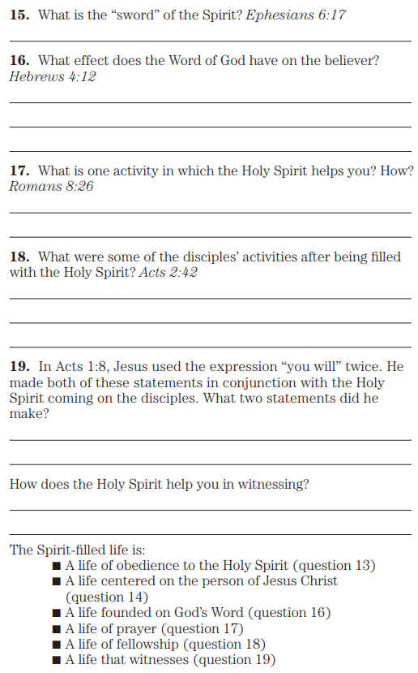
Ephesians 6:17 also receive the helmet of salvation, and the sword of the Spirit, which is the word of God
Hebrews 4:12 For the word of God is living and active and sharper than any two-edged sword, and piercing as far as the division of soul and spirit, of both joints and marrow, and able to judge the thoughts and intentions of the heart.
Romans 8:26 And in the same way the Spirit also helps our weakness, for we do not know how to pray as we should, but the Spirit Himself intercedes for us with groanings too deep for words
Acts 2:42 And they were continually devoting themselves to the apostles’ teaching and to the fellowship, to the breaking of bread and to the prayers.
Acts 1:8 but you will receive power when the Holy Spirit has come upon you; and you shall be My witnesses both in Jerusalem, and in all Judea and Samaria, and even to the end of the earth.”

Slide 9
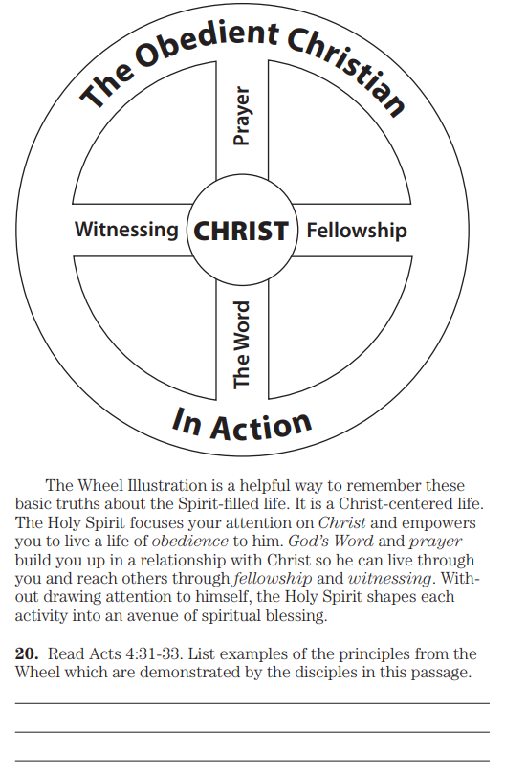
Acts 4:31 And when they had prayed earnestly, the place where they had gathered together was shaken, and they were all filled with the Holy Spirit and began to speak the word of God with confidence.
32 And the congregation of those who believed were of one heart and soul, and not one was saying that any of his possessions was his own, but, for them, everything was common. 33 And with great power the apostles were bearing witness to the resurrection of the Lord Jesus, and great grace was upon them all.

