Slide 1
WORSHIP IN SONG
He Will Hold Me Fast https://www.youtube.com/watch?v=BP0dtwXWQ_M
John 4:24 God is spirit, and those who worship Him must worship in spirit and truth.”
Colossians 3:16 Let the word of Christ dwell in you richly, with all wisdom teaching and admonishing one another with psalms and hymns and spiritual songs, singing with gratefulness in your hearts to God.
Ephesians 5:19 [speak] to one another in psalms and hymns and spiritual songs, singing and making melody with your heart to the Lord; 20 always giving thanks for all things in the name of our Lord Jesus Christ to God, even the Father.

Slide 2
Your life in christ
Design for Discipleship – Book 1

Slide 3
NOT BY BREAD ALONE

Slide 5
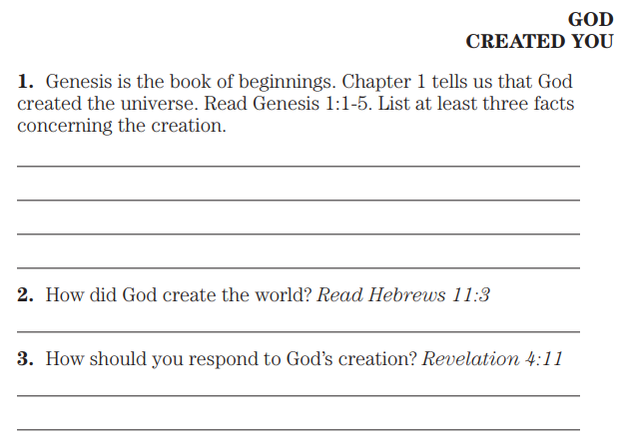
1 In the beginning God created the heavens and the earth. 2 And the earth was formless and void, and darkness was over the surface of the deep, and the Spirit of God was hovering over the surface of the waters. 3 Then God said, “Let there be light”; and there was light. 4 And God saw that the light was good; and God separated the light from the darkness. 5 And God called the light day, and the darkness He called night. And there was evening and there was morning, one day.
Hebrews 11:3 By faith we understand that the worlds were prepared by the word of God, so that what is seen was not made out of things which are visible.
Revelation 4:11 “Worthy are You, our Lord and our God, to receive glory and honor and power, for You created all things, and because of Your will they existed, and were created.”

Slide 6
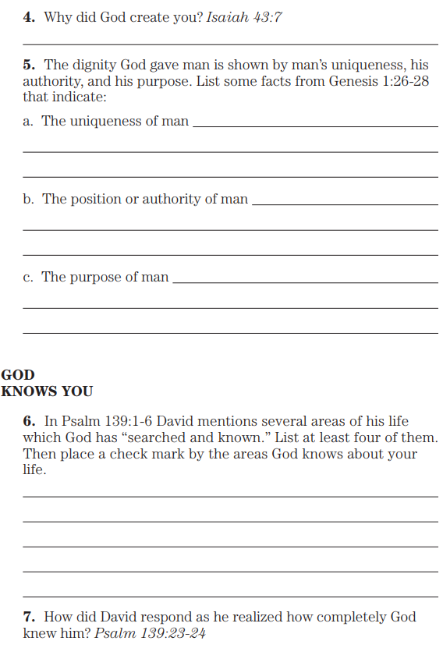
Isaiah 43:7 Everyone who is called by My name, and whom I have created for My glory, whom I have formed, even whom I have made.”
Genesis 1:26 Then God said, “Let Us make man in Our image, according to Our likeness, so that they will have dominion over the fish of the sea and over the birds of the sky and over the cattle and over all the earth and over every creeping thing that creeps on the earth.” 27 And God created man in His own image, in the image of God He created him; male and female He created them. 28 God blessed them, and God said to them, “Be fruitful and multiply, and fill the earth, and subdue it; and have dominion over the fish of the sea and over the birds of the sky and over every living thing that creeps on the earth.”
Psalm 139: 1 O Yahweh, You have searched me and known me. 2 You know when I sit down and when I rise up; You understand my thought from afar. 3 You scrutinize my path and my lying down, and are intimately acquainted with all my ways. 4 Even before there is a word on my tongue, Behold, O Yahweh, You know it all. 5 You have enclosed me behind and before, and You have put Your hand upon me. 6 Such knowledge is too wonderful for me; It is too high, I cannot attain to it…
…23 Search me, O God, and know my heart; Try me and know my anxious thoughts; 24 And see if there be any hurtful way in me,
And lead me in the everlasting way.

Slide 7
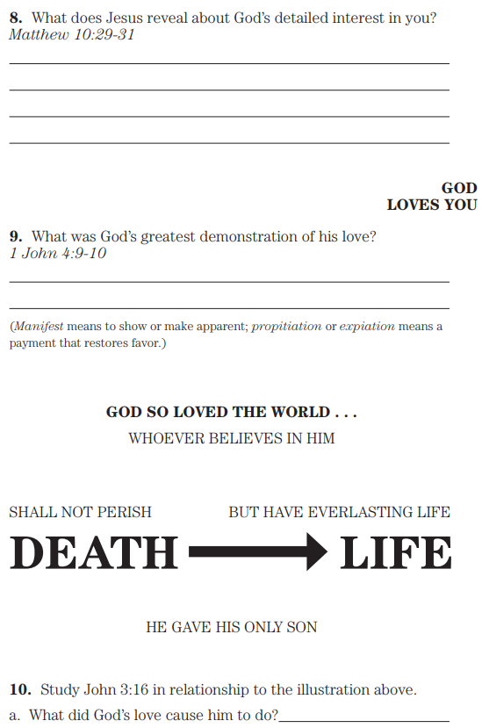
Matthew 10:29 Are not two sparrows sold for an assarion? And yet not one of them will fall to the ground apart from your Father. 30 But the very hairs of your head are all numbered. 31 So do not fear; you are more valuable than many sparrows.
1 John 4:9 By this the love of God was manifested in us, that God has sent His only begotten Son into the world so that we might live through Him. 10 In this is love, not that we have loved God, but that He loved us and sent His Son to be the propitiation for our sins.
John 3:16 “For God so loved the world, that He gave His only begotten Son, that whoever believes in Him shall not perish, but have eternal life.

Slide 8
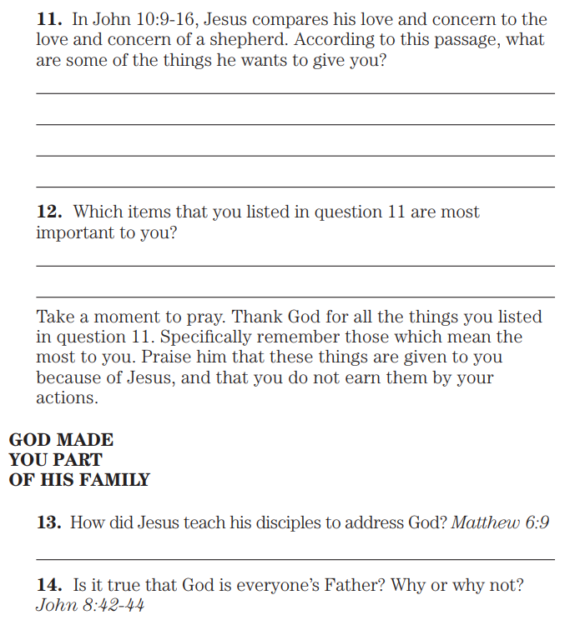
John 10:9 I am the door; if anyone enters through Me, he will be saved, and will go in and out and find pasture. 10 The thief comes only to steal and kill and destroy; I came that they may have life, and have it abundantly. 11 “I am the good shepherd; the good shepherd lays down His life for the sheep. 12 He who is a hired hand, and not a shepherd, who is not the owner of the sheep, sees the wolf coming, and leaves the sheep and flees—and the wolf snatches and scatters them— 13 because he is a hired hand and is not concerned about the sheep. 14 I am the good shepherd, and I know My own and My own know Me, 15 even as the Father knows Me and I know the Father; and I lay down My life for the sheep. 16 And I have other sheep, which are not from this fold; I must bring them also, and they will hear My voice; and they will become one flock with one shepherd.
Matthew 6:9 “Pray, then, in this way: ‘Our Father who is in heaven,
Hallowed be Your name.
John 8:42 Jesus said to them, “If God were your Father, you would love Me, for I proceeded forth and have come from God, for I have not even come of Myself, but He sent Me. 43 Why do you not understand what I am saying? It is because you cannot hear My word. 44 You are of your father the devil, and you want to do the desires of your father. He was a murderer from the beginning, and does not stand in the truth because there is no truth in him. Whenever he speaks a lie, he speaks from his own nature, for he is a liar and the father of lies.

Slide 9
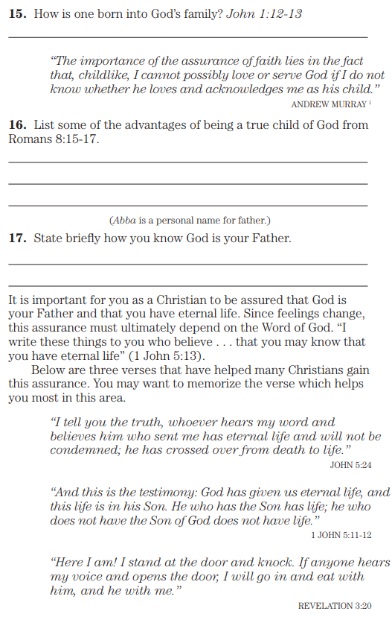
John 1:12 But as many as received Him, to them He gave the right to become children of God, even to those who believe in His name, 13 who were born, not of blood nor of the will of the flesh nor of the will of man, but of God.
Romans 8:15 For you have not received a spirit of slavery leading to fear again, but you have received the Spirit of adoption as sons by whom we cry out, “Abba! Father!” 16 The Spirit Himself testifies with our spirit that we are children of God, 17 and if children, also heirs, heirs of God and fellow heirs with Christ, if indeed we suffer with Him so that we may also be glorified with Him.

