Slide 2
Colossians 3:16 Let the word of Christ dwell in you richly, with all wisdom teaching and admonishing one another with psalms and hymns and spiritual songs, singing with gratefulness in your hearts to God. Amazing Grace

Slide 3
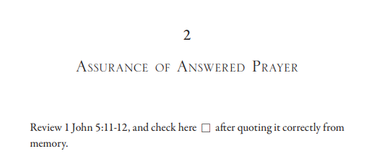
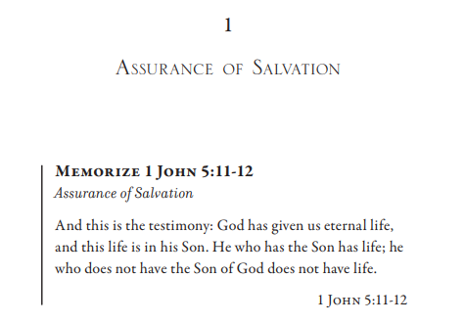

Slide 4
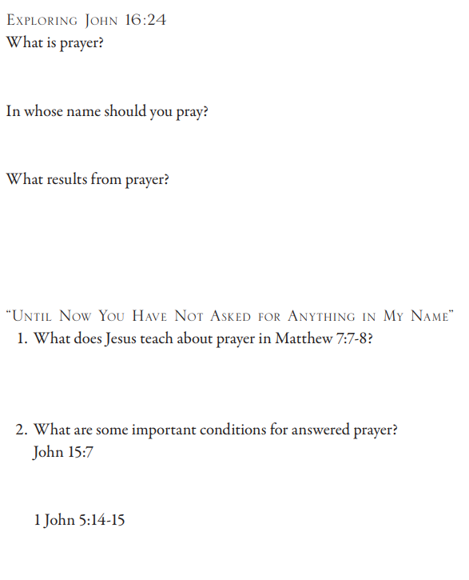
John 16:24 Until now you have asked for nothing in My name; ask and you will receive, so that your joy may be made complete. Matthew 7:7 “Ask, and it will be given to you; seek, and you will find; knock, and it will be opened to you. 8 For everyone who asks receives, and he who seeks finds, and to him who knocks it will be opened. John 15:7 If you abide in Me, and My words abide in you, ask whatever you wish, and it will be done for you. 1 John 5:14 And this is the confidence which we have before Him, that, if we ask anything according to His will, He hears us. 15 And if we know that He hears us in whatever we ask, we know that we have the requests which we have asked from Him.

Slide 5
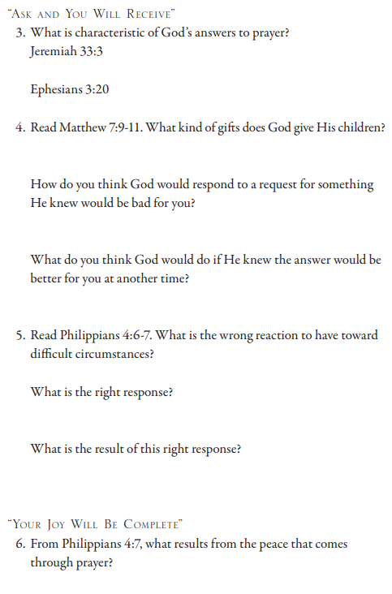
Jeremiah 3:3 ‘Call to Me and I will answer you, and I will tell you great and mighty things, which you do not know.’ Ephesians 2:20 Now to Him who is able to do far more abundantly beyond all that we ask or understand, according to the power that works within us Matthew 7:9 Or what man is there among you who, when his son asks for a loaf, will give him a stone? 10 Or if he asks for a fish, he will not give him a snake, will he? 11 If you then, being evil, know how to give good gifts to your children, how much more will your Father who is in heaven give what is good to those who ask Him! Philippians 4:6 Be anxious for nothing, but in everything by prayer and petition with thanksgiving let your requests be made known to God. 7 And the peace of God, which surpasses all comprehension, will guard your hearts and your minds in Christ Jesus.

Slide 6
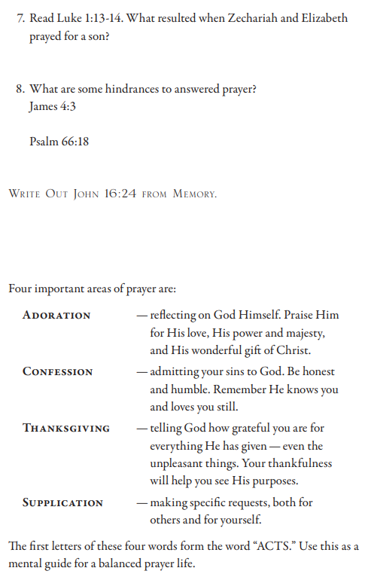
Luke 1:13 But the angel said to him, “Do not be afraid, Zechariah, for your prayer has been heard, and your wife Elizabeth will bear you a son, and you will call his name John. 14 And you will have joy and gladness, and many will rejoice at his birth. James 4:3 You ask and do not receive, because you ask with wrong motives, so that you may spend it on your pleasures. Psalm 66:18 If I see wickedness in my heart, The Lord will not hear;

Slide 7
