Slide 2
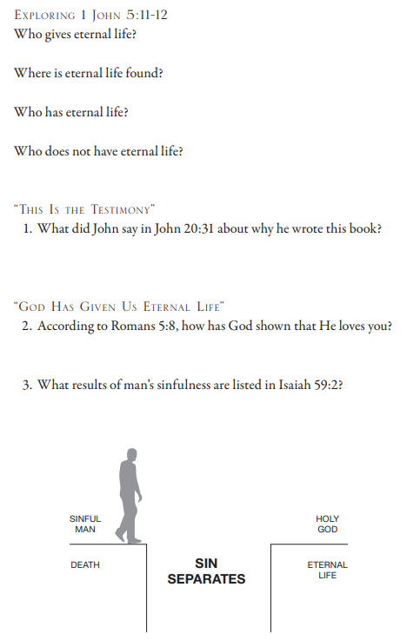
1 John 5:11 And the witness is this, that God gave us eternal life, and this life is in His Son. 12 He who has the Son has the life; he who does not have the Son of God does not have that life. John 20:31 but these have been written so that you may believe that Jesus is the Christ, the Son of God; and that believing you may have life in His name. Romans 5:8 But God demonstrates His own love toward us, in that while we were yet sinners, Christ died for us. Isaiah 59:2 But your iniquities have made a separation between you and your God, And your sins have hidden His face from you so that He does not hear.

Slide 3
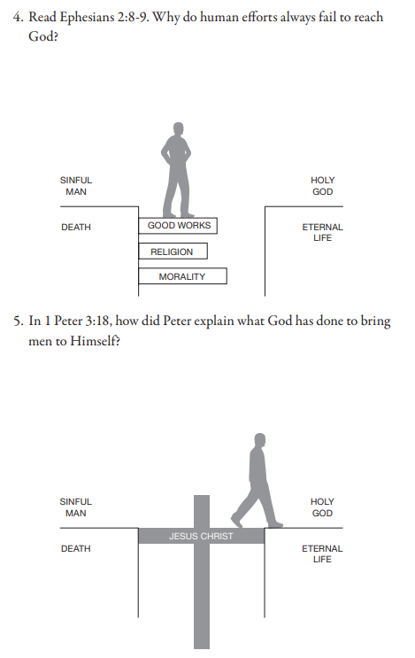
Ephesians 2:8 For by grace you have been saved through faith, and this not of yourselves, it is the gift of God; ⁹ not of works, so that no one may boast. 1 Peter 3:18 For Christ also suffered for sins once for all, the righteous for the unrighteous, so that He might bring you to God, having been put to death in the flesh, but made alive in the spirit;

Slide 4
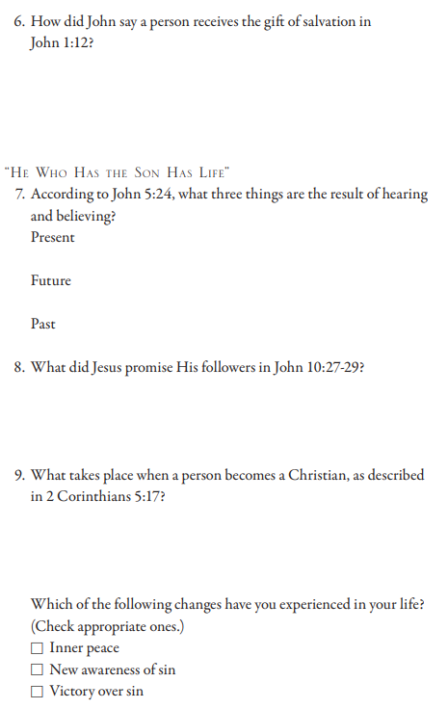
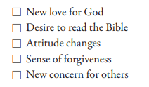
John 1:12 But as many as received Him, to them He gave the right to become children of God, even to those who believe in His name John 5:24 “Truly, truly, I say to you, he who hears My word, and believes Him who sent Me, has eternal life, and does not come into judgment, but has passed out of death into life. John 10:27 My sheep hear My voice, and I know them, and they follow Me; 28 and I give eternal life to them, and they will never perish—ever; and no one will snatch them out of My hand. 29 My Father, who has given them to Me, is greater than all; and no one is able to snatch them out of the Father’s hand. 2 Corinthians 5:17 Therefore if anyone is in Christ, he is a new creation; the old things passed away; behold, new things have come.

Slide 5
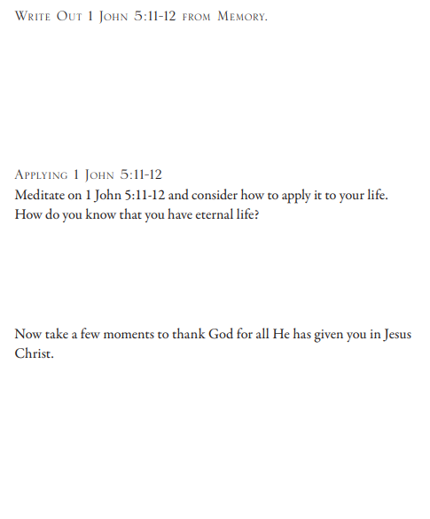
1 John 5:11 And the witness is this, that God gave us eternal life, and this life is in His Son. 12 He who has the Son has the life; he who does not have the Son of God does not have that life.

