Slide 1
WORSHIP IN SONG
Nothing but the Blood https://www.youtube.com/watch?v=aeyiQG9Wg14 John 4:24 God is spirit, and those who worship Him must worship in spirit and truth.”
Colossians 3:16 Let the word of Christ dwell in you richly, with all wisdom teaching and admonishing one another with psalms and hymns and spiritual songs, singing with gratefulness in your hearts to God.
Ephesians 5:19 [speak] to one another in psalms and hymns and spiritual songs, singing and making melody with your heart to the Lord; 20 always giving thanks for all things in the name of our Lord Jesus Christ to God, even the Father.

Slide 2
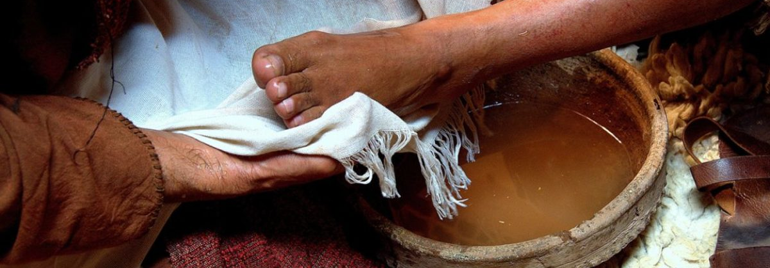

Slide 3
Maundy
Maundy Thursday
Maundy comes from the Latin word ”mandatum” which means Command (Like Mandate)
What is the command given on the day before Good Friday?
Celebration of the events prior to the crucifixion of Jesys in John 13:1-38

Slide 4
Maundy Thursday – john 13
The Lord’s Supper
13:1 Now before the Feast of the Passover, Jesus knowing that His hour had come that He would depart out of this world to the Father, having loved His own who were in the world, He loved them ^{[a]}to the end. ² And during supper, the devil having already put into the heart of Judas Iscariot, the son of Simon, to betray Him, ³ Jesus, knowing that the Father had given all things into His hands, and that He had come forth from God and was going back to God, ⁴ *got up from supper, and *laid aside His garments; and taking a towel, He tied it around Himself.

Slide 5
Maundy Thursday – john 13
Jesus Washes the Disciples’ Feet
⁵ Then He *poured water into the washbasin, and began to wash the disciples’ feet and to wipe them with the towel which He had tied around Himself. ⁶ So He *came to Simon Peter. He *said to Him, “Lord, are You going to wash my feet?” ⁷ Jesus answered and said to him, “What I am doing you do not realize now, but you will understand afterwards.” ⁸ Peter *said to Him, “You will never wash my feet—ever!” Jesus answered him, “If I do not wash you, you have no part with Me.” ⁹ Simon Peter *said to Him, “Lord, not only my feet, but also my hands and my head.” ¹⁰ Jesus *said to him, “He who has bathed needs only to wash his feet, but is completely clean; and you are clean, but not all of you.” ¹¹ For He knew the one who was betraying Him; for this reason He said, “Not all of you are clean.”

Slide 6
Maundy Thursday – john 13
…¹² So when He had washed their feet, and taken His garments and reclined at the table again, He said to them, “Do you know what I have done to you? ¹³ You call Me Teacher and Lord; and ^{[b]}you are right, for so I am. ¹⁴ If I then, the Lord and the Teacher, washed your feet, you also ought to wash one another’s feet. ¹⁵ For I gave you an example that you also should do as I did to you. ¹⁶ Truly, truly, I say to you, a slave is not greater than his master, nor is one who is sent greater than the one who sent him. ¹⁷ If you know these things, you are blessed if you do them. ¹⁸ I do not speak about all of you. I know the ones I have chosen; but that the Scripture may be fulfilled, ‘He who eats My bread has lifted up his heel against Me.’ ¹⁹ From now on I am telling you before it occurs, so that when it does occur, you may believe that I am He. ²⁰ Truly, truly, I say to you, he who receives anyone I send receives Me; and he who receives Me receives Him who sent Me.”

Slide 7
Maundy Thursday – john 13
Jesus Predicts His Betrayal
²¹ When Jesus had said these things, He became troubled in spirit, and bore witness and said, “Truly, truly, I say to you, that one of you will ^{[c]}betray Me.” ²² The disciples began looking at one another, perplexed about whom He *spoke. ²³ There was reclining on Jesus’ bosom one of His disciples, whom Jesus loved. ²⁴ So Simon Peter *gestured to him to inquire, “Who is the one of whom He is speaking?” ²⁵ He, leaning back thus on Jesus’ bosom, *said to Him, “Lord, who is it?”

Slide 8
Maundy Thursday – john 13
…²⁶ Jesus *answered, “He is the one for whom I shall dip the piece of bread and give it to him.” So when He had dipped the piece of bread, He *took and *gave it to Judas, the son of Simon Iscariot. ²⁷ And after the piece of bread, Satan then entered into him. Therefore Jesus *said to him, “What you do, do quickly.” ²⁸ Now no one of those reclining at the table knew for what purpose He had said this to him. ²⁹ For some were thinking, because Judas had the money box, that Jesus was saying to him, “Buy the things we have need of for the feast”; or else, that he should give something to the poor. ³⁰ So after receiving the piece of bread, he went out immediately. And it was night.

Slide 9
Maundy Thursday – john 13
³¹ Therefore when he had gone out, Jesus *said, “Now ^{[d]}is the Son of Man glorified, and God ^{[e]}is glorified in Him; ^{32 [f]}if God is glorified in Him, God will also glorify Him in Himself, and will glorify Him immediately. ³³ Little children, I am with you a little while longer. You will seek Me; and as I said to the Jews, now I also say to you, ‘Where I am going, you cannot come.’ ³⁴ A new commandment I give to you, that you love one another, even as I have loved you, that you also love one another. ³⁵ By this all will know that you are My disciples, if you have love for one another.”

Slide 10
Maundy Thursday – john 13
³⁶ Simon Peter *said to Him, “Lord, where are You going?” Jesus answered, “Where I go, you cannot follow Me now; but you will follow later.” ³⁷ Peter *said to Him, “Lord, why can I not follow You right now? I will lay down my life for You.” ³⁸ Jesus *answered, “Will you lay down your life for Me? Truly, truly, I say to you, a rooster will not crow until you deny Me three times.

Slide 11
Maundy Thursday – john 13
Bible Study Tool: S.P.E.C.K.
S. – Sin to confess / avoid: In the passage, does God say something about sin? Is there a sin to confess? Is there a sin that I should avoid?
P. – Promise to keep: Does God communicate a promise for me to claim?
E. – Example to follow: Do I find people in this passage that give a good role model? What character traits and which actions are good? Which are not good?
C. – Command to obey: Are there any specific commands given for me to follow. What does God want me to apply to my life today and this week so that I develop Godly character and habits?
K. – Knowledge about God: What does this passage tell me about God or about Jesus Christ or the Holy Spirit? What is God like? What are His attributes? What does He do? What does He like and dislike? What is His attitude?

