Slide 1
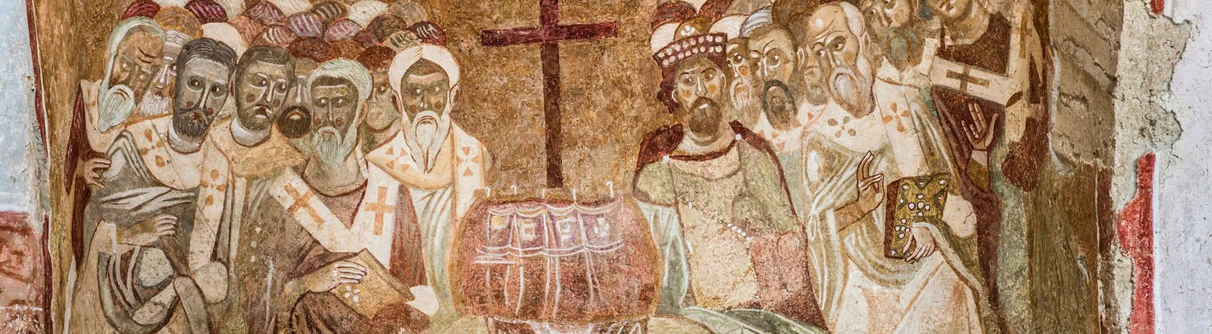
NICENE CREED
AFTER 1700 YEARS

Slide 2
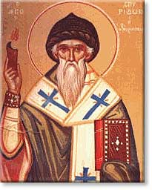
ARIUS
Pre-325
Arius was born in Libya ~250 A.D.
Tall, thin, walked barefoot, winsome personality, musical
Presbyter in Alexandria under his Bishop Alexander
Taught “there was a time when the son was not”

Slide 3
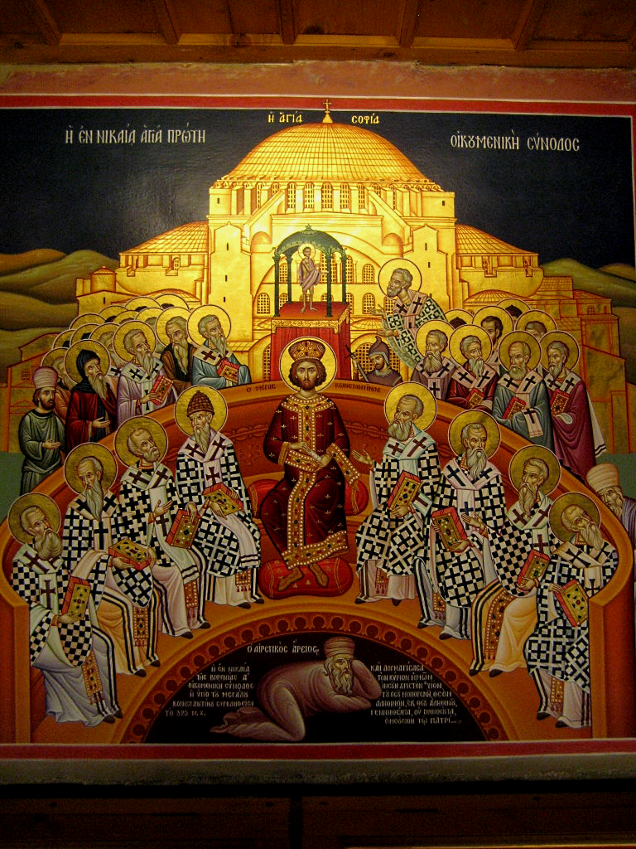
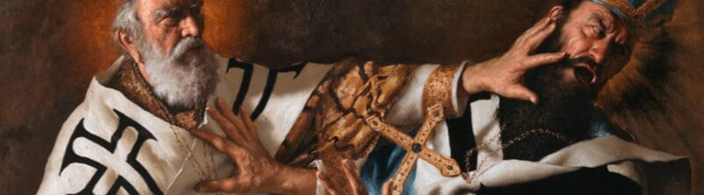
THE COUNCIL OF
NICAEA
In 325 Constantine calls a council at Nicaea
First Ecumenical Council
Deliberations about whether Arius taught falsehood
Athanasius vs
Eusebius & Arius
Arius and his teachings are condemned

Slide 4
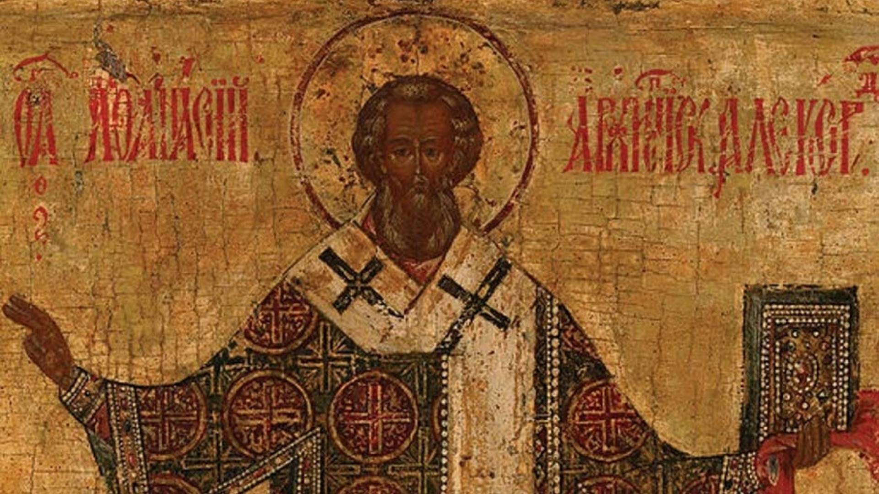
VERDICT
]
The Father and Son are co-equal and co-eternal and…
ARE homoouisious, “of one substance” / essence / being, but
NOT heteroousios “of different substance” / essence / being, &
NOT homoiousios “of similar substance” / essence / being

Slide 5
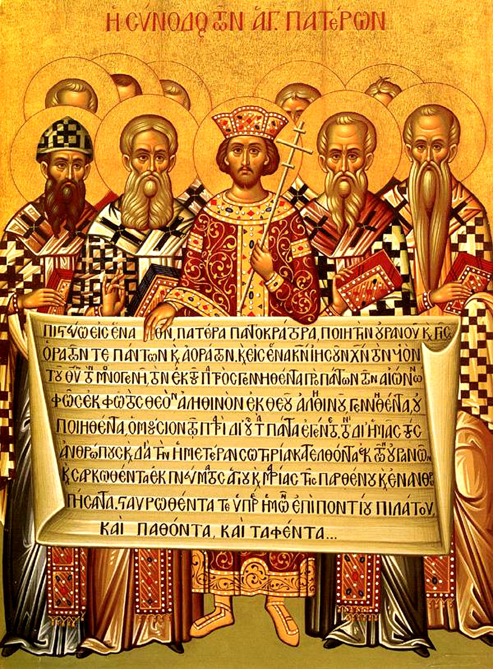
CREED
The overwhelming majority of Bishops condemned Arius as a heretic
Anyone preaching his ideas or possessing his manuscripts may be convicted of a capital crime.
Formulated an official Creed to affirm, against Arian heresy
Important to this day: Cults

Slide 6
THE NICENE CREED
We believe in one God, the Father Almighty,
Maker of all things visible and invisible.
And in one Lord Jesus Christ, the Son of God, begotten
of the Father, the only-begotten; that is, of the essence of the Father, God of God, Light of Light, very God of very God, begotten, not made, consubstantial with the Father;
By whom all things were made;
Who for us men, and for our salvation, came down and was incarnate and was made man;
He suffered, and the third day he rose again, ascended into heaven;
From thence he shall come to judge the quick and the dead.
And in the Holy Ghost.

Slide 7
Structure of the Nicene Creed (325)
01
02
03
WE BELIEVE IN THE FATHER (MAKER)
AND IN ONE LORD JESUS CHRIST (BEGOTTEN NOT MADE / CONSUBSTANTIAL)
I JESUS IS MAKER
II JESUS BECAME INCARNATE
III JESUS’S PASSION
IV JESUS WILL COME AGAIN
AND IN THE HOLY SPIRIT

Slide 8
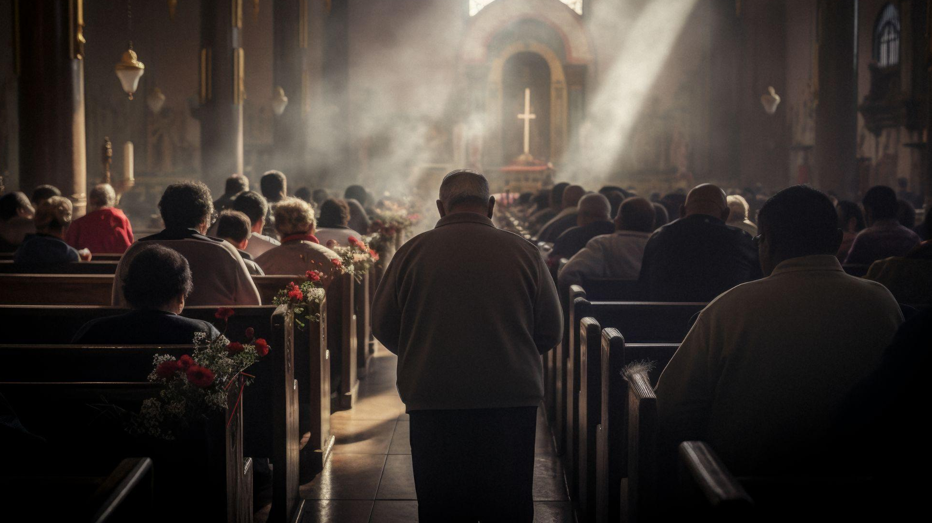
01
WE BELIEVE IN THE FATHER

Slide 9
THE NICENE CREED
1 We believe in one God, the Father Almighty,
Maker of all things visible and invisible.

Slide 10
In one God…
1 Corinthians 8:6 yet for us there is one God, the Father, from whom are all things and we exist for Him, and one Lord, Jesus Christ, by whom are all things, and we exist through Him.
Deuteronomy 6:4 “Hear, O Israel! Yahweh is our God, Yahweh is one!
Mark 12:28 And when one of the scribes came and heard them arguing, he recognized that He had answered them well and asked Him, “What commandment is the foremost of all?” 29 Jesus answered, “The foremost is, ‘Hear, O Israel! The Lord our God is one Lord;

Slide 11
…The Father Almighty
1 Corinthians 8:6 yet for us there is one God, the Father, from whom are all things and we exist for Him, and one Lord, Jesus Christ, by whom are all things, and we exist through Him.
  Ephesians 4:4 There is one body and one Spirit, just as also you were called in one hope of your calling; 5 one Lord, one faith, one baptism; 6 one God and Father of all who is over all and through all and in all.

Slide 12
Maker of all things visible and invisible
1 Corinthians 8:6 yet for us there is one God, the Father, from whom are all things and we exist for Him, and one Lord, Jesus Christ, by whom are all things, and we exist through Him.
Isaiah 42:5 Thus says the God, Yahweh, Who created the heavens and stretched them out, Who spread out the earth and its offspring, Who gives breath to the people on it, and spirit to those who walk in it…
Jeremiah 23:17 ‘Ah Lord Yahweh! Behold, You have made the heavens and the earth by Your great power and by Your outstretched arm! Nothing is too difficult for You…
Ephesians 4:6 one God and Father of all who is over all and through all and in all.

Slide 13
02
AND IN ONE LORD JESUS CHRIST

Slide 14
THE NICENE CREED
2 And in one Lord Jesus Christ,
the Son of God, begotten of the Father [the only-begotten; that is, of the essence of the Father, God of God], Light of Light, very God of very God, begotten, not made, consubstantial with the Father;

Slide 15
…and in One Lord Jesus Christ
1 Corinthians 8:6 yet for us there is one God, the Father, from whom are all things and we exist for Him, and one Lord, Jesus Christ, by whom are all things, and we exist through Him.
Romans 14:9 For to this end Christ died and lived again, that He might be Lord both of the dead and of the living.

Slide 16
the Son of God, begotten of the Father,
Mark 1:1 The beginning of the gospel of Jesus Christ, the Son of God.
Mark 15:39 And when the centurion, who was standing right in front of Him, saw the way He breathed His last, he said, “Truly this man was God’s Son!”
John 1:18 No one has seen God at any time; the only begotten God who is in the bosom of the Father, He has explained Him.
John 3:16 “For God so loved the world, that He gave His only begotten Son, that whoever believes in Him shall not perish, but have eternal life.

Slide 17
[God of God], Light of Light, very God of very God
Hebrews 1:3 [Jesus] who is the radiance of His glory and the exact representation of His (God’s) nature
Luke 2:32 A Light for revelation to the Gentiles, And for the glory of Your people Israel.”
John 1: 4 In Him was life, and the life was the Light of men. 5 And the Light shines in the darkness, and the darkness did not overtake it.
Colossians 1:15 Who is the image of the invisible God…
1:19 For in Him all the fullness of God was pleased to dwell…
Colossians 2:9 For in Him all the fullness of Deity dwells bodily

Slide 18
begotten, not made, consubstantial with the Father
John 1:14 And the Word became flesh… 18 No one has seen God at any time; the only begotten God who is in the bosom of the Father, He has explained Him.
John 3:16 “For God so loved the world, that He gave His only begotten Son, that whoever believes in Him shall not perish, but have eternal life.
John 10:30 I and the Father are one.”
John 14:9 …He who has seen Me has seen the Father; how can you say, ‘Show us the Father’? 10 Do you not believe that I am in the Father, and the Father is in Me? The words that I say to you I do not speak from Myself, but the Father abiding in Me does His works.

Slide 19
By whom all things were made;
1 Corinthians 8:6 yet for us there is one God, the Father, from whom are all things and we exist for Him, and one Lord, Jesus Christ, by whom are all things, and we exist through Him.
Romans 11:36 For from Him and through Him and to Him are all things. To Him be the glory forever. Amen.
Acts 17:24 The God who made the world and all things in it, since He is Lord of heaven and earth, does not dwell in temples made with hands;

Slide 20
Who for us men, and for our salvation, came down and was incarnate and was made man;
In the incarnation of Jesus, God put on a body and flesh. In doing so, he chose to predispose Himself to all the vulnerabilities and complexities of what it meant to be human-- particularly, and perhaps especially, the sorrow, suffering, trauma, and death we experience as people. With cooperative obedience under the power of the Holy Spirit, Mary was God’s chosen vessel who brought the Son into the world. Jesus was uniquely born of a virgin to reflect His distinct status as both fully God and fully man.
Jesus was uniquely born of a virgin to reflect His distinct status as both fully God and fully man.

Slide 21
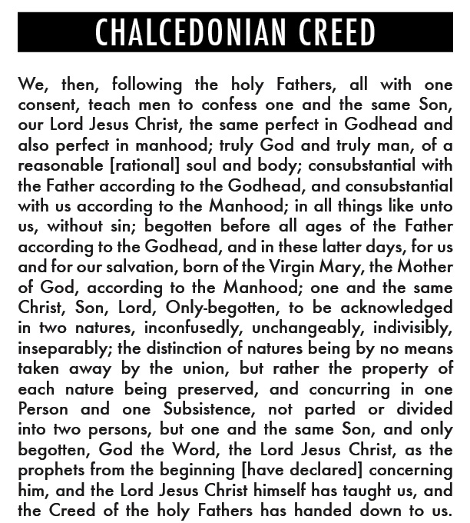
Who for us men, and for our salvation, came down and was incarnate and was made man;

Slide 22
Who for us men, and for our salvation, came down and was incarnate and was made man;
Isaiah 7:14 Therefore the Lord Himself will give you a sign: Behold, the virgin will be with child and bear a son, and she will call His name Immanuel [God with us].
Isaiah 25:9 And it will be said in that day, “Behold, this is our God in whom we have hoped that He would save us. This is Yahweh in whom we have hoped; Let us rejoice and be glad in His salvation.”

Slide 23
Who for us men, and for our salvation, came down and was incarnate and was made man;
Luke 19:9 And Jesus said to him, “Today salvation has come to this house, because he, too, is a son of Abraham. 10 For the Son of Man has come to seek and to save the lost.”
John 3:13 And no one has ascended into heaven, but He who descended from heaven, the Son of Man.
John 12:44 And Jesus cried out and said, “He who believes in Me, does not believe in Me but in Him who sent Me. 45 And he who sees Me sees the One who sent Me. 46 I have come as Light into the world, so that everyone who believes in Me will not remain in darkness. 47 And if anyone hears My words and does not keep them, I do not judge him; for I did not come to judge the world, but to save the world.

Slide 24
Who for us men, and for our salvation, came down and was incarnate and was made man;
John 17: 1 Jesus spoke these things; and lifting up His eyes to heaven, He said, “Father, the hour has come; glorify Your Son, that the Son may glorify You, 2 even as You gave Him authority over all flesh, that to all whom You have given Him, He may give eternal life. 3 And this is eternal life, that they may know You, the only true God, and Jesus Christ whom You have sent. 4 I glorified You on the earth, having finished the work which You have given Me to do.
2 Corinthians 5:21 He made Him who knew no sin to be sin on our behalf, so that we might become the righteousness of God in Him.

Slide 25
Who for us men, and for our salvation, came down and was incarnate and was made man;
Ephesians 2:8 For by grace you have been saved through faith, and this not of yourselves, it is the gift of God; 9 not of works, so that no one may boast.
Philippians 2:6 who, although existing in the form of God, did not regard equality with God a thing to be grasped, 7 but emptied Himself, by taking the form of a slave, by being made in the likeness of men. 8 Being found in appearance as a man, He humbled Himself by becoming obedient to the point of death, even death on a cross.
1 Timothy 1:15 It is a trustworthy saying and deserving full acceptance: that Christ Jesus came into the world to save sinners, among whom I am foremost.

Slide 26
Who for us men, and for our salvation, came down and was incarnate and was made man;
John 1:14 And the Word became flesh, and dwelt among us, and we beheld His glory, glory as of the only begotten from the Father, full of grace and truth.
Galatians 4:4 But when the fullness of the time came, God sent forth His Son, born of a woman, born under the Law
Hebrews 2:17 Therefore, He had to be made like His brothers in all things, so that He might become a merciful and faithful high priest in things pertaining to God, to make propitiation for the sins of the people.

Slide 27
He suffered, and the third day he rose again
Christ suffered at the hands of people-- the very people he came to save ultimately rejected him, scorned him, and killed him. Jesus suffered physical and emotional abuse, mockery and betrayal, mental anguish, and spiritual abandonment. After this suffering, Jesus—the immortal God who took up mortal flesh—died a real death.
He was buried in a guarded and sealed tomb, and it seemed as if the story was over. Can you begin to imagine the discovery of an empty tomb three days later? The news was staggering: Jesus was not in the grave; Jesus was no longer dead. Jesus is alive!

Slide 28
He suffered, and the third day he rose again
Why was Jesus crucified and not put to death in some other way? Crucifixion was
considered the worst possible death – not only from the fact that it was long and painful,
but also because the public humiliation was reserved for the worst of criminals.

Slide 29
He suffered, and the third day he rose again
Isaiah 53:3 He was despised and forsaken of men, A man of sorrows and acquainted with grief; And like one from whom men hide their face He was despised, and we did not esteem Him. 4 Surely our griefs He Himself bore, And our sorrows He carried; Yet we ourselves esteemed Him stricken, Smitten of God, and afflicted.

Slide 30
He suffered, and the third day he rose again
Matthew 27:30 And they spat on Him, and took the reed and began to beat Him on the head. 31 When they had mocked Him, they took the scarlet robe off Him and put His own garments back on Him, and led Him away to crucify Him.
Matthew 28:5 And the angel answered and said to the women, “Do not be afraid; for I know that you are looking for Jesus who has been crucified. 6 He is not here, for He has risen, just as He said. Come, see the place where He was lying.

Slide 31
He suffered, and the third day he rose again
Mark 10:33 “Behold, we are going up to Jerusalem, and the Son of Man will be betrayed to the chief priests and the scribes; and they will condemn Him to death and will deliver Him over to the Gentiles. 34 And they will mock Him and spit on Him, and flog Him and kill Him, and three days later He will rise again.”
Mark 15:19 And they kept beating His head with a reed, and spitting on Him; and kneeling, they were bowing down before Him. 20 And after they had mocked Him, they took the purple robe off Him and put His own garments on Him. And they *led Him out to crucify Him.

Slide 32
He suffered, and the third day he rose again
Mark 15:45 And ascertaining this from the centurion, he granted the body to Joseph. 46 And when Joseph had bought a linen cloth and took Him down, he wrapped Him in the linen cloth and laid Him in a tomb which had been hewn out in the rock. And he rolled a stone against the entrance of the tomb.
Mark 16:6 And he *said to them, “Do not be amazed; you are looking for Jesus the Nazarene, who has been crucified. He has risen; He is not here; behold, the place where they laid Him.

Slide 33
He suffered, and the third day he rose again
Luke 24:46 and He said to them, “Thus it is written, that the Christ would suffer and rise again from the dead the third day,
John 19: 1 Pilate then took Jesus and flogged Him. 2 And when the soldiers twisted together a crown of thorns, they put it on His head, and put a purple robe on Him; 3 and they were coming to Him and saying, “Hail, King of the Jews!” and were giving Him slaps in the face…
30 Therefore when Jesus had received the sour wine, He said, “It is finished!” And bowing His head, He gave up His spirit.

Slide 34
He suffered, and the third day he rose again
John 19:33 but coming to Jesus, when they saw that He was already dead, they did not break His legs…
40 So they took the body of Jesus and bound it in linen wrappings with the spices, as is the burial custom of the Jews. 41 Now in the place where He was crucified there was a garden, and in the garden a new tomb in which no one had yet been laid. 42 Therefore because of the Jewish day of Preparation, since the tomb was nearby, they laid Jesus there.

Slide 35
He suffered, and the third day he rose again
Acts 2:24 But God raised Him up again, putting an end to the agony of death, since it was impossible for Him to be held in its power…
32 This Jesus God raised up again, to which we are all witnesses.
Acts 3:15 but put to death the Author of life, whom God raised from the dead, a fact to which we are witnesses.
Acts 13:29 And when they had finished all that was written concerning Him, they took Him down from the tree and laid Him in a tomb. 30 But God raised Him from the dead;

Slide 36
He suffered, and the third day he rose again
Romans 10:9 that if you confess with your mouth Jesus as Lord, and believe in your heart that God raised Him from the dead, you will be saved;
2 Corinthians 5: 15 And He died for all, so that they who live would no longer live for themselves, but for Him who died and rose again on their behalf.
Philippians 2:8 Being found in appearance as a man, He humbled Himself by becoming obedient to the point of death, even death on a cross.

Slide 37
He suffered, and the third day he rose again
1 Peter 3:18 For Christ also suffered for sins once for all, the righteous for the unrighteous, so that He might bring you to God, having been put to death in the flesh, but made alive in the spirit;
Hebrews 2:9 But we do see Him who was made [a]for a little while lower than the angels—Jesus, because of the suffering of death crowned with glory and honor, so that by the grace of God He might taste death for everyone…
18 For since He Himself was tempted in that which He has suffered, He is able to come to help those who are tempted.

Slide 38
He suffered, and the third day he rose again
Revelation 1:18 and the living One; and I was dead, and behold, I am alive forever and ever, and I have the keys of death and of Hades.

Slide 39
He suffered, and the third day he rose again
THE GOSPEL
1 Corinthians 15:15 Now I make known to you, brothers, the gospel which I proclaimed as good news to you, which also you received, in which also you stand, 2 by which also you are saved, if you hold fast the word which I proclaimed to you as good news, unless you believed for nothing.
3 For I delivered to you as of first importance what I also received…

Slide 40
He suffered, and the third day he rose again
[3]… that Christ died for our sins according to the Scriptures, 4 and that He was buried, and that He was raised on the third day according to the Scriptures, 5 and that He appeared to Cephas, then to the twelve. 6 After that He appeared to more than five hundred brothers at one time, most of whom remain until now, but some have fallen asleep. 7 After that, He appeared to James, then to all the apostles…

Slide 41
He suffered, and the third day he rose again
8 and last of all, as to one untimely born, He appeared to me also. 9 For I am the least of the apostles, and not worthy to be called an apostle, because I persecuted the church of God. 10 But by the grace of God I am what I am, and His grace toward me did not prove vain; but I labored even more than all of them, yet not I, but the grace of God with me. 11 Whether then it was I or they, so we preach and so you believed.

Slide 42
C
O
R
E
1
15

