Slide 2
Colossians 3:16 Let the word of Christ dwell in you richly, with all wisdom teaching and admonishing one another with psalms and hymns and spiritual songs, singing with gratefulness in your hearts to God. Reformation Hymn https://www.youtube.com/watch?v=SiDw12zR814

Slide 3
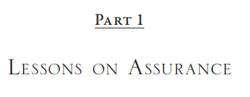
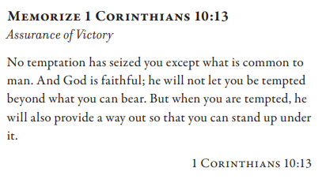
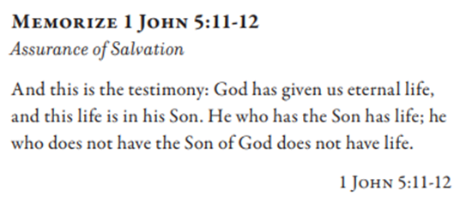
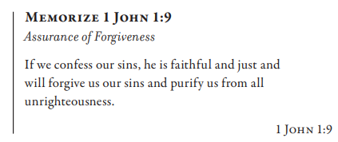
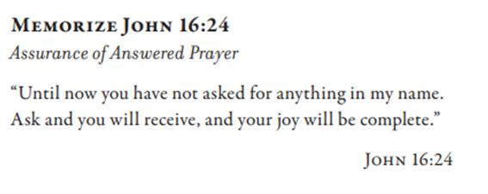

Slide 4
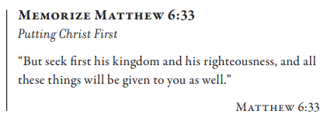

Slide 5
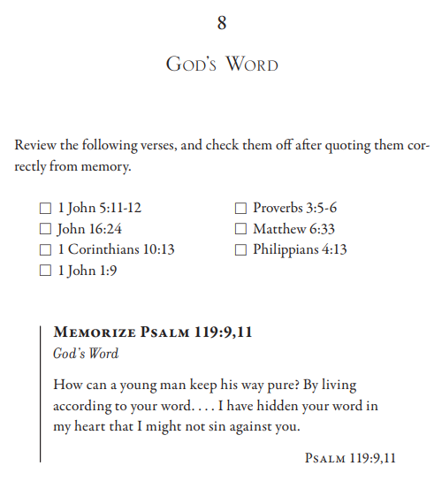
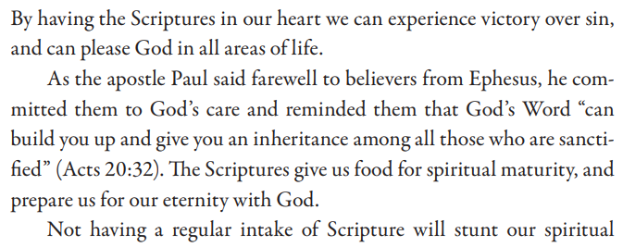

Slide 6
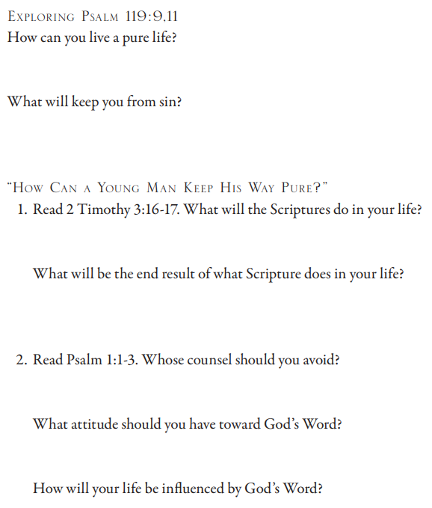
Psalm 119: 9 How can a young man keep his way pure? By keeping it according to Your word… 11 Your word I have treasured in my heart, that I may not sin against You. 2 Timothy 3:16 All Scripture is God-breathed and profitable for teaching, for reproof, for correction, for training in righteousness, 17 so that the man of God may be equipped, having been thoroughly equipped for every good work. Psalm 1: How blessed is the man who does not walk in the counsel of the wicked, nor stand in the way of sinners, nor sit in the seat of scoffers! 2 But his delight is in the law of Yahweh, and in His law he meditates day and night. 3 And he will be like a tree firmly planted by streams of water, which yields its fruit in its season and its leaf does not wither; and in whatever he does, he prospers.

Slide 7
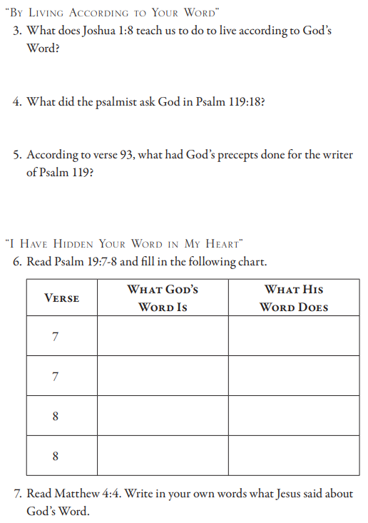
Joshua 1:8 This book of the law shall not depart from your mouth, but you shall meditate on it day and night, so that you may be careful to do according to all that is written in it; for then you will make your way successful, and then you will be prosperous. Psalm 119:18 Open my eyes, that I may behold wonderful things from Your law. Psalm 119:93 I will never forget Your precepts, for by them You have revived me. Psalm 19:7 The law of Yahweh is perfect, restoring the soul; The testimony of Yahweh is sure, making wise the simple. 8 The precepts of Yahweh are right, rejoicing the heart; The commandment of Yahweh is pure, enlightening the eyes. Matthew 4:4 But He answered and said, “It is written, ‘Man shall not live on bread alone, but on every word that proceeds out of the mouth of God.’”

Slide 8
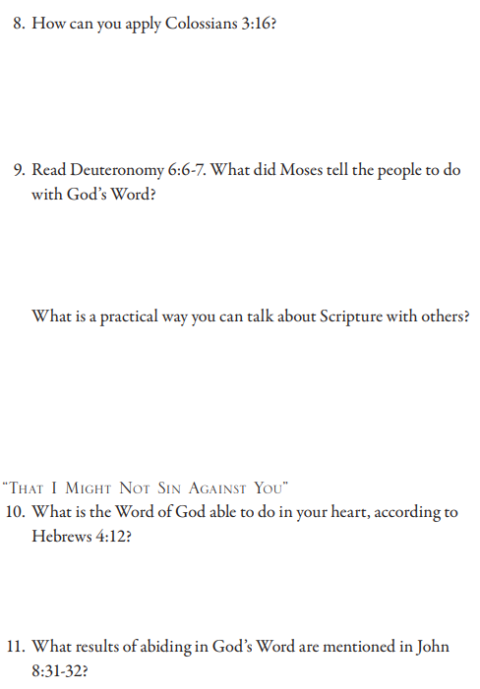
Colossians 3:16 Let the word of Christ dwell in you richly, with all wisdom teaching and admonishing one another with psalms and hymns and spiritual songs, singing with gratefulness in your hearts to God. Deuteronomy 6:6 These words, which I am commanding you today, shall be on your heart. 7 You shall teach them diligently to your sons and shall speak of them when you sit in your house and when you walk by the way and when you lie down and when you rise up. Hebrews 4:12 For the word of God is living and active and sharper than any two-edged sword, and piercing as far as the division of soul and spirit, of both joints and marrow, and able to judge the thoughts and intentions of the heart. John 8:31 So Jesus was saying to those Jews who had believed Him, “If you abide in My word, then you are truly My disciples; 32 and you will know the truth, and the truth will make you free.”

Slide 9
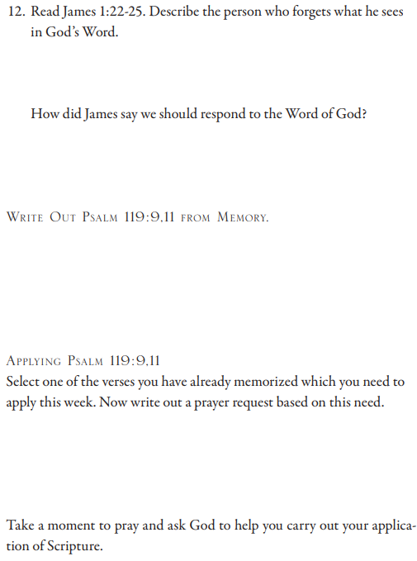
James 1:22 But become doers of the word, and not merely hearers who delude themselves. 23 For if anyone is a hearer of the word and not a doer, he is like a man who looks at his natural face in a mirror; 24 for once he looked at himself and has gone away, he immediately forgot what kind of person he was. 25 But one who looks intently at the perfect law, the law of freedom, and abides by it, not having become a forgetful hearer but a doer of the work, this man will be blessed in what he does. Psalm 119: 9 How can a young man keep his way pure? By keeping it according to Your word… 11 Your word I have treasured in my heart, that I may not sin against You.

