Slide 2
https://tinyurl.com/ucbcso

Slide 3
Colossians 3:16 Let the word of Christ dwell in you richly, with all wisdom teaching and admonishing one another with psalms and hymns and spiritual songs, singing with gratefulness in your hearts to God. Holy Holy Holy

Slide 4
1 Holy, holy, holy! Lord God Almighty! Early in the morning our song shall rise to Thee; Holy, holy, holy! merciful and mighty! God in three Persons, blessed Trinity!

Slide 5
2 Holy, holy, holy! all the saints adore Thee, casting down their golden crowns around the glassy sea; cherubim and seraphim, falling down before Thee, which wert and art and evermore shalt be.

Slide 6
3 Holy, holy, holy! though the darkness hide Thee, though the eye of sinful man Thy glory may not see; only Thou art holy, there is none beside Thee, perfect in pow'r, in love, and purity.

Slide 7
4 Holy, holy, holy! Lord God Almighty! All Thy works shall praise Thy name, in earth and sky and sea; Holy, holy, holy! merciful and mighty! God in three Persons, blessed Trinity!

Slide 8
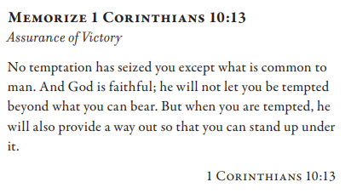
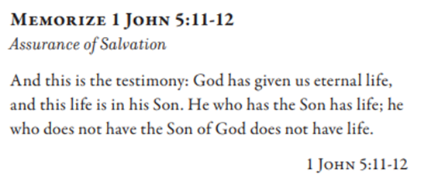
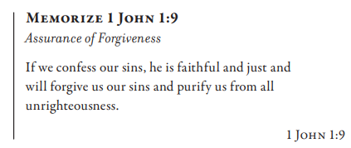
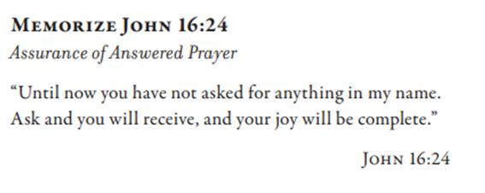

Slide 9
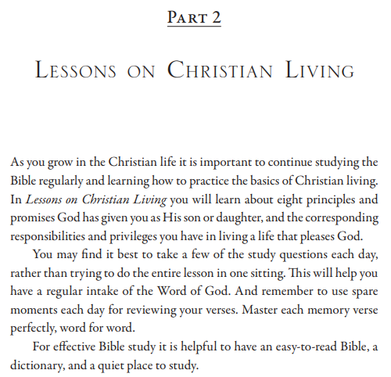

Slide 10
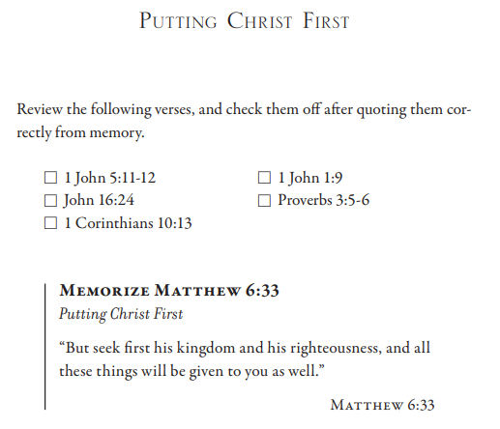
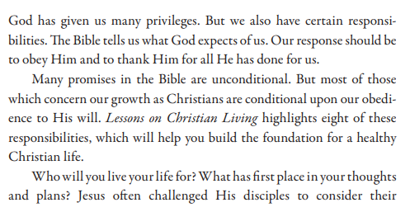
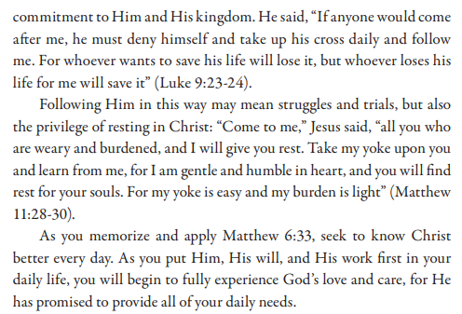

Slide 11
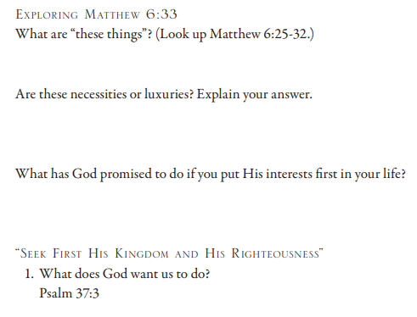
Matthew 6:25 “For this reason I say to you, do not be worried about your life, as to what you will eat or what you will drink; nor for your body, as to what you will put on. Is not life more than food, and the body more than clothing? 26 Look at the birds of the air, that they do not sow, nor reap nor gather into barns, and yet your heavenly Father feeds them. Are you not worth much more than they? 27 And who of you by being worried can add a single cubit to his life span? 28 And why are you worried about clothing? Observe how the lilies of the field grow; they do not toil nor do they spin, 29 yet I say to you that not even Solomon in all his glory clothed himself like one of these. 30 But if God so clothes the grass of the field, which is alive today and tomorrow is thrown into the furnace, will He not much more clothe you? You of little faith! 31 Do not worry then, saying, ‘What will we eat?’ or ‘What will we drink?’ or ‘What will we wear for clothing?’ 32 For all these things the Gentiles eagerly seek; for your heavenly Father knows that you need all these things. 33 But seek first His kingdom and His righteousness, and all these things will be added to you. Psalm 37:3 Trust in Yahweh and do good; Dwell in the land and cultivate faithfulness.

Slide 12
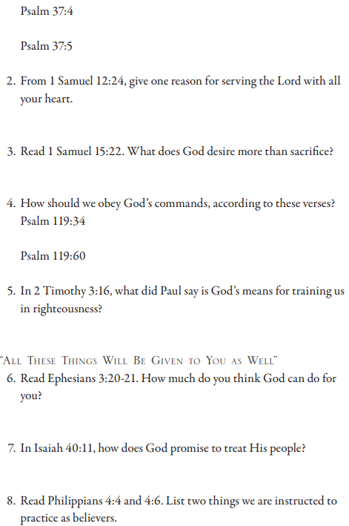
Psalm 37: 4 Delight yourself in Yahweh; And He will give you the desires of your heart. 5 Commit your way to Yahweh, Trust in Him, and He will do it. 1 Samuel 12:24 Only fear Yahweh and serve Him in truth with all your heart; for see what great things He has done for you. 1 Samuel 15:22 And Samuel said, “Has Yahweh as much delight in burnt offerings and sacrifices as in obeying the voice of Yahweh? Behold, to obey is better than sacrifice, and to heed than the fat of rams. Psalm 119: 34 Cause me to understand, that I may observe Your law and keep it with all my heart… 60 I hastened and did not delay to keep Your commandments. 2 Timothy 3:16 All Scripture is God-breathed and profitable for teaching, for reproof, for correction, for training in righteousness, Ephesians 3:20 Now to Him who is able to do far more abundantly beyond all that we ask or understand, according to the power that works within us, 21 to Him be the glory in the church and in Christ Jesus to all generations forever and ever. Amen. Isaiah 40:11 Like a shepherd He will shepherd His flock; In His arm He will gather the lambs and carry them in His bosom; He will gently lead the nursing ewes. Philippians 4:4 Rejoice in the Lord always; again I will say, rejoice! …6 Be anxious for nothing, but in everything by prayer and petition with thanksgiving let your requests be made known to God.

Slide 13
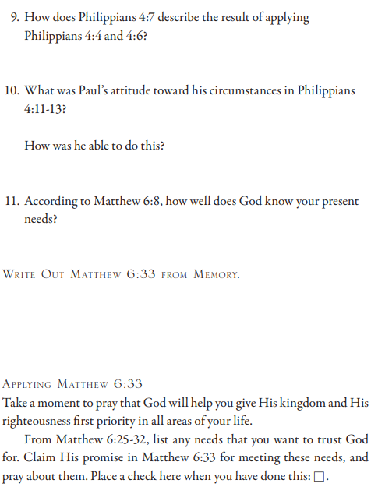
Philippians 4:4 Rejoice in the Lord always; again I will say, rejoice! 5 Let your considerate spirit be known to all men. The Lord is near. 6 Be anxious for nothing, but in everything by prayer and petition with thanksgiving let your requests be made known to God. 7 And the peace of God, which surpasses all comprehension, will guard your hearts and your minds in Christ Jesus… 11 Not that I speak from want, for I learned to be content in whatever circumstances I am. 12 I know how to get along with humble means, and I also know how to live in abundance; in any and all things I have learned the secret of being filled and going hungry, both of having abundance and suffering need. 13 I can do all things through Him who strengthens me. Matthew 6:8 Therefore, do not be like them; for your Father knows what you need before you ask Him.

