Slide 1
WORSHIP IN SONG
My Hope is Built on Nothing Less https://www.youtube.com/watch?v=Ty8tw7ydxB4 John 4:24 God is spirit, and those who worship Him must worship in spirit and truth.”
Colossians 3:16 Let the word of Christ dwell in you richly, with all wisdom teaching and admonishing one another with psalms and hymns and spiritual songs, singing with gratefulness in your hearts to God.
Ephesians 5:19 [speak] to one another in psalms and hymns and spiritual songs, singing and making melody with your heart to the Lord; 20 always giving thanks for all things in the name of our Lord Jesus Christ to God, even the Father.

Slide 2
The Spirit-Filled Christian
Design for Discipleship – Book 2

Slide 6
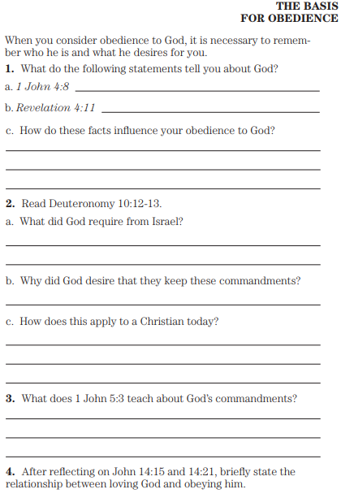
1 John 4:8 The one who does not love does not know God, because God is love.
Revelation 4:11 “Worthy are You, our Lord and our God, to receive glory and honor and power, for You created all things, and because of Your will they existed, and were created.”
Deuteronomy 10:12 “So now, Israel, what does Yahweh your God ask from you, but to fear Yahweh your God, to walk in all His ways and love Him, and to serve Yahweh your God with all your heart and with all your soul, 13 and to keep the commandments of Yahweh and His statutes which I am commanding you today for your good?
1 John 5:3 For this is the love of God, that we keep His commandments; and His commandments are not burdensome.
John 14:15 “If you love Me, you will keep My commandments.
…21 He who has My commandments and keeps them is the one who loves Me; and he who loves Me will be loved by My Father, and I will love him and will disclose Myself to him.”

Slide 7
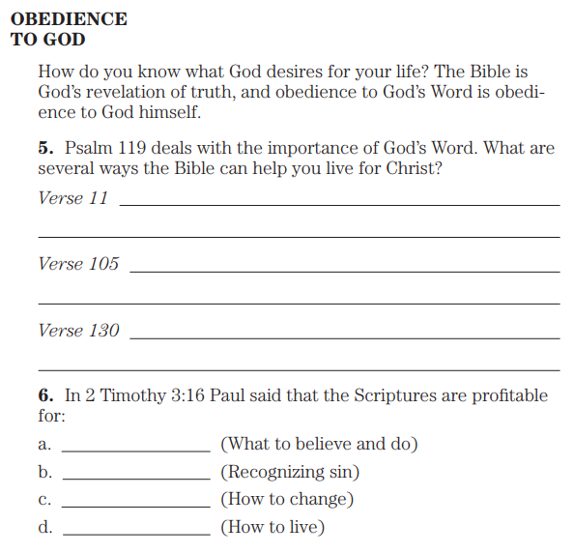
Psalm 119:11 Your word I have treasured in my heart,
That I may not sin against You.
…105 Your word is a lamp to my feet
And a light to my path.
…130 The unfolding of Your words gives light;
It gives understanding to the simple.
2 Timothy 3:16 All Scripture is God-breathed and profitable for teaching, for reproof, for correction, for training in righteousness

Slide 8
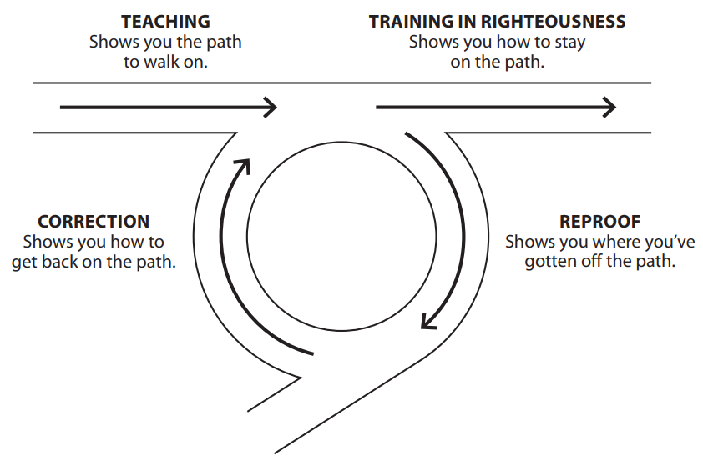
2 Timothy 3:16 All Scripture is God-breathed and profitable for teaching, for reproof, for correction, for training in righteousness

Slide 9
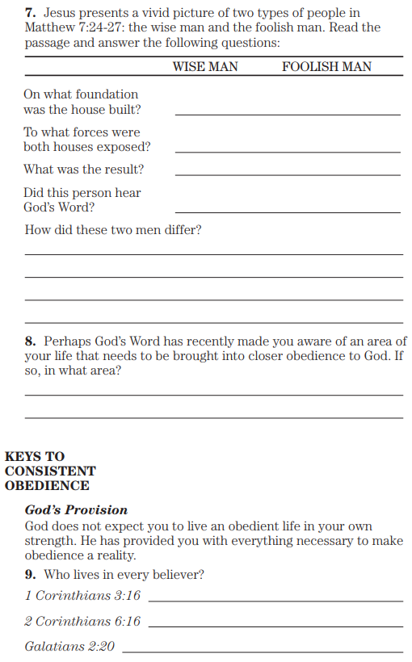
Matthew 7:24 “Therefore everyone who hears these words of Mine and does them, may be compared to a wise man who built his house on the rock. 25 And the rain descended, and the rivers came, and the winds blew and fell against that house; and yet it did not fall, for it had been founded on the rock. 26 And everyone hearing these words of Mine and not doing them, may be compared to a foolish man who built his house on the sand. 27 And the rain descended, and the rivers came, and the winds blew and slammed against that house; and it fell—and great was its fall.”
1 Corinthians 3:16 Do you not know that you are a sanctuary of God and that the Spirit of God dwells in you?
2 Corinthians 6:16 Or what agreement has a sanctuary of God with idols? For we are a sanctuary of the living God; just as God said, “I will dwell in them and walk among them; And I will be their God, and they shall be My people.
Galatians 2:20 I have been crucified with Christ, and it is no longer I who live, but Christ lives in me. And the life which I now live in the flesh I live by faith in the Son of God, who loved me and gave Himself up for me.

Slide 10
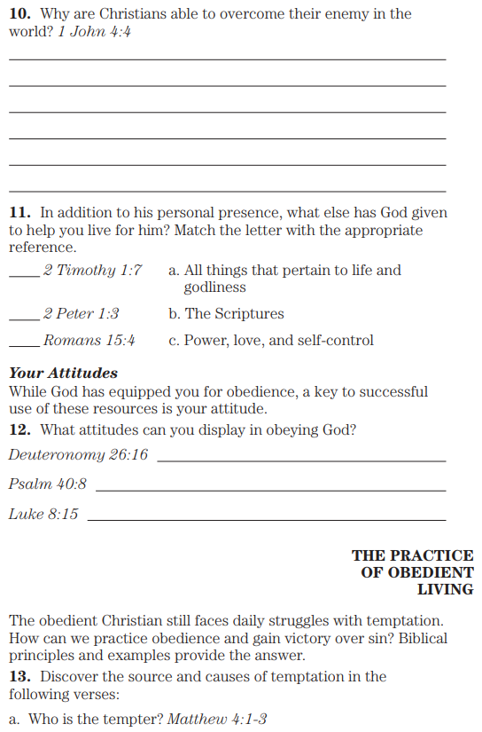
1 John 4:4 You are from God, little children, and have overcome them; because greater is He who is in you than he who is in the world.
2 Timothy 1:7 For God has not given us a spirit of timidity, but of power and love and self-discipline.
2 Peter 1:3 seeing that His divine power has granted to us everything pertaining to life and godliness, through the full knowledge of Him who called us by His own glory and excellence.
Romans 15:4 For whatever was written in earlier times was written for our instruction, so that through the perseverance and the encouragement of the Scriptures we might have hope.
Deuteronomy 26:16 “This day Yahweh your God commands you to do these statutes and judgments. You shall therefore be careful to do them with all your heart and with all your soul.
Psalm 40:8 I desire to do Your will, O my God; Your law is within my inner being.”
Luke 8:15 But the seed in the good soil, these are the ones who have heard the word in an honest and good heart, and hold it fast, and bear fruit with perseverance.
Matthew 4:1 Then Jesus was led up by the Spirit into the wilderness to be tempted by the devil. 2 And after He had fasted forty days and forty nights, He then became hungry. 3 And the tempter came and said to Him, “If You are the Son of God, command that these stones become bread.”

Slide 11
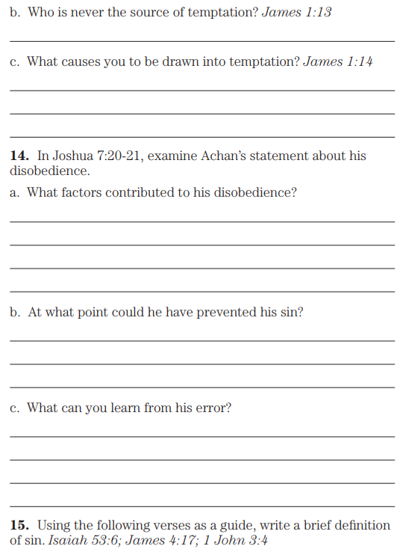
James 1:13 Let no one say when he is tempted, “I am being tempted by God”; for God cannot be tempted by evil, and He Himself does not tempt anyone. 14 But each one is tempted when he is carried away and enticed by his own lust.
Joshua 7:20 So Achan answered Joshua and said, “Truly, I have sinned against Yahweh, the God of Israel, and this is what I did: 21 I saw among the spoil a beautiful mantle from Shinar and two hundred shekels of silver and a bar of gold fifty shekels in weight; then I coveted them and took them; and behold, they are concealed in the earth inside my tent with the silver underneath it.”
Isaiah 53:6 All of us like sheep have gone astray, Each of us has turned to his own way; But Yahweh has caused the iniquity of us all To fall on Him.
James 4:17 Therefore, to one who knows to do the right thing and does not do it, to him it is sin.
1 John 3:4 Everyone who does sin also does lawlessness; and sin is lawlessness.

Slide 12
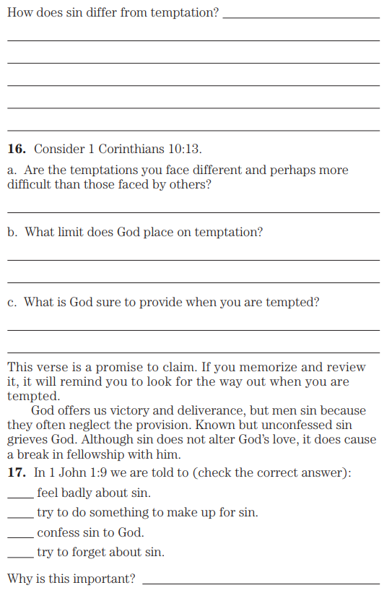
1 Corinthians 10:13 No temptation has overtaken you but such as is common to man, but God is faithful, who will not allow you to be tempted beyond what you are able, but with the temptation will provide the way of escape also, so that you will be able to endure it.
1 John 1:9 If we confess our sins, He is faithful and righteous to forgive us our sins and to cleanse us from all unrighteousness.

Slide 13
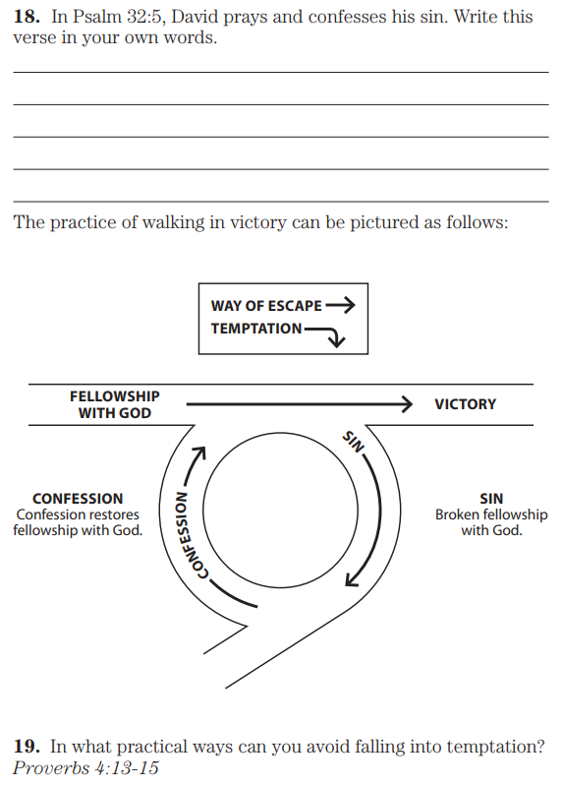
Psalm 32:5 I acknowledged my sin to You, And my iniquity I did not cover up; I said, “I will confess my transgressions to Yahweh;” And You forgave the iniquity of my sin. Selah.
Proverbs 4:13 Seize discipline; do not let go. Guard her, for she is your life.
14 Do not enter the path of wicked men And do not step into the way of evil men.15 Avoid it, do not pass by it;
Stray from it and pass on.

Slide 14
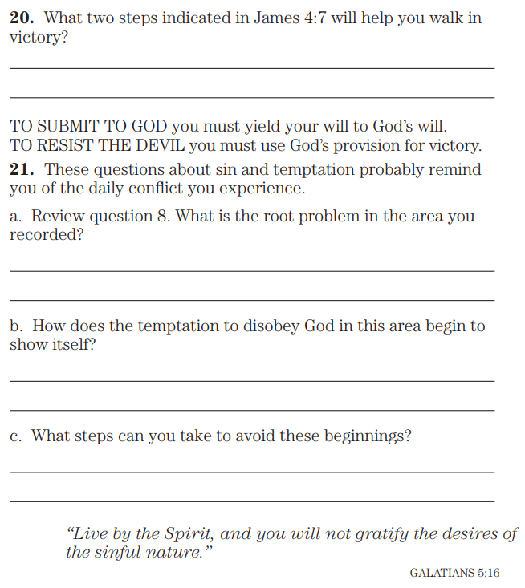
James 4:7 Be subject therefore to God. Resist the devil and he will flee from you.

