Slide 1
WORSHIP IN SONG
Whate’er My God Ordains is Right Whate’er My God Ordains is Right John 4:24 God is spirit, and those who worship Him must worship in spirit and truth.”
Colossians 3:16 Let the word of Christ dwell in you richly, with all wisdom teaching and admonishing one another with psalms and hymns and spiritual songs, singing with gratefulness in your hearts to God.
Ephesians 5:19 [speak] to one another in psalms and hymns and spiritual songs, singing and making melody with your heart to the Lord; 20 always giving thanks for all things in the name of our Lord Jesus Christ to God, even the Father.

Slide 2
The Spirit-Filled Christian
Design for Discipleship – Book 2

Slide 4
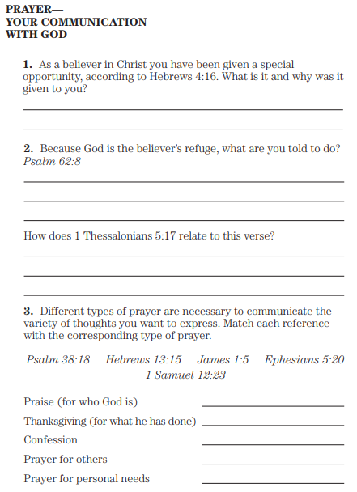
Hebrews 4:16 Therefore let us draw near with confidence to the throne of grace, so that we may receive mercy and find grace to help in time of need.
Psalm 62:8 Trust in Him at all times, O people; Pour out your heart before Him; God is a refuge for us. Selah.
1 Thessalonians 5:17 pray without ceasing;
Psalm 38:18 For I confess my iniquity; I am full of anxiety because of my sin.
Hebrews 13:15 Through Him then, let us continually offer up a sacrifice of praise to God, that is, the fruit of lips that confess His name.
James 1:5 But if any of you lacks wisdom, let him ask of God, who gives to all generously and without reproach, and it will be given to him.
Ephesians 5:20 always giving thanks for all things in the name of our Lord Jesus Christ to God, even the Father;
1 Samuel 12:23 Moreover, as for me, far be it from me that I should sin against Yahweh by ceasing to pray for you; but I will instruct you in the good and upright way.

Slide 5
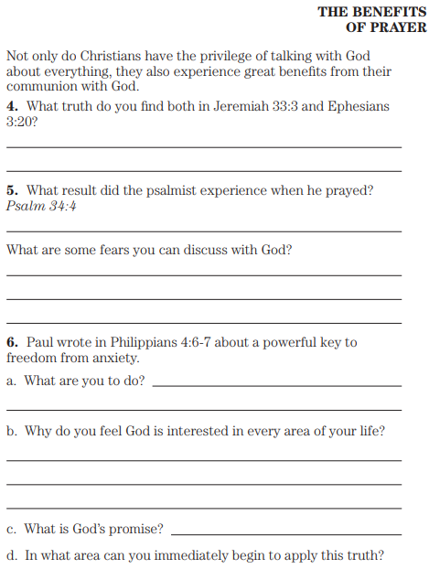
Ephesians 3:20 Now to Him who is able to do far more abundantly beyond all that we ask or understand, according to the power that works within us
Psalm 34:4 I inquired of Yahweh, and He answered me, and delivered me from all that I dread.
Philippians 4:6 Be anxious for nothing, but in everything by prayer and petition with thanksgiving let your requests be made known to God. 7 And the peace of God, which surpasses all comprehension, will guard your hearts and your minds in Christ Jesus.

Slide 6
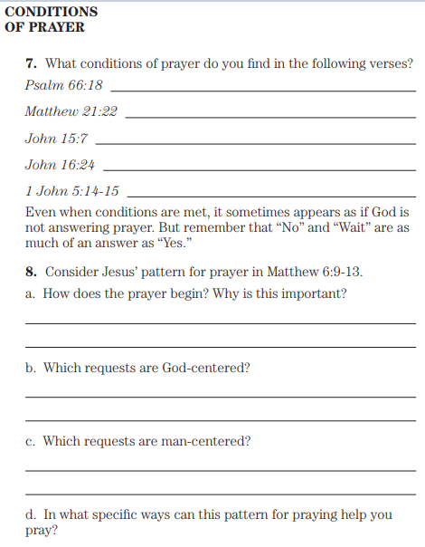
Psalm 66:18 If I see wickedness in my heart, the Lord will not hear
Matthew 21:22 And all things you ask in prayer, believing, you will receive.”
John 15:7 If you abide in Me, and My words abide in you, ask whatever you wish, and it will be done for you.
John 16:24 Until now you have asked for nothing in My name; ask and you will receive, so that your joy may be made complete.
1 John 5:14 And this is the confidence which we have before Him, that, if we ask anything according to His will, He hears us. 15 And if we know that He hears us in whatever we ask, we know that we have the requests which we have asked from Him.
Matthew 6:9 “Pray, then, in this way: ‘Our Father who is in heaven, Hallowed be Your name. 10 Your kingdom come. Your will be done, On earth as it is in heaven. 11 Give us this day our daily bread. 12 And forgive us our debts, as we also have forgiven our debtors. 13 And do not lead us into temptation, but deliver us from the evil one. [For Yours is the kingdom and the power and the glory forever. Amen.’]

Slide 7
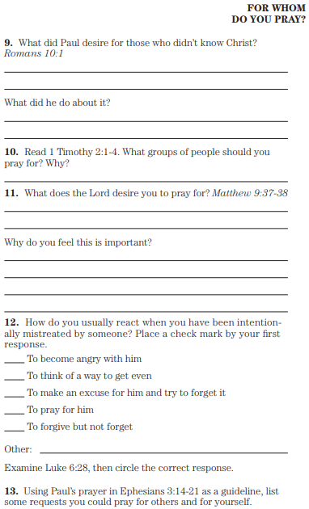
Romans 10:1 Brothers, my heart’s desire and my prayer to God for them is for their salvation.
1 Timothy 2:1 First of all, then, I exhort that petitions and prayers, requests and thanksgivings, be made for all men, 2 for kings and all who are in authority, so that we may lead a tranquil and quiet life in all godliness and dignity. 3 This is good and acceptable in the sight of God our Savior, 4 who desires all men to be saved and to come to the full knowledge of the truth.
Matthew 9:37 Then He *said to His disciples, “The harvest is plentiful, but the workers are few. 38 Therefore pray earnestly to the Lord of the harvest to send out workers into His harvest.”
Luke 6:28 bless those who curse you, pray for those who disparage you.
Ephesians 3:14 For this reason I bow my knees before the Father, 15 from whom every family in heaven and on earth is named, 16 that He would give you, according to the riches of His glory, to be strengthened with power through His Spirit in the inner man, 17 so that Christ may dwell in your hearts through faith; and that you, being firmly rooted and grounded in love, 18 may be able to comprehend with all the saints what is the breadth and length and height and depth, 19 and to know the love of Christ which surpasses knowledge, that you may be filled up to all the fullness of God. 20 Now to Him who is able to do far more abundantly beyond all that we ask or understand, according to the power that works within us, 21 to Him be the glory in the church and in Christ Jesus to all generations forever and ever. Amen.

Slide 8
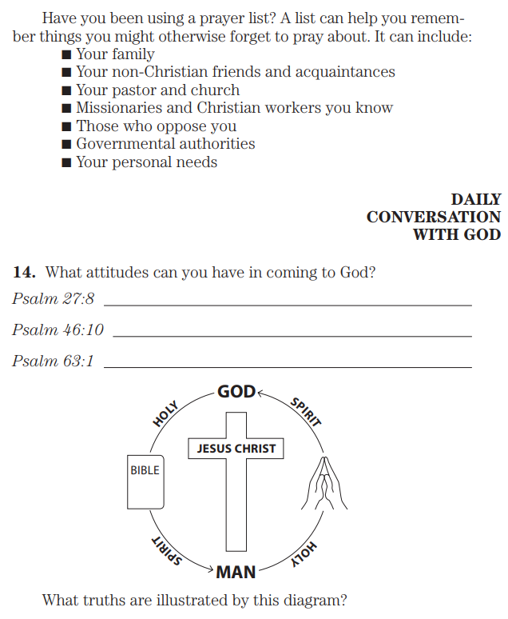
Psalm 27:On Your behalf my heart says, “Seek My face,”
“Your face, O Yahweh, I shall seek.”
Psalm 46:10 “Cease striving and know that I am God;
I will be exalted among the nations, I will be exalted in the earth.”
Psalm 63:1 O God, You are my God; I shall seek You earnestly; My soul thirsts for You, my flesh yearns for You, In a dry and weary land without water.

Slide 9
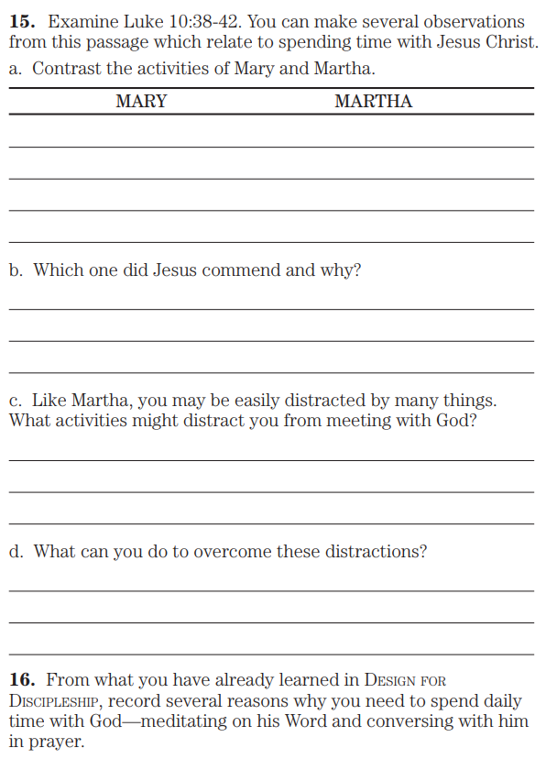
Luke 10:38 Now as they were traveling along, He entered a village; and a woman named Martha welcomed Him into her home. 39 And she had a sister called Mary, who was also seated at the Lord’s feet, listening to His word. 40 But Martha was distracted with all her preparations; and she came up to Him and said, “Lord, do You not care that my sister has left me to do all the preparations alone? Then tell her to help me.” 41 But the Lord answered and said to her, “Martha, Martha, you are worried and bothered about so many things, 42 but only one thing is necessary, for Mary has chosen the good part, which shall not be taken away from her.”

