Slide 2
Joy to the World https://www.youtube.com/watch?v=kyciMYZq2-Y John 4:24 God is spirit, and those who worship Him must worship in spirit and truth.” Colossians 3:16 Let the word of Christ dwell in you richly, with all wisdom teaching and admonishing one another with psalms and hymns and spiritual songs, singing with gratefulness in your hearts to God. Ephesians 5:19 [speak] to one another in psalms and hymns and spiritual songs, singing and making melody with your heart to the Lord; 20 always giving thanks for all things in the name of our Lord Jesus Christ to God, even the Father.

Slide 3
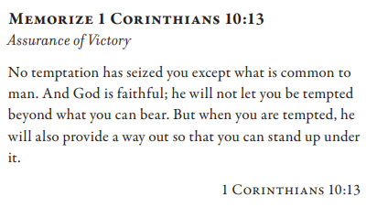
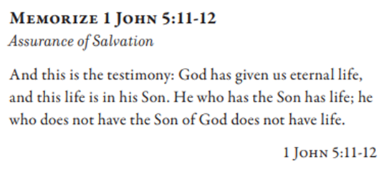
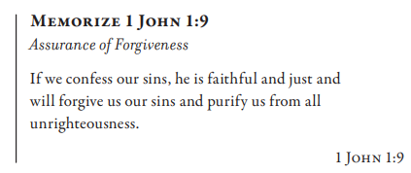
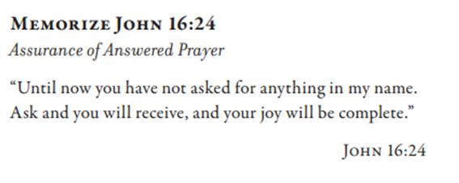

Slide 4
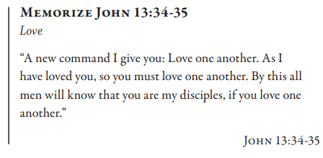
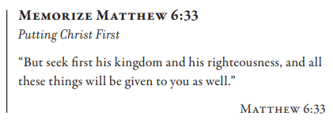
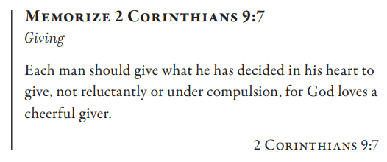
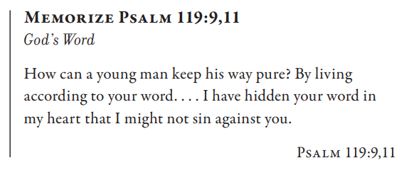
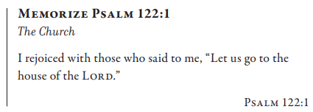

Slide 6
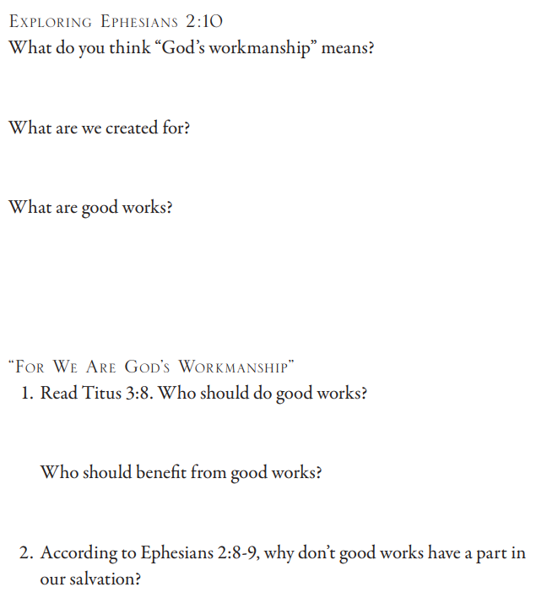
Ephesians 2:10 For we are His workmanship, created in Christ Jesus for good works, which God prepared beforehand so that we would walk in them. Titus 3:8 This is a trustworthy saying. And concerning these things I want you to speak confidently, so that those who have believed God will be intent to lead in good works. These things are good and profitable for men. Ephesians 2:8 For by grace you have been saved through faith, and this not of yourselves, it is the gift of God; 9 not of works, so that no one may boast.

Slide 7
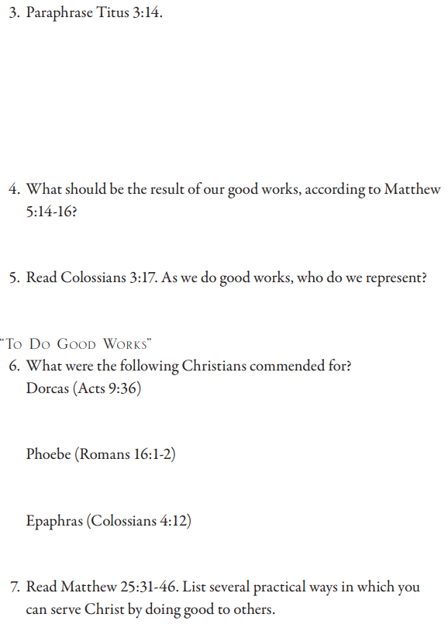
Titus 3:14 And our people must also learn to lead in good works to meet pressing needs, so that they will not be unfruitful. Matthew 5:14 “You are the light of the world. A city set on a hill cannot be hidden; 15 nor does anyone light a lamp and put it under a basket, but on the lampstand, and it gives light to all who are in the house. 16 Let your light shine before men in such a way that they may see your good works, and glorify your Father who is in heaven. Colossians 3:17 And whatever you do in word or deed, do all in the name of the Lord Jesus, giving thanks to God the Father through Him. Acts 9:36 Now in Joppa there was a disciple named Tabitha (which translated is called Dorcas). This woman was full of good works and charity which she continually did. Romans 16: 1 Now I commend to you our sister Phoebe, who is a servant of the church which is at Cenchrea; 2 that you receive her in the Lord in a manner worthy of the saints, and that you help her in whatever matter she may have need of you; for she herself has also been a benefactor of many, and of myself as well. Colossianas 4:12 Epaphras, who is one of your number, a slave of Christ Jesus, sends you his greetings, always striving for you in his prayers, that you may stand complete and fully assured in all the will of God.

Slide 8
Matthew 25:31 “But when the Son of Man comes in His glory, and all the angels with Him, then He will sit on His glorious throne. 32 And all the nations will be gathered before Him; and He will separate them from one another, as the shepherd separates the sheep from the goats; 33 and He will put the sheep on His right, and the goats on the left. 34 “Then the King will say to those on His right, ‘Come, you who are blessed of My Father, inherit the kingdom, which has been prepared for you from the foundation of the world. 35 For I was hungry, and you gave Me something to eat; I was thirsty, and you gave Me something to drink; I was a stranger, and you invited Me in; 36 naked, and you clothed Me; I was sick, and you visited Me; I was in prison, and you came to Me.’ 37 Then the righteous will answer Him, saying, ‘Lord, when did we see You hungry, and feed You, or thirsty, and give You something to drink? 38 And when did we see You a stranger, and invite You in, or naked, and clothe You? 39 And when did we see You sick, or in prison, and come to You?’ 40 And the King will answer and say to them, ‘Truly I say to you, to the extent that you did it to one of these brothers of Mine, even the least of them, you did it to Me.’ 41 “Then He will also say to those on His left, ‘Depart from Me, accursed ones, into the eternal fire which has been prepared for the devil and his angels; 42 for I was hungry, and you gave Me nothing to eat; I was thirsty, and you gave Me nothing to drink; 43 I was a stranger, and you did not invite Me in; naked, and you did not clothe Me; sick, and in prison, and you did not visit Me.’ 44 Then they themselves also will answer, saying, ‘Lord, when did we see You hungry, or thirsty, or a stranger, or naked, or sick, or in prison, and did not take care of You?’ 45 Then He will answer them, saying, ‘Truly I say to you, to the extent that you did not do it to one of the least of these, you did not do it to Me.’ 46 And these will go away into eternal punishment, but the righteous into eternal life.”

Slide 9
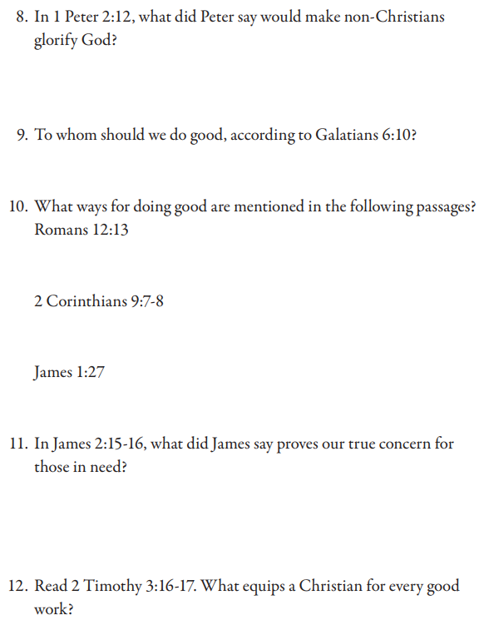
1 Peter 2:12 by keeping your conduct excellent among the Gentiles, so that in the thing which they slander you as evildoers, they may because of your good works, as they observe them, glorify God in the day of visitation.
Galatians 6:10 So then, while we have opportunity, let us do good to all people, and especially to those who are of the household of the faith.
Romans 12:13 contributing to the needs of the saints, pursuing hospitality.
2 Corinthians 9:7 Each one must do just as he has purposed in his heart, not grudgingly or under compulsion, for God loves a cheerful giver. 8 And God is able to make every grace abound to you, so that in everything at every time having every sufficiency, you may have an abundance for every good deed;
James 1:27 Pure and undefiled religion before our God and Father is this: to visit orphans and widows in their affliction, and to keep oneself unstained by the world.
James 2:15 If a brother or sister is without clothing and in need of daily food, 16 and one of you says to them, “Go in peace, be warmed and be filled,” and yet you do not give them what is necessary for their body, what use is that?
2 Timothy 3:6 All Scripture is God-breathed and profitable for teaching, for reproof, for correction, for training in righteousness, 17 so that the man of God may be equipped, having been thoroughly equipped for every good work.

