Slide 1
WORSHIP IN SONG
All Glory be to Christ https://youtu.be/I6P2R9aTAPI?si=mnq8LFAXqmLj-HQR
John 4:24 God is spirit, and those who worship Him must worship in spirit and truth.”
Colossians 3:16 Let the word of Christ dwell in you richly, with all wisdom teaching and admonishing one another with psalms and hymns and spiritual songs, singing with gratefulness in your hearts to God.
Ephesians 5:19 [speak] to one another in psalms and hymns and spiritual songs, singing and making melody with your heart to the Lord; 20 always giving thanks for all things in the name of our Lord Jesus Christ to God, even the Father.

Slide 2
Your life in christ
Design for Discipleship – Book 1

Slide 4
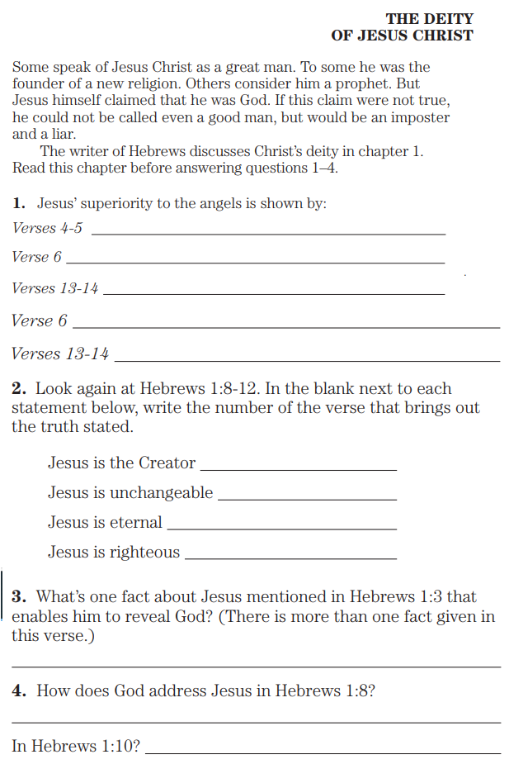
Hebrews 1:1 God, having spoken long ago to the fathers in the prophets in many portions and in many ways, 2 in these last days spoke to us in His Son, whom He appointed heir of all things, through whom also He made the worlds, 3 who is the radiance of His glory and the exact representation of His nature, and upholds all things by the word of His power; who, having accomplished cleansing for sins, sat down at the right hand of the Majesty on high, 4 having become so much better than the angels, as He has inherited a more excellent name than they. 5 For to which of the angels did He ever say, “You are My Son, Today I have begotten You”? And again, “I will be a Father to Him And He shall be a Son to Me”? 6 And when He again brings the firstborn into the world, He says, “And let all the angels of God worship Him.” 7 And of the angels He says, “Who makes His angels winds, And His ministers flaming fire.” 8 But of the Son He says, “Your throne, O God, is forever and ever, And the scepter of uprightness is the scepter of Your kingdom. 9 You have loved righteousness and hated lawlessness; Therefore God, Your God, has anointed You With the oil of gladness above Your companions.” 10 And, “You, Lord, in the beginning founded the earth, And the heavens are the works of Your hands; 11 They will perish, but You remain; And they all will wear out like a garment, 12 And like a mantle You will roll them up; Like a garment they will also be changed. But You are the same, And Your years will not come to an end.” 13 But to which of the angels has He ever said, “Sit at My right hand, Until I put Your enemies As a footstool for Your feet”? 14 Are they not all ministering spirits, sent to render service for the sake of those who will inherit salvation?

Slide 5
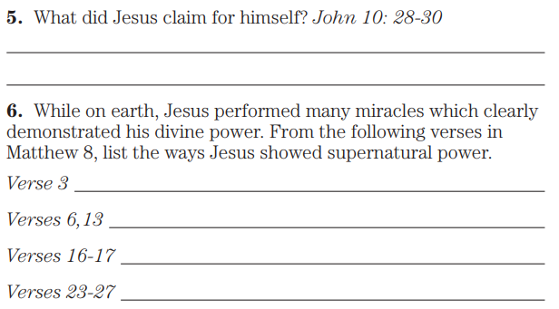
John 10:28 and I give eternal life to them, and they will never perish—ever; and no one will snatch them out of My hand. 29 My Father, who has given them to Me, is greater than all; and no one is able to snatch them out of the Father’s hand. 30 I and the Father are one.”
Matthew 8:3 And Jesus stretched out His hand and touched him, saying, “I am willing; be cleansed.” And immediately his leprosy was cleansed.
…6 and saying, “Lord, my servant is lying paralyzed at home, fearfully tormented.”
…13 And Jesus said to the centurion, “Go; it shall be done for you as you have believed.” And the servant was healed that very moment.
…16 Now when evening came, they brought to Him many who were demon-possessed; and He cast out the spirits with a word, and healed all who were ill 17 in order to fulfill what was spoken through Isaiah the prophet, saying, “He Himself took our infirmities and carried away our diseases.”
…23 And when He got into the boat, His disciples followed Him. 24 And behold, there arose a great storm on the sea, so that the boat was being covered with the waves; but Jesus Himself was sleeping. 25 And they came to Him and got Him up, saying, “Save us, Lord; we are perishing!” 26 And He *said to them, “Why are you so cowardly, you men of little faith?” Then He got up and rebuked the winds and the sea, and it became perfectly calm. 27 And the men marveled, and said, “What kind of a man is this, that even the winds and the sea obey Him?”

Slide 6
John 11:39 Jesus *said, “Remove the stone.” Martha, the sister of the deceased, *said to Him, “Lord, by this time he smells, for he has been dead four days.” 40 Jesus *said to her, “Did I not say to you that if you believe, you will see the glory of God?” 41 So they removed the stone. Then Jesus raised His eyes, and said, “Father, I thank You that You have heard Me. 42 And I knew that You always hear Me; but because of the crowd standing around I said this, so that they may believe that You sent Me.” 43 And when He had said these things, He cried out with a loud voice, “Lazarus, come forth.” 44 The man who had died came forth, bound hand and foot with wrappings, and his face was wrapped around with a cloth. Jesus *said to them, “Unbind him, and let him go.”
Matthew 16:13 Now when Jesus came into the district of Caesarea Philippi, He was asking His disciples, saying, “Who do people say that the Son of Man is?” 14 And they said, “Some say John the Baptist; and others, Elijah; but still others, Jeremiah, or one of the prophets.” 15 He *said to them, “But who do you say that I am?” 16 And Simon Peter answered and said, “You are the Christ, the Son of the living God.”

Slide 7
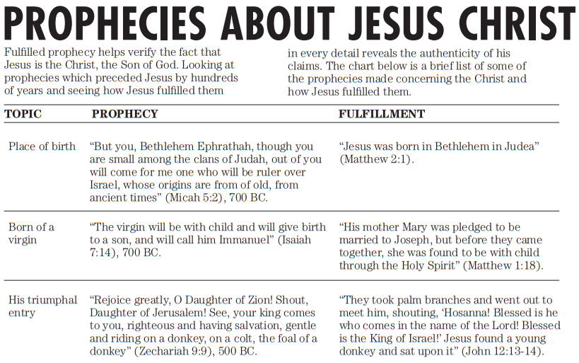

Slide 8
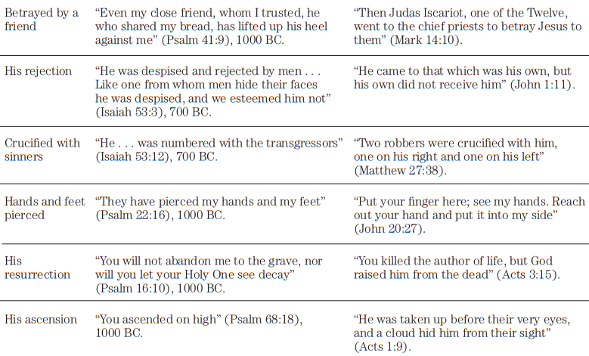

Slide 9
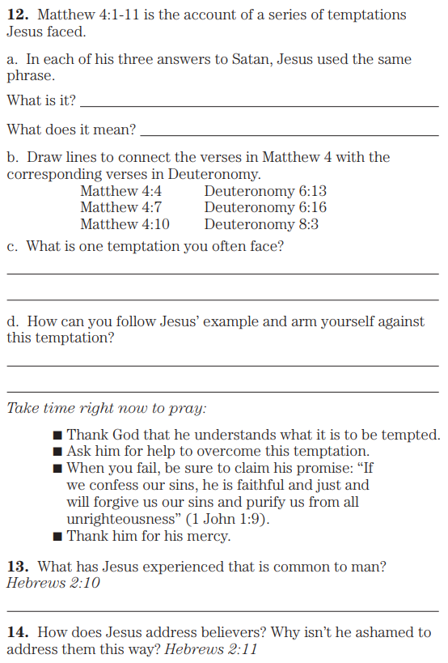
Matthew 4:1Then Jesus was led up by the Spirit into the wilderness to be tempted by the devil. 2 And after He had fasted forty days and forty nights, He then became hungry. 3 And the tempter came and said to Him, “If You are the Son of God, command that these stones become bread.” 4 But He answered and said, “It is written, ‘Man shall not live on bread alone, but on every word that proceeds out of the mouth of God.’” 5 Then the devil *took Him into the holy city and had Him stand on the pinnacle of the temple, 6 and *said to Him, “If You are the Son of God, throw Yourself down; for it is written, ‘He will command His angels concerning You’; and ‘On their hands they will bear You up, Lest You strike Your foot against a stone.’” 7 Jesus said to him, “Again, it is written, ‘You shall not put the Lord your God to the test.’” 8 Again, the devil *took Him to a very high mountain and *showed Him all the kingdoms of the world and their glory; 9 and he said to Him, “All these things I will give You, if You fall down and worship me.” 10 Then Jesus *said to him, “Go, Satan! For it is written, ‘You shall worship the Lord your God, and serve Him only.’” 11 Then the devil *left Him; and behold, angels came and began to minister to Him.
Deuteronomy 6:13 Yahweh your God you shall fear; and Him you shall serve; and by His name you shall swear. …16 “You shall not put Yahweh your God to the test, as you tested Him at Massah.
Deuteronomy 8:3 And He humbled you and let you be hungry and fed you with manna which you did not know, nor did your fathers know, that He might make you know that man does not live by bread alone, but by everything that proceeds out of the mouth of Yahweh.
Hebrews 2:10 For it was fitting for Him, for whom are all things, and through whom are all things, in bringing many sons to glory, to perfect the author of their salvation through sufferings. 11 For both He who sanctifies and those who are being sanctified are all of One; for which reason He is not ashamed to call them brothers,

Slide 10
Hebrews 2:14 Therefore, since the children share in flesh and blood, He Himself likewise also partook of the same, that through death He might render powerless him who had the power of death, that is, the devil, 15 and might free those who through fear of death were subject to slavery all their lives.

