Slide 1
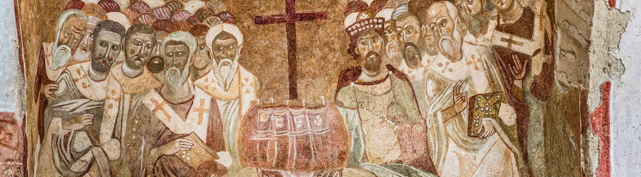
NICENE CREED
AFTER 1700 YEARS

Slide 2
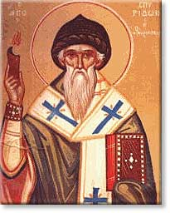
ARIUS
Pre-325
Arius was born in Libya ~250 A.D.
Tall, thin, walked barefoot, winsome personality, musical
Presbyter in Alexandria under his Bishop Alexander
Taught “there was a time when the son was not”

Slide 3
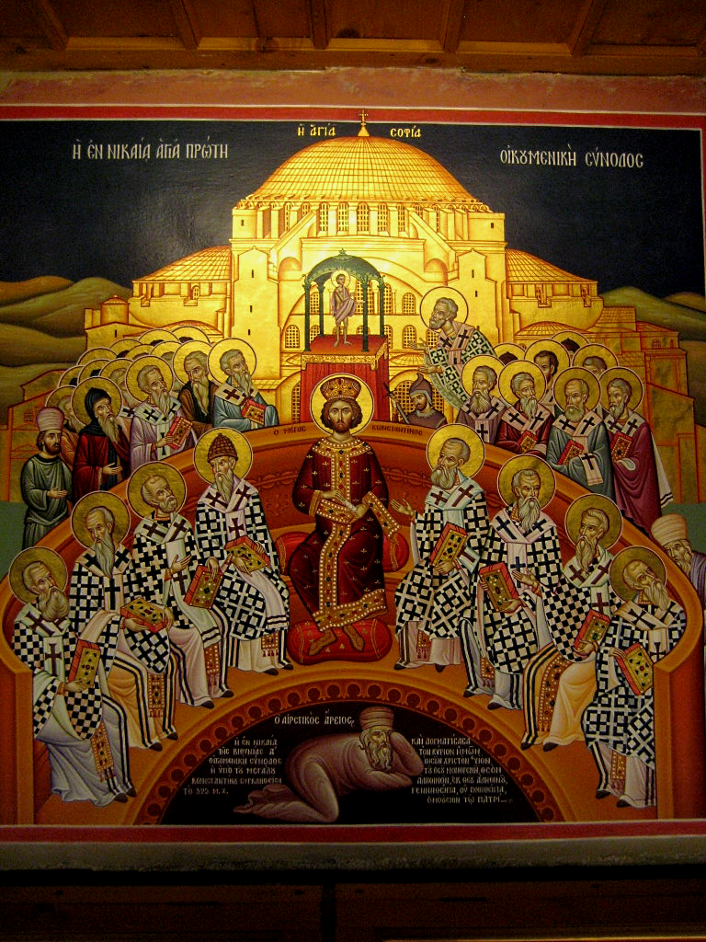
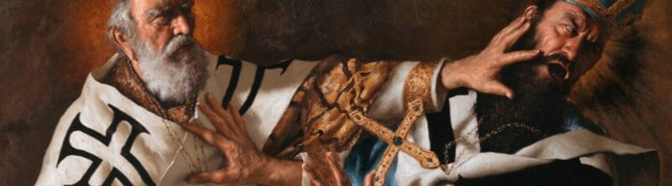
THE COUNCIL OF
NICAEA
In 325 Constantine calls a council at Nicaea
First Ecumenical Council
Deliberations about whether Arius taught falsehood
Athanasius vs
Eusebius & Arius
Arius and his teachings are condemned

Slide 4
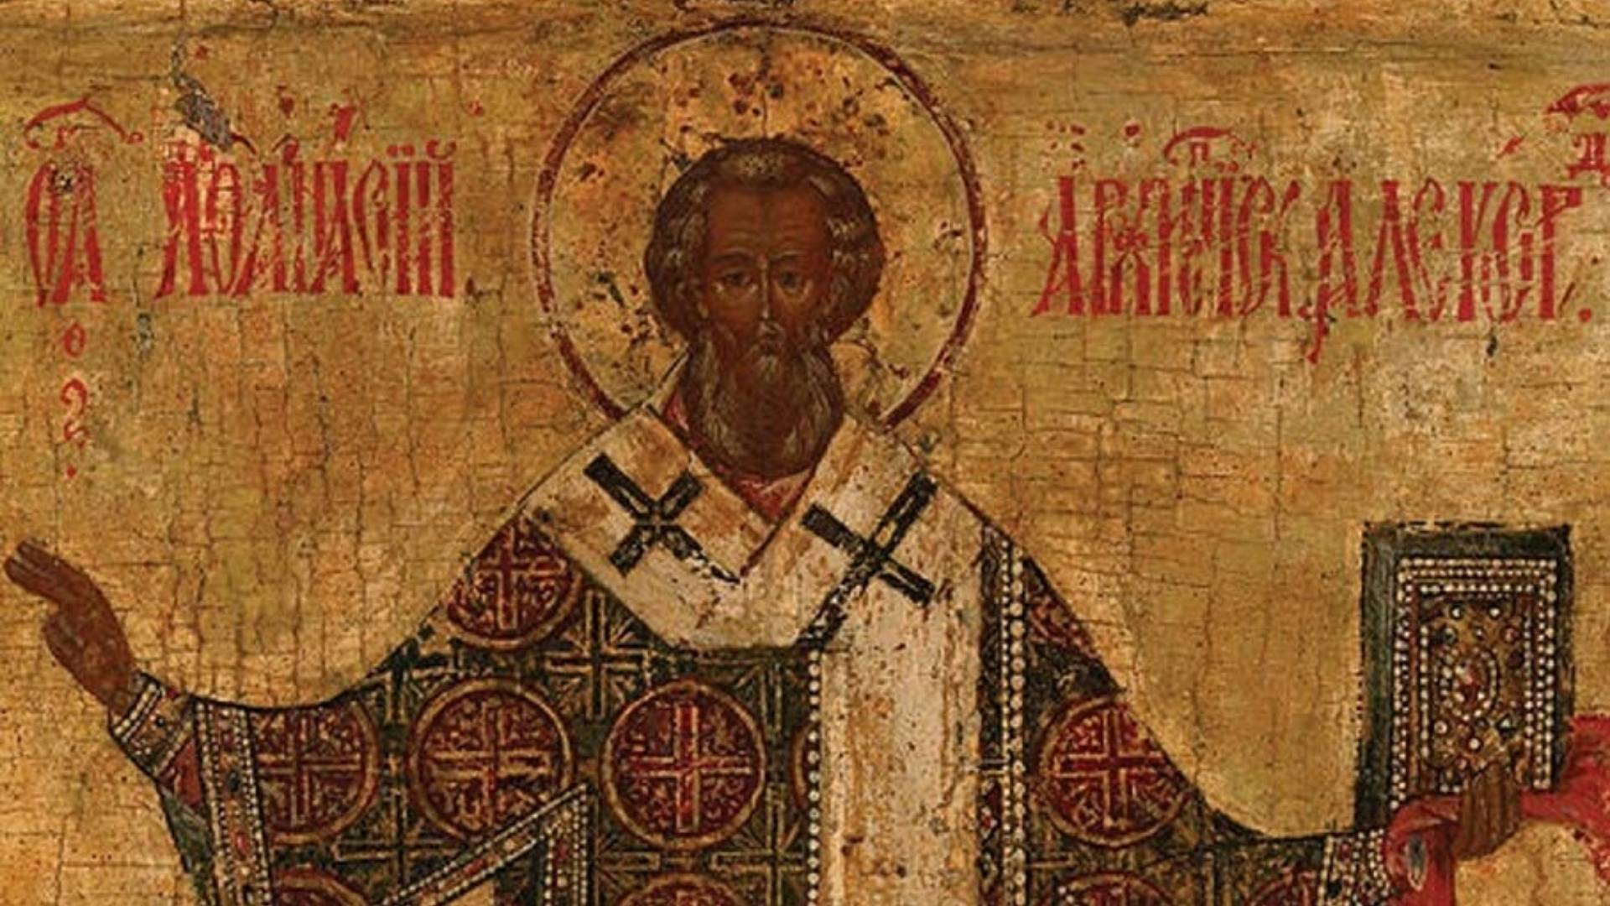
VERDICT
]
The Father and Son are co-equal and co-eternal and…
ARE homoouisious, “of one substance” / essence / being, but
NOT heteroousios “of different substance” / essence / being, &
NOT homoiousios “of similar substance” / essence / being

Slide 5
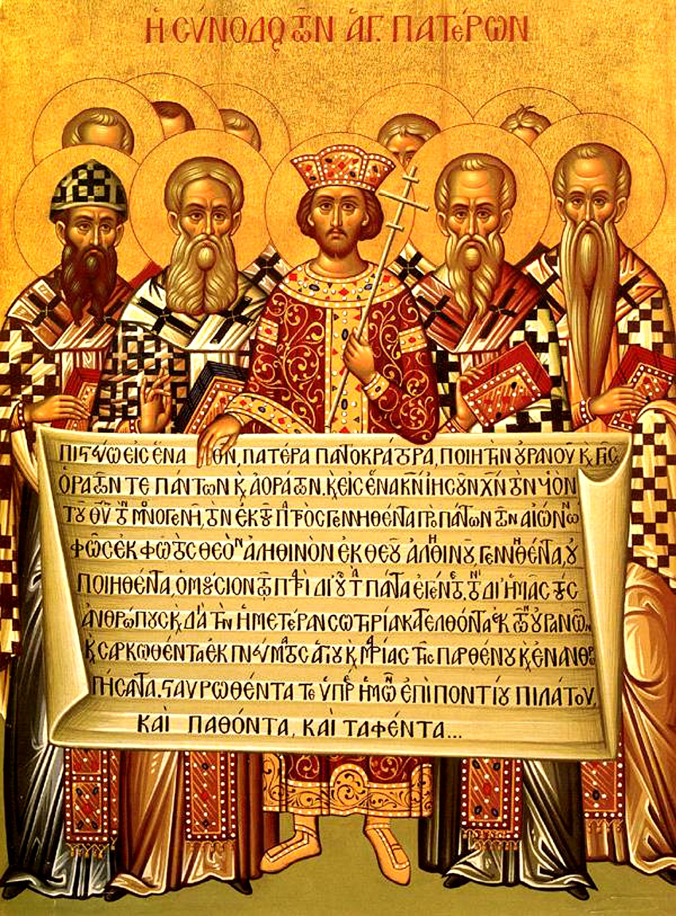
CREED
The overwhelming majority of Bishops condemned Arius as a heretic
Anyone preaching his ideas or possessing his manuscripts may be convicted of a capital crime.
Formulated an official Creed to affirm, against Arian heresy
Important to this day: Cults

Slide 6
THE NICENE CREED
We believe in one God, the Father Almighty,
Maker of all things visible and invisible.
And in one Lord Jesus Christ, the Son of God, begotten
of the Father, the only-begotten; that is, of the essence of the Father, God of God, Light of Light, very God of very God, begotten, not made, consubstantial with the Father;
By whom all things were made;
Who for us men, and for our salvation, came down and was incarnate and was made man;
He suffered, and the third day he rose again, ascended into heaven;
From thence he shall come to judge the quick and the dead.
And in the Holy Ghost.

Slide 7
Structure of the Nicene Creed (325)
01
02
03
WE BELIEVE IN THE FATHER (MAKER)
AND IN ONE LORD JESUS CHRIST (BEGOTTEN NOT MADE / CONSUBSTANTIAL)
I JESUS IS MAKER
II JESUS BECAME INCARNATE
III JESUS’S PASSION
IV JESUS WILL COME AGAIN
AND IN THE HOLY SPIRIT

Slide 8
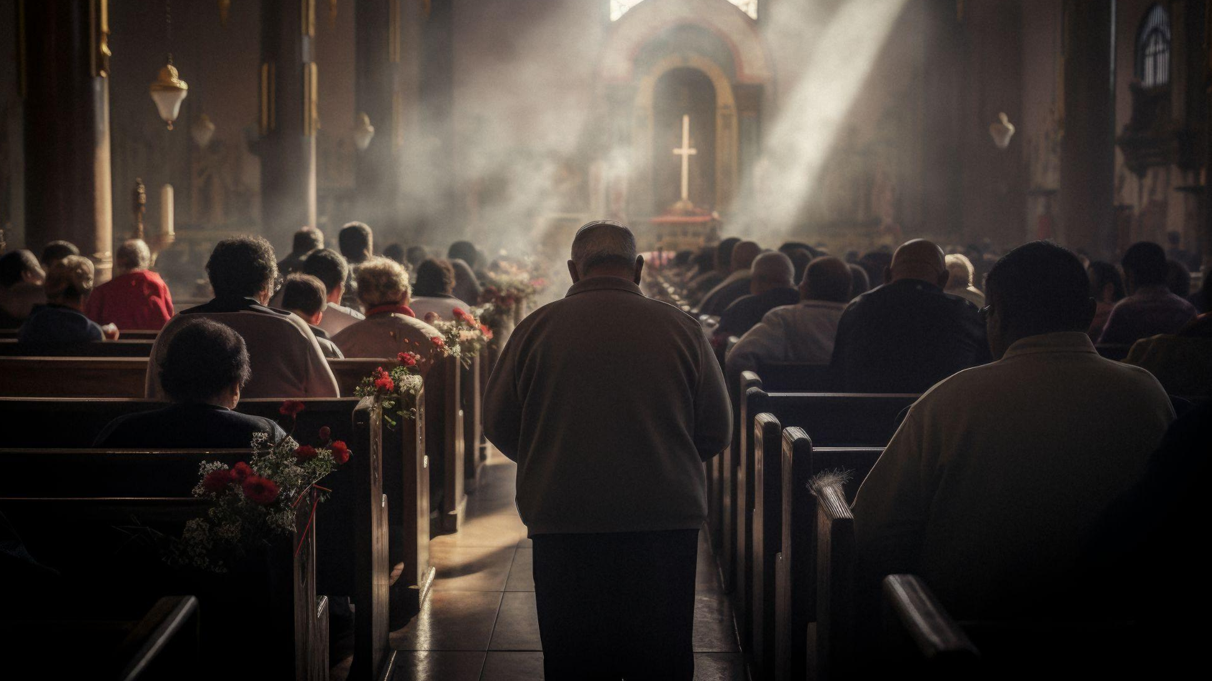
01
WE BELIEVE IN THE FATHER

Slide 9
THE NICENE CREED
1 We believe in one God, the Father Almighty,
Maker of all things visible and invisible.

Slide 10
In one God…
1 Corinthians 8:6 yet for us there is one God, the Father, from whom are all things and we exist for Him, and one Lord, Jesus Christ, by whom are all things, and we exist through Him.
Deuteronomy 6:4 “Hear, O Israel! Yahweh is our God, Yahweh is one!
Mark 12:28 And when one of the scribes came and heard them arguing, he recognized that He had answered them well and asked Him, “What commandment is the foremost of all?” 29 Jesus answered, “The foremost is, ‘Hear, O Israel! The Lord our God is one Lord;

Slide 11
…The Father Almighty
1 Corinthians 8:6 yet for us there is one God, the Father, from whom are all things and we exist for Him, and one Lord, Jesus Christ, by whom are all things, and we exist through Him.
  Ephesians 4:4 There is one body and one Spirit, just as also you were called in one hope of your calling; 5 one Lord, one faith, one baptism; 6 one God and Father of all who is over all and through all and in all.

Slide 12
Maker of all things visible and invisible
1 Corinthians 8:6 yet for us there is one God, the Father, from whom are all things and we exist for Him, and one Lord, Jesus Christ, by whom are all things, and we exist through Him.
Isaiah 42:5 Thus says the God, Yahweh, Who created the heavens and stretched them out, Who spread out the earth and its offspring, Who gives breath to the people on it, and spirit to those who walk in it…
Jeremiah 23:17 ‘Ah Lord Yahweh! Behold, You have made the heavens and the earth by Your great power and by Your outstretched arm! Nothing is too difficult for You…
Ephesians 4:6 one God and Father of all who is over all and through all and in all.

Slide 13
02
AND IN ONE LORD JESUS CHRIST

Slide 14
THE NICENE CREED
2 And in one Lord Jesus Christ,
the Son of God, begotten of the Father [the only-begotten; that is, of the essence of the Father, God of God], Light of Light, very God of very God, begotten, not made, consubstantial with the Father;

Slide 15
…and in One Lord Jesus Christ
1 Corinthians 8:6 yet for us there is one God, the Father, from whom are all things and we exist for Him, and one Lord, Jesus Christ, by whom are all things, and we exist through Him.
Romans 14:9 For to this end Christ died and lived again, that He might be Lord both of the dead and of the living.

Slide 16
the Son of God, begotten of the Father,
Mark 1:1 The beginning of the gospel of Jesus Christ, the Son of God.
Mark 15:39 And when the centurion, who was standing right in front of Him, saw the way He breathed His last, he said, “Truly this man was God’s Son!”
John 1:18 No one has seen God at any time; the only begotten God who is in the bosom of the Father, He has explained Him.
John 3:16 “For God so loved the world, that He gave His only begotten Son, that whoever believes in Him shall not perish, but have eternal life.

Slide 17
[God of God], Light of Light, very God of very God
Hebrews 1:3 [Jesus] who is the radiance of His glory and the exact representation of His (God’s) nature
Luke 2:32 A Light for revelation to the Gentiles, And for the glory of Your people Israel.”
John 1: 4 In Him was life, and the life was the Light of men. 5 And the Light shines in the darkness, and the darkness did not overtake it.
Colossians 1:15 Who is the image of the invisible God…
1:19 For in Him all the fullness of God was pleased to dwell…
Colossians 2:9 For in Him all the fullness of Deity dwells bodily

Slide 18
begotten, not made, consubstantial with the Father
Confessing Jesus is of “the same being” or “one essence” with the Father is to believe Jesus is of equal divinity as the Father.
Jesus is the source of creation, not as a fellow creature, but as the Creator. Confessing Jesus is of “the same being” or “one essence” with the Father is to believe Jesus is of equal divinity as the Father, though they are different “persons”
Because the Father “fathered” Jesus, Jesus was not made or created in such a way that He is a creature as humans and animals are.

Slide 19
begotten, not made, consubstantial with the Father
Isaiah 9:6 For a child will be born to us, a son will be given to us; and the government will rest on His shoulders; and His name will be called Wonderful Counselor, Mighty God, Eternal Father, Prince of Peace.
Isaiah 46:5 “To whom would you liken Me and make Me equal and compare Me, that we would be alike?

Slide 20
begotten, not made, consubstantial with the Father
To whom would you liken Me and make Me equal and compare Me, that we would be alike?
Matthew 11:27 All things have been handed over to Me by My Father; and no one knows the Son except the Father; nor does anyone know the Father except the Son, and anyone to whom the Son wills to reveal Him.
Matthew 28:18 And Jesus came up and spoke to them, saying, “All authority has been given to Me in heaven and on earth.

Slide 21
begotten, not made, consubstantial with the Father
To whom would you liken Me and make Me equal and compare Me, that we would be alike?
John 8:12 Then Jesus again spoke to them, saying, “I am the Light of the world; he who follows Me will never walk in the darkness, but will have the Light of life.” … 9:5 While I am in the world, I am the light of the world.”
John 11:25 Jesus said to her, “I am the resurrection and the life; he who believes in Me will live even if he dies,
John 14:6 Jesus *said to him, “I am the way, and the truth, and the life. No one comes to the Father but through Me.

Slide 22
begotten, not made, consubstantial with the Father
John 1:14 And the Word became flesh, and dwelt among us, and we beheld His glory, glory as of the only begotten from the Father, full of grace and truth. 15 John *bore witness about Him and cried out, saying, “This was He of whom I said, ‘He who comes after me has been ahead of me, for He existed before me.’” 16 For of His fullness we have all received, and grace upon grace. 17 For the Law was given through Moses; grace and truth came through Jesus Christ. 18 No one has seen God at any time; the only begotten God who is in the bosom of the Father, He has explained Him.

Slide 23
begotten, not made, consubstantial with the Father
John 3:16 “For God so loved the world, that He gave His only begotten Son, that whoever believes in Him shall not perish, but have eternal life.
John 10:30 I and the Father are one.”
John 14:9 Jesus *said to him, “Have I been with you all so long and have you not come to know Me, Philip? He who has seen Me has seen the Father; how can you say, ‘Show us the Father’? 10 Do you not believe that I am in the Father, and the Father is in Me? The words that I say to you I do not speak from Myself, but the Father abiding in Me does His works.

Slide 24
begotten, not made, consubstantial with the Father
John 17:22 The glory which You have given Me I have given to them, that they may be one, just as We are one; 23 I in them & You in Me, that they may be perfected in unity, so that the world may know that You sent Me, and loved them, even as You have loved Me. 24 Father, I desire that they also, whom You have given Me, be with Me where I am, so that they may see My glory which You have given Me, for You loved Me before the foundation of the world.

Slide 25
begotten, not made, consubstantial with the Father
1 Corinthians 8:6 yet for us there is one God, the Father, from whom are all things and we exist for Him, and one Lord, Jesus Christ, by whom are all things, and we exist through Him.
Philippians 2:6 who, although existing in the form of God, did not regard equality with God a thing to be grasped
Hebrews 1:2 in these last days spoke to us in His Son, whom He appointed heir of all things, through whom also He made the worlds, 3 who is the radiance of His glory and the exact representation of His nature, and upholds all things by the word of His power; who, having accomplished cleansing for sins, sat down at the right hand of the Majesty on high

Slide 26
begotten, not made, consubstantial with the Father
Colossians 1:15 Who is the image of the invisible God, the firstborn of all creation. 16 For in Him all things were created, both in the heavens and on earth, visible and invisible, whether thrones or dominions or rulers or authorities—all things have been created through Him and for Him.
17 And He is before all things,
And in Him all things hold together.
18 And He is the head of the body, the church;
Who is the beginning, the firstborn from the dead, so that He Himself will come to have first place in everything.
19 For in Him all the fullness of God was pleased to dwell,

Slide 27
By whom all things were made;
This is a direct quote from John 1:3. This statement means that the Son is not a creature. Rather, He is the Creator, the very agent through Whom all created things came into being.
Jesus is the source of creation, not as a fellow creature, but as the Creator.
Jesus was with the Father at the time of Creation and participated in it with the Father

Slide 28
By whom all things were made;
Arius had argued that the Father and the Son were only similar (homoiousis) in their substance
Athanasius maintained that they were the same (homoousis) substance.
Tremendous, prolonged debate and conflict surrounded the accuracy and acceptance of these words, with literally just one iota separating heresy from orthodoxy.

Slide 29
By whom all things were made;
1 Corinthians 8:6 yet for us there is one God, the Father, from whom are all things and we exist for Him, and one Lord, Jesus Christ, by whom are all things, and we exist through Him.
Genesis 1:1 In the beginning God created the heavens and the earth. 2 And the earth was formless and void, and darkness was over the surface of the deep, and the Spirit of God was hovering over the surface of the waters. (cf. John 1)

Slide 30
By whom all things were made;
_{What are “all things” ?}
John 1:In the beginning was the Word, and the Word was with God, and the Word was God. 2 He was in the beginning with God. 3 All things came into being through Him, and apart from Him nothing came into being that has come into being… 10 He was in the world, and the world was made through Him, and the world did not know Him.

Slide 31
By whom all things were made;
_{What are “all things” ?}
Hebrews 1:1 God, having spoken long ago to the fathers in the prophets in many portions and in many ways, 2 in these last days spoke to us in His Son, whom He appointed heir of all things, through whom also He made the worlds… 8 But of the Son He says… 10 … “You, Lord, in the beginning founded the earth, and the heavens are the works of Your hands

Slide 32
By whom all things were made;
_{What are “all things” ?}
Isaiah 40:22 It is He who inhabits above the circle of the earth, and its inhabitants are like grasshoppers; It is He who stretches out the heavens like a curtain and spreads them out like a tent to inhabit. 23 It is He who reduces rulers to nothing, who makes the judges of the earth utterly formless. 24 Scarcely have they been planted; Scarcely have they been sown; Scarcely has their stem taken root in the earth, but He merely blows on them, and they wither, and the storm carries them away like stubble. 25 “To whom then will you liken Me that I would be his equal?” says the Holy One. 26 Lift up your eyes on high and see who has created these stars, the One who leads forth their host by number, He calls them all by name; because of the greatness of His vigor and the strength of His power, not one of them is missing.

Slide 33
By whom all things were made;
_{What are “all things” ?}
Isaiah 44:24 Thus says Yahweh, your Redeemer, and the one who formed you from the womb, “I, Yahweh, am the maker of all things,Stretching out the heavens by Myself and spreading out the earth all alone,

Slide 34
By whom all things were made;
Genesis 1:26 Then God said, “Let Us make man in Our image, according to Our likeness, so that they will have dominion over the fish of the sea and over the birds of the sky and over the cattle and over all the earth and over every creeping thing that creeps on the earth.”
Job 38:4 Where were you when I laid the foundation of the earth? Tell Me, if you know understanding

Slide 35
By whom all things were made;
Psalm 19:1 The heavens are telling of the glory of God; And the expanse is declaring the work of His hands.
Psalm 33:6 By the word of Yahweh the heavens were made, And by the breath of His mouth all their host.
Psalm 95:6 Come, let us worship and bow down, let us kneel before Yahweh our Maker.
Psalm 139:14 I will give thanks to You, for I am fearfully and wonderfully made; Wonderful are Your works, and my soul knows it very well.

Slide 36
By whom all things were made;
Proverbs 8:27 When He established the heavens, I was there, When He marked out a circle on the face of the deep
Isaiah 43:20 The beasts of the field will glorify Me, The jackals and the ostriches, Because I have given waters in the wilderness and rivers in the wasteland, To give drink to My chosen people. 21 The people whom I formed for Myself will recount My praise.

Slide 37
By whom all things were made;
Isaiah 45:12 It is I who made the earth and created man upon it. I stretched out the heavens with My hands, and I commanded all their host.
Revelation 4:11 “Worthy are You, our Lord and our God, to receive glory and honor and power, for You created all things, and because of Your will they existed, and were created.”

Slide 38
By whom all things were made;
Romans 1:20 For since the creation of the world His invisible attributes, both His eternal power and divine nature, have been clearly seen, being understood through what has been made, so that they are without excuse. 21 For even though they knew God, they did not glorify Him as God or give thanks, but they became futile in their thoughts, and their foolish heart was darkened. 22 Professing to be wise, they became fools, 23 and exchanged the glory of the incorruptible God for an image in the likeness of corruptible man and of birds and four-footed animals and crawling creatures. 24 Therefore God gave them over in the lusts of their hearts to impurity, so that their bodies would be dishonored among them. 25 For they exchanged the truth of God for a lie, and worshiped and served the creature rather than the Creator, who is blessed forever. Amen.

Slide 39
By whom all things were made;
Romans 11:36 For from Him and through Him and to Him are all things. To Him be the glory forever. Amen.
Acts 17:24 The God who made the world and all things in it, since He is Lord of heaven and earth, does not dwell in temples made with hands;
Ephesians 2:10 For we are His workmanship, created in Christ Jesus for good works, which God prepared beforehand so that we would walk in them.

Slide 40
By whom all things were made;
Galatians 6:15 For neither is circumcision anything, nor uncircumcision, but a new creation.
2 Corinthians 5:17 Therefore if anyone is in Christ, he is a new creation; the old things passed away; behold, new things have come… 21 He made Him who knew no sin to be sin on our behalf, so that we might become the righteousness of God in Him.
Ephesians 4:24 and to put on the new man, which in the likeness of God has been created in righteousness and holiness of the truth.

Slide 41
By whom all things were made;
Revelation 3:14 “And to the angel of the church in Laodicea write: This is what the Amen, the faithful and true Witness, the Beginning of the creation of God, says…
Revelation 22:13 I am the Alpha and the Omega, the first and the last, the beginning and the end.” 14 Blessed are those who wash their robes, so that they may have the authority to the tree of life and may enter by the gates into the city. 15 Outside are the dogs and the sorcerers and the sexually immoral persons and the murderers and the idolaters, and everyone who loves and practices lying.

