Slide 2
O Come All Ye Faithful https://www.youtube.com/watch?v=Q8dgI4-bVPU John 4:24 God is spirit, and those who worship Him must worship in spirit and truth.” Colossians 3:16 Let the word of Christ dwell in you richly, with all wisdom teaching and admonishing one another with psalms and hymns and spiritual songs, singing with gratefulness in your hearts to God. Ephesians 5:19 [speak] to one another in psalms and hymns and spiritual songs, singing and making melody with your heart to the Lord; 20 always giving thanks for all things in the name of our Lord Jesus Christ to God, even the Father.

Slide 3
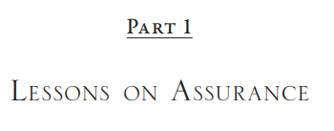
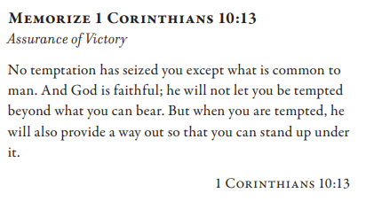
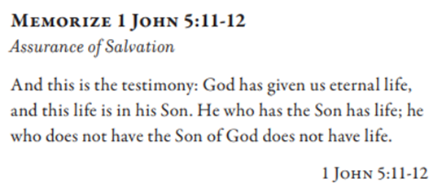
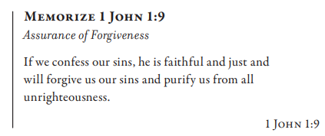
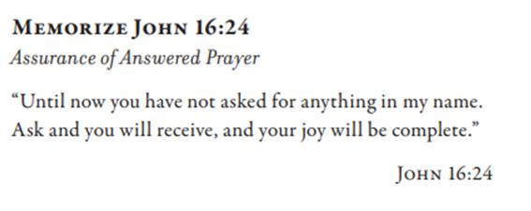

Slide 4
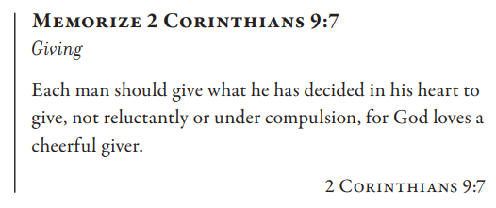
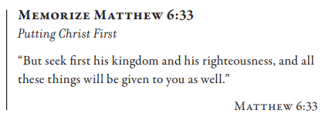
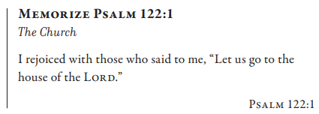
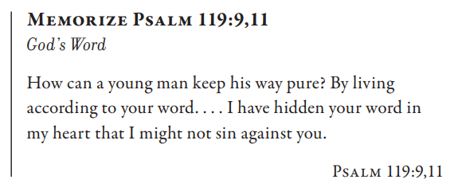
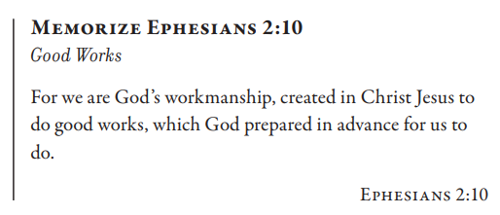
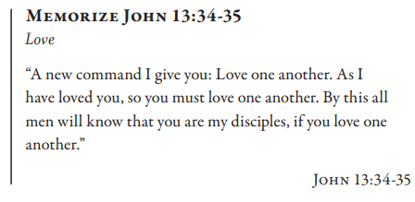

Slide 5
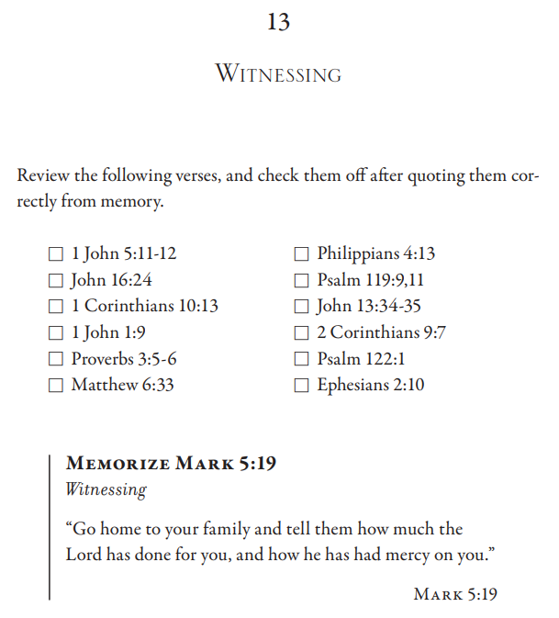

Slide 6
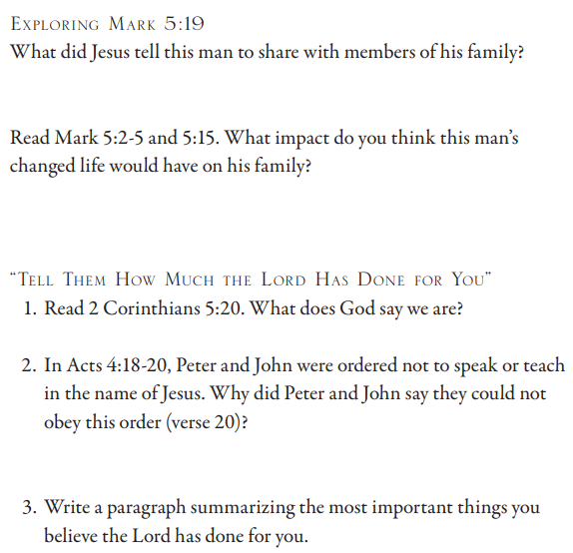
Mark 5:19 And He did not let him, but He *said to him, “Go home to your people and report to them what great things the Lord has done for you, and how He had mercy on you.” …2 And when He got out of the boat, immediately a man from the tombs with an unclean spirit met Him, 3 who had his dwelling among the tombs. And no one was able to bind him anymore, even with a chain; 4 because he had often been bound with shackles and chains, and the chains had been torn apart by him and the shackles broken in pieces, and no one was strong enough to subdue him. 5 And constantly, night and day, among the tombs and in the mountains, he was crying out and gashing himself with stones. …15 And they *came to Jesus and *observed the demon-possessed man sitting down, clothed and in his right mind, the very man who had the “legion”; and they became frightened. 2 Corinthians 5:20 So then, we are ambassadors for Christ, as God is pleading through us. We beg you on behalf of Christ, be reconciled to God. Acts 4:18 And when they had summoned them, they commanded them not to speak or teach at all in the name of Jesus. 19 But Peter and John answered and said to them, “Whether it is right in the sight of God to hear you rather than God, you be the judge; 20 for we cannot stop speaking about what we have seen and heard.”

Slide 7
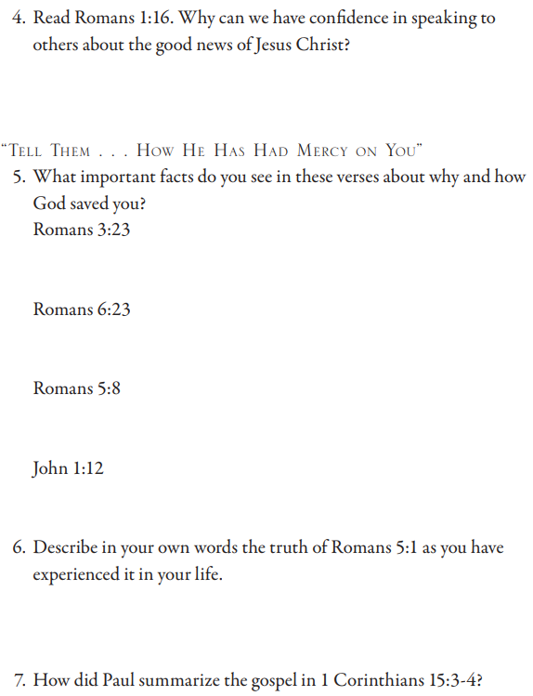
Romans 1:16 For I am not ashamed of the gospel, for it is the power of God for salvation to everyone who believes, to the Jew first and also to the Greek. Romans 3:23 for all have sinned and fall short of the glory of God Romans 6:23 For the wages of sin is death, but the gracious gift of God is eternal life in Christ Jesus our Lord. Romans 5:8 But God demonstrates His own love toward us, in that while we were yet sinners, Christ died for us. John 1:12 But as many as received Him, to them He gave the right to become children of God, even to those who believe in His name, Romans 5:1 Therefore, having been justified by faith, [a]we have peace with God through our Lord Jesus Christ, 1 Corinthians 15:3 For I delivered to you as of first importance what I also received, that Christ died for our sins according to the Scriptures, 4 and that He was buried, and that He was raised on the third day according to the Scriptures,

Slide 8
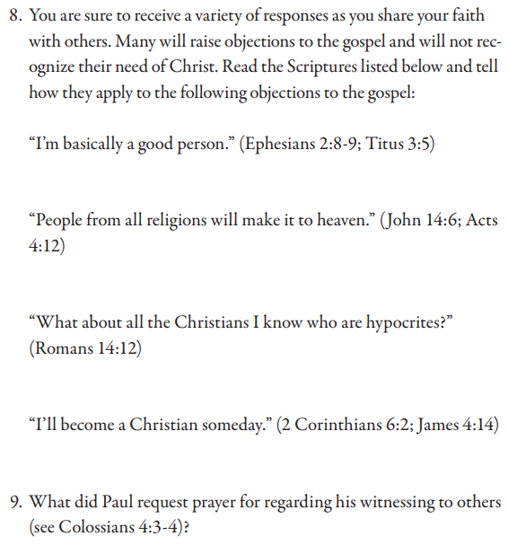
Colossians 4:3 praying at the same time for us as well, that God will open up to us a door for the word, so that we may speak the mystery of Christ, for which I have also been bound, 4 that I may make it manifest in the way I ought to speak.

Slide 9
Ephesians 2:8 For by grace you have been saved through faith, and this not of yourselves, it is the gift of God; 9 not of works, so that no one may boast. Titus 3:5 He saved us, not by works which we did in righteousness, but according to His mercy, through the washing of regeneration and renewing by the Holy Spirit, John 14:6 Jesus *said to him, “I am the way, and the truth, and the life. No one comes to the Father but through Me. Acts 4:12 And there is salvation in no one else, for there is no other name under heaven that has been given among men by which we must be saved.”
Romans 14:12 So then each one of us will give an account of himself to God. James 4:14 Yet you do not know what your life will be like tomorrow. You are a vapor that appears for a little while and then vanishes away.

