Slide 2
Fairest Lord Jesus https://www.youtube.com/watch?v=La3O7DU8GNU John 4:24 God is spirit, and those who worship Him must worship in spirit and truth.” Colossians 3:16 Let the word of Christ dwell in you richly, with all wisdom teaching and admonishing one another with psalms and hymns and spiritual songs, singing with gratefulness in your hearts to God. Ephesians 5:19 [speak] to one another in psalms and hymns and spiritual songs, singing and making melody with your heart to the Lord; 20 always giving thanks for all things in the name of our Lord Jesus Christ to God, even the Father.

Slide 3
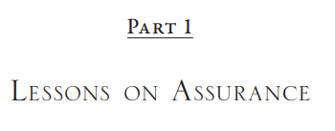
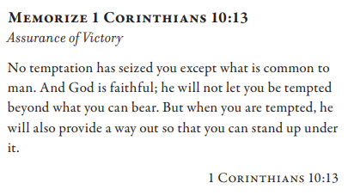
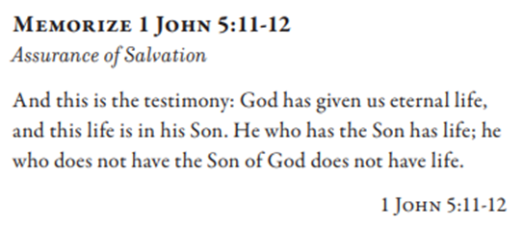
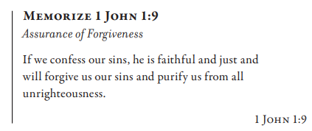
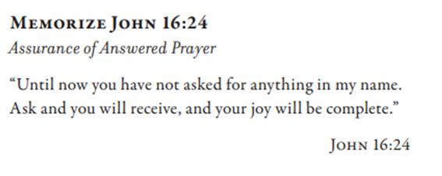

Slide 4
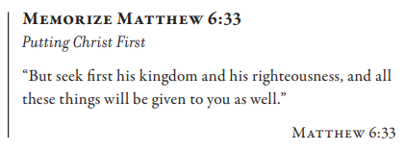
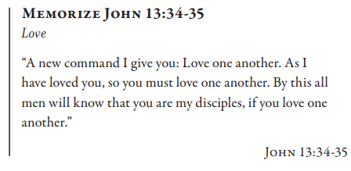
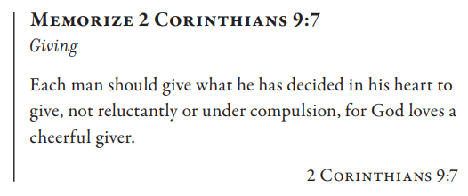
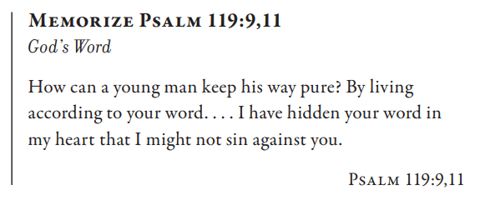

Slide 5
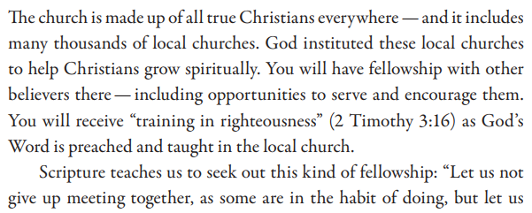

Slide 6
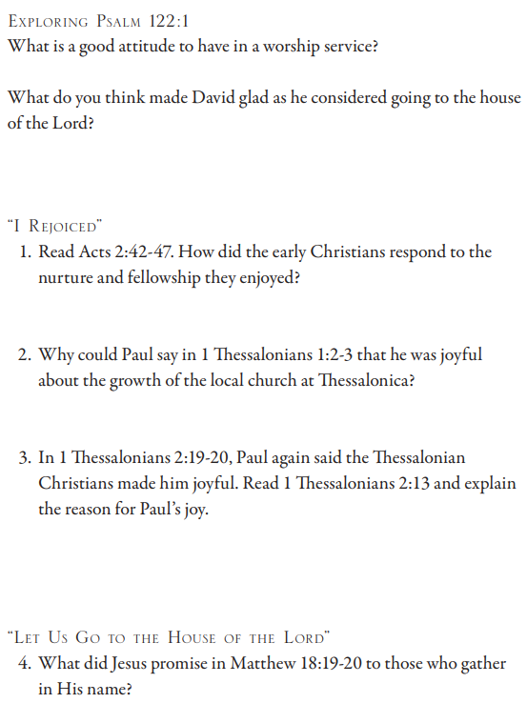
Psalm 122: 1 I was glad when they said to me, “Let us go to the house of Yahweh.” Acts 2:42 And they were continually devoting themselves to the apostles’ teaching and to the fellowship, to the breaking of bread and to the prayers. 43 And fear came upon every soul; and many wonders and signs were taking place through the apostles. 44 And all those who had believed were together and had all things in common; 45 and they began selling their property and possessions and were dividing them up with all, as anyone might have need. 46 And daily devoting themselves with one accord in the temple and breaking bread from house to house, they were taking their meals together with gladness and sincerity of heart, 47 praising God and having favor with all the people. And the Lord was adding to their number daily those who were being saved. 1 Thessalonians 1:2 We give thanks to God always for all of you, making mention of you in our prayers; 3 remembering without ceasing your work of faith and labor of love and steadfastness of hope in our Lord Jesus Christ before our God and Father 1 Thessalonians 2:19 For who is our hope or joy or crown of boasting? Is it not even you, before our Lord Jesus at His coming? 20 For you are our glory and joy. Matthew 18:19 “Again I say to you, that if two of you agree on earth about anything that they may ask, it shall be done for them by My Father who is in heaven. 20 For where two or three have gathered together in My name, I am there in their midst.”

Slide 7
Ephesians 4:11 And He Himself gave some as apostles, and some as prophets, and some as evangelists, and some as pastors and teachers, 12 for the equipping of the [a]saints for the work of service, to the building up of the body of Christ, 13 until we all attain to the unity of the faith, and of the full knowledge of the Son of God, to a mature man, to the measure of the stature which belongs to the fullness of Christ, 14 so that we are no longer to be children, tossed here and there by waves and carried about by every wind of doctrine, by the trickery of men, by craftiness in deceitful scheming, 15 but speaking the truth in love, we are to grow up in all aspects into Him who is the head, that is Christ, 16 from whom the whole body, being joined and held together by what every joint supplies, according to the properly measured working of each individual part, causes the growth of the body for the building up of itself in love. 1 Thessalonians 5:12 But we ask of you, brothers, that you know those who labor among you, and lead you in the Lord and admonish you, 13 and that you regard them very highly in love because of their work. Live in peace with one another. Hebrews 13:7 Remember your leaders, who spoke the word of God to you; and considering the result of their conduct, imitate their faith.

Slide 8
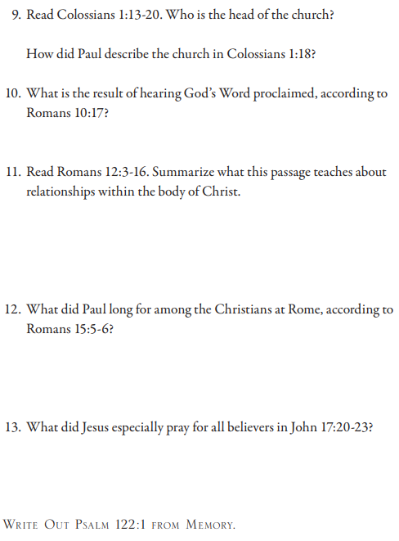
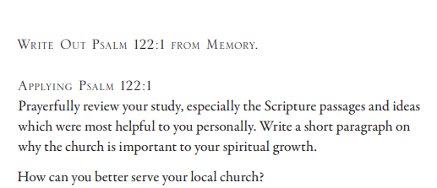
Colossians 1:13 Who rescued us from the authority of darkness, and transferred us to the kingdom of the Son of His love, 14 in whom we have redemption, the forgiveness of sins. 15 Who is the image of the invisible God, the firstborn of all creation. 16 For in Him all things were created, both in the heavens and on earth, visible and invisible, whether thrones or dominions or rulers or authorities—all things have been created through Him and for Him. 17 And He is before all things, And in Him all things hold together. 18 And He is the head of the body, the church; Who is the beginning, the firstborn from the dead, so that He Himself will come to have first place in everything. 19 For in Him all the fullness of God was pleased to dwell, 20 And through Him to reconcile all things to Himself, having made peace through the blood of His cross—through Him—whether things on earth or things in heaven.
Romans 10:17 So faith comes from hearing, and hearing by the word of Christ.
Romans 12:3 For through the grace given to me I say to each one among you not to think more highly of himself than he ought to think; but to think so as to have sound thinking, as God has allotted to each a measure of faith. 4 For just as we have many members in one body and all the members do not have the same function, 5 so we, who are many, are one body in Christ, and individually members one of another, 6 but having gifts that differ according to the grace given to us: whether prophecy, in agreement with the faith; 7 or service, in his serving; or he who teaches, in his teaching; 8 or he who exhorts, in his exhortation; he who gives, with generosity; he who leads, with diligence; he who shows mercy, with cheerfulness. 9 Let love be without hypocrisy—by abhorring what is evil, clinging to what is good, 10 being devoted to one another in brotherly love, giving preference to one another in honor, 11 not lagging behind in diligence, being fervent in spirit, serving the Lord, 12 rejoicing in hope, persevering in affliction, being devoted to prayer, 13 contributing to the needs of the saints, pursuing hospitality. 14 Bless those who persecute you; bless, and do not curse. 15 Rejoice with those who rejoice; weep with those who weep, 16 by being of the same mind toward one another, not being haughty in mind, but associating with the humble. Do not be wise in your own mind.
Romans 15:5 Now may the God of perseverance and encouragement grant you to be of the same mind with one another according to Christ Jesus, 6 so that with one accord you may with one voice glorify the God and Father of our Lord Jesus Christ.

