Slide 1
WORSHIP IN SONG
And Can It Be And Can It Be - Stuart Townend [with lyrics] - YouTube John 4:24 God is spirit, and those who worship Him must worship in spirit and truth.”
Colossians 3:16 Let the word of Christ dwell in you richly, with all wisdom teaching and admonishing one another with psalms and hymns and spiritual songs, singing with gratefulness in your hearts to God.
Ephesians 5:19 [speak] to one another in psalms and hymns and spiritual songs, singing and making melody with your heart to the Lord; 20 always giving thanks for all things in the name of our Lord Jesus Christ to God, even the Father.

Slide 2
The Spirit-Filled Christian
Design for Discipleship – Book 2

Slide 4
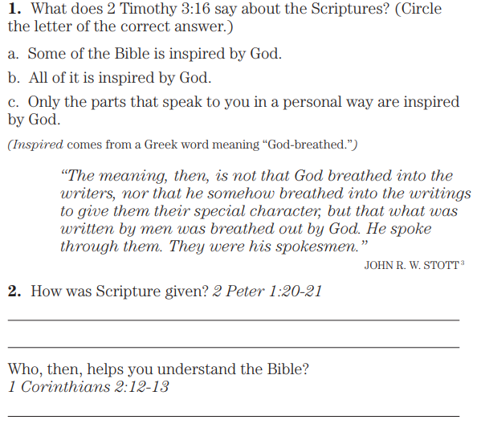
2 Timothy 3:16 All Scripture is God-breathed and profitable for teaching, for reproof, for correction, for training in righteousness,
2 Peter 1:20 Know this first of all, that no prophecy of Scripture comes by one’s own interpretation. 21 For no prophecy was ever made by the will of man, but men being moved by the Holy Spirit spoke from God.
1 Corinthians 2:12 Now we have received, not the spirit of the world, but the Spirit who is from God, so that we may know the depths graciously given to us by God, 13 of which depths we also speak, not in words taught by human wisdom, but in those taught by the Spirit, combining spiritual depths with spiritual words.

Slide 6
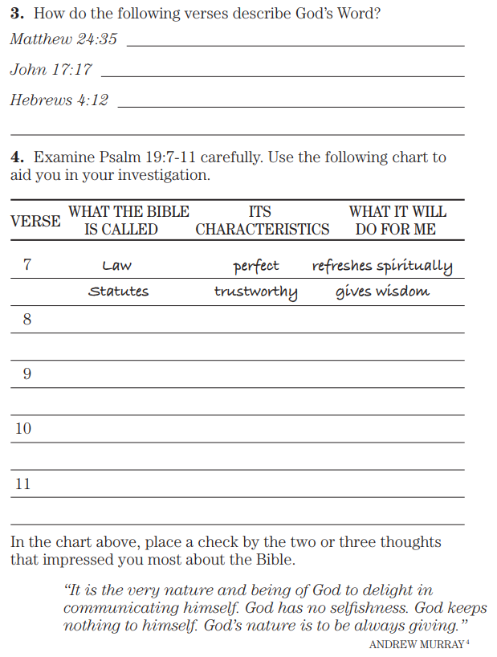
Matthew 24:35 Heaven and earth will pass away, but My words will not pass away.
John 17:17 Sanctify them by the truth; Your word is truth.
Hebrews 4:12 For the word of God is living and active and sharper than any two-edged sword, and piercing as far as the division of soul and spirit, of both joints and marrow, and able to judge the thoughts and intentions of the heart.
Psalm 19:7 The law of Yahweh is perfect, restoring the soul; The testimony of Yahweh is sure, making wise the simple. 8 The precepts of Yahweh are right, rejoicing the heart; The commandment of Yahweh is pure, enlightening the eyes. 9 The fear of Yahweh is clean, enduring forever; The judgments of Yahweh are true; they are righteous altogether. 10 They are more desirable than gold, even more than much fine gold; Sweeter also than honey and the drippings of the honeycomb. 11 Moreover, by them Your slave is warned; In keeping them there is great reward.

Slide 7
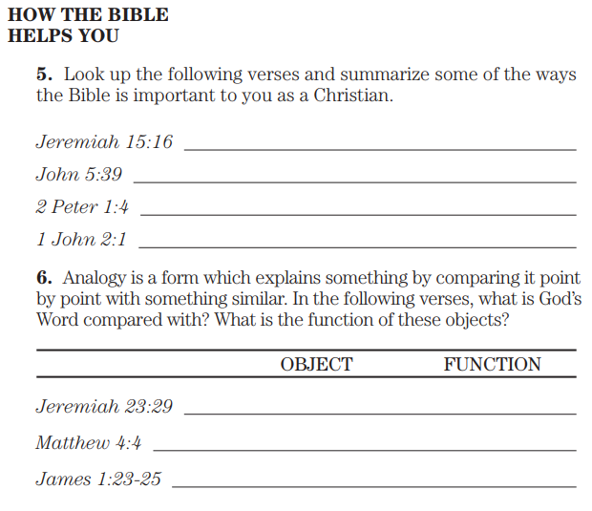
Jeremiah 15:16 Your words were found, and I ate them, And Your words became for me joy and gladness in my heart, For I have been called by Your name, O Yahweh God of hosts.
John 5:39 You search the Scriptures because you think that in them you have eternal life; it is these that bear witness about Me;
2 Peter 1:4 For by these He has granted to us His precious and magnificent promises, so that by them you may become partakers of the divine nature, having escaped the corruption that is in the world by lust.
1 John 2:1 My little children, I am writing these things to you so that you may not sin. And if anyone sins, we have an Advocate with the Father, Jesus Christ the righteous;
Jeremiah 23:29 “Is not My word like fire?” declares Yahweh, “and like a hammer which shatters a rock?
Matthew 4:4 But He answered and said, “It is written, ‘Man shall not live on bread alone, but on every word that proceeds out of the mouth of God.’”
James 1:23 For if anyone is a hearer of the word and not a doer, he is like a man who looks at his natural face in a mirror; 24 for once he looked at himself and has gone away, he immediately forgot what kind of person he was. 25 But one who looks intently at the perfect law, the law of freedom, and abides by it, not having become a forgetful hearer but a doer of the work, this man will be blessed in what he does.

Slide 8
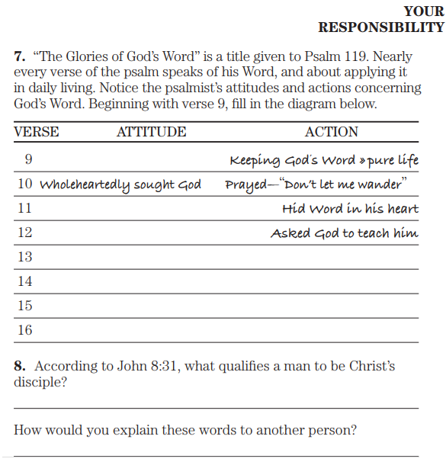
Psalm 199:9 How can a young man keep his way pure?
By keeping it according to Your word.
10 With all my heart I have sought You;
Do not let me stray from Your commandments.
11 Your word I have treasured in my heart,
That I may not sin against You.
12 Blessed are You, O Yahweh;
Teach me Your statutes.
13 With my lips I have recounted
All the judgments of Your mouth.
14 I have rejoiced in the way of Your testimonies,
As much as in all riches.
15 I will muse upon Your precepts
And look upon Your ways.
16 I shall delight in Your statutes;
I shall not forget Your word.
John 8:31 So Jesus was saying to those Jews who had believed Him, “If you abide in My word, then you are truly My disciples;

Slide 9
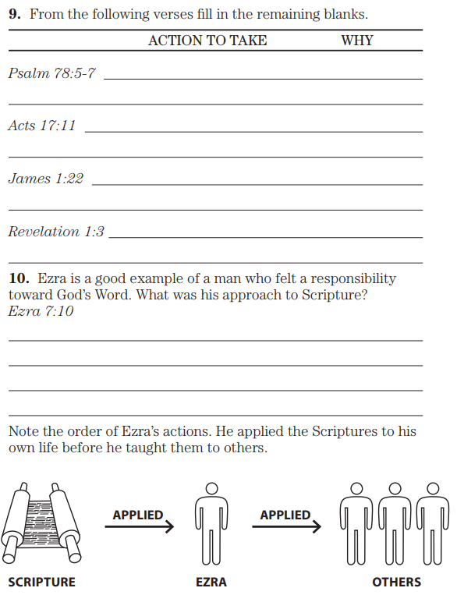
Psalm 78:5 For He established a testimony in Jacob and set a law in Israel, Which He commanded our fathers that they should teach them to their children, 6 That the generation to come might know, even the children yet to be born, that they may arise and recount them to their children, 7 That they should set their confidence in God and not forget the deeds of God, but observe His commandments
Acts 17:11 Now these were more noble-minded than those in Thessalonica, for they received the word with great eagerness, examining the Scriptures daily to see whether these things were so.
James 1:22 But become doers of the word, and not merely hearers who delude themselves.
Revelation 1:3 Blessed is he who reads and those who hear the words of the prophecy and keep the things which are written in it, for the time is near.
Ezra 7:10 For Ezra had set his heart to study the law of Yahweh and to practice it, and to teach His statute and judgment in Israel.

Slide 10
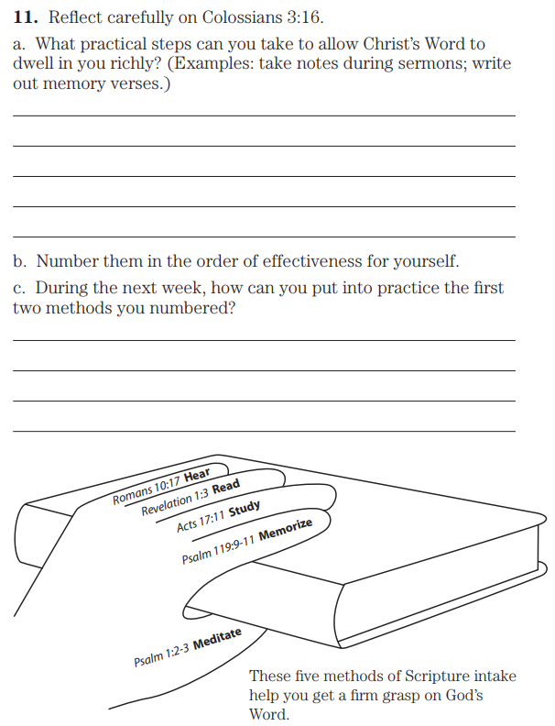
Colossians 3:16 Let the word of Christ dwell in you richly, with all wisdom teaching and admonishing one another with psalms and hymns and spiritual songs, singing [d]with gratefulness in your hearts to God. Romans 10:17 So faith comes from hearing, and hearing by the word of Christ.
Revelation 1:3 Blessed is he who reads and those who hear the words of the prophecy and keep the things which are written in it, for the time is near.
Acts 17:11 Now these were more noble-minded than those in Thessalonica, for they received the word with great eagerness, examining the Scriptures daily to see whether these things were so.
Psalm 119:9 How can a young man keep his way pure? By keeping it according to Your word. 10 With all my heart I have sought You; Do not let me stray from Your commandments. 11 Your word I have treasured in my heart, that I may not sin against You.
Psalm 1:2 But his delight is in the law of Yahweh, and in His law he meditates day and night. 3 And he will be like a tree firmly planted by streams of water, which yields its fruit in its season and its leaf does not wither; and in whatever he does, he prospers.

Slide 11
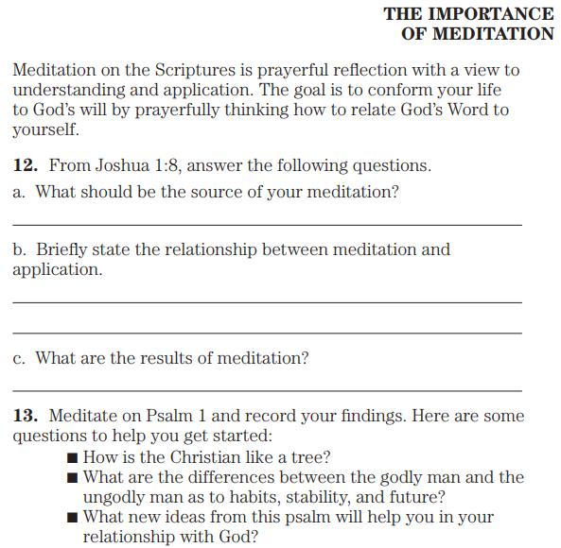
Joshua 1:8 This book of the law shall not depart from your mouth, but you shall meditate on it day and night, so that you may be careful to do according to all that is written in it; for then you will make your way successful, and then you will be prosperous.

