Slide 1
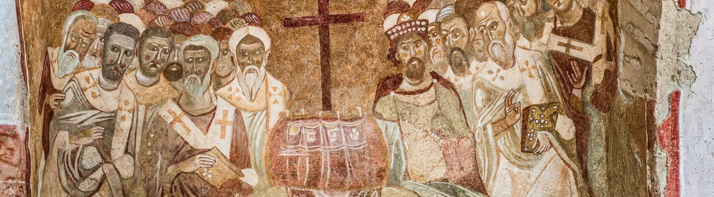
NICENE CREED
AFTER 1700 YEARS

Slide 2
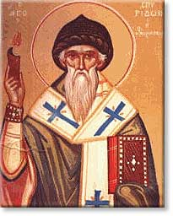
ARIUS
Pre-325
Arius was born in Libya ~250 A.D.
Tall, thin, walked barefoot, winsome personality, musical
Presbyter in Alexandria under his Bishop Alexander
Taught “there was a time when the son was not”

Slide 3
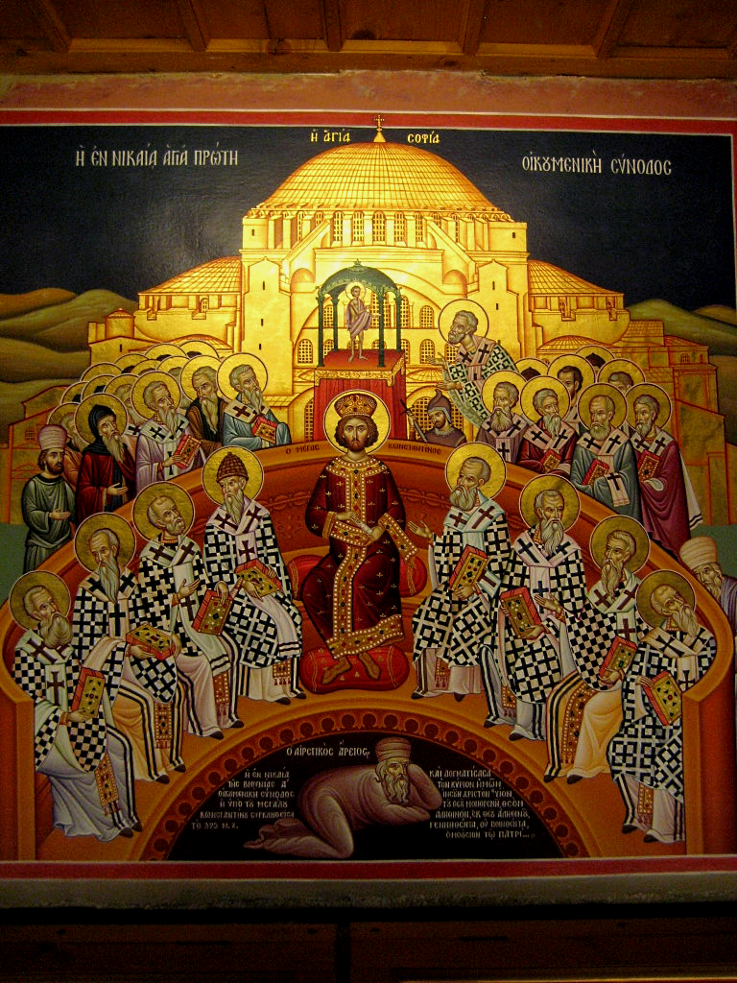
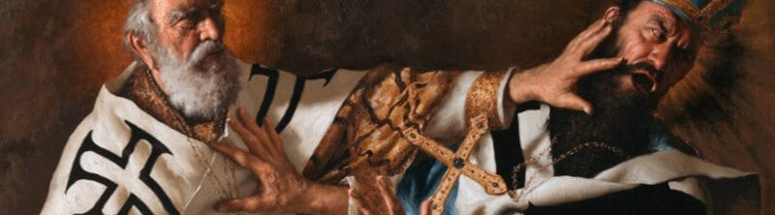
THE COUNCIL OF
NICAEA
In 325 Constantine calls a council at Nicaea
First Ecumenical Council
Deliberations about whether Arius taught falsehood
Athanasius vs
Eusebius & Arius
Arius and his teachings are condemned

Slide 4
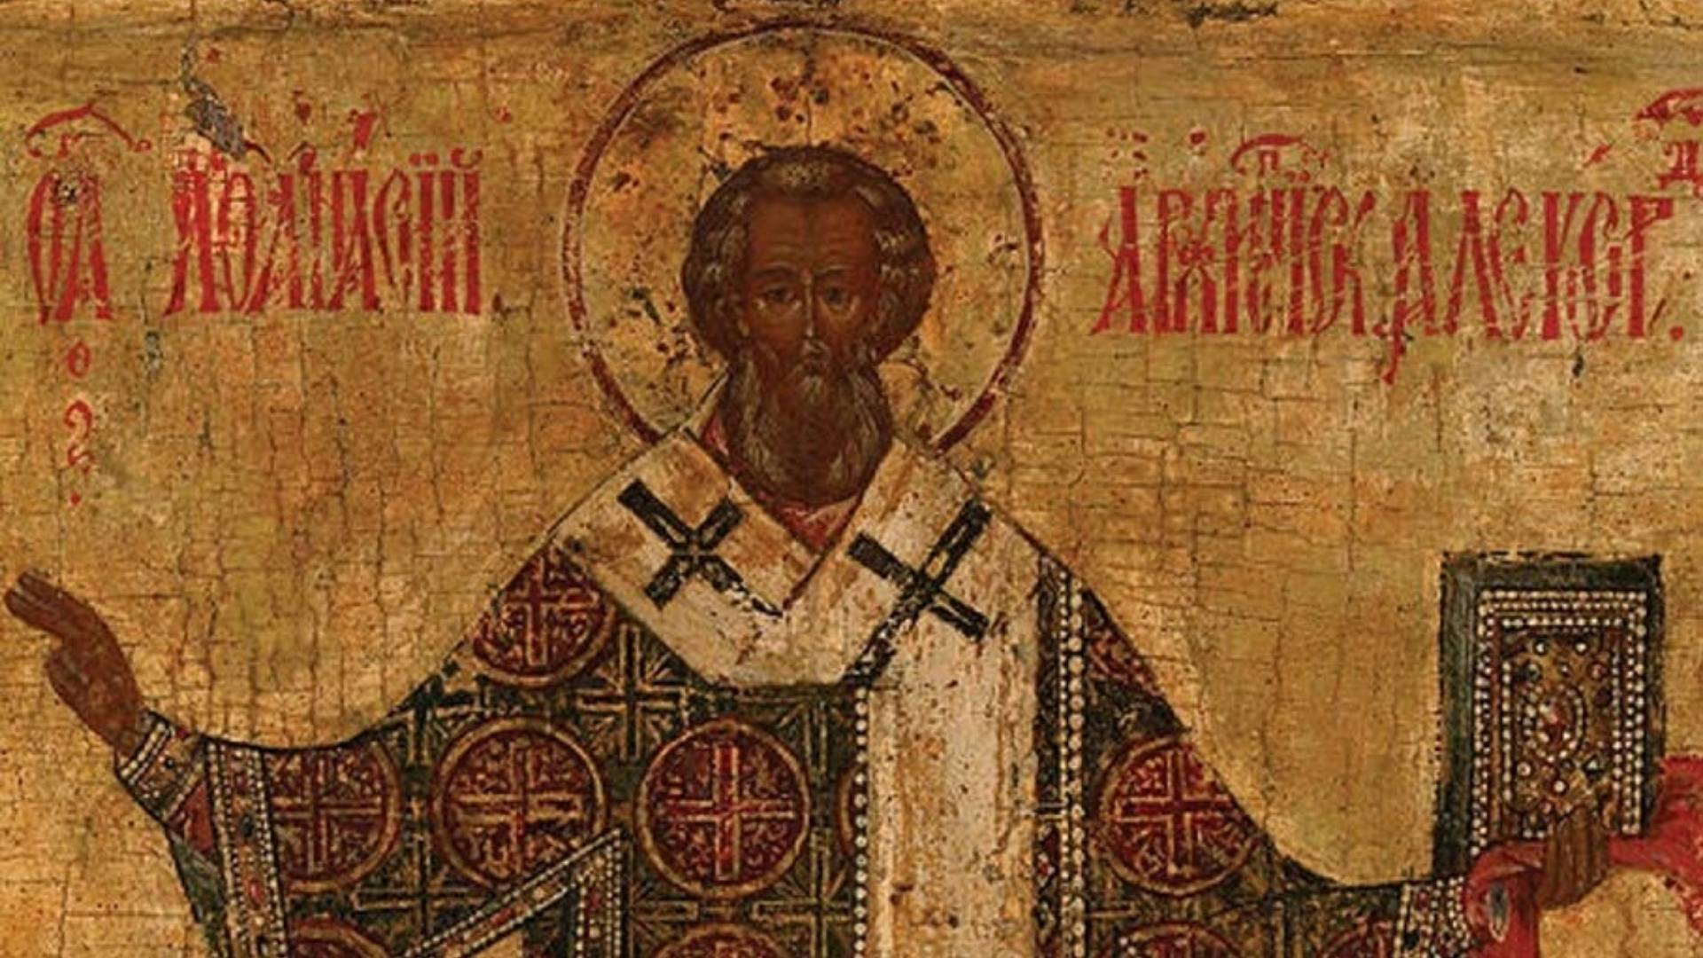
VERDICT
]
The Father and Son are co-equal and co-eternal and…
ARE homoouisious, “of one substance” / essence / being, but
NOT heteroousios “of different substance” / essence / being, &
NOT homoiousios “of similar substance” / essence / being

Slide 5
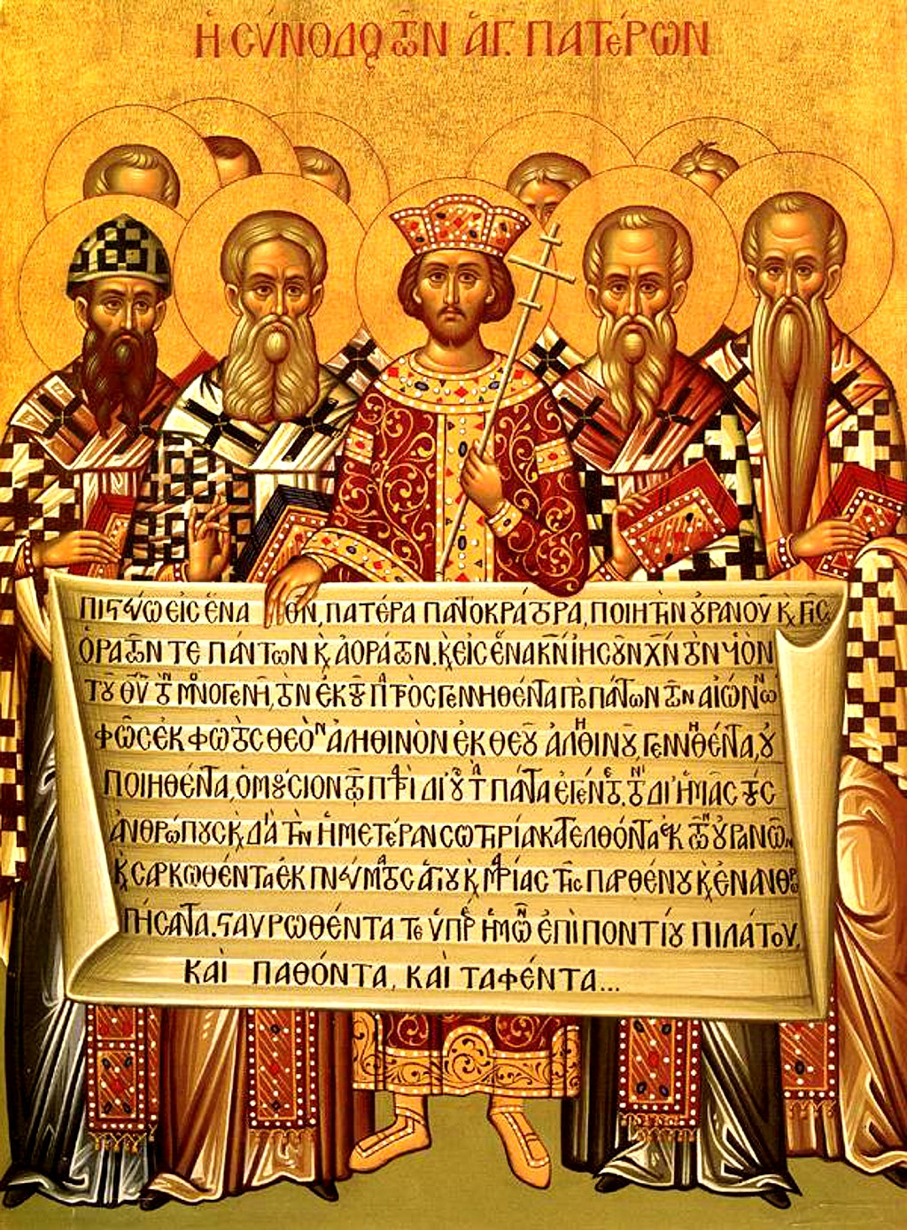
CREED
The overwhelming majority of Bishops condemned Arius as a heretic
Anyone preaching his ideas or possessing his manuscripts may be convicted of a capital crime.
Formulated an official Creed to affirm, against Arian heresy
Important to this day: Cults

Slide 6
THE NICENE CREED
We believe in one God, the Father Almighty,
Maker of all things visible and invisible.
And in one Lord Jesus Christ, the Son of God, begotten of the Father, Light of Light, very God of very God, begotten, not made, consubstantial with the Father;
By whom all things were made;
Who for us men, and for our salvation, came down and was incarnate and was made man;
He suffered, and the third day he rose again, ascended into heaven;
From thence he shall come to judge the quick and the dead.
And in the Holy Ghost.

Slide 7
Structure of the Nicene Creed (325)
01
02
03
WE BELIEVE IN THE FATHER (MAKER)
AND IN ONE LORD JESUS CHRIST (BEGOTTEN NOT MADE / CONSUBSTANTIAL)
I JESUS IS MAKER
II JESUS BECAME INCARNATE
III JESUS’S PASSION
IV JESUS WILL COME AGAIN
AND IN THE HOLY SPIRIT

Slide 8
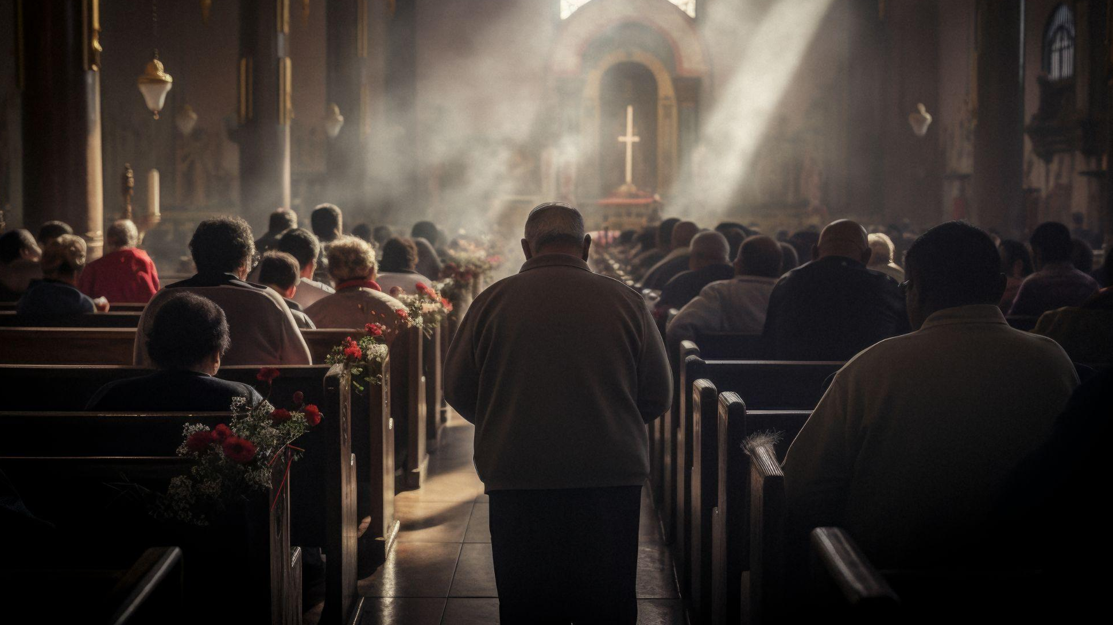
01
WE BELIEVE IN THE FATHER

Slide 9
THE NICENE CREED
1 We believe in one God, the Father Almighty,
Maker of all things visible and invisible.

Slide 10
In one God…
1 Corinthians 8:6 yet for us there is one God, the Father, from whom are all things and we exist for Him, and one Lord, Jesus Christ, by whom are all things, and we exist through Him.
Deuteronomy 6:4 “Hear, O Israel! Yahweh is our God, Yahweh is one!
Mark 12:28 And when one of the scribes came and heard them arguing, he recognized that He had answered them well and asked Him, “What commandment is the foremost of all?” 29 Jesus answered, “The foremost is, ‘Hear, O Israel! The Lord our God is one Lord;

Slide 11
…The Father Almighty
1 Corinthians 8:6 yet for us there is one God, the Father, from whom are all things and we exist for Him, and one Lord, Jesus Christ, by whom are all things, and we exist through Him.
  Ephesians 4:4 There is one body and one Spirit, just as also you were called in one hope of your calling; 5 one Lord, one faith, one baptism; 6 one God and Father of all who is over all and through all and in all.

Slide 12
Maker of all things visible and invisible
1 Corinthians 8:6 yet for us there is one God, the Father, from whom are all things and we exist for Him, and one Lord, Jesus Christ, by whom are all things, and we exist through Him.
Isaiah 42:5 Thus says the God, Yahweh, Who created the heavens and stretched them out, Who spread out the earth and its offspring, Who gives breath to the people on it, and spirit to those who walk in it…
Jeremiah 23:17 ‘Ah Lord Yahweh! Behold, You have made the heavens and the earth by Your great power and by Your outstretched arm! Nothing is too difficult for You…
Ephesians 4:6 one God and Father of all who is over all and through all and in all.

Slide 13
02
AND IN ONE LORD JESUS CHRIST

Slide 14
THE NICENE CREED
2 And in one Lord Jesus Christ, the Son of God, begotten of the Father, Light of Light, very God of very God, begotten, not made, consubstantial with the Father;

Slide 15
…and in One Lord Jesus Christ
The goal of the Nicene Creed is to clearly showcase the full deity and full humanity of Jesus along with the three-in-one nature of God. This phrase moves us into confessing the second person of the Trinity, Jesus Christ.
Contra Arius we must affirm that Jesus is Lord and Christ in the fullest measure of their meaning

Slide 16
…and in One Lord Jesus Christ
In Jesus’ time, “lordship” meant absolute, undisputed ownership. The person called “lord” was an absolute, undisputed master. Throughout the New Testament, those who interacted with Jesus, but did not yet believe, addressed Him with titles of honour, like “teacher” or “rabbi”. The titles of “Lord” and “Master” were reserved only for His disciples and apostles – those that truly believed. This is why in Mark 4:45, when Judas betrayed Jesus with a kiss, he called Jesus “Rabbi” and not “Lord”.

Slide 17
…and in One Lord Jesus Christ
“Jesus” comes from the Hebrew name Yeshua, meaning “the Lord / God saves”. It is significant that when the Son of God became man, He was given a human name. This demonstrates His humanity. Jesus is fully human and fully God. We have become used to calling him “Jesus Christ”. But in reality, “Christ” is not His surname! “Christ” means “anointed one”

Slide 18
…and in One Lord Jesus Christ
1 Corinthians 8:6 yet for us there is one God, the Father, from whom are all things and we exist for Him, and one Lord, Jesus Christ, by whom are all things, and we exist through Him.
Romans 14:9 For to this end Christ died and lived again, that He might be Lord both of the dead and of the living.

Slide 19
…and in One Lord Jesus Christ
Luke 6:46 “Now why do you call Me, ‘Lord, Lord,’ and do not do what I say?
John 13:13 You call Me Teacher and Lord; and you are right, for so I am.
2 Corinthians 4:5 For we do not preach ourselves but Jesus Christ as Lord, and ourselves as your slaves for the sake of Jesus.

Slide 20
…and in One Lord Jesus Christ
Romans 10:9 that if you confess with your mouth Jesus as Lord, and believe in your heart that God raised Him from the dead, you will be saved;
John 20:28 Thomas answered and said to Him, “My Lord and my God!”

Slide 21
…and in One Lord Jesus Christ
Matthew 16:15 He *said to them, “But who do you say that I am?” 16 And Simon Peter answered and said, “You are the Christ, the Son of the living God
Galatians 3:27 For all of you who were baptized into Christ have clothed yourselves with Christ.
1 Timothy 2:5 For there is one God, and one mediator also between God and men, the man Christ Jesus
Galatians 2:20 I have been crucified with Christ, and it is no longer I who live, but Christ lives in me. And the life which I now live in the flesh I live by faith in the Son of God, who loved me and gave Himself up for me.

Slide 22
…and in One Lord Jesus Christ
Romans 6:23 For the wages of sin is death, but the gracious gift of God is eternal life in Christ Jesus our Lord.
Colossians 1:27 to whom God willed to make known what is the riches of the glory of this mystery among the Gentiles, which is Christ in you, the hope of glory.

Slide 23
the Son of God, begotten of the Father,
The “only Begotten Son of God” means that Jesus’ relationship to God the Father is different than ours. Jesus is truly both Man and God. Throughout the Old and New Testaments, two special titles have been reserved for Jesus – “Son of Man” and “Son of God”. To say that Jesus is “born of the Father” means that He comes from the same divine essence as the Father, which means that He and the Father are of the same kind.

Slide 24
the Son of God, begotten of the Father,
The goal of the Nicene Creed is to clearly showcase the full deity and full humanity of Jesus along with the three-in-one nature of God. This phrase moves us into confessing the second person of the Trinity, Jesus Christ. The best way to understand “only-begotten” is to think about Jesus as the “natural-born” Son of God-- contrasted with adoption which is the means by which we become sons and daughters of God. While we are all in the same family, the means are different. In this instance, “only-begotten” showcases that Jesus is unique in His relationship to God.

Slide 25
the Son of God, begotten of the Father,
Remember, the Nicene Creed is correcting Arius’ opposite statement, “There was a time that Jesus was not.” Oftentimes, “begotten” implies origin, and we see here that Jesus’ origin is timeless and eternal. Jesus has always existed and transcends beyond time.

Slide 26
the Son of God, begotten of the Father,
Psalm 2:7 “I will surely tell of the decree of Yahweh: He said to Me, ‘You are My Son, today I have begotten You.
  God’s decree is eternal, before there was time, day, or even a “today”
Hebrews 1:5 For to which of the angels did He ever say, “You are My Son, today I have begotten You”? …

Slide 27
the Son of God, begotten of the Father,
Mark 1:1 The beginning of the gospel of Jesus Christ, the Son of God.
Mark 15:39 And when the centurion, who was standing right in front of Him, saw the way He breathed His last, he said, “Truly this man was God’s Son!”
John 1:1 In the beginning was the Word, and the Word was with God, and the Word was God. 2 He was in the beginning with God. 3 All things came into being through Him, and apart from Him nothing came into being that has come into being.

Slide 28
the Son of God, begotten of the Father,
John 1:18 No one has seen God at any time; the only begotten God who is in the bosom of the Father, He has explained Him.
John 3:16 “For God so loved the world, that He gave His only begotten Son, that whoever believes in Him shall not perish, but have eternal life.
John 17:5 Now, Father, glorify Me together with Yourself, with the glory which I had with You before the world was.

Slide 29
the Son of God, begotten of the Father,
Romans 8:29 Because those whom He foreknew, He also predestined to become conformed to the image of His Son, so that He would be the firstborn among many brothers…
The Son of God is the firstborn, as in preimminent or having paramount rank, dignity, or importance : outstanding, supreme

Slide 30
the Son of God, begotten of the Father,
Firstborn does not demand that Jesus is literally created first in the sense Arius taught. It does often mean that in human terms, the first born, but connotes the supremacy of what the firstborn inherited. Greek prototokos denotes supremacy, preeminence, or first in rank.
For example, in Exodus 4:22, Israel is called “firstborn” and certainly they were not the first nation created, but as God’s people they had preeminence. In Psalm 89:27, David, because of his status (i.e., his preeminence), is called “firstborn” and he was technically “last born” (note: in the LXX, both passages have prōtotokos).

Slide 31
the Son of God, begotten of the Father,
Colossians 1:15 Who is the image of the invisible God, the firstborn of all creation. 16 For in Him all things were created, both in the heavens and on earth, visible and invisible, whether thrones or dominions or rulers or authorities—all things have been created through Him and for Him. 17 And He is before all things, and in Him all things hold together. 18 And He is the head of the body, the church; Who is the beginning, the firstborn from the dead, so that He Himself will come to have first place in everything.

Slide 32
the Son of God, begotten of the Father,
Galatians 3:26 For you are all sons of God through faith in Christ Jesus.
2 Corinthians 5:17 Therefore if anyone is in Christ, he is a new creation; the old things passed away; behold, new things have come.
Romans 8:1 Therefore there is now no condemnation for those who are in Christ Jesus.
Galatians 3:28 There is neither Jew nor Greek, there is neither slave nor free man, there is no male and female, for you are all one in Christ Jesus. … in the prototokos

