Slide 2
Colossians 3:16 Let the word of Christ dwell in you richly, with all wisdom teaching and admonishing one another with psalms and hymns and spiritual songs, singing with gratefulness in your hearts to God. Praise to the Lord, the Almighty

Slide 3
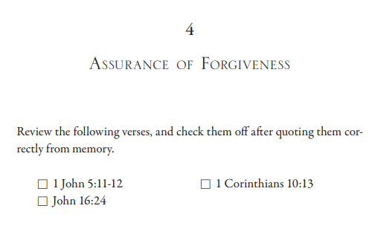
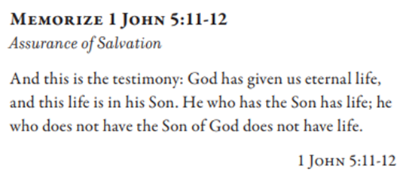
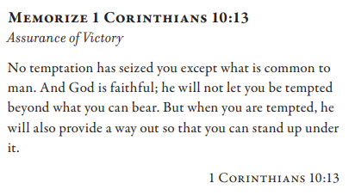
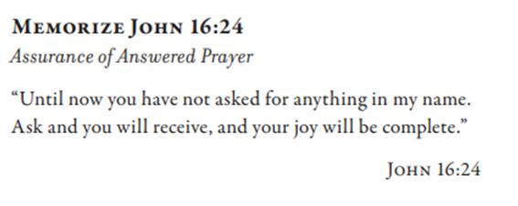

Slide 5
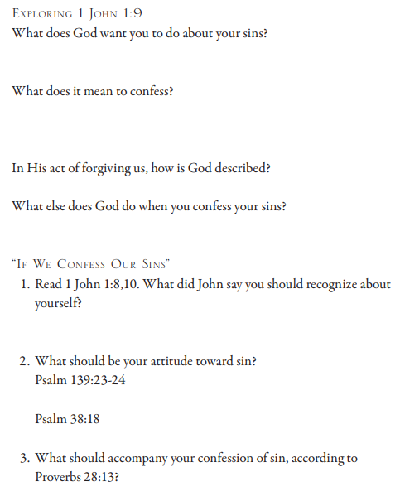
1 John 1:8 If we say that we have no sin, we deceive ourselves and the truth is not in us. 9 If we confess our sins, He is faithful and righteous to forgive us our sins and to cleanse us from all unrighteousness. 10 If we say that we have not sinned, we make Him a liar and His word is not in us. Psalm 139:23 Search me, O God, and know my heart; Try me and know my anxious thoughts; 24 And see if there be any hurtful way in me, And lead me in the everlasting way. Psalm 38:18 For I confess my iniquity; I am full of anxiety because of my sin. Proverbs 28:13 He who conceals his transgressions will not prosper, But he who confesses and forsakes them will receive compassion.

Slide 6
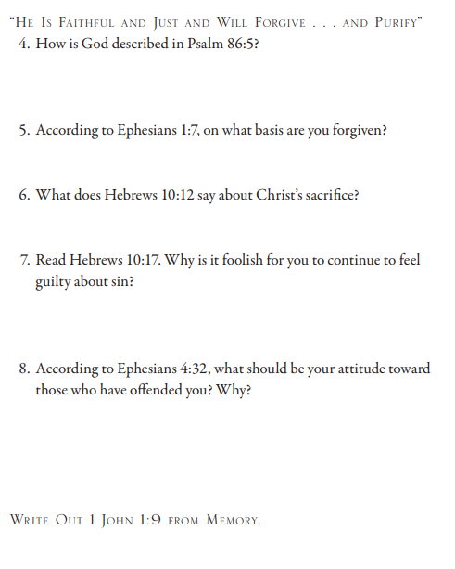
Psalm 86:5 For You, Lord, are good, and by nature forgiving, And abundant in lovingkindness to all who call upon You. Ephesians 1:7 In Him we have redemption through His blood, the forgiveness of our transgressions, according to the riches of His grace Hebrews 10:12 but He, having offered one sacrifice for sins for all time, sat down at the right hand of God… 17 “And their sins and their lawless deeds I will remember no more.” Ephesians 4:32 Instead, be kind to one another, tender-hearted, graciously forgiving each other, just as God in Christ also has graciously forgiven you.

