Slide 1
WORSHIP IN SONG
Whate’er My God Ordains is Right Whate’er My God Ordains is Right John 4:24 God is spirit, and those who worship Him must worship in spirit and truth.”
Colossians 3:16 Let the word of Christ dwell in you richly, with all wisdom teaching and admonishing one another with psalms and hymns and spiritual songs, singing with gratefulness in your hearts to God.
Ephesians 5:19 [speak] to one another in psalms and hymns and spiritual songs, singing and making melody with your heart to the Lord; 20 always giving thanks for all things in the name of our Lord Jesus Christ to God, even the Father.

Slide 2
The Spirit-Filled Christian
Design for Discipleship – Book 2

Slide 4
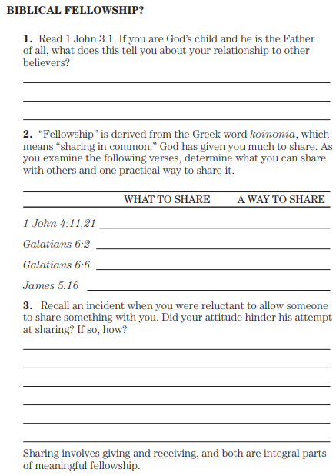
1 John 3:1 See how great a love the Father has given to us, that we would be called children of God; and we are. For this reason the world does not know us, because it did not know Him.
1 John 4:11 Beloved, if God so loved us, we also ought to love one another… 21 And this commandment we have from Him, that the one who loves God should love his brother also.
Galatians 6:2 Bear one another’s burdens, and so fulfill the law of Christ… 6 And the one who is instructed in the word is to share in all good things with the one who instructs him.
James 5:16 Therefore, confess your sins to one another, and pray for one another so that you may be healed. The effective prayer of a righteous man can accomplish much.

Slide 5
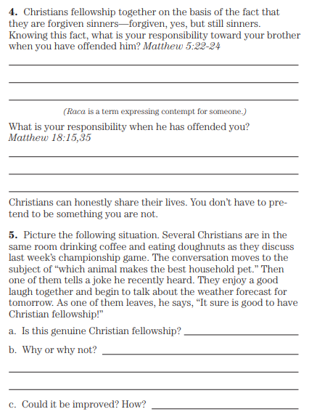
Matthew 5:22 But I say to you that everyone who is angry with his brother shall be guilty before the court; and whoever says to his brother, ‘Raca,’ shall be guilty before the Sanhedrin; and whoever says, ‘You fool,’ shall be guilty enough to go into the fiery hell. 23 Therefore if you are presenting your offering at the altar, and there remember that your brother has something against you, 24 leave your offering there before the altar and go; first be reconciled to your brother, and then come and present your offering.
Matthew 18:15 “Now if your brother sins, go and show him his fault, between you and him alone; if he listens to you, you have won your brother… 35 My heavenly Father will also do the same to you, if each of you does not forgive his brother from your hearts.”

Slide 6
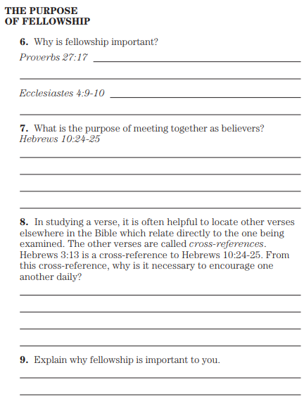
Proverbs 27:17 Iron sharpens iron, So one man sharpens another.
Ecclesiastes 4:9 Two are better than one because they have good wages for their labor. 10 For if either of them falls, the one will lift up his companion. But woe to the one who falls when there is not a second one to lift him up.
Hebrews 10:24 And let us consider how to stimulate one another to love and good deeds, 25 not forsaking our own assembling together, as is the habit of some, but encouraging one another, and all the more as you see the day drawing near.
Hebrews 3:13 But encourage one another day after day, as long as it is still called “Today,” so that none of you will be hardened by the deceitfulness of sin.

Slide 7
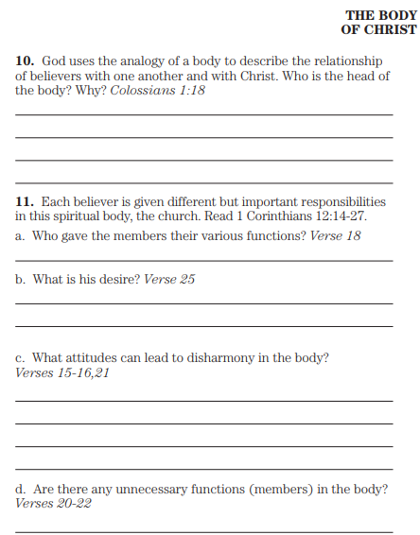
Colossians 1:18 And He is the head of the body, the church;
Who is the beginning, the firstborn from the dead, so that He Himself will come to have first place in everything.
1 Corinthians 12:14 For also the body is not one member, but many. 15 If the foot says, “Because I am not a hand, I am not a part of the body,” it is not for this reason any the less a part of the body. 16 And if the ear says, “Because I am not an eye, I am not a part of the body,” it is not for this reason any the less a part of the body. 17 If the whole body were an eye, where would the hearing be? If the whole were hearing, where would the sense of smell be? 18 But now God has appointed the members, each one of them, in the body, just as He desired. 19 And if they were all one member, where would the body be? 20 But now there are many members, but one body. 21 And the eye cannot say to the hand, “I have no need of you”; or again the head to the feet, “I have no need of you.” 22 On the contrary, how much more is it that the members of the body which seem to be weaker are necessary, 23 and those members of the body which we think as less honorable, on these we bestow more abundant honor, and our less presentable members become much more presentable, 24 whereas our more presentable members have no such need. But God has so composed the body, giving more abundant honor to that member which lacked, 25 so that there may be no division in the body, but that the members may have the same care for one another. 26 And if one member suffers, all the members suffer with it; if one member is honored, all the members rejoice with it. 27 Now you are Christ’s body, and individually members of it.

Slide 8
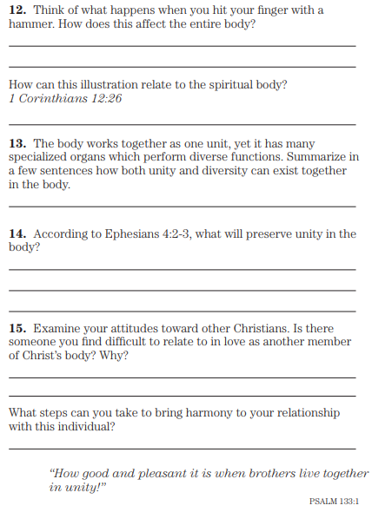
1 Corinthians 12:26 And if one member suffers, all the members suffer with it; if one member is honored, all the members rejoice with it.
Ephesians 4:2 with all humility and gentleness, with patience, bearing with one another in love, 3 being diligent to keep the unity of the Spirit in the bond of peace.

Slide 9
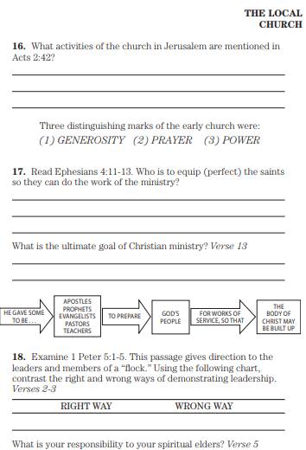
Acts 2:42 And they were continually devoting themselves to the apostles’ teaching and to the fellowship, to the breaking of bread and to the prayers.
Ephesians 4:11 And He Himself gave some as apostles, and some as prophets, and some as evangelists, and some as pastors and teachers, 12 for the equipping of the saints for the work of service, to the building up of the body of Christ, 13 until we all attain to the unity of the faith, and of the full knowledge of the Son of God, to a mature man, to the measure of the stature which belongs to the fullness of Christ,
1 Peter 1:5 Therefore, I exhort the elders among you, as your fellow elder and witness of the sufferings of Christ, and a partaker also of the glory that is to be revealed, 2 shepherd the flock of God among you, overseeing not under compulsion, but willingly, according to God; and not for dishonest gain, but with eagerness; 3 nor yet as lording it over those allotted to you, but being examples to the flock. 4 And when the Chief Shepherd appears, you will receive the unfading crown of glory. 5 You younger men, likewise, be subject to your elders. And all of you, clothe yourselves with humility toward one another, for God is opposed to the proud, but gives grace to the humble.

Slide 10
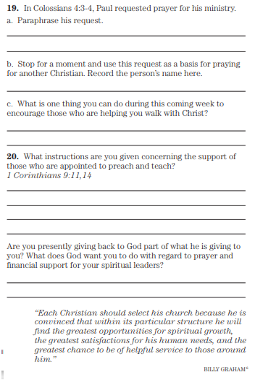
Colossians 4:3 praying at the same time for us as well, that God will open up to us a door for the word, so that we may speak the mystery of Christ, for which I have also been bound, 4 that I may make it manifest in the way I ought to speak.
1 Corinthians 9:11 If we sowed spiritual things in you, is it too much if we reap material things from you? …14 So also the Lord directed those who proclaim the gospel to get their living from the gospel.

