Slide 1
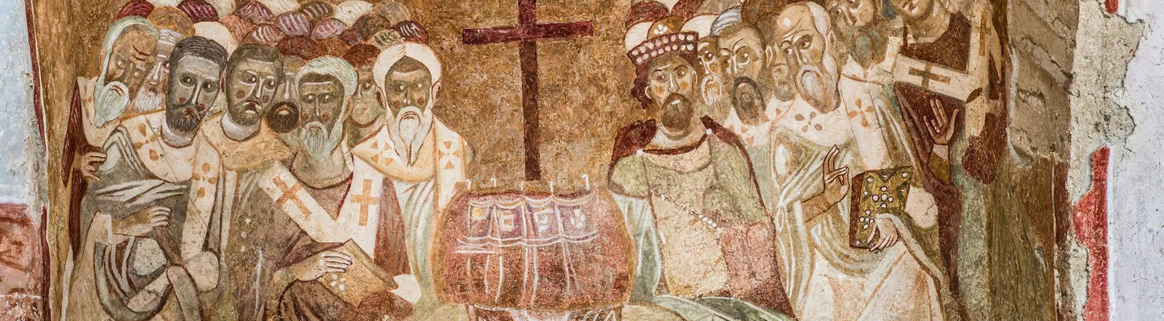
NICENE CREED
AFTER 1700 YEARS

Slide 2
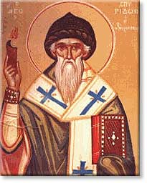
ARIUS
Pre-325
Arius was born in Libya ~250 A.D.
Tall, thin, walked barefoot, winsome personality, musical
Presbyter in Alexandria under his Bishop Alexander
Taught “there was a time when the son was not”

Slide 3
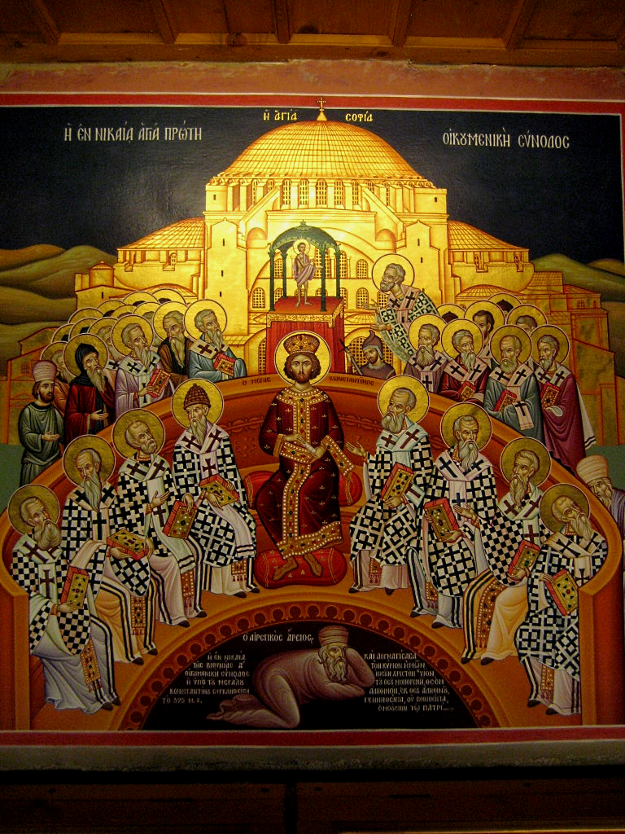
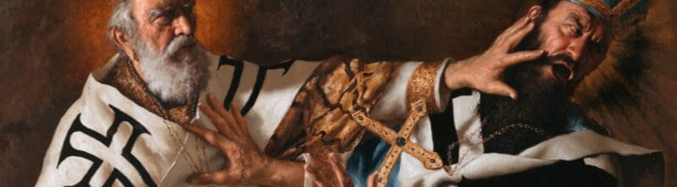
THE COUNCIL OF
NICAEA
In 325 Constantine calls a council at Nicaea
First Ecumenical Council
Deliberations about whether Arius taught falsehood
Athanasius vs
Eusebius & Arius
Arius and his teachings are condemned

Slide 4
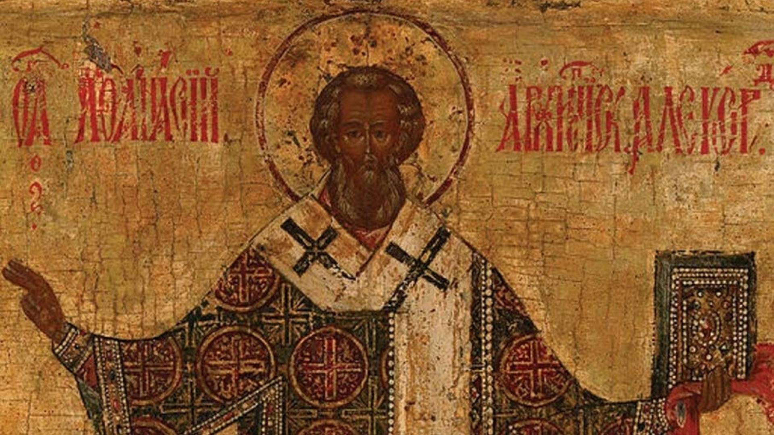
VERDICT
]
The Father and Son are co-equal and co-eternal and…
ARE homoouisious, “of one substance” / essence / being, but
NOT heteroousios “of different substance” / essence / being, &
NOT homoiousios “of similar substance” / essence / being

Slide 5
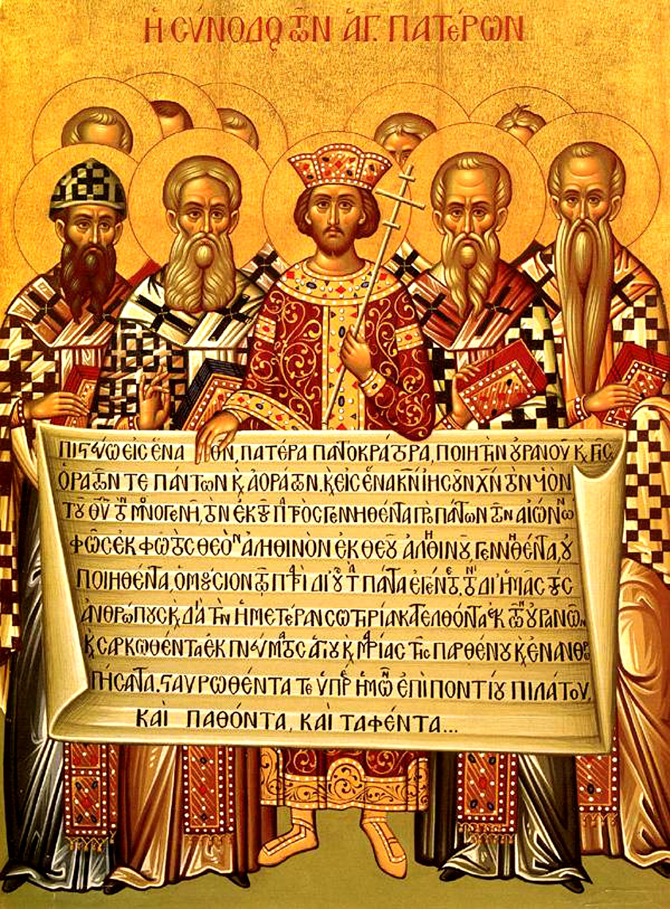
CREED
The overwhelming majority of Bishops condemned Arius as a heretic
Anyone preaching his ideas or possessing his manuscripts may be convicted of a capital crime.
Formulated an official Creed to affirm, against Arian heresy
Important to this day: Cults

Slide 6
THE NICENE CREED
We believe in one God, the Father Almighty,
Maker of all things visible and invisible.
And in one Lord Jesus Christ, the Son of God, begotten
of the Father the only-begotten; that is, of the essence of the Father, God of God, Light of Light, very God of very God, begotten, not made, consubstantial with the Father;
By whom all things were made;
Who for us men, and for our salvation, came down and was incarnate and was made man;
He suffered, and the third day he rose again, ascended into heaven;
From thence he shall come to judge the quick and the dead.
And in the Holy Ghost.

Slide 7
Structure of the Nicene Creed (325)
01
02
03
WE BELIEVE IN THE FATHER (MAKER)
AND IN ONE LORD JESUS CHRIST (BEGOTTEN NOT MADE / CONSUBSTANTIAL)
I JESUS IS MAKER
II JESUS BECAME INCARNATE
III JESUS’S PASSION
IV JESUS WILL COME AGAIN
AND IN THE HOLY SPIRIT

Slide 8
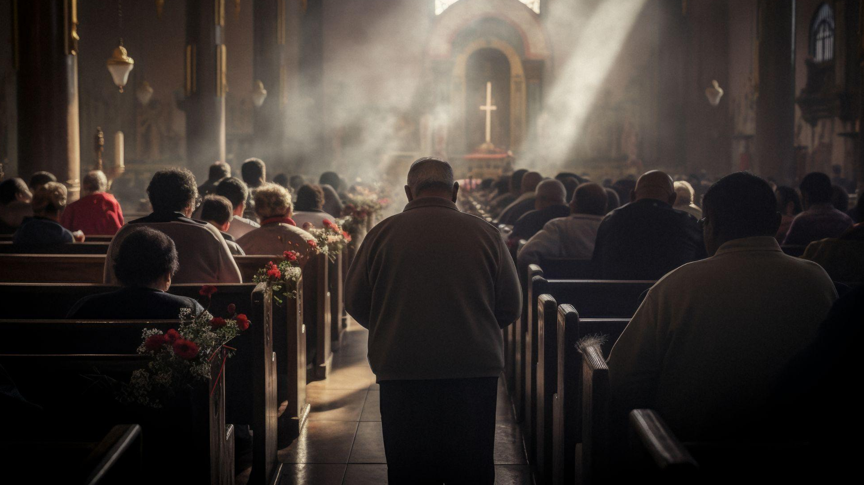
01
WE BELIEVE IN THE FATHER

Slide 9
THE NICENE CREED
1 We believe in one God, the Father Almighty,
Maker of all things visible and invisible.

Slide 10
In one God…
1 Corinthians 8:6 yet for us there is one God, the Father, from whom are all things and we exist for Him, and one Lord, Jesus Christ, by whom are all things, and we exist through Him.
Deuteronomy 6:4 “Hear, O Israel! Yahweh is our God, Yahweh is one!
Mark 12:28 And when one of the scribes came and heard them arguing, he recognized that He had answered them well and asked Him, “What commandment is the foremost of all?” 29 Jesus answered, “The foremost is, ‘Hear, O Israel! The Lord our God is one Lord;

Slide 11
…The Father Almighty
1 Corinthians 8:6 yet for us there is one God, the Father, from whom are all things and we exist for Him, and one Lord, Jesus Christ, by whom are all things, and we exist through Him.
  Ephesians 4:4 There is one body and one Spirit, just as also you were called in one hope of your calling; 5 one Lord, one faith, one baptism; 6 one God and Father of all who is over all and through all and in all.

Slide 12
Maker of all things visible and invisible
1 Corinthians 8:6 yet for us there is one God, the Father, from whom are all things and we exist for Him, and one Lord, Jesus Christ, by whom are all things, and we exist through Him.
Isaiah 42:5 Thus says the God, Yahweh, Who created the heavens and stretched them out, Who spread out the earth and its offspring, Who gives breath to the people on it, and spirit to those who walk in it…
Jeremiah 23:17 ‘Ah Lord Yahweh! Behold, You have made the heavens and the earth by Your great power and by Your outstretched arm! Nothing is too difficult for You…
Ephesians 4:6 one God and Father of all who is over all and through all and in all.

Slide 13
02
AND IN ONE LORD JESUS CHRIST

Slide 14
THE NICENE CREED
2 And in one Lord Jesus Christ,
the Son of God, begotten of the Father [the only-begotten; that is, of the essence of the Father, God of God], Light of Light, very God of very God, begotten, not made, consubstantial with the Father;

Slide 15
…and in One Lord Jesus Christ
1 Corinthians 8:6 yet for us there is one God, the Father, from whom are all things and we exist for Him, and one Lord, Jesus Christ, by whom are all things, and we exist through Him.
Romans 14:9 For to this end Christ died and lived again, that He might be Lord both of the dead and of the living.

Slide 16
the Son of God, begotten of the Father,
The “only Begotten Son of God” means that Jesus’ relationship to God the Father is different than ours. Jesus is truly both Man and God. Throughout the Old and New Testaments, two special titles have been reserved for Jesus – “Son of Man” and “Son of God”. To say that Jesus is “born of the Father” means that He comes from the same divine essence as the Father, which means that He and the Father are of the same kind.

Slide 17
the Son of God, begotten of the Father,
The goal of the Nicene Creed is to clearly showcase the full deity and full humanity of Jesus along with the three-in-one nature of God. This phrase moves us into confessing the second person of the Trinity, Jesus Christ. The best way to understand “only-begotten” is to think about Jesus as the “natural-born” Son of God-- contrasted with adoption which is the means by which we become sons and daughters of God. While we are all in the same family, the means are different. In this instance, “only-begotten” showcases that Jesus is unique in His relationship to God.

Slide 18
the Son of God, begotten of the Father,
Remember, the Nicene Creed is correcting Arius’ opposite statement, “There was a time that Jesus was not.” Oftentimes, “begotten” implies origin, and we see here that Jesus’ origin is timeless and eternal. Jesus has always existed and transcends beyond time.

Slide 19
the Son of God, begotten of the Father,
Psalm 2:7 “I will surely tell of the decree of Yahweh: He said to Me, ‘You are My Son, today I have begotten You.
  God’s decree is eternal, before there was time, day, or even a “today”
Hebrews 1:5 For to which of the angels did He ever say, “You are My Son, today I have begotten You”? …

Slide 20
the Son of God, begotten of the Father,
Mark 1:1 The beginning of the gospel of Jesus Christ, the Son of God.
Mark 15:39 And when the centurion, who was standing right in front of Him, saw the way He breathed His last, he said, “Truly this man was God’s Son!”
John 1:1 In the beginning was the Word, and the Word was with God, and the Word was God. 2 He was in the beginning with God. 3 All things came into being through Him, and apart from Him nothing came into being that has come into being.

Slide 21
the Son of God, begotten of the Father,
John 1:18 No one has seen God at any time; the only begotten God who is in the bosom of the Father, He has explained Him.
John 3:16 “For God so loved the world, that He gave His only begotten Son, that whoever believes in Him shall not perish, but have eternal life.
John 17:5 Now, Father, glorify Me together with Yourself, with the glory which I had with You before the world was.

Slide 22
[God of God], Light of Light, very God of very God
This phrase was added as a direct result of the fourth-century Arian heresy. When you hear “eternally begotten”, one might tend to think about the future of eternity, but eternity also projects backwards!
Jesus, as God, has existed from before the beginning. As humans, who live in the realm of sequential time, this is a tough concept to understand. Arius’ teaching was that “The Logos is not eternal. God begat Him and before He was begotten, He did not exist”.
This means that there was a time when the Word did not exist. Athanasius, a young deacon at the Council, fought hard to defend the accurate teaching of the Church on this matter and his reply to Arius was “The begetting of the Logos was not an event in time, but an eternal relationship.”

Slide 23
[God of God], Light of Light, very God of very God
This set of three statements affirm Jesus is God. Jesus is not partially God, a lesser edition of God, nor is He a secondary God. Jesus is truly God-- fully, completely, essentially, and actually. The metaphor of light underlines the inseparability of Father and Son. In the same way light cannot separate from itself, so it is with Father and Son. Something to consider: Recall Jesus’ self-declaration in the gospel of John, “I am the Light of the World.” In the person of Christ we see God in the flesh-- the Light of the World who created light for the world.

Slide 24
[God of God], Light of Light, very God of very God
Jesus and the Father relate to each other as a source of light relates
The expression “light of light” comes from Athanasius’ writings. He used the analogy of light to explain that the Father and the Son were the same in substance.
Athanasius stated that a son can only be the same sort of being as his father – if the Father is God; the Son is God also.
The rhythmic 3 couplets say undeniably what Arius denied: Jesus IS God

Slide 25
[God of God], Light of Light, very God of very God
Hebrews 1:3 [Jesus] who is the radiance of His glory and the exact representation of His (God’s) nature, and upholds all things by the word of His power; who, having accomplished cleansing for sins, sat down at the right hand of the Majesty on high…
Colossians 1:15 Who is the image of the invisible God, the firstborn of all creation… 19 For in Him all the fullness of God was pleased to dwell,
Colossians 2:9 For in Him all the fullness of Deity dwells bodily

Slide 26
[God of God], Light of Light, very God of very God
Romans 9:5 whose are the fathers, and from whom is the Christ according to the flesh, who is God over all, blessed forever. Amen.
John 1:18 No one has seen God at any time; the only begotten God who is in the bosom of the Father, He has explained Him.

Slide 27
[God of God], Light of Light, very God of very God
Isaiah 43:10 “You are My witnesses,” declares Yahweh, “And My servant whom I have chosen, So that you may know and believe Me and understand that I am He. Before Me there was no god formed, and there will be none after Me.
John 8:24 Therefore I said to you that you will die in your sins. For unless you believe that I am He, you will die in your sins.”

Slide 28
[God of God], Light of Light, very God of very God
Isaiah 40:3 A voice [a]is calling, “Prepare the way for Yahweh in the wilderness; Make smooth in the desert a highway for our God. 4 Let every valley be lifted up, and every mountain and hill be made low; And let the rough ground become a plain, And the rugged terrain a broad valley;
Mark 1:3 The voice of one crying in the wilderness, ‘Make ready the way of the Lord, Make His paths straight.’”

Slide 29
[God of God], Light of Light, very God of very God
Isaiah 40:3 A voice [a]is calling, “Prepare the way for Yahweh in the wilderness; Make smooth in the desert a highway for our God. 4 Let every valley be lifted up, and every mountain and hill be made low; And let the rough ground become a plain, And the rugged terrain a broad valley;
Mark 1:3 The voice of one crying in the wilderness, ‘Make ready the way of the Lord, Make His paths straight.’”
Who is the way made ready for?

Slide 30
[God of God], Light of Light, very God of very God
Isaiah 6:1 In the year of King Uzziah’s death I saw the Lord sitting on a throne, high and lifted up, with the train of His robe filling the temple.
John 12:40 “He has blinded their eyes and He hardened their heart, lest they see with their eyes and understand with their heart, and return and I heal them.” 41 These things Isaiah said because he saw His glory, and he spoke about Him.
Who did Isaiah see?

Slide 31
[God of God], Light of Light, very God of very God
Isaiah 44:6 “Thus says Yahweh, the King of Israel and his Redeemer, Yahweh of hosts: ‘I am the first, and I am the last, and there is no God besides Me.
Revelation 1:17 And when I saw Him, I fell at His feet like a dead man. And He placed His right hand on me, saying, “Do not fear; I am the first and the last
Who is the first and the last?

Slide 32
[God of God], Light of Light, very God of very God
Zechariah 2:10 “And I will pour out on the house of David and on the inhabitants of Jerusalem [a]the Spirit of grace and of supplication, so that they will look on Me whom they have pierced; and they will mourn for Him, as one mourns for an only son, and they will weep bitterly over Him like the bitter weeping over a firstborn.
Revelation 1:7 Behold, He is coming with the clouds, and every eye will see Him, even those who pierced Him; and all the tribes of the earth will mourn over Him. Yes, amen.
Who is speaking in Zechariah chapter 12?
Who was pierced?

Slide 33
[God of God], Light of Light, very God of very God
2 Corinthians 4:4 in whose case the god of this age has blinded the minds of the unbelieving [a]so that they might not see the light of the gospel of the glory of Christ, who is the image of God. 5 For we do not preach ourselves but Jesus Christ as Lord, and ourselves as your slaves [b]for the sake of Jesus. 6 For God, who said, “Light shall shine out of darkness,” is the One who has shone in our hearts to give the Light of the knowledge of the glory of God in the face of Christ.

Slide 34
[God of God], Light of Light, very God of very God
Isaiah 9:2 [a]The people who walk in darkness Will see a great light; Those who live in the land of the shadow of death, The light will shine on them.
Luke 2:32 A Light for revelation to the Gentiles, And for the glory of Your people Israel.”
Matthew 4:16 The people who were sitting in darkness saw a great Light, And those who were sitting in the land and shadow of death, Upon them a Light dawned.”
Isaiah 60:3 Nations will come to your light, And kings to the brightness of your rising.

Slide 35
[God of God], Light of Light, very God of very God
Luke 4:16 And He came to Nazareth, where He had been brought up, and as was His custom, He entered the synagogue on the Sabbath and stood up to read. 17 And the scroll of the prophet Isaiah was handed to Him. And He opened the scroll and found the place where it was written,
18 “The Spirit of the Lord is upon Me
Because He anointed Me to preach the gospel to the poor
He has sent Me to proclaim release to the captives,
And recovery of sight to the blind,

Slide 36
[God of God], Light of Light, very God of very God
John 9:1 As He passed by, He saw a man blind from birth. 2 And His disciples asked Him, saying, “Rabbi, who sinned, this man or his parents, that he would be born blind?” 3 Jesus answered, “Neither this man nor his parents sinned, but this was so that the works of God might be manifested in him. 4 We must work the works of Him who sent Me as long as it is day; night is coming when no one can work. 5 While I am in the world, I am the light of the world.” 6 When He had said this, He spat on the ground, made clay of the saliva, and rubbed the clay on his eyes, 7 and said to him, “Go, wash in the pool of Siloam” (which is translated, Sent). So he went away and washed, and came back seeing.

Slide 37
[God of God], Light of Light, very God of very God
Acts 9:1 Now Saul, still breathing [b]threats and murder against the disciples of the Lord, went to the high priest, 2 and asked for letters from him to the synagogues at Damascus, so that if he found any belonging to the Way, both men and women, he might bring them bound to Jerusalem. 3 And as he was traveling, it happened that when he was approaching Damascus, suddenly a light from heaven flashed around him; 4 and falling to the ground, he heard a voice saying to him, “Saul, Saul, why are you persecuting Me?” 5 And he said, “Who are You, Lord?” And He said, “I am Jesus whom you are persecuting, 6 but rise up and enter the city, and it will be told you what you must do.” 7 And the men who traveled with him stood speechless, hearing the voice but seeing no one. 8 And Saul got up from the ground, and though his eyes were open, he could see nothing. Leading him by the hand, they brought him into Damascus. 9 And he was three days without sight, and neither ate nor drank.

Slide 38
[God of God], Light of Light, very God of very God
John 3:21 But he who practices the truth comes to the Light, so that his deeds may be manifested as having been done by God.”
1 John 1:7 but if we walk in the Light as He Himself is in the Light, we have fellowship with one another, and the blood of Jesus His Son cleanses us from all sin.

