Slide 2
Colossians 3:16 Let the word of Christ dwell in you richly, with all wisdom teaching and admonishing one another with psalms and hymns and spiritual songs, singing with gratefulness in your hearts to God. Luther – A Mighty Fortress

Slide 3
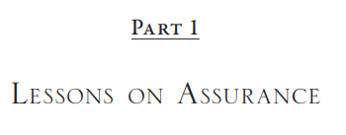
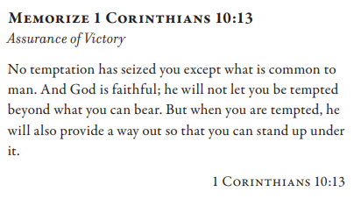
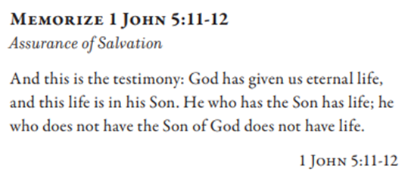
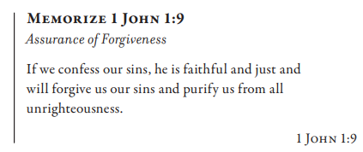
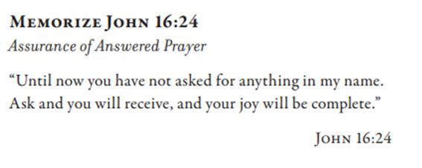

Slide 4
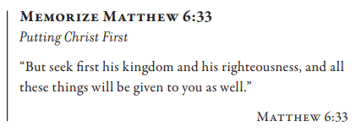

Slide 5
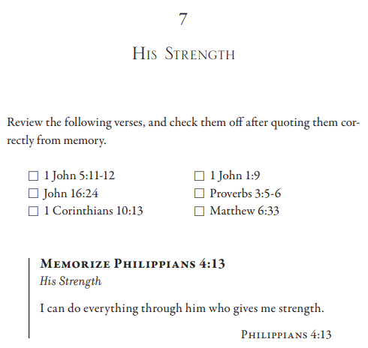
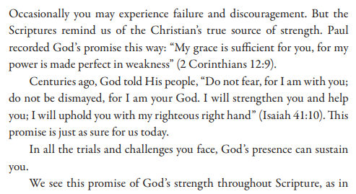

Slide 6
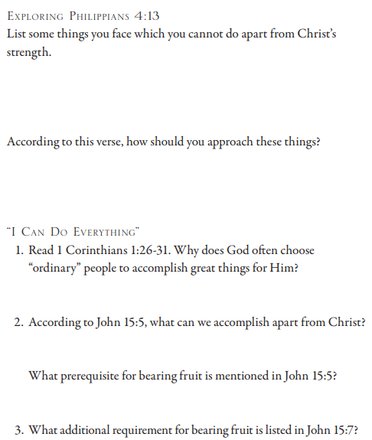
Philippians 4:13 I can do all things through Him who strengthens me. 1 Corinthians 1:26 For consider your calling, brothers, that there were not many wise according to the flesh, not many mighty, not many noble. 27 But God has chosen the foolish things of the world to shame the wise, and God has chosen the weak things of the world to shame the things which are strong, 28 and the base things of the world and the despised God has chosen, the things that are not, so that He may abolish the things that are, 29 so that no flesh may boast before God. 30 But by His doing you are in Christ Jesus, who became to us wisdom from God, and righteousness and sanctification, and redemption, 31 so that, just as it is written, “Let him who boasts, boast in the Lord.” John 15:5 I am the vine, you are the branches; he who abides in Me and I in him, he bears much fruit, for apart from Me you can do nothing… 7 If you abide in Me, and My words abide in you, ask whatever you wish, and it will be done for you.

Slide 7
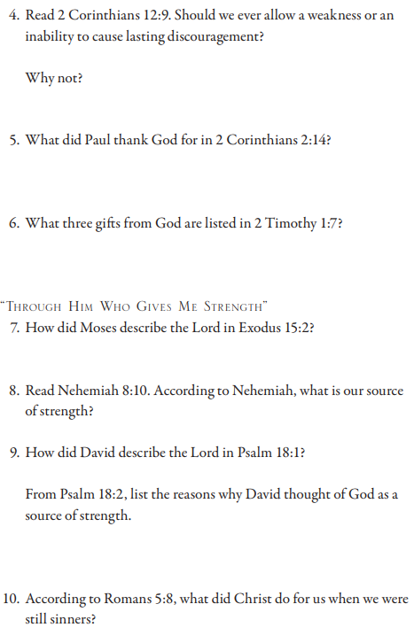
2 Corinthians 12:9 And He has said to me, “My grace is sufficient for you, for power is perfected in weakness.” Most gladly, therefore, I will rather boast in my weaknesses, so that the power of Christ may dwell in me… 14 Here for this third time I am ready to come to you, and I will not be a burden to you; for I do not seek what is yours, but you. For children ought not to save up for their parents, but parents for their children. 2 Timothy 1:7 For God has not given us a spirit of timidity, but of power and love and self-discipline. Exodus 15:2 Yah is my strength and song, and He has become my salvation; This is my God, and I will praise Him; My father’s God, and I will extol Him. Nehemiah 8:10 Then he said to them, “Go, eat of the fat, drink of the sweet, and send portions to him who has nothing prepared; for this day is holy to our Lord. Do not be grieved, for the joy of Yahweh is your strength.” Psalm 18:1 He said, “I love You, O Yahweh, my strength.” 2 Yahweh is my rock and my fortress and my deliverer, my God, my rock, in whom I take refuge; my shield and the horn of my salvation, my stronghold. Romans 5:8 But God demonstrates His own love toward us, in that while we were yet sinners, Christ died for us.

Slide 8
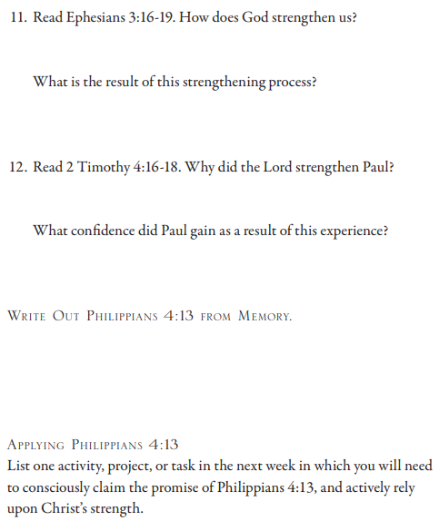
Ephesians 3:16 that He would give you, according to the riches of His glory, to be strengthened with power through His Spirit in the inner man, 17 so that Christ may dwell in your hearts through faith; and that you, being firmly rooted and grounded in love, 18 may be able to comprehend with all the saints what is the breadth and length and height and depth, 19 and to know the love of Christ which surpasses knowledge, that you may be filled up to all the fullness of God. 2 Timothy 4:16 At my first defense no one supported me, but all deserted me. May it not be counted against them. 17 But the Lord stood with me and strengthened me, so that through me the preaching might be fulfilled, and that all the Gentiles might hear. And I was rescued out of the lion’s mouth. 18 The Lord will rescue me from every evil deed, and will save me unto His heavenly kingdom; to Him be the glory forever and ever. Amen.

