Slide 1
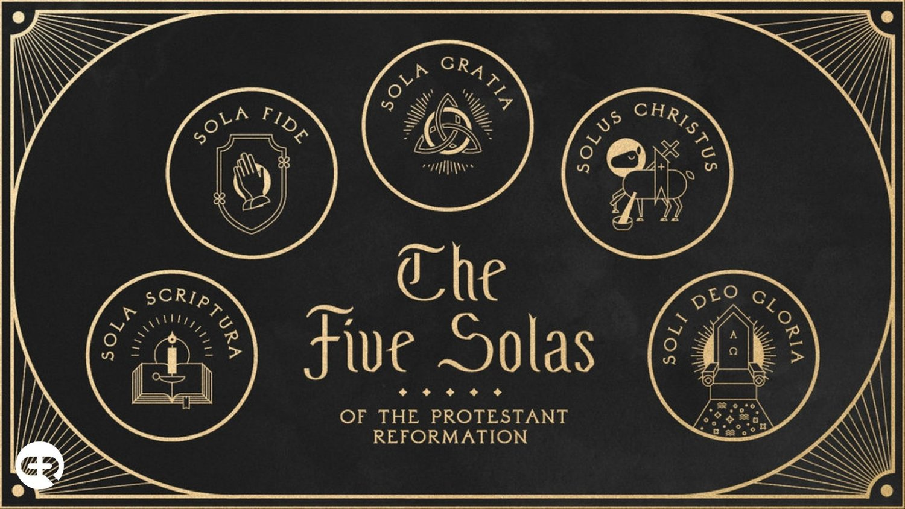
The 5 Solas of The Reformation

Slide 2
OCTOBER 31, 1517. –
The date most historians would say as the beginning of the Reformation when…
Martin Luther nailed his 95 theses to the church door at Wittenburg, GERMANRY
A date generally regarded as the birthday of the Reformation.

Slide 3
OUT OF THE MANY, WHAT MAKES ONE PART OF TRUE CHRISTIANITY? What sets one apart from other groups claiming to be Christians?

Slide 4
Definitions:
SOLA - The Latin word sola means "alone" or "only" in English.
The 5 SOLAS - The five solas articulated five (5) fundamental beliefs of the Protestant Reformation, pillars which the Reformers believed to be essentials of the Christian life and practice.

Slide 5
The 5 SOLAS:
The 5 Solas of the Protestant Reformation is the TOUCHSTONE of Evangelical Christianity.
It is the test of genuine truths and beliefs in the midst of an ocean of beliefs and multiple religious mysteries and teachings.
The 5 Solas stands as the guidepost for all TRUE CHRISTIAN LIFE AND PRACTICE.

Slide 6
1. Sola Scriptura ("by Scripture alone")
The Scripture Alone is the Standard
Formal cause of the Reformation
In 1521 at the historic interrogation of Luther at the Diet of Worms, he declared his conscience to be captive to the Word of God saying, "Unless I am overcome with testimonies from Scripture or with evident reasons -- for I believe neither the Pope nor the Councils, since they have often erred and contradicted one another -- I am overcome by the Scripture texts which I have adduced, and my conscience is bound by God's Word.“
“Here I stand I can do no other” (allegedly)

Slide 7
Sola Scriptura
Scripture is the…
Sole infallible rule of faith for faith and practice in the church.

Slide 8
Sola Scriptura
2 Timothy 3:14 But you, continue in the things you learned and became convinced of, knowing from whom you learned them, 15 and that from childhood you have known the sacred writings which are able to make you wise unto salvation through faith which is in Christ Jesus. 16 All Scripture is God-breathed and profitable for teaching, for reproof, for correction, for training in righteousness, 17 so that the man of God may be equipped, having been thoroughly equipped for every good work.
cf. Deuteronomy 6:6 These words, which I am commanding you today, shall be on your heart. 7 You shall teach them diligently to your sons…
OT in view, but does not limit ALL

Slide 9
Sola Scriptura
2 Peter 1:19 And we have as more sure the prophetic word, to which you do well to pay attention as to a lamp shining in a dark place, until the day dawns and the morning star arises in your hearts. 20 Know this first of all, that no prophecy of Scripture comes by one’s own interpretation. 21 For no prophecy was ever made by the will of man, but men being moved by the Holy Spirit spoke from God.

Slide 10
Sola Scriptura
Matthew 22:29 But Jesus answered and said to them, “You are mistaken, not understanding the Scriptures nor the power of God. 30 For in the resurrection they neither marry nor are given in marriage, but are like angels in heaven. 31 But regarding the resurrection of the dead, have you not read what was spoken to you by God, saying, 32 ‘I am the God of Abraham, and the God of Isaac, and the God of Jacob’? He is not the God of the dead but of the living.” 33 And when the crowds heard this, they were astonished at His teaching.

Slide 11
Sola Scriptura
Hebrews 1:1 God, having spoken long ago to the fathers in the prophets in many portions and in many ways, 2 in these last days spoke to us in His Son…

Slide 12
Sola Scriptura
Peter Quotes Paul as Scripture
2 Peter 3:15 and consider the patience of our Lord as salvation, just as also our beloved brother Paul, according to the wisdom given him, wrote to you, 16 as also in all his letters, speaking in them of these things, in which are some things hard to understand, which the untaught and unstable distort, as they do also the rest of the Scriptures, to their own destruction.

Slide 13
Sola Scriptura
Paul Quotes Luke as Scripture
1 Timothy 5:18 For the Scripture says, “You shall not muzzle the ox while it is threshing,” and “The laborer is worthy of his wages.” (Quotes OT & NT)
Deuteronomy 25:4 “You shall not muzzle the ox while it is threshing. (OT)
Luke 10:7 Stay in that house, eating and drinking what they give you; for the laborer is worthy of his wages. Do not keep moving from house to house. (NT)
1 Corinthians 9:9 For it is written in the Law of Moses, “You shall not muzzle the ox while it is threshing.” Is God merely concerned about oxen? (Only Quotes OT)

Slide 14
Sola Scriptura
Paul refers to his own writings as Scripture
1 Thessalonians 2:13 And for this reason we also thank God without ceasing that when you received the word of God which you heard from us, you accepted it not as the word of men, but for what it really is, the word of God, which also is at work in you who believe.
2 Thessalonians 2:15 So then, brothers, stand firm and hold to the traditions which you were taught, whether by word of mouth or by letter from us.
1 Corinthians 14:37 If anyone thinks he is a prophet or spiritual, let him recognize that the things which I write to you are the Lord’s commandment. 38 But if anyone remains ignorant about this, he is ignored by God.

Slide 15
Sola Scriptura
Luke claims Apostolic tradition
Luke 1:1 Inasmuch as many have undertaken to compile an account of the things that have been fulfilled among us, 2 just as those, who from the beginning were eyewitnesses and servants of the word, handed them down to us, 3 it seemed fitting for me as well, having investigated everything carefully from the beginning, to write it out for you in orderly sequence, most excellent Theophilus, 4 so that you may know the certainty about the things you have been taught.

Slide 16
Sola Scriptura
Revelation
Revelation 1:1 The Revelation of Jesus Christ, which God gave Him to show to His slaves the things which must soon happen; and He indicated this by sending it through His angel to His slave John, 2 who bore witness to the word of God and to the witness of Jesus Christ, even to all that he saw. 3 Blessed is he who reads and those who hear the words of the prophecy and keep the things which are written in it, for the time is near.
22:18 I bear witness to everyone who hears the words of the prophecy of this book: If anyone adds to them, God will add to him the plagues which are written in this book. 19 And if anyone takes away from the words of the book of this prophecy, God will take away his part from the tree of life and from the holy city, which are written in this book.

