Slide 1
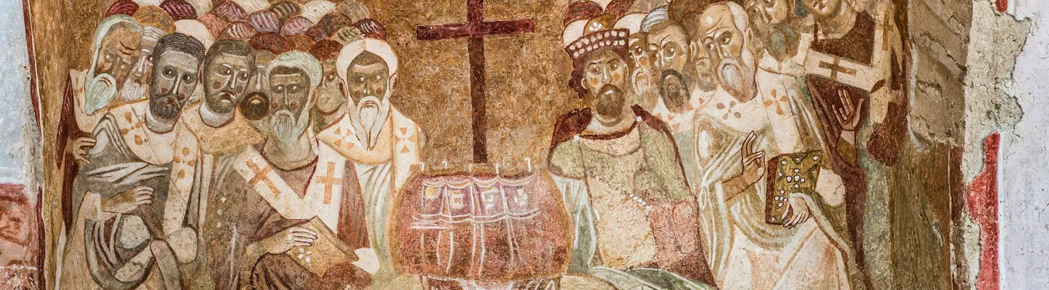
NICENE CREED
AFTER 1700 YEARS

Slide 2
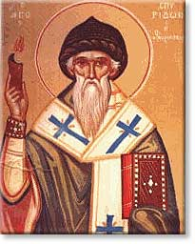
ARIUS
Pre-325
Arius was born in Libya ~250 A.D.
Tall, thin, walked barefoot, winsome personality, musical
Presbyter in Alexandria under his Bishop Alexander

Slide 3
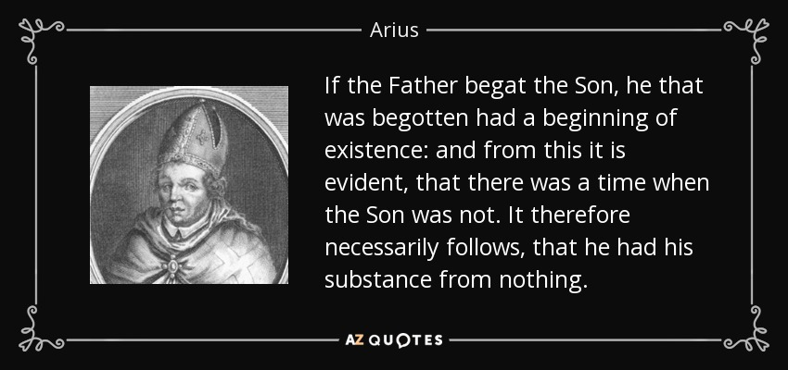
Famous song lyrics ♬“There was (once) a time when Christ was not” ♬
CHALLENGE
BEGOTTEN
CHURCH HISTORY VOLUME ONE, EVERETT FERGUSON
Began teaching contrary to Alexander’s teaching that the Father and the Son are co-eternal.
Arius thought that “begotten” meant “created” or “made.”
“Arius taught that Jesus Christ was not derived from the substance of the Father, but, as the first and highest of God’s creations, became the instrument of all the rest of creation.”

Slide 4
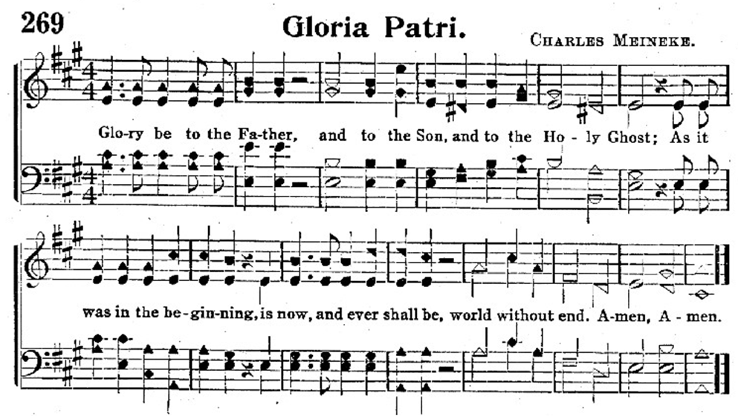
The Gloria Patri
Many Christians disagreed with Arius so began singing a song that’s still used in the church today
Also known as “the lesser doxology”
Anonymously written
~2nd century
https://youtu.be/EAJ4YQmUaBk?si=Uj0i49yuHYdIvsaq

Slide 5
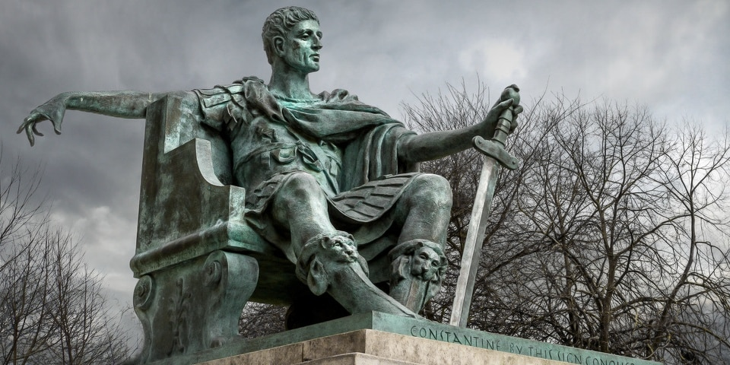
Emperor Constantine
Converted to Christianity
Saw the theological conflict and wanted to resolve it.
Used his power to convene bishops from the east and the west

Slide 6
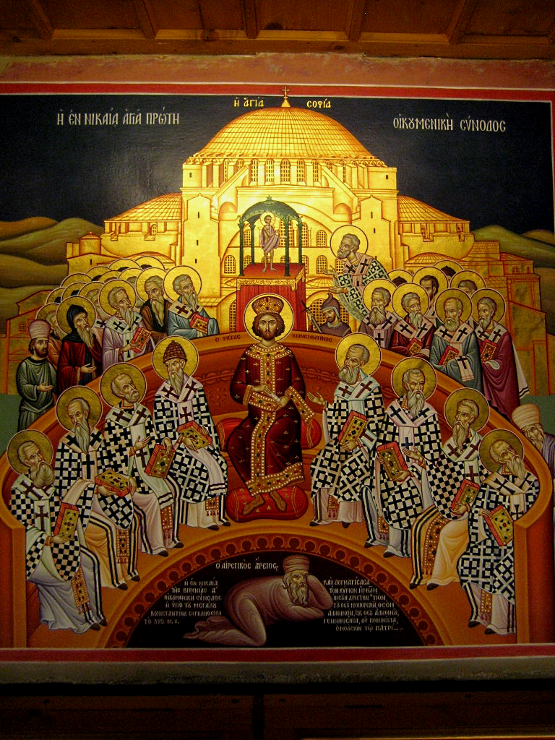
THE COUNCIL OF
NICEA
In 325 Constantine calls a council at Nicea
Historically named the Council of Nicea
Invited Bishops from the West and the East
First Ecumenical Council
Deliberations about whether Arius taught falsehood

Slide 7
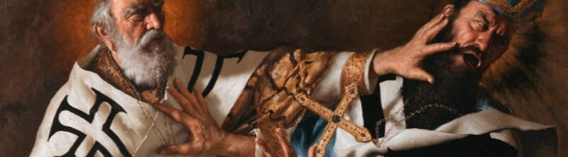
Conflict
Two bishops lost eyes from persecution
Another bishop hamstrung
Bishop Paul of Caesarea hands hot irons, paralyzed
St. Nick’s Slap
Eusebius & Arius vs Athanasius
Black Dwarf
Exiled 5 times defending the deity of Christ
Athanasius Contra Mundum

Slide 8
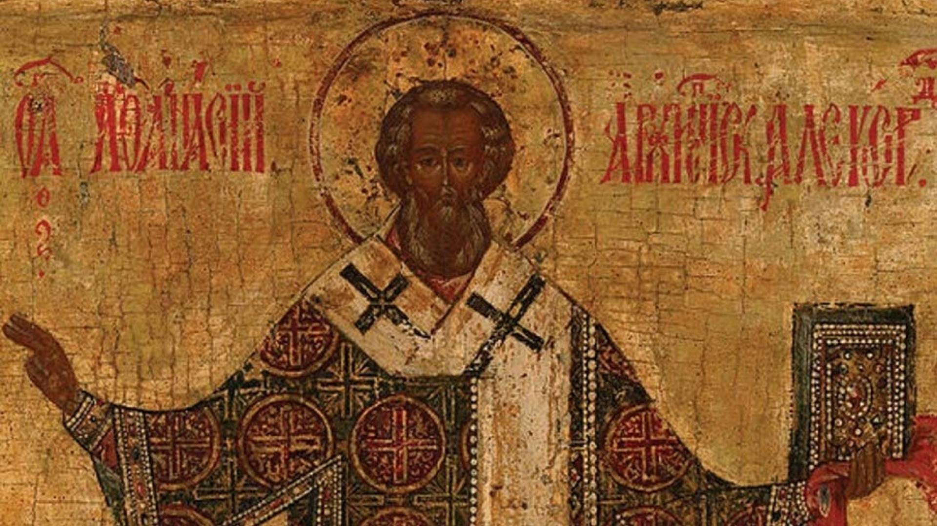
VERDICT
Athanasius insisted that there is no place in Christian thought for any kind of an intermediate being between God and man, between Creator and creature. And he argues passionately that true redemption is accomplished only through God the Son, not an intermediary. Athanasius wins the day at the Council of Nicaea, the Father and the Son are co-eternal and of one substance (homoousius.)”
NOT heteroousios “of different essence/being” and
NOT homoiousios “of similar or like essence/being”
All but 3 agreed of the ~250 bishops attending

Slide 9
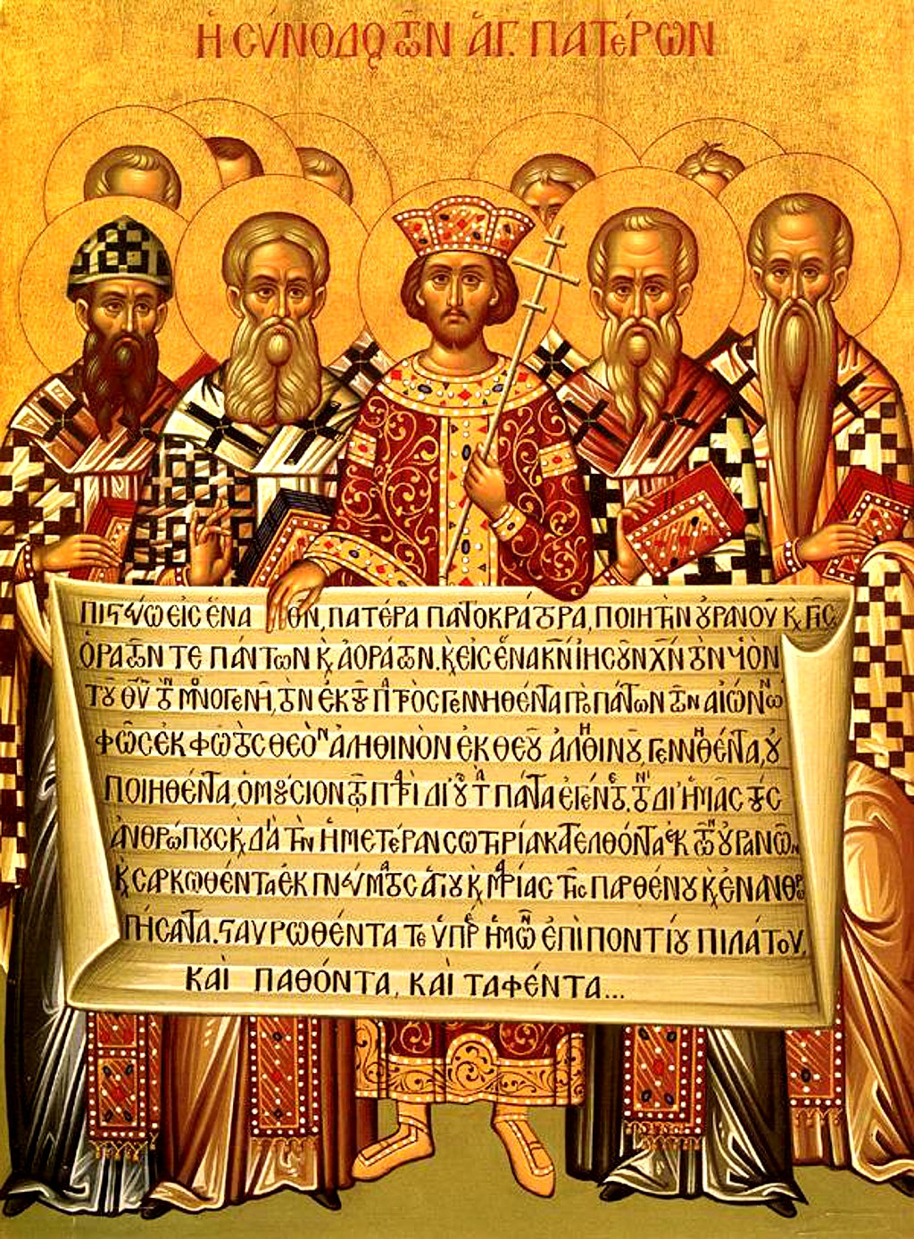
CREED
The overwhelming majority of Bishops condemned Arius as a heretic
Anyone preaching his ideas or possessing his manuscripts may be convicted of a capital crime.
Formulated an official Creed to affirm, against Arian heresy
Important to this day: Cults

Slide 10
THE NICENE CREED
We believe in one God, the Father Almighty,
Maker of all things visible and invisible.
And in one Lord Jesus Christ, the Son of God, begotten of the Father [the only-begotten; that is, of the essence of the Father, God of God,] Light of Light, very God of very God, begotten, not made, consubstantial with the Father;
By whom all things were made [both in heaven by whom all things were made; and on earth];
Who for us men, and for our salvation, came down and was incarnate and was made man;
He suffered, and the third day he rose again, ascended into heaven;
From thence he shall come to judge the quick and the dead.
And in the Holy Ghost.

Slide 11
Structure of the Nicene Creed (325)
01
02
03
WE BELIEVE IN THE FATHER (MAKER)
AND IN ONE LORD JESUS CHRIST (BEGOTTEN NOT MADE / CONSUBSTANTIAL)
I JESUS IS MAKER
II JESUS BECAME INCARNATE
III JESUS’S PASSION
IV JESUS WILL COME AGAIN
AND IN THE HOLY SPIRIT

Slide 12
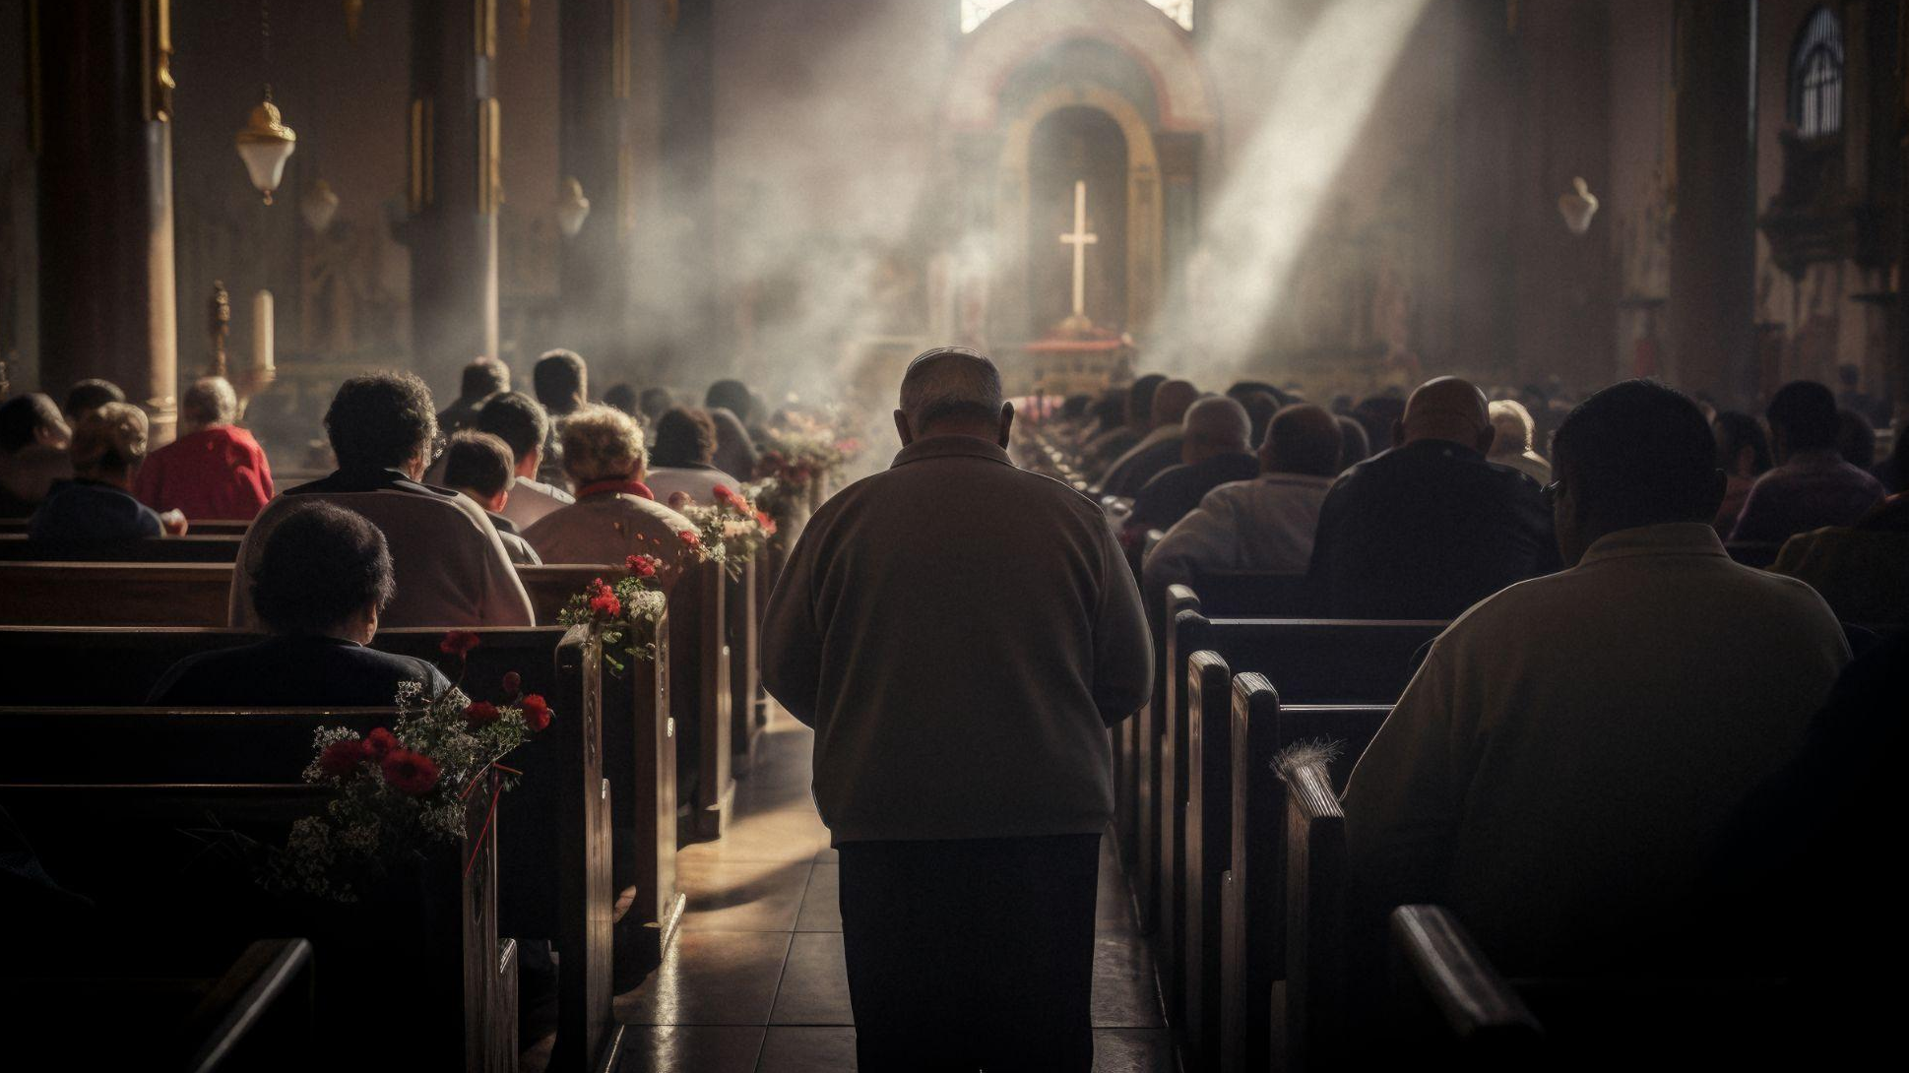
01
WE BELIEVE IN THE FATHER

Slide 13
THE NICENE CREED
1 We believe in one God, the Father Almighty,
Maker of all things visible and invisible.

Slide 14
What is a creed?
Creeds are statements of belief rooted deeply in scripture. Like the short version of a long story, or the sparknotes of an entire book: Creeds are shareable, summary statements of Christian beliefs. They are meant to be said aloud for us to declare and for others to hear. They are personal and individual-- the word, credo, where we get “creed” literally means “I believe.” And yet, there is value in the people of God confessing together (corporately) what “we believe,” too. Creeds are memorable and shareable because of their short lengths, allowing for biblical truths to easily pass from generation to generation (which reflects the rich, oral tradition followers of God have been doing for a long time! See Ex 13:14-16; Deut 6:4-9, 20-25; I Cor 15:3-4; I Tim 4:16; II Tim 2:15-18).

Slide 15
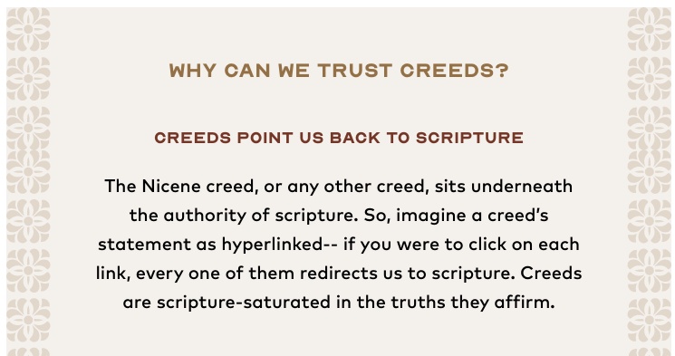

Slide 16
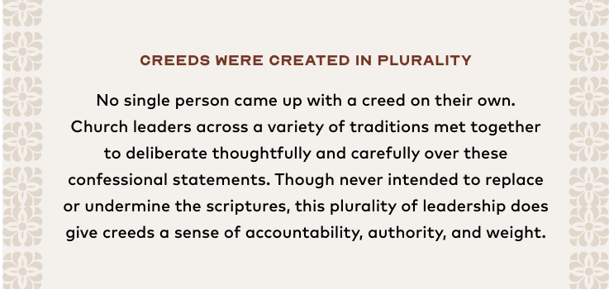

Slide 17
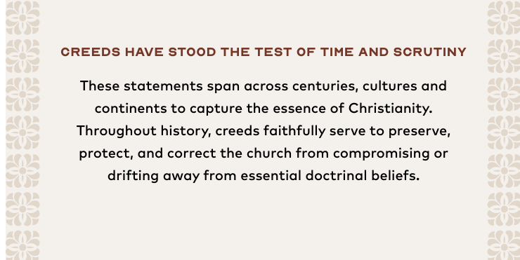

Slide 18
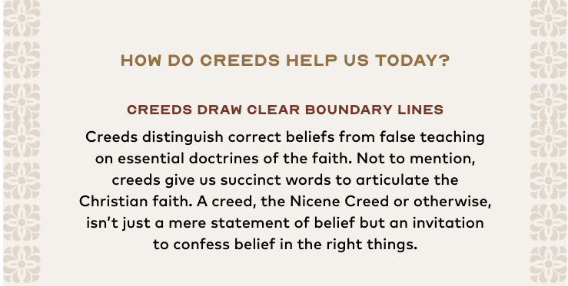

Slide 19
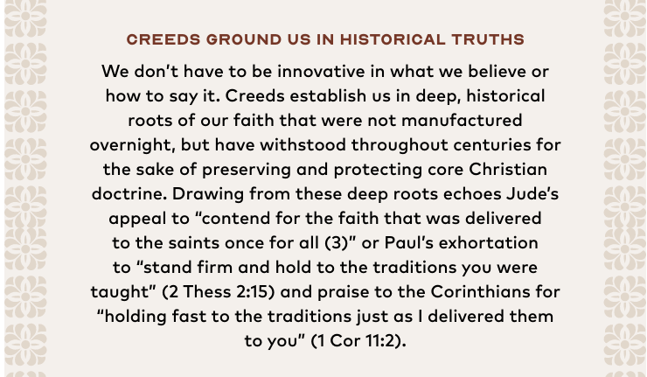

Slide 20
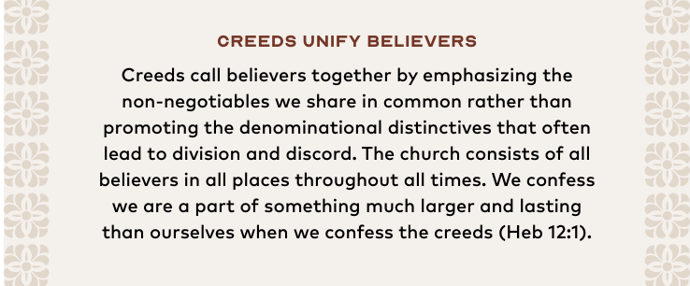

Slide 21
We Believe…
The very first words are absolutely vital to the purpose of the Nicene Creed.
It was designed to unify, as well as exclude;
to define which understandings were acceptable and which were not.
It was about the unity of Christians from the very first word.

Slide 22
We Believe…
The text of the Creed in Common Worship begins in the first-person plural, as in the original Greek text, ‘We believe’
This recalls the fact that Christian belief is something that is shared / corporate
With other Christians around the world
And also a faith that stretches back in time to the early Church.

Slide 23
What does it mean to believe?
There are many levels…
Belief that makes no difference.
An example would be: “I believe that there is a New York City.” Even though you may have never actually been to New York City, it is simply a fact that must be accepted or rejected by the intellect.

Slide 24
What does it mean to believe?
There are many levels…
Belief that makes some difference.
A statement such as “I believe that exercise will make me feel better” fits. For the fact to have effect, it must be put into action, and only then does it have some impact upon one’s health and well-being.

Slide 25
What does it mean to believe?
There are many levels…
Belief that demands a response.
“I believe that with God, all things are possible.” If I truly believe, it will change my entire outlook on life. This is the level of belief that is used in the opening of the Nicene Creed.

Slide 26
We Believe…
James 2:19 You believe that God is one. You do well; the demons also believe, and shudder.
Does Satan believe God exists? Of course, he does. Satan, however, does not have the belief that demands the right response. He believes that there is a God, but he does not BELIEVE “IN” GOD. He trusts more in his own will, and distrusts God’s plan to eternal happiness. Believe = TOTAL TRUST

Slide 27
We Believe…
James 2:19 You believe that God is one. You do well; the demons also believe, and shudder.
To say this together in worship is, as James reminds us in his letter, is more than an intellectual acknowledgment that God exists (James 2.19). It means something like ‘We commit ourselves to God.’

Slide 28
Belief
John 3:16 “For God so loved the world, that He gave His only begotten Son, that whoever believes in Him shall not perish, but have eternal life.
John 20:29 Jesus *said to him, “Because you have seen Me, have you believed? Blessed are those who did not see, and yet believed.”

Slide 29
Belief
John 14:1 “Do not let your heart be troubled; believe in God, believe also in Me.
Romans 10:9 that if you confess with your mouth Jesus as Lord, and believe in your heart that God raised Him from the dead, you will be saved; 10 for with the heart a person believes, leading to righteousness, and with the mouth he confesses, leading to salvation.

Slide 30
Belief
Mark 9:24 Immediately the boy’s father cried out and was saying, “I do believe; help my unbelief.”

