Slide 1
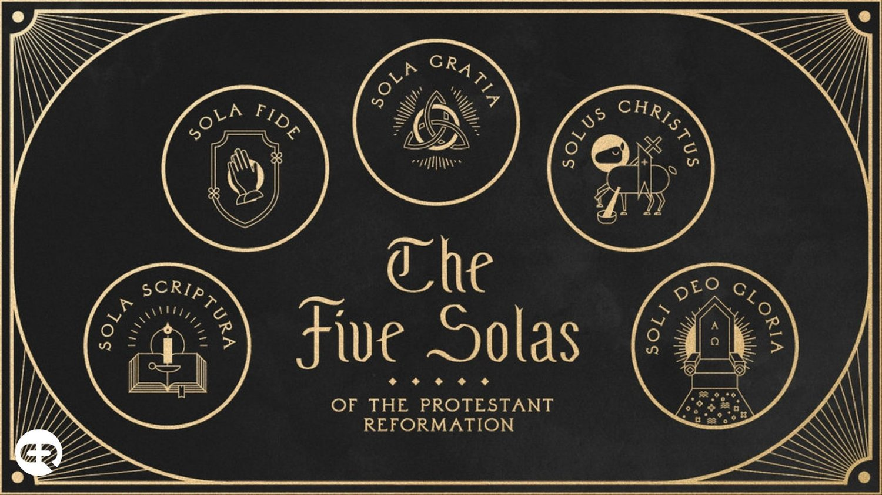
The 5 Solas of The Reformation

Slide 2
IN CHRIST ALONE https://www.youtube.com/watch?v=est8VHSaJcE
John 4:24 God is spirit, and those who worship Him must worship in spirit and truth.”
Colossians 3:16 Let the word of Christ dwell in you richly, with all wisdom teaching and admonishing one another with psalms and hymns and spiritual songs, singing with gratefulness in your hearts to God.
Ephesians 5:19 [speak] to one another in psalms and hymns and spiritual songs, singing and making melody with your heart to the Lord; 20 always giving thanks for all things in the name of our Lord Jesus Christ to God, even the Father;

Slide 3
OCTOBER 31, 1517. –
The date most historians would say as the beginning of the Reformation when…
Martin Luther nailed his 95 theses to the church door at Wittenburg, GERMANRY
A date generally regarded as the birthday of the Reformation.

Slide 4
Definitions:
SOLA - The Latin word sola means "alone" or "only" in English.
The 5 SOLAS - The five solas articulated five (5) fundamental beliefs of the Protestant Reformation, pillars which the Reformers believed to be essentials of the Christian life and practice.

Slide 5
The 5 SOLAS:
The 5 Solas of the Protestant Reformation is the TOUCHSTONE of Evangelical Christianity.
It is the test of genuine truths and beliefs in the midst of an ocean of beliefs and multiple religious mysteries and teachings.
The 5 Solas stands as the guidepost for all TRUE CHRISTIAN LIFE AND PRACTICE.

Slide 6
1. Sola Scriptura ("by Scripture alone")
The Scripture Alone is the Standard
Formal cause of the Reformation
In 1521 at the historic interrogation of Luther at the Diet of Worms, he declared his conscience to be captive to the Word of God saying, "Unless I am overcome with testimonies from Scripture or with evident reasons -- for I believe neither the Pope nor the Councils, since they have often erred and contradicted one another -- I am overcome by the Scripture texts which I have adduced, and my conscience is bound by God's Word.“
“Here I stand I can do no other” (allegedly)

Slide 7
Sola Scriptura
Scripture is the…
Sole infallible rule of faith for faith and practice in the church.
2 Timothy 3:16 All Scripture is God-breathed and profitable for teaching, for reproof, for correction, for training in righteousness, 17 so that the man of God may be equipped, having been thoroughly equipped for every good work.

Slide 8
2. Sola Gratia ("by grace alone")
Sola gratia is the teaching that salvation comes by God’s Grace Alone— not as something merited by the sinner. This means that salvation is an unearned gift from God for Jesus' sake.
Not by good works or religious works
Grace defined: "unmerited favor“ or rather “demerited favor”
3. Sola Fide (“through faith alone")
Sola fide is the teaching that salvation comes through man’s Faith Alone— not as cooperating with works
Not by good works or religious works
Faith is more than content and agreement, but total trust

Slide 9
Grace by which we are saved Faith through which we are saved
Ephesians 2:8 For by grace you have been saved through faith, and this not of yourselves, it is the gift of God; 9 not of works, so that no one may boast.
Locus classicus
Against partial grace or a mere power
Grace and Faith are a Gift!
Gift vs Earnings

Slide 10
Grace and Faith
Ephesians 2:1 And you were dead]in your transgressions and sins, 2 in which you formerly walked according to the course of this world, according to the ruler of the power of the air, the spirit that is now working in the sons of disobedience, 3 among whom we all also formerly conducted ourselves in the lusts of our flesh, doing the desires of the flesh and of the mind, and were by nature children of wrath, even as the rest. 4 But God, being rich in mercy because of His great love with which He loved us, 5 even when we were dead in our transgressions, made us alive together with Christ—by grace you have been saved—

Slide 11
Monergism
Monergism not Synergism
Romans 8:6 For the mind set on the flesh is death, but the mind set on the Spirit is life and peace, 7 because the mind set on the flesh is hostile toward God, for it does not subject itself to the law of God, for it is not even able to do so, 8 and those who are in the flesh are not able to please God.
John 3:19 And this is the judgment, that the Light has come into the world, and men loved the darkness rather than the Light, for their deeds were evil
Man is unable to save himself, it is a work of God!

Slide 12
Case Study: Paul
Who was Saul/Paul?
Acts 22:6 “But it happened that as I was on my way, approaching Damascus about noontime, a very bright light suddenly flashed from heaven all around me, 7 and I fell to the ground and heard a voice saying to me, ‘Saul, Saul, why are you persecuting Me?’ 8 And I answered, ‘Who are You, Lord?’ And He said to me, ‘I am Jesus the Nazarene, whom you are persecuting.’ 9 And those who were with me beheld the light, to be sure, but did not understand the voice of the One who was speaking to me. 10 And I said, ‘What should I do, Lord?’ And the Lord said to me, ‘Rise up and go on into Damascus, and there you will be told of all that has been determined for you to do.’ 11 But since I could not see because of the glory of that light, being led by the hand by those who were with me, I came into Damascus..

Slide 13
Great exchange, double imputation of sin / justification
2 Corinthians 5:21 He made Him who knew no sin to be sin on our behalf, so that we might become the righteousness of God in Him.

Slide 14
Abraham, our Patriarch (Father in the faith) & his salvation
Romans 4:21 and being fully assured that what God had promised, He was able also to do. 22 Therefore it was also counted to him as righteousness.
Galatians 3:6 Just as Abraham believed God and it was counted to him as righteousness, 7 so know that those who are of faith, those are sons of Abraham.
Genesis 15:6 Then he believed in Yahweh; and He counted it to him as righteousness.
DECLARED / counted righteous *BEFORE* testing of Isaac (good works) or Circumcision (religious works)

Slide 15
4. Solus Christus ("Christ alone”)
By Christ's Work Alone are We Saved
Solus Christus is the teaching that CHRIST is the only mediator between God and man, and that there is salvation through no other (hence, the phrase is sometimes rendered in the ablative case, solo Christo, meaning that salvation is "by Christ alone").
Christ alone is the foundation and focus of our faith
Christ alone is the way to God
Christ alone can save us and not…
Man
Church
Works
Rituals

Slide 16
Theology of the mediator
A middle person who intervenes on behalf of
As sinners God is unapproachable
As we normatively do not have access directly to God audibly or face to face, through the history of mankind we have accessed God through mediators
OT: only priests could enter the Holy of Holies in the tabernacle/temple

Slide 17
Theology of the mediator
Leviticus 16: 2 And Yahweh said to Moses: “Tell your brother Aaron that he shall not enter at any time into the holy place inside the veil, before the mercy seat which is on the ark, so that he will not die; for I will appear in the cloud over the mercy seat. 3 Aaron shall enter the holy place with this: with a bull from the herd for a sin offering and a ram for a burnt offering…
Numbers 3:5 Then Yahweh spoke to Moses, saying, 6 “Bring the tribe of Levi near and have them stand before Aaron the priest, that they may minister to him. 7 And they shall keep his responsibility… 10 So you shall appoint Aaron and his sons that they may keep their priesthood, but the outsider who comes near shall be put to death.”

Slide 18
Theology of the mediator
Hebrews 9:23 Therefore it was necessary for the copies of the things in the heavens to be cleansed with these, but the heavenly things themselves with better sacrifices than these. 24 For Christ did not enter holy places made with hands, mere copies of the true ones, but into heaven itself, now to appear in the presence of God for us; 25 nor was it that He would offer Himself often, as the high priest enters the holy places year by year with blood that is not his own. 26 Otherwise, He would have needed to suffer often since the foundation of the world; but now once at the consummation of the ages He has been manifested to put away sin by the sacrifice of Himself. 27 And inasmuch as it is appointed for men to die once and after this comes judgment, 28 so Christ also, having been offered once to bear the sins of many, will appear a second time for salvation without reference to sin, to those who eagerly await Him.

Slide 19
Theology of the mediator
Hebrews 1:1 God, having spoken long ago to the fathers in the prophets in many portions and in many ways, 2 in these last days spoke to us in His Son, whom He appointed heir of all things, through whom also He made the worlds…
Hebrews is about finality from former things
Hebrews 7:23 And the former priests, on the one hand, existed in greater numbers because they were prevented by death from continuing…
Former priests are finished… BUT Jesus!

Slide 20
New Testament Offices
1 Timothy 3:3 It is a trustworthy saying: if any man aspires to the office of overseer, he desires a good work. 2 An overseer, then, must be above reproach [and other qualifications] 8 Deacons likewise must be dignified [and other qualifications]
Only 2 offices exist in the New Testament Church from the PASTORAL Epistles
Overseer: bishop, elder, pastor
Deacon
What is missing?
Priests

Slide 21
New Testament Offices
1 Timothy 2:5 For there is one God, and one mediator also between God and men, the man Christ Jesus
One = sola
Men in former times had many men as mediators in an ongoing fashion
Men now since the cross of Christ have one man (God-man) as mediator in a finished final once for all way- to all who are saved by grace through faith!

